Slide 1
New Evaluator Training for Evaluating Support Professionals
Office of Educator Excellence & Certification Services
Notes:
Thank you for taking the time to participate in this district-directed training for evaluating SPs. Ideally, this module will be completed with a cross-section of both seasoned evaluators who have prior experience evaluating supporting professionals (SPs), as well as new evaluators who have yet to evaluate SPs. Activities are intentionally designed for small group interaction, discussion, and calibration. Therefore, this module is not intended, nor developed, for individual use. Additionally, this module builds on the content delivered during the two-day New Evaluator Training for Evaluating Teachers. It is critical that all new evaluators have first participated in the teacher training before participating in this SP training.
We recommend the following steps to ensure a productive and organized training session:
Secure adequate space for viewing, discussion, and movement
Identify a lead facilitator who is responsible for reading/discussing content according to the slide notes provided, as well time-keeping for planned activities
Consult and become familiar with the Facilitator’s Guide prior to the training date to ensure a productive and structured session
Have copies of handouts and posters made in advance of the session; have the SP Guidebook downloaded and available for easy reference
Allow – and protect! – approximately 5 hours of uninterrupted time to complete this session as it is intended (more time will be needed if you plan to offer breaks and lunch) If 5 uninterrupted hours are unavailable for your team, the facilitator can divide the training into sections as they see fit based on local needs.
For Student Learning, determine whether or not your school/district will employ one or more of the new Student Learning Options. If so, you’ll want to include information on the Student Learning webpage & in the guidebooks.
On behalf of RIDE’s Office of Educator Excellence & Certification Services, we hope that you find this training session to be informative and an excellent use of your precious time.

Slide 2
Reflecting on Educator Evaluation
With your district team, discuss how, in your experience, you see the roles of support professionals as different from teachers.
Notes:
Facilitator Note: Depending on the size of your team, discuss this question as a whole group or in pairs.
Speaking note(s): The main takeaway here is that while both educators, teachers and SPs are different, and therefore support students’ learning in different ways. Where teachers provide direct instruction to students, SP’s provide services that have a direct impact on access to learning. This distinction should be the lens through which SPs are evaluated.

Slide 3
Results from 2018-19 SurveyWorks
Question | Responded Favorably | Change from 2017-18
At your school, how valuable are the available PD opportunities? | 38% | 0
How much input do you have into individualizing your own PD opportunities? | 40% | -4
Overall, how much do you learn about teaching from the leaders at your school? | 52% | -2
Overall, how supportive has the school been of your growth? | 53% | 0
How positive is the tone that school leaders set for the culture of the school? | 65% | -4
Overall, how positive is the influence of the school leaders on the quality of your work? | 63% | -1
How knowledgeable are your school leaders about what is going on in the school? | 73% | -3
How often do you discuss evaluation scores? | 19% | -2
Notes:
Speaking Notes: This slide shows the most recent statewide SurveyWorks data as well as a comparison point from last year’s data. As you consider these questions and the extent to which SPs responded favorably, realize the important role that you, the instructional leaders in your district, play in affecting SP’s experiences with school administrators and their own professional learning. In particular, note the last question: How often do you discuss evaluation scores? With only 19% of SPs across the state responding favorably, one cannot help but to think about the missed opportunity to leverage the evaluation process as an embedded professional learning opportunity.
Our hope is that this training session will get you to think more deeply and critically about the positive and supportive role that evaluation can – and should – play as part of an educator’s development, support, and growth within the talent management continuum.

Slide 4
Your Role as Instructional Leaders
Dedicate time and effort to develop, support, and grow your educators
Give priority feedback
Focus on educator growth
Collect and analyze data from practice
Positively affect student outcomes
Notes:
Speaking Notes: It’s important to consider how becoming an evaluator is only one aspect of being an instructional leader. Our identity is developed through our collective experiences, thus the way we have experienced being evaluated may shape how we approach evaluating others. As an instructional leader, evaluation is a tool that you will use toward professional growth and improvement. It is only one piece of your larger responsibilities, which include positively affecting student outcomes. While this training will be geared towards educator evaluation, the skills you learn here will be applicable to other aspects of your practice as an instructional leader—conducting classroom walkthroughs, facilitating focused instructional conversations with educators, coaching and inducting both seasoned new faculty.

Slide 5
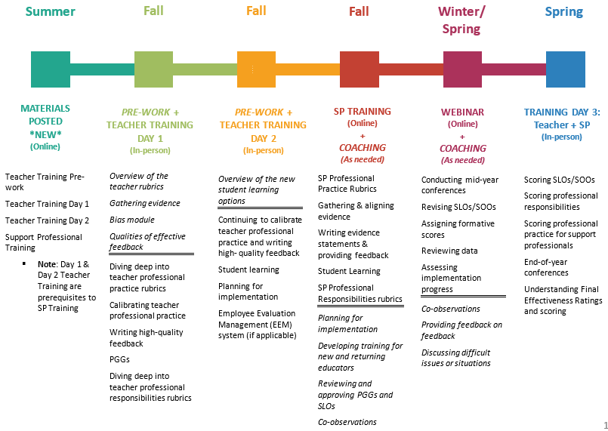
Training Overview
Notes:
Speaking Notes: This slide lays out the year at-a-glance with regard to training sessions and opportunities. Training on the teacher model was a pre-requisite for this training. We’ll use some of that understanding, and similar activities to drive the learning for today’s session.

Slide 6
Intended Outcomes
By the end of the day, you will:
Understand the differences and similarities between the Teacher and SP evaluation models
Become familiar with the SP Professional Practice rubrics
Understand the process for gathering and aligning evidence of Professional Practice for SPs in order to write evidence statements and to provide feedback
Understand the process for approving Student Outcome Objectives (SOOs)
Understand Professional Responsibilities and the approval of PGGs
Notes:
[Read Intended Outcomes]

Slide 7
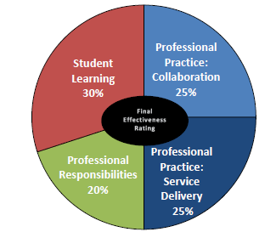
Support Professionals
Notes:
Facilitator’s Note: It is recommended that the group have the digital SP Guidebook available at this time. Point out the following:
Student Learning: SPs use “SOOs” in place of SLOs, which will be covered today
PR: There are 7 domains for PR, as opposed to the 9 for teachers. PR7 is still the PGG, like the teacher model.
PP: In place of “Classroom Management”, SPs are evaluated on “Collaboration”. In place of “Instruction”, SPs are evaluated on their “Service Delivery”
Speaking Notes: The following section of the training will discuss the nuances of this evaluation model, in comparison to the teacher model which is both similar and different. It is important to note the different processes needed to give SPs your due diligence in a full evaluation year.

Slide 8
Who is Evaluated Using the Support Professional System?
Support
Professionals
School Psychologists
Instructional Leaders
Mathematics Specialists/Consultants
Speech-Language Pathologists
School Social Workers
Reading Specialists/Consultants
School Counselors
English as a Second Language Specialists/Consultants
School Nurse Teachers
Notes:
Speaking Notes: Support professionals provide supports through various roles & responsibilities in our schools and districts that lead to the conditions needed for student learning. In order for students to learn, it takes many professionals to attend to the whole-child’s needs. As they are listed here, these roles are designated by certification as evaluated using the SP model, which has not had changes since 2015-16. The first four that are bolded are the most common SPs holding certificates at this time.
It is also important to note that teaching assistants & paraprofessionals are not part of the SP designation for evaluation purposes as they are not certified in these positions, thus not requiring an evaluation. Your districts may use a tool to evaluate these professionals in another way. Final note, OT/PT should be evaluated by the Dept. of Health, and are not technically SPs because we do not certify them through RIDE. In some districts, they are evaluated by the district due to the collective bargaining agreement, which is a district-level decision. RIDE does not collect data from these roles.

Slide 9
Connector #1: Teachers & Support Professionals
Discuss how relationships between support professionals and teachers are important.
How might you design structures in your school to improve those relationships?
Notes:
Speaking Notes: Again, depending on the size of your team, discuss this question as a whole group or in pairs. It is recommended that participants write answers on post-its and then move them to the chart paper. Teams should definitely keep this question “alive” throughout the session – wherever possible, revisit, and add ideas to the poster.
One of the overarching goals for this session is to find ways to answer this question in order to establish or improve the ways in which educators work with one another – the more purposeful the relationships among the adults in the building, the more impact they’ll have on the students they serve, thereby affecting outcomes.

Slide 10
Professional Practice: Collaboration &
Service Delivery
Notes:
Speaking Notes: In this next section, we will discuss Professional Practice for Support Professionals. This accounts for 50% of the overall Final Effectiveness Rating. At this point – you’ll want to navigate to the guidebook found here: http://www.ride.ri.gov/TeachersAdministrators/EducatorEvaluation/RIModelEvaluationResources.aspx. Alternatively/additionally, each participant may want to individually have the guidebook opened on their laptop to have the option of referencing the guidebook when needed.
.

Slide 11
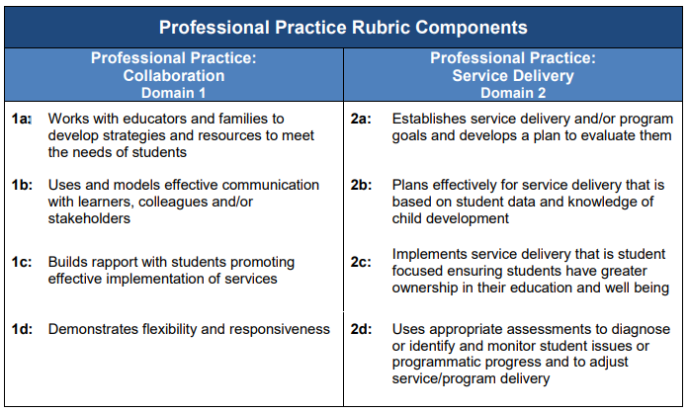
Professional Practice
Evaluators gather evidence through one announced observation, two unannounced observations, and natural interactions throughout the year.
Notes:
Speaking Notes: Professional Practice rubrics are geared toward the various roles and responsibilities of SPs in general. Note that the rubrics are agnostic of role – which provides flexibility, but some challenges in applying language to a particular individual’s role. This first set of activities will help us to become more familiar with the rubrics themselves, and then to see how they may or may not look different across the most common SP roles in RI LEAs. Additionally, our goal is to clarify how the evidence-collection process is different from teachers, requiring you to devise a process that will help you to collect evidence and provide high-quality feedback when required in the model.

Slide 12
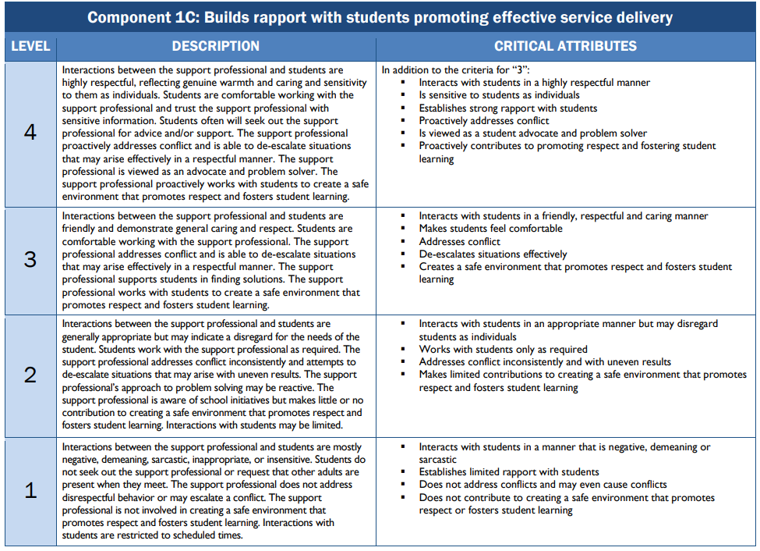
Professional Practice: Instruction Rubric Example
Notes:
Speaking Notes: In your guidebooks, the professional practice rubrics begin on page 38. Here you can see page 44 is an example of rubric 1c, noting similarly to the teacher rubrics that we want to focus on the PLDs on the left-most column. As always, using the PLD language with the preponderance of evidence will be important for providing formative & summative observation scores, which are done differently than teachers. Feedback is given after each of three “segments” where evidence is gathered over time, and which culminates with a formal observation. We’ll talk more about this process in a little bit. One notable difference between SP and T models is that there is no “Examples” column after the “Critical Attributes”.
In our next activity, you’ll help each other generate ideas for what examples might look like in practice, based on your experiences.

Slide 13
Activity: Rubric Values & Examples Part I
Move to your assigned component poster(s)
Review the rubric and discuss the component with your partner.
Then, chart your answers to the following questions/prompts:
What is valued in this component as explained in the descriptors?
What are some general examples and non-examples of what this could like during an observation?
Share out the values and examples for each component
Notes:
Facilitator’s Note: This activity will require some set up so it is strongly advised that you consult the facilitator’s guide for specific steps. At a minimum, there will be no less than 2 people per component, as discussion is a key piece of this activity. Depending on the number of participants, you will assign people to posters, accordingly (e.g., if you have 8 people, pair them off so each partnership will review 2 components).

Slide 14
Activity: Rubric Values & Examples Part II
Pairs will now read assigned SP role – be prepared to share main points with group
Next, each pair will share out their SP role so that whole group has an understanding and appreciation of each
Then, partners return to their component poster(s):
Given the SP roles you discussed, what are some specific examples and non-examples of what this could like during an observation?
Complete another round of sharing specific examples to the whole group
Notes:
Speaking Notes: Like the previous activity, you should consult the facilitator’s guide for additional direction. We’ve provided you with handouts (see playlist) from each of the professional associations of the 5 of the most common SP roles in RI: School Counselor, School Psychologist, Speech-Language Pathologist, School Nurse, and Social Worker. Each of the pairs from the previous activity will review ONE of the SP roles. Depending on the number of pairs you have, you may need to prioritize which SP roles you review. If so, consider the composition of your LEA/schools in order to make an informed decision about which roles are most prevalent in your LEA/school(s).
Facilitator’s Note: For posterity, we recommend that you take pictures of each of the posters after the activity is complete and be sure to disseminate the learnings to all participants.

Slide 15
Professional Practice: Collaboration &
Service Delivery
Notes:
Speaking Notes: We hope you found the last two activities to be helpful in framing your understanding of the 8 components that comprise professional practice for SP’s. The next few slides will get into the specifics of the model details.

Slide 16
SPs: Observing Professional Practice
Requirements:
Conduct at least three conferences: BOY, MOY, EOY
Conduct at least three formal observations (one announced, at least a week in advance, and two unannounced), of which both are at least 20 min. in length.
Evidence is collected over segmented time periods, and are scored holistically at the end of the year.
Evidence statements and written feedback are provided after each segment.
Refer to pages 3-4 in the Guidebook for information on Non-Summative Year vs. Full Evaluation Year
LEA Flexibility Factors:
Additional observations
Pre-post conferences
Narrower windows for observations
Notes:
Speaking Notes: Just as with teachers, SP’s have three observations – one announced and two unannounced. The rest is where the teacher model and the SP model diverge – [READ THE REMAINDER OF THE SLIDE]. This is also a great time to discuss any LEA Flexibility Factors in which your LEA engages.

Slide 17
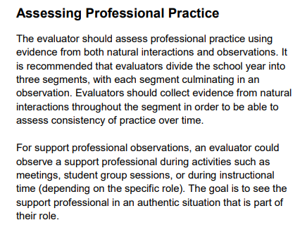
SP Guidebook:
Page 11
Notes:
Facilitator’s Note: Allow participants to first read the content of this slide, as the next slide will illustrate the concept of “segmenting” the year for SPs.

Slide 18
Observing Professional Practice
Professional Practice is assessed using evidence from three segments. Each segment should capture evidence from (1) natural interactions throughout the year and (2) the culminating observation at the end of each segment.
Segment 1
9/1/18: Begin taking notes
Segment 2
12/2/18: Begin taking notes for this segment
Segment 3
3/1/19: Begin taking notes for this segment
12/1/18: Segment ends with formal Observation #1
2/28/19: Segment ends with formal Observation #2
5/15/19: Segment ends with formal Observation #3
Notes:
Speaking Notes: This slide aims to show how an evaluator might segment the year in order to accomplish 3 observations. What’s important to note is that each segment ends with a formal observation, announced or unannounced. Additionally, it’s important to note just how different this model is from the teacher one. While teachers receive feedback and scores after each observation, SPs will only receive feedback but will not receive actual scores for each of the 8 components until the EOY, as their professional practice scores are holistic in nature and encompass evidence from both natural interactions and observations.

Slide 19
Observing Professional Practice
Each segment requires that you:
Gather Evidence
Write Evidence Statements
Provide Feedback
Notes:
Speaking Notes: Now that you can conceptualize how SP professional practice is assessed, we will shift our focus to how you will gather evidence throughout each segment.

Slide 20
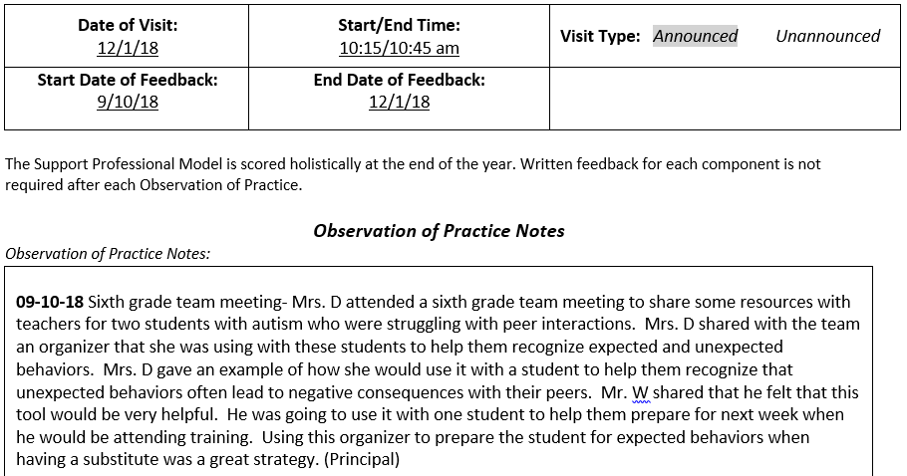
Sample Segment Notes Form
Notes:
Speaking Notes: Here is an example of what notes from a segment would look like. The format of this suggested observation form is located on our website for your use. If you use the Frontline system, this looks similar to the EEM forms. Here, you’ll keep track of the notes from both natural interactions and the culminating formal observation for the segment. Note how the date and the note-taker are both identified. This will be useful to ensure that both evaluator and complementary evaluator are keeping track of who-has-seen-what.
Also notice how this entry is truly an evidence statement, as it is devoid of subjective and biased language, only capturing what was actually seen, heard, or done. This will be important in our next activity as we align these notes – the evidence! – to SP professional practice components.

Slide 21
Activity: Aligning Evidence to Components
Read all of the notes/evidence collected in the Segment #1 form
Then, using the Professional Practice rubrics in your guidebook, align each piece of evidence (within the notes) to components.
Consider how you’ll need to formatively score to align the language of the evidence to the rubrics.
Once finished, work with your team to calibrate around the alignment of components and evidence.
Were you able to find evidence for all eight components?
Finally, the whole-group will discuss the process, and what worked or was difficult when compared to teacher observations of practice.
Notes:
Facilitator’s Note: Like the previous activities, you should consult the facilitator’s guide for additional direction. And again, you will need to consider how many participants you have and organize accordingly. For instance, you may decide to assign each person a note/piece of evidence; or, if you have a smaller group, you may assign each pair several notes/pieces of evidence to analyze. FYI, there are 10 note entries for Segment #1.
Speaking Notes: Ultimately, the evaluator will need to “pull out” and “code” each piece of evidence to a professional practice component. This will allow the evaluator to write evidence statements for as many components as were found within the notes. Writing evidence statements for support professionals is analogous to writing rationales in the teacher model. Unlike the teacher model, though, you do not need to find evidence for each component at the end of every segment. While ideally you will have evidence from all 8 components found within the segment, you may not have had the opportunity, either through natural interactions or in the observation, to observe them all. It will be important to keep some method of “tracking” observed components from one segment to the next so that evaluators may be more intentional about finding evidence for ones not yet seen. Remember that SP professional practice is scored holistically at the end of the year, not after each observations like teachers.
From here, these evidence statements will provide the direction and content of the written feedback you will provide which we will get to in a little bit.

Slide 22
Observation Notes
(The Evidence)
Helps the evaluator capture evidence of practice to write evidence statements, and craft feedback. The observation notes should focus on the words spoken by the SP, the actions by the SP.
Evidence Statements
(Rationale)
Helps the SP understand the reasoning for each formative component score (1-4) by providing evidence and explanation that aligns with a performance-level descriptor.
Feedback
Helps the SP improve their practice by identifying strengths (practices that they should continue) and areas for improvement (changes to their practice that they should prioritize).
Notes:
Speaking Notes: This slide shows the progression of how notes lead to evidence statements which ultimately lead to feedback. Again, it may be helpful to think about evidence statements as analogous to rationales in the teacher model. Since SPs will not be scored on their 8 professional practice components until the end of the year, it is critical that they receive evidence statements and feedback after each segment to build a formative understanding of their performance.

Slide 23
Observing Professional Practice
Each segment requires that you:
Gather Evidence
Write Evidence Statements
Provide Feedback
Notes:
Speaking Notes: Now that we’ve gathered evidence from the notes provided, we are ready to write actual evidence statements and finally, to provide feedback.

Slide 24
Writing Evidence Statements
Evidence statements should include:
Rubric language from the level descriptor of the formative score
Evidence from the observation notes
Evidence statements should exclude:
Judgment statements
Feedback on what should have been done differently
1C: Builds Rapport
Mrs. D’s interactions with students are friendly and demonstrate general caring and respect. Mrs. D greets students by name and engages them in brief conversations about their weekend, or makes comments such as “Make good choices today.” In a social skills group, Mrs. D supported students in finding solutions, and used questioning techniques to foster student learning in a safe environment.
Notes:
Speaking Notes: As you begin to write evidence statements, you will want to review all of the “coded” notes from the segment. Which, depending on what you’ve observed in any particular segment, may be anywhere from zero to several. You only write evidence statements for those components for which you have evidence. For example, if you have evidence for 3 examples of 1C (as is shown in this slide) you will want to weave in excerpts of all three using direct language from the performance level descriptor (PLD) that most closely aligns with the body of evidence you’ve collected thus far for this component. Like with the teacher model, you will choose the PLD based on the preponderance of evidence. And like the teacher model, you should borrow direct language from the PLD to craft your evidence statements.
Facilitator’s Note: Pause here so participants can see and understand how evidence of 1C found within the provided notes works with the PLD language to create an evidence statement that is aligned with a “3” level descriptor.

Slide 25
Activity: Writing Evidence Statements
Individually, practice writing two evidence statements: one for each professional practice domain (your choice). Use two different colors/markings to differentiate between rubric language and evidence from the observation.
Then, engage in a partner-share or whole-group share
Next, compare group’s evidence statements with the ‘Answer Key’ provided
Notes:
Facilitator’s Note: Like the previous activities, you should consult the facilitator’s guide for additional direction. And again, you will need to consider how many participants you have and organize accordingly. When participants have completed writing their two evidence statements, one from each domain, allow for time to share with a partner or with the whole group, depending on how many participants you have. In any case, the facilitator will want to ensure that evidence statements are comprised of both the rubric language from the appropriate performance level descriptor level and excerpted language from actual evidence. Together, the evidence statement should read clearly, be free from any spelling and grammatical errors, and most importantly, contain only objective data of practice.
Before moving to feedback, allow participants to take several minutes to read through the Segment #1 Notes with Evidence Statements. This resource is the “answer sheet,” if you will. RIDE staff calibrated with these notes to first align to components and then to write actual evidence statements. Your group will likely find it useful to compare theirs with RIDE’s.

Slide 26
Prioritized
Specific
Actionable
Positive & Appropriate
Timely
Feedback is important in supporting continuous improvement, and takes time to ensure it is of high quality.
Notes:
Speaking Notes: Now, that the notes have been coded and evidence statements have been written, the evaluator is ready to write feedback. As with any educator in any setting, it is important to remember that feedback should be prioritized, specific, actionable, appropriate, and timely. As the facilitator, you will want to stress how critical it is that SPs receive feedback in a timey manner – when educators receive feedback too long after the fact, the evaluator’s suggestions become less relevant and the context less clear. You will also want to clarify/remind participants if your LEA has any contractual timelines to abide by regarding when feedback must be delivered.
Facilitator’s Note: Allow participants to peruse the Providing High-Quality Written Feedback to Educators, as it will prime them for the next activity.

Slide 27
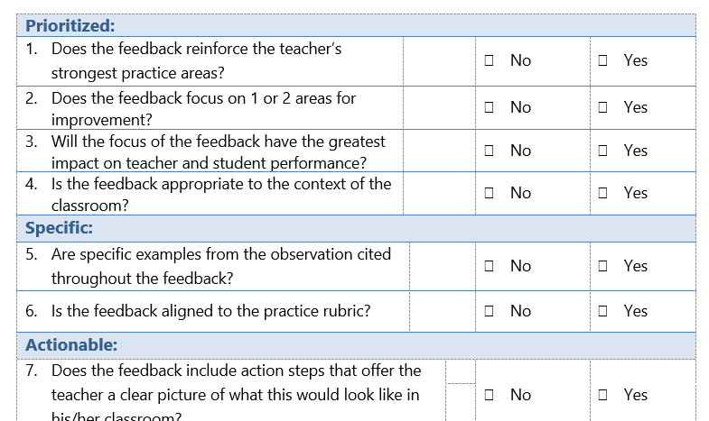
Activity: Reviewing Feedback
Read written feedback provided
Using the QRT – determine the quality of this feedback.
Provide suggestions for improvement, if any.
Notes:
Facilitator’s Note: Now, participants should take a few minutes have a copy of the feedback example as well as the Quality Review Tool (QRT) in front of them. Allow sufficient time to individually read the feedback and mark the QRT accordingly. It is recommended that, depending on the size of the group, participants share and discuss their annotated QRT with either a partner or with the whole group.

Slide 28
Student Outcome Objectives (SOOs)
SOOs
Notes:
Speaking Notes: We are ready to transition to the Student Learning component of the Support Professional model which accounts for 30% of the overall Final Effectiveness Rating. This section will primarily focus on Student Outcome Objectives, or SOOs, now that we have completed the professional practice piece of the SP training.

Slide 29
Connector #2: Teachers & Support Professionals
What are the differences between support professionals’ and teachers’ roles in supporting student outcomes?
Notes:
Speaking Notes: At the beginning of the session, we engaged in the first connector that asked you to think about the structures needed to support a healthy partnership between SPs and teachers. Here, we’d like you to think deeply about the differences between SPs’ and Teachers’ roles in supporting student outcomes.
Facilitator’s Note: Again, depending on the size of your team, discuss this question as a whole group or in pairs. It recommended that you chart answers/ideas on chart paper via post-its notes. Teams should definitely keep this question “alive” throughout the rest session – wherever possible, revisit, and add ideas to the poster.

Slide 30
SLO/SOO Decision Tree
Page 15 in SP Guidebook
Notes:
Speaking Notes: This page helps educators determine whether or not they will craft SLOs or SOOs, and how many of each depending on their direct relationship to student learning. Here, we can see that the majority of teachers will set SLOs, while most often, SPs will set SOOs because generally speaking, SPs provide specialized services or manage programs. However, based on particular roles, some SP roles use 1 SLO and 1 SOO – an example would be an EL Coordinator who pulls a group of students receiving a Tier 3 intervention and who also coordinates all EL testing for students in her school.
Facilitator’s Note: This may be a good place to pause to think about the SPs in your school/districts – what are their roles? Will they do 2 SOOs or do they have more nuanced roles where in addition to managing a program, for instance, they also provide some direct instruction to students? Have your evaluators actually use the decision tree to determine if the SPs on their caseloads will do SOOs or and SLO/SOO combination.

Slide 31
Student Learning Flexibilities
Notes:
Speaking Notes: This slide shows the new flexibilities that were introduced for the 2019-20 school year: The SLO Flex and the SOO Flex. For both SLOs and SOOs, support professionals now have the option to employ flexible processes and procedures in measuring their impact on student learning, either directly through demonstrated progress toward specific, measureable goals, or through increasing access to learning. As with any flexibility offered in the evaluation system, support professionals must first seek leadership approval before taking advantage of any of the following flexibilities.
Facilitator’s note: As the facilitator of this session, you will want to have already considered whether or not the SPs in your district will be able to take advantage of these new flexibilities or not so all evaluators are on the same page.

Slide 32
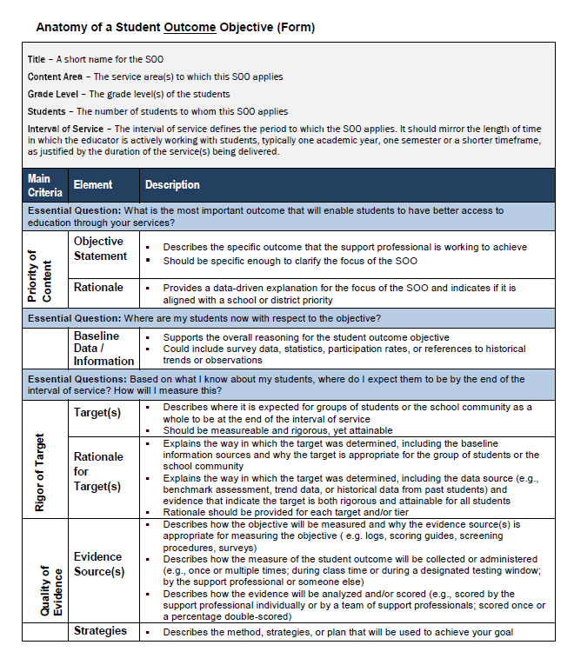
The Anatomy of SOOs
Today, we’ll focus on the three primary areas of SLOs:
Priority of Content
Rigor of Target(s)
Quality of Evidence
SP Guidebook:
Page 19
Notes:
Speaking Notes: As with an SLO, the SOO, too, is described as having an “anatomy,’ to better understand its components. On page 19 in your guidebooks, you can see the anatomy of an SOO, which SPs use to measure student outcomes based on their roles and responsibilities. The notable differences between an SLO for teachers and building admins, are that there is no “Aligned Standards” section in the “Priority of Content” section, but there is an additional “Strategies” section related to the “Quality of Evidence.” Today we’ll look at a sample to see how this section applies to the specific role of an SP in practice.

Slide 33
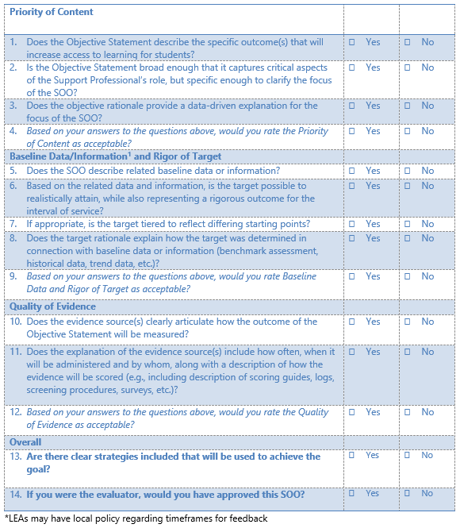
Approving SOOs Activity
Independently Review SOO
Table group calibration
Complete SOO Quality Review Tool
10 min
10 min
20 min
Notes:
Facilitator’s Note: Now, participants should have a copy of the SOO example as well as the SOO Quality Review Tool (QRT) in front of them. Allow sufficient time to independently review the SOO and complete the SOO QRT. It is recommended that, depending on the size of the group, participants share, discuss, and calibrate with their annotated QRT with either a partner or with the whole group. As the facilitator, it is advised that you will have already completed this task in advance so that you can be on-hand to redirect and provide guidance, as needed. Ultimately, you will want your group to ultimately be calibrated on what will be accepted and what won’t. For any items that do not past muster, discuss and determine how the SP could revise the SOO in order to reach acceptance.
Take advantage of this afforded time to stress to your new evaluators the ways in which your district values student learning and that SOOs are the accepted measure to quantify a SP’s effectiveness with regard to student learning.
**If employing SOO Flex, refer to the SP guidebook (Ed. IV) on page 20. Highlight how flexibilities can be applied to the student group(s), standards, cycle of instruction (i.e. length of time), and a less time-restricted structure for setting learning targets (i.e. expectations for students’ learning).
***If asked why SPs do not have the option for Embedded Practice or Student Learning Goals, remind them that while the two-year pilot resulted in new options for student learning, it was designed solely for teachers’ specific roles in direct instruction of students. That said, we found that the flexibilities would provide another avenue for SPs to design and modify SOOs as needed, based on the use of local data.

Slide 34
Professional Responsibilities
Notes:
Speaking Notes: We are ready to transition to our final section, Professional Responsibilities. This accounts for 20% of the overall FER. At this point, it will be helpful to turn to Page 53 of your guidebooks to view the professional practice rubrics at a glance. Where teachers have 9 PRs for which they are scores, SPs have 7 – SPs do not have Domain 4 (Planning).

Slide 35
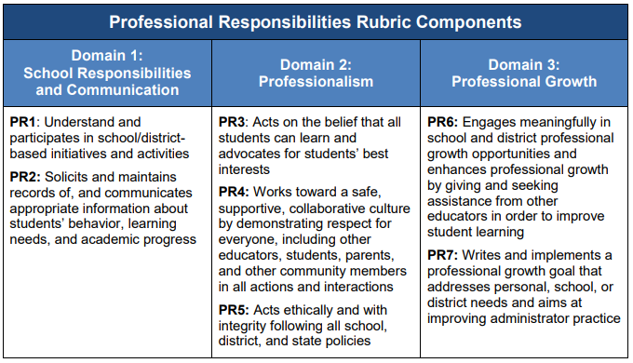
Professional Responsibilities
Evaluators gather evidence through one announced observation, two unannounced observations, and natural interactions.
Notes:
Speaking Notes: Like with teachers, PRs may be observed both in practice and as artifacts. The group may find it helpful to quickly discuss how they may keep rack of and record evidence of PRs from both natural interactions and observations.
More information about assessing PRs can be found in the guidebook on page 13.
Next up is the Professional Growth Goal or PGG. Like with Teachers, SPs receiving a full evaluation must submit a PGG that will be approved and scored by the evaluator.

Slide 36
Professional Growth Goals (PGGs)
Notes:
Speaking Notes: Again, all SPs receiving a full evaluation, must create a PGG. It will be scored at the end of the year using PR 7 of the PR rubrics. The focus should be on the educator’s professional learning throughout the year.

Slide 37
Professional Growth Goal
Beginning of Year
Educator writes and submits a Professional Growth Goal.
Middle of Year
If needed, the SP and evaluator may revise the Professional Growth Goal.
End of Year
The evaluator scores the Professional Growth Goal using PR7 of the Professional Responsibilities rubric.
The SP and evaluator review summative feedback on the Professional Growth Goal.
The evaluator reviews the Professional Growth Goal and either approves the goal or provides feedback on how to improve the goal.
Notes:
Speaking Notes: Not unlike the teacher model, this slide shows the progression of steps/actions that both SP and evaluator will take in order to ensure the successful completion of the PGG.

Slide 38
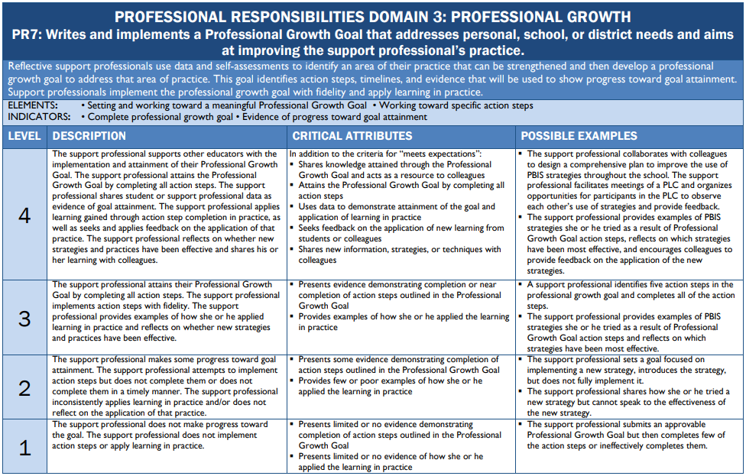
Notes:
Speaking Notes: Now we will practice the process of approving a PGG. Using the samples in your folders, review the PGG and determine whether or not you would approve it. Note: there are two samples provided. Given time constraints or other factors, you may decide one or both makes sense to do. There does not exist a Quality Review Tool for the PGG so be sure to use the PR7 rubric (p. 62) to consider what the end product should look like. Be sure to discuss and explain why or why not?
Facilitator’s Note: Again, depending on the number of participants you have, consider sharing via pairs or whole group.

Slide 39
Planning Your Year: Next Steps
Beginning of Year
Middle of Year
End of Year
Before School Starts
Based on what you learned today, consider the following questions as you plan for both Ts & SPs in your evaluation caseloads:
Questions to Consider:
How many SPs in your caseload? What are their roles?
What are the key steps you need to take to ensure you are following implementation timelines? Have you set up your segments, yet?
When will your first observations take place?
Notes:
Facilitator’s Note: Allow participants enough time to work through the “Questions to Consider.” If possible and if known, you may consider having ready the answers to Question #1, as new evaluators will need this info to effectively plan for implementation.

Slide 40
Closure
It is important for the RIDE team to have feedback about this training. We ask that facilitators and attendees complete the following survey to inform the content and process of this training:
https://www.surveymonkey.com/r/ExternalEdEval
Resources
RIDE website: http://www.ride.ri.gov/
Evaluation email: EdEval@ride.ri.gov
Notes:
Facilitator’s Note: Please encourage participants to complete the survey before completing the training. Additionally, if there are outstanding questions and concerns – about the SP model or evaluation in general – please reach out to edeval@ride.ri.gov.

