Slide 1
Providing High-Quality Written Feedback to Educators
LEA Calibration Session
March 2014

Slide 2
Goals, Norms, and Agenda
Goals:
Practice using the Feedback Quality Review Tool
Identify individuals’ areas of strength and areas of improvement in the feedback they have been offering to teachers this year
Identify next steps for ongoing improvement of feedback to teachers
Norms:
Commitment to work through disagreement
Safety to share ideas
Equal air time (stand up/sit back)
Agenda:
Welcome & Introductions
Framing
High-Quality Feedback
Video #1
Video #2
Examining our own feedback to educators
Reflection & Closing

Slide 3
Framing
Dylan William, a formative assessment expert, speaking about educator quality at a conference:
What is one aspect of Dylan William’s
speech that resonates with you?

Slide 4
Feedback across the state
Of those who had received one or more Observations/Site Visits…
85% of teachers and 80% of administrators had received their feedback and scores,
compared to 78% and 76% last year.
Actionable
66% of teachers and
82% of administrators
felt the feedback
received was actionable
Specific
77% of teachers and
81% of administrators
felt the feedback
received was specific
Helpful
53% of teachers and
77% of administrators
felt it would help
improve practice
87% of teachers and 96% of administrators made some level of change to their teaching practice as a result of the feedback received, compared with 66% last year.

Slide 5
The difference between observation notes, rationale, and feedback
Observation Notes
Helps the evaluator capture evidence of the teaching episode to determine scores, write rationale, and craft feedback. The observation notes should focus on the words spoken by the teacher and students, the actions by the teacher and students, and the appearance of the classroom.
Rationale
Helps the educator understand the reasoning for each component score (1-4) by providing evidence and explanation that aligns with a performance-level descriptor.
Feedback
Helps the educator improve their practice by identifying strengths (practices that they should continue) and areas for improvement (changes to their practice that they should prioritize).
Notes:
Talking point: make sure participants understand that “appearance” does not translate to “clean” but rather includes things like “objective and agenda on the board, etc”

Slide 6
Qualities of effective feedback
To be effective, feedback after observations should be:
Prioritized
Specific
Actionable
Have a supportive tone
Be given as soon after an evaluation/assessment as possible
Notes:
Potential talking point: bring up how feedback should be free of grammatical and spelling errors because people can be distracted or insulted when what they receive has errors in it. Unintentionally it can also undermine credibility. We say this because we received feedback from educators last year saying they were frustrated by feedback that had errors in it.

Slide 7
Prioritized
While it is important that the rationale address all components of the rubric, positive and constructive feedback should be focused. Substantial feedback across all or many components is overwhelming to a teacher and does not indicate what is essential or where they should start. Prioritized feedback hones in on the ideas and strategies that are the most important for the educator to continue or adjust to move forward in their practice.
Prioritized
An observation receives 3s on all components of the rubric but the evaluator highlights the two that are making the biggest impact on student learning
An observation receives a combination of 1s, 2s, and 3s, but the evaluator prioritizes feedback on the components that should be addressed first, even if it is not the lowest score
Not Prioritized
A teacher gets 1 sentence of feedback on all components of the rubric
A teacher gets significant feedback on most or all components of the rubric
Does the feedback reinforce the teacher’s strongest practice areas?
Does the feedback focus on 1 or 2 areas for improvement?
Will the focus of the feedback have the greatest impact on teacher and student performance?
Is the feedback appropriate to the context of the classroom?

Slide 8
Specific
Feedback should be clear, precise, and cite specific examples from the observation. The feedback should directly support the teacher’s practice in the rubric components.
Specific
“You have an effective routine in place so that students know what to do when they finish work early…”
Not Specific
“You have great classroom management…”
Are specific examples from the observation cited throughout the feedback?
Is the feedback aligned to the practice rubric?

Slide 9
Actionable
Effective feedback includes actionable next steps that the teacher may use to improve their practice in the immediate future. Actionable feedback provides resources or strategies to implement into practice and offers the teacher a clear picture of what this would look like in his/her classroom.
Actionable
In this lesson it was unclear if students knew the purpose of the lesson based on the questions they were asking. Identify and communicate a clear lesson objective for students stating what they will be learning and why. Post the objective on the board so students can see it, introduce the objective at the beginning of the lesson, and refer to it throughout. Make sure that each activity helps students reach the objective.
Not Actionable
In this lesson students didn’t know the purpose of the lesson based on the questions they were asking. Make sure the objective is clear to students.
Does the feedback include action steps that offer the teacher a clear picture of what this would look like in his/her classroom?
Is the feedback feasible to implement successfully in the near future?
Does the feedback include resources or strategies the teacher can utilize?

Slide 10
Feedback Model
Each component has a couple sentence description with specific evidence from the observation explaining the rationale for each score. The language clearly connects back to the rubric performance level descriptors.
Rationale
Feedback
Open with positive reinforcement
Target 2-4 specific areas of the teaching episode that you want to encourage the teacher to continue in their practice.
Be specific and reference examples from the rationale to make the feedback concrete.
Then offer constructive feedback
Hone in on 1 or 2 areas to give prioritized and actionable feedback.
Explain why this is a priority to focus on and suggest strategies or resources the teacher could employ moving forward.

Slide 11
Feedback Model
Identifies three areas with specific examples where the practice is strongest and the teacher should continue. All relate to rubric components.
Positive Reinforcement:
This lesson shows you have established a positive culture for learning. Your students demonstrated a strong effort and consistent commitment to learning the material. Additionally, your enthusiasm for the content, and insistence that all students learn the key concepts added to the positive culture (2b).
In this lesson classroom procedures and routines were executed consistently by students which helped to maximize instructional time. It was clear that students knew what was expected of them. Transitions were smooth and you were able to call students quickly back to attention when transitioning between activities with your verbal cue (2c).
In this lesson you use voice and presence to maintain authority and convey caring for students. Students were well behaved throughout the lesson. Students followed directions the first time and demonstrated a clear understanding of behavioral expectations and rules through their actions throughout the class. Interactions in the classroom were positive throughout the lesson (2d).

Slide 12
Feedback Model
Prioritizes one area
Constructive Feedback:
During your lesson most questions asked were either knowledge or comprehension questions, students were not challenged to explain their thinking and had very little opportunity to discuss their ideas with each other. Challenge students to think critically and engage in discussion with their peers throughout the lesson . In order to do this you should prepare questions that require higher-order thinking such as analyzing, synthesizing or evaluating when prepping your lesson. In addition, have students explain their answers when appropriate and allow students to challenge each other’s responses in order to promote student dialogue. Attached is a link to several resources on Bloom’s Taxonomy that could help you to create your questions: http://www.bloomstaxonomy.org/ Ask yourself: “How do I create opportunities for students to think critically and challenge each other’s thinking?”
Identifies the aspect that can be improved.
Articulates what this aspect should look or sound like instead.
Offers action steps for the teacher to achieve the desired outcome.
Connects the teacher with a resource that could help them in their action step.
Ends the feedback with a guiding question for the teacher to use as a frame for their development.

Slide 13
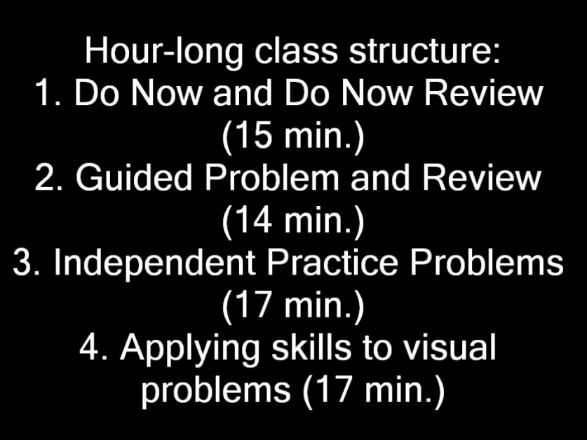
Videos
Video #1:
9th grade Reading
Video #2:
7th grade Math
*7th grade math video from Measures of Effective Teaching Extension (METX)

Slide 14
Examining Our Own Feedback to Educators
Get out the feedback you brought
Review the feedback using the Quality Review Tool
Identify areas of strength and areas for improvement in your feedback
Be ready to share out

Slide 15
New and Forthcoming Resources
DCA’s can run Feedback Reports in EPSS
Live Binder of Resources to use when crafting feedback
Questions? Email us at edeval@ride.ri.gov.
Thank you!

