Slide 1

Division of Teaching & Learning
June 2020
Selecting & ImplementingHigh-Quality Curriculum Materials (HQCM) in Rhode Island
Notes:
Over the past three years, RIDE continues to work with districts through a statewide strategy to select, adopt, and implement high quality curriculum materials. This is nationwide call for schools and districts to respond to improve students’ equitable access to high-quality materials that are aligned to grade-level content and provide a foundation for instructional rigor. Since 2017 when this work started, it is important for us to review the work that has, and continues to happen across Rhode Island, in addition to what will come next in this important systemic shift.

Slide 2

Notes:
In 2017, a cross-office, collaborative team at RIDE worked to define curriculum as a starting point for a statewide strategy aligned to national priorities with the Council for Chief State School Officers. This was the beginning of a long-term process to align priorities, and support LEAs, in the process of selecting and adopting high quality curriculum materials in Rhode Island. You can find our full infographic to share at: https://www.ride.ri.gov/Portals/0/Uploads/Documents/Instruction-and-Assessment-World-Class-Standards/HQCM-Bundle/HQCM_CurriculumMatters_June2020.pdf

Slide 3
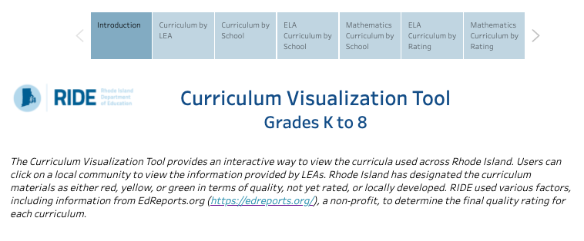
RI’s Curriculum Visualization Tool
Notes:
This is an exciting addition to our curriculum resources in Rhode Island. Launched in early 2020, RIDE worked with LEAs to compile curricula used in K-8 math and ELA to develop this interactive tool for RI LEAs. High School is currently under development and will be included in a near-future iteration. This tool is designed to be used for any, or all of the following: (1) talk with teachers & principals to find out more about the curriculum selection process, initial launch, and implementation, depending on where they are in the process; (2) share the cost for curriculum-specific professional learning opportunities; and (3) calibrate with other teacher leaders and administrators using walkthrough tools to understand implementation. Note that we currently have two (2) years of data from 2018-19 and 2019-20.

Slide 4
RIGL§ 16.22.30-33: The ”Curriculum” Bill
Set Academic Standards
Develop statewide academic standards and curriculum frameworks in core content areas
Develop Lists of HQCM
Identify at least five (5) examples of HQCM in English Language Arts (ELA), Mathematics, and Science
Support Implementation
Support LEAs in the selection and implementation of HQCM
Notes:
Signed into law in 2019, the RI Curriculum Bill has three main objectives for all RI schools: [READ SLIDE]. During the 2019-20 school year, the Council on Elementary & Secondary Education approved the existing standards for ELA, math, and Science. Concurrently, RIDE worked with state & national partners to develop the lists of HQCM in ELA and math ahead of the legislative timeline to release for RI schools. This was done intentionally to support LEAs in advancing the urgent work of selecting and implementing HQCM for all students. From there, as RI schools continue to select and implement, RIDE will continue to provide support through implementation, including collaborative opportunities for LEAs who are implementing similar curricula in regional areas of RI. Ultimately, the LEA is responsible for selecting & implementing HQCM, and RIDE is responsible for providing the supports needed to do this work well.

Slide 5
Guidance Documents for Selecting HQCM in RI
Notes:
We recognize the process of selection and implementation is a shift away from past practices. In support of new thinking, with new materials, RIDE has worked to develop a suite of guidance, resources, and tools to support LEAs through the selection processes that result in the adoption of new HQCM. We will review some of these today, in part, and our subsequent webinars will highlight other documents more in-depth to help you all unpack these resources found here: https://www.ride.ri.gov/InstructionAssessment/Curriculum.aspx

Slide 6
Timeline for Lists
Content Area | Initial List Released | Updated List(s) Released | Required LEA Adoption
Mathematics | June 2020 | January 2021 | June 30, 2023
English Language Arts | June 2020 | January 2021 | June 30, 2023
Science | June 2021 | January 2022 | June 30, 2025
Notes:
This timeline grid, found in the overall selection & implementation guidance document, frames when lists will be initially released and updated, toward the required deadlines for adoption in ELA, math, and science. Therefore, at this time, only ELA and math lists are available for LEAs to begin the selection process, which when done well, is a comprehensive process undertaken by a team of educators and administrators. We will talk more about this overall process in the following slides.

Slide 7
How to Read RI’s HQCM Lists
Approved English Language Arts (ELA) Curricula | Publisher | Grade Span
Amplify ELA (2016) Core Knowledge Language Arts (CKLA) (2015) | Amplify Amplify | 6-8 K-5
ARC (American Reading Company) Core (2017) | ARC | K-12
Benchmark Advance (2018) | Benchmark Education Company | 6 only (3-5 Not HQ)
Developing Core Literacy Proficiencies (2016) | Odell Education | 6-12
EL Education K-5 Language Arts (2017) Expeditionary Learning (2016) EL Education LearnZillion EL Education K-5 Language Arts (2019) | Open Up Resources EL Education LearnZillion | K-5 6-8 K-5
Engage NY (2016) | Engage NY | 6-8
Into Literature (2020) Into Reading (2020) | Houghton Mifflin Harcourt Houghton Mifflin Harcourt | 6-12 K-6
LearnZillion Guidebooks (2018) | LearnZillion | 6-8
MyPerspectives (2017) myView Literacy (2020) ReadyGEN (2016)* | Pearson Pearson Pearson | 6-12 K-5 K-6
Paths to College &Career (2016) Paths to College & Career English Language Arts 9-12 (2015) | John Wiley & Sons John Wiley & Sons | 6-8 9-12
While some curriculum meets the standard for high-quality in one grade, it is important to choose curricula that offer vertical alignment across multiple grade levels for continuity.
Curricula that are boxed indicate a relationship.
Take note of the publishing year that is on the approved list
as many curricula have multiple editions.
Curriculum with an asterisk are suitable for districts currently using, but not suggested for new adoptions.
Notes:
This is a snapshot of the approved list of ELA curricula. We want to emphasize the information located in the key, at the end of the table in each of the lists. You have three columns: [Approved Curriculum, Publisher, and Approved Grade Span]. The distinction between the curriculum name, and its publisher and publication date are important, as there are often many editions to curricula and only the specified ones on the list will be approved. From there, there are four additional points we want to highlight: [see categories above left].

Slide 8
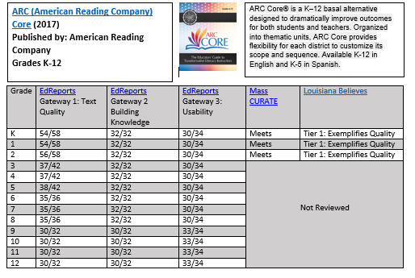
How to Read the Companion Documents
Link to homepage of publisher’s website
Overview description of curriculum
Link to EdReports’ review of curriculum
Other reviews (i.e. MA DESE and/or Louisiana DOE)
EdReports’ gateway scores
Notes:
This is a snapshot of the open-page companion document, which is an embedded link on the lists, for the American Reading Company (ARC) ELA curriculum. These pages were developed to offer you additional information about each of the curricula on the approved list.
Please note:
The link to homepage of the curriculum website
An overview description of the curriculum written by the publisher
Links to the EdReports’ review of the curriculum
EdReports’ gateway scores- note where points were lost and dig deeper into reports to find out why
Other reviews by Massachusetts Dept of Ed and Louisiana Dept of Ed; these link to reports and final rating(s)

Slide 9
Options to Waive Selection of HQCM
Financial Hardship
Third-party Review
Student Achievement
For LEAs who, due to financial hardship, cannot acquire HQCM before the 2023/2025 deadlines
For LEAs who use a curriculum not yet rated by EdReports but want to fund a third-party review for standards alignment
For LEAs who have achieved 75% proficiency on state assessment(s) w/ no identified subgroups for targeted assistance
Notes:
As we have discussed, it is required that all RI LEAs adopt HQCM in ELA and math by 2023, and science by 2025. While we recognize that this policy shift evokes a multitude of questions, and reactions, it’s helpful for us to take a moment to talk about the options for waiving the selection of HQCM from RI’s approved list. There are three: [READ SLIDE]. This is high-level information for the purposes of this webinar. We will be hosting a webinar solely dedicated to these waiver options on Wednesday, July 29, from 2-3PM. During this time, we will unpack each waiver option, and the application process, and provide time for questions to be answered. So, for now, we’ll continue forward with our presentation. You can find this webinar on the “Waivers” tab of our curriculum landing page for your review.

Slide 10
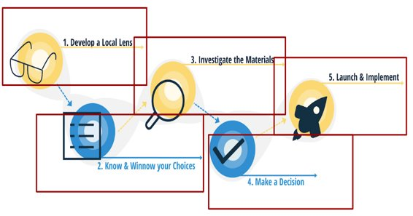
HQCM Selection Workbook & Cohort
Notes:
With 24 LEAs across three cohorts, RIDE has collaborated with EdReports to support teams of administrators and teachers to select and adopt high-quality curriculum materials in ELA and math. The fourth and next cohort will continue to do the same, with some additional support for science as information becomes available ahead of the 2025 legislative timeline. Overall, EdReports is a leader in the development of a comprehensive process for teams to conduct in the process to select and adopt HQCM, which is found in the guidebook, available on our website and is categorized by the five stages of HQCM selection seen here on the right.

Slide 11
Selecting High-Quality Materials
Develop Your Local Lens
Gather data
Establish a committee
Know & Winnow Your Choices
Understand the market
Indentify a subset of programs that can be deeply investigated for alignment to your local criteria
Investigate the Materials
Engage in a hands-on study of 2-4 products to deeply understand before making a decision
Make Your Decision
Develop your instructional vision
Set priorities to ensure a successful adoption & launch
Using RIDE's tool(s), review materials for MLLs, Foundational Skills (K-5), and CRSE
Launch and Implement
Work with your committee to analyze evidence collected during the study
Make a final selection that meets your local priorities
Plan how you will prepare teachers & leaders to implement materials with integrity and assess the implementation program
Notes:
This provides a more detailed look at each of the five categories referenced on the page below. In all, you can see that this process is not as simple as pulling from RI’s List of Approved Curricula – it’s a comprehensive and collaborative local process to ensure the selected curriculum aligns to your school & district’s instructional vision in the respective content area as well as students’ needs.

Slide 12

Review Tools to Support HQCM Selection
Multilingual Learner (MLL) Review Tools
Culturally Responsive & Sustaining Education (CRSE) Tools
K-2 Audit Tool for Foundational Reading Skills
Notes:
In order to ensure that LEAs have selected the high-quality curriculum that best meets their needs, RIDE has developed several tools to dig deeper during the investigation phase. The tools include:
Multilingual Learner Review Tool for ELA Curricula
Multilingual Learner Review Tool for Mathematics Curricula
Culturally Responsive and Sustaining Education Tool for ELA Curricula
Culturally Responsive and Sustaining Education Tool for Mathematics Curricula
K-2 Audit Tool for Foundational Reading Skills
A webinar is being held on July 27 from 2-3 to explain these tools and the processes for reviewing curricula in detail. This webinar will be available for your review under the “Review Tools” tab on our curriculum landing page.

Slide 13

Procurement & Planning to Launch HQCM
Procure & Distribute New Materials
Set Goals & Plan for Monitoring of Goals
Plan for Assessments & Grading
Plan for Training Teachers & Leaders
Determine Expectations for Use
Plan for Coaching & Embedded Supports
Notes:
Once a high-quality curriculum that fits the LEAs needs has been selected, the work continues concurrently, and into the next phase of procurement and planning to launch the selected curriculum. This phase includes distributing materials, removing old materials, setting goals, determining common expectations for use, scheduling training for teachers & leader, and planning for coaching & embedded supports throughout the first year. Seen here, the stages of procurement and planning are supported by stages 2 & 3 in the Instruction Partners’ guide found under the ”Overall Guidance” tab on our curriculum landing page. This guide picks up where the EdReports’ work for selection ends.

Slide 14
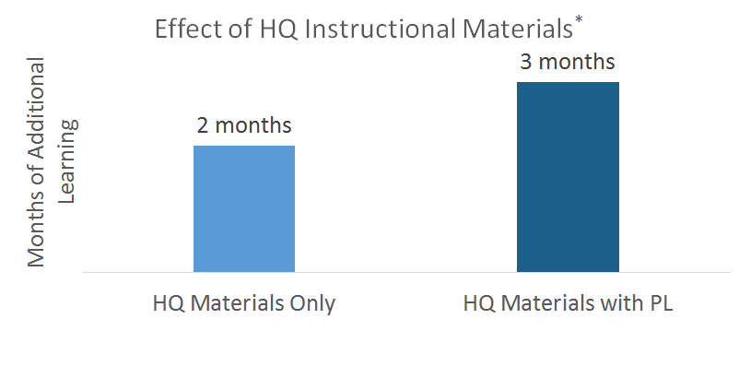
What is the relationship between HQCM and professional learning?
*Jackson, C. K., & Makarin, A. (2016). Simplifying Teaching: A Field Experiment with Online" Off-the-Shelf" Lessons. National Bureau of Economic Research
Notes:
Getting high-quality materials is extremely important, but it’s only part of the work that needs to happen. Equally important is having a planned, sustained, and strong professional learning plan for how teachers will be supported in their use of these materials in the first and subsequent years after the launch. The study referenced here is one we have used before because it shows that having HQ materials matters, but there is a substantially larger impact on student learning when PL is paired with those HQ materials. Compounded over time, that extra month of learning can truly support closing the achievement gap.

Slide 15
What might RIDE’s implementation support for HQCM look like moving forward?
Professional Learning & Implementation Strategies
Facilitate between PL providers, publishers & LEAs
Increase local capacity for curriculum specific PL
Engage stakeholders to increase support & funding
Implementation cohort(s) to support LEAs
Intensive implementation support for 2 LEAs
Utilize social media to showcase LEAs’ work
Notes:
As this work continues to develop across RI, RIDE is planning several different ways to support LEAs with the implementation phase of adopting high-quality materials including, but not limited to the above areas.

Slide 16
What might an LEA’s implementation support for HQCM look like moving forward?
Walkthrough Tools
Unit Unpacking Protocol
Lesson Preparation Protocol
Training(s) from Publisher
Analyzing Student Work Protocol
Coaching support
Notes:
More specifically, LEAs can leverage some of the piloting strategies RIDE has completed with LEAs in each of the following areas that can support a successful launch.

Slide 17
Thank you!
Register on our Curriculum Webpage for our upcoming webinars:
  Review Tools Webinar: Monday, July 27 from 2-3
  Waiver Options Webinar: Wednesday, July 29 from 2-3
Contact curriculum@ride.ri.gov with additional questions.

