Slide 1
Building Capacity for a Collaborative ENL & General Education Model: A Five-Module Course for School-Based Teams Module 5 Building Capacity for Routine Collaboration
Notes:
Narration:

Slide 2
Review of Course Modules
Module 1 – Introduction to the Standards-Based Lesson Tuning Protocol
Module 2 – Analyzing the Focus Standard of a Lesson
Module 3 –Tuning Lesson Elements
Module 4 – Integrating Supports for ENLs
Module 5 – Building Capacity for Routine Collaboration
Notes:
Edits:

Slide 3
Module 5 Intended Outcomes
By the end of Module 5, participants will:
Be able to begin implementing a plan to build school-level capacity for teachers to routinely engage in collaborative discussions around instruction.

Slide 4
Module 5 Agenda
Pages
5-3
Review Group Norms
Debrief the 4th Round of Collaborative Practice
Participate in Text-Based Discussion
Capacity Self-Assessment
Strategic Planning
Course Feedback

Slide 5
Review Group Norms
Norms of Collaboration
Pay Attention to Self & Others
Pause
Paraphrase
Put Ideas on the Table
Provide Data
Probe
Place inquiry at the Center
Review the Norms of Collaboration or your group’s preset norms.
Select a norm to focus on for the day.

Slide 6
Reminder: We Welcome Your Feedback
As mentioned in Module 1, this course is a new resource being provided by the Rhode Island Department of Education. As you take this course, you may have ideas about how to improve it. We welcome all suggestions, big and small.
To expedite the giving of feedback, please use this link to access an electronic form where you can send us your thoughts.
https://goo.gl/2dst6a

Slide 7
Debriefing the Tuning Process
Reflection

Slide 8
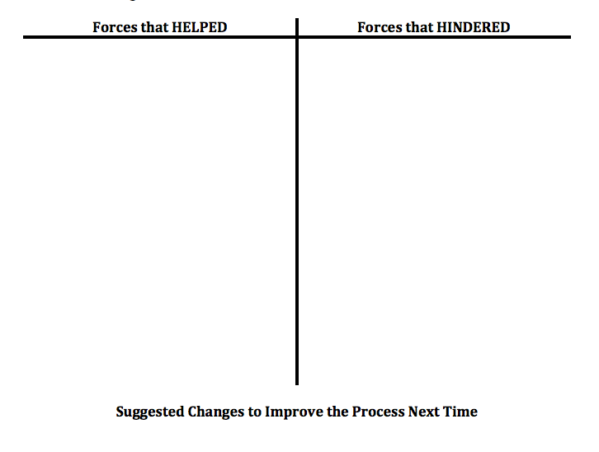
Debriefing the Tuning Process
Pages
5-5
Directions
Reflect
Use the Debriefing Tool to identify what HELPED or HINDERED the process
Share and discuss
Revise process for next time.
Record changes

Slide 9
What are Professional Learning Communities
Text-Based Discussion

Slide 10
Activity: Text-Based Discussion
Pages
5-2a-c
As part of your pre-work for Module 5, you were asked to
Read the Leadership in Action briefs by the New England Secondary School Consortium entitled What are Professional Learning Communities? and I Want to Know More
Complete the Active Reading Organizer

Slide 11
Activity: Text-Based Discussion
Pages
5-2a-c
As a group, consider and discuss the following prompts:
Why are PLCs a powerful way to support teacher learning?
To what extent has your exhibited the high impact attributes of PLCs when engaging in lesson tuning?
Why would establishing PLCs in your school be important for supporting the instruction of ENLs in all classrooms?

Slide 12
PLC Capacity Assessment
Collaborative Activity

Slide 13
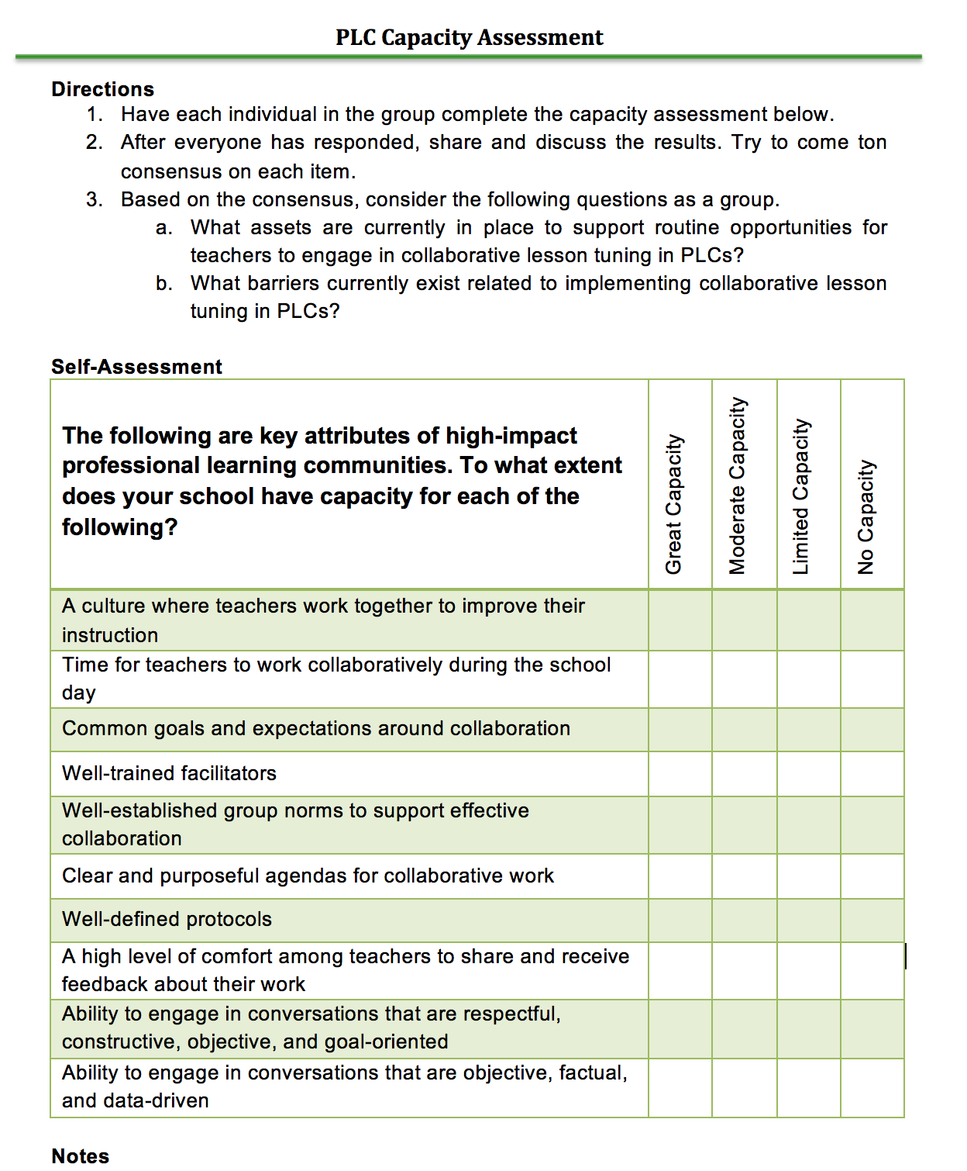
Activity: PLC Capacity Assessment
Pages
5-6
Directions
Turn to the PLC Capacity Assessment sheet in your booklet.
Individually complete the PLC Capacity Assessment.
Next, as a group share and come to consensus for each item.
Discuss school-level assets and barriers related to PLCs.

Slide 14
Developing a Plan to Support Lesson Tuning in PLCs School-Wide
Strategic Planning

Slide 15
Strategic Planning
Pages
5-7a-b
Use the Strategic Planning Guide and Strategic Mapping Organizer in your booklet to plan next steps.
Set a Goal
Define Barriers and Obstacles
Identify Strategic Steps and Action
Clarify Roles and Responsibilities
Schedule Times to Check In

Slide 16
Wrapping Up Module 5

Slide 17
What was accomplished in Module 5
Review of Group Norms
Text-Based Discussion
Feature and Function Activity
Watched and Discussed Demonstration Videos

Slide 18
What was accomplished in Module 5
Review Group Norms
Debrief the 4th Round of Collaborative Practice
Participate in Text-Based Discussion
Capacity Self-Assessment
Strategic Planning
Course Feedback

Slide 19
Activity
Discuss the intended outcomes for Module 5. To what extent do you feel they were met?
By the end of Module 5, participants will:
Be able to begin implementing a plan to build school-level capacity for teachers to routinely engage in collaborative discussions around instruction.

Slide 20
Course Feedback & Certificate of Completion
Congratulations on completing all five modules of the following course: Building Capacity for a Collaborative ENL & General Education Model!
Please take a few moments to individually complete the course evaluation at the following link:
https://goo.gl/UaEDfP
Once all of the above have been completed, please email Jillian Belanger at Jillian.Belanger@ride.ri.gov to do the following:
Send a copy of your team’s plan, and
Receive certificates of completion.

Slide 21
Thank you for participating in this course. We look forward to your feedback! It’s time to celebrate!

Slide 22
Summary Statement
The heart of Rhode Island Collaborative ENL and General Education Model is for RIDE to provide districts and schools with resources to help build capacity to help all learners succeed – particularly including English Learners and students with disabilities.

