Slide 1



Presentation for:
Statewide Facilities Assessment & Planning Services
Assessment and Recommended Action Plan Information Session

Slide 2

Introduction
  Performed over 270 million SF of K12 assessments since 2007
  Helped garner public support for more than $6 billion in public referendums since 2014
  Assessments overseen by licensed professionals
  Performed 3rd statewide assessment for MA – 2016
    Successfully informed funding and budgeting
  Nationally recognized leaders in educational facility planning
  Experience in 47 states & DC
  Over 260 facility plans for urban, suburban & rural communities

Slide 3
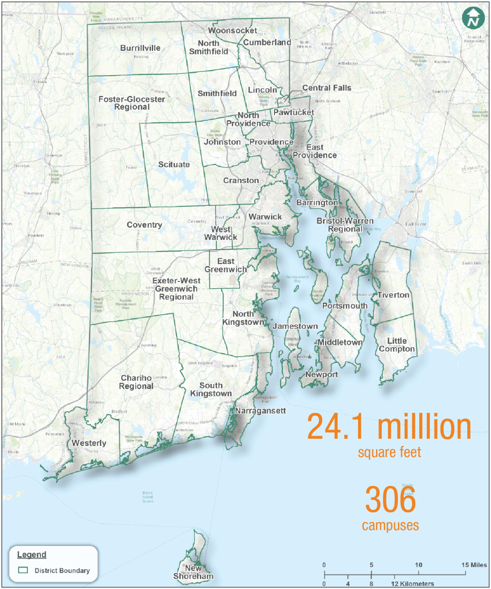
Purpose
  Introduce the Process
  Share Findings
    New SBA Website
    Facility Condition Assessment
    Jacobs Recommendations for Consideration
  Engage Stakeholders
    What are your thoughts?

Slide 4
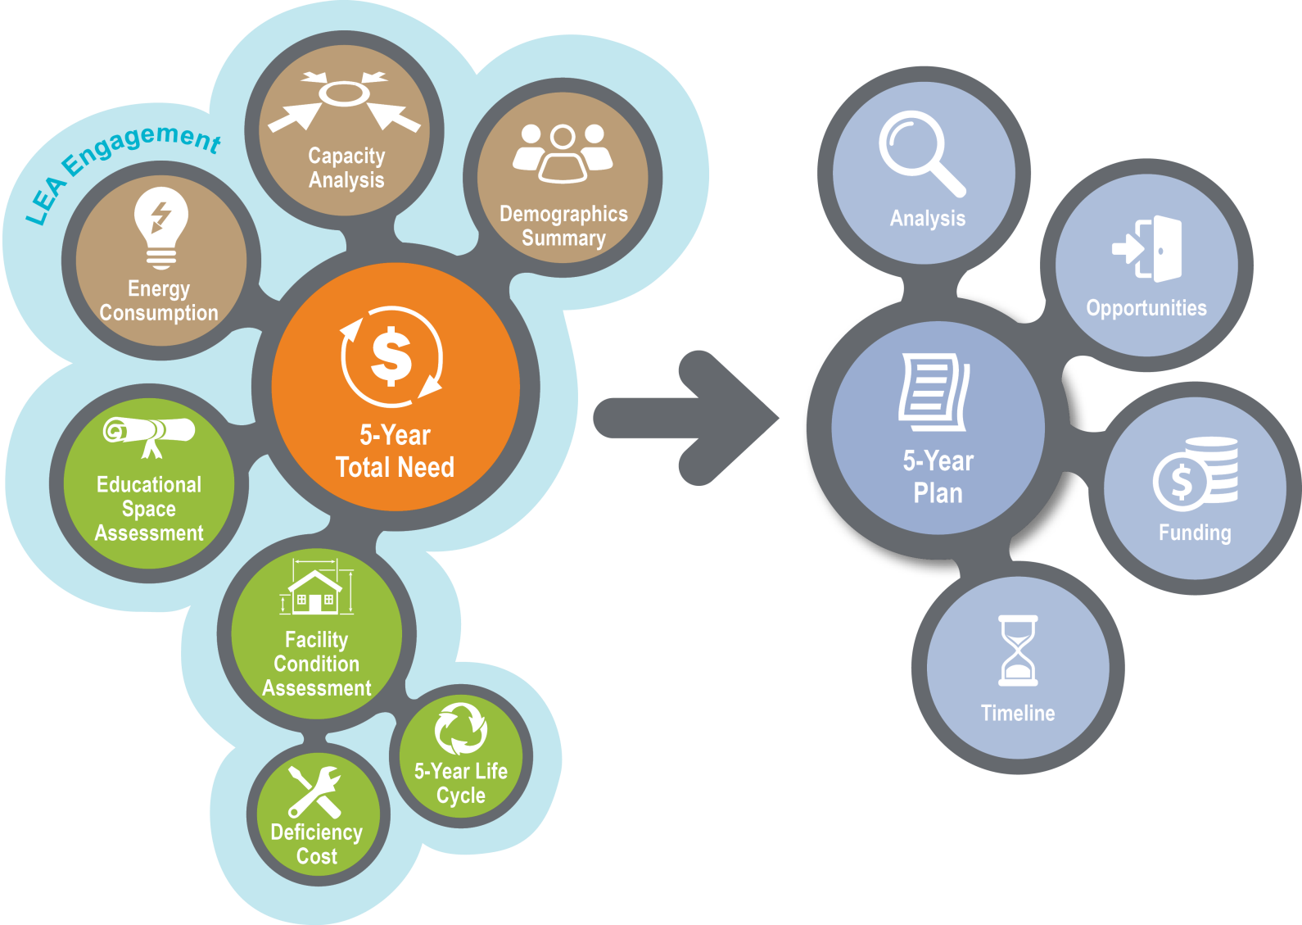

Introduction
State of Rhode Island Schoolhouses
Rhode Island Schoolhouse
Jacobs Recommendations
for Consideration
New
School Building Authority
Website

Slide 5

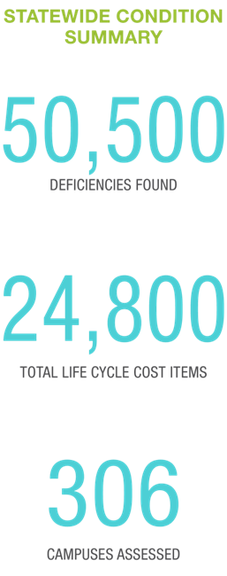
Facility Condition Assessment
  Facility condition assessment evaluates the general health of physical facilities
  Condition assessment data:
    Prioritize deficiencies and life cycle costs based on impact to facility/learning environment
    Calculate Facility Condition Index

Slide 6
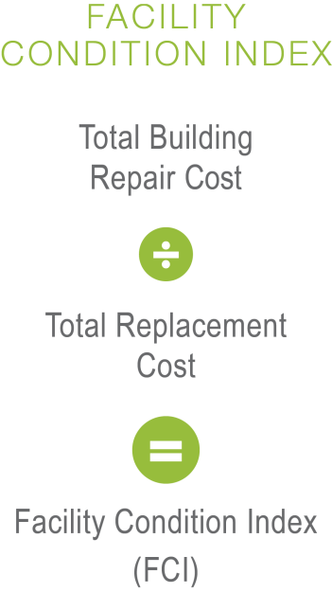
Five Year Facility Condition Index (FCI)
  General Indicator of a facilities health
  The higher the FCI the greater the need
  Financial modeling suggests FCIs of 65% or greater are candidates for replacement
  FCI is only one indicator and is not the only factor to consider when identifying renovation, replacement or closure candidates

Slide 7

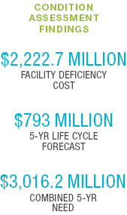
Combined Five Year Need
  Combines current deficiencies costs and five year life cycle renewal costs
  Provides a more comprehensive analysis of the facility needs statewide

Slide 8

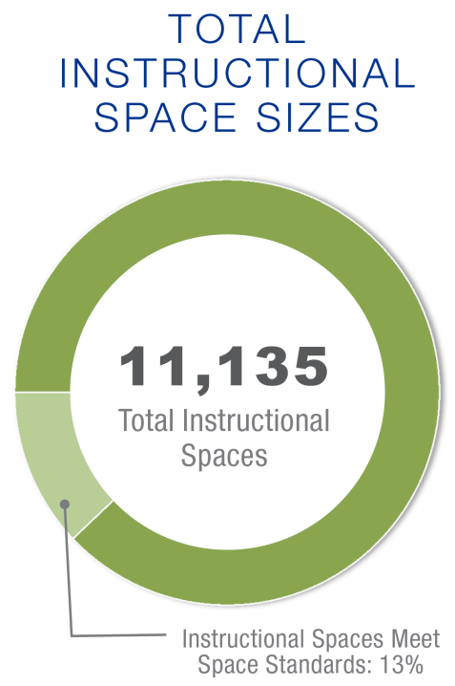
Educational Program Space Analysis
  Identifies the degree to which a school facility can adequately support the instructional mission and methods
  Standards based on RI School Construction Regulations
  Standards based assessment for consistency
  Correctable items are given a cost estimate
  Space deficiencies were identified

Slide 9
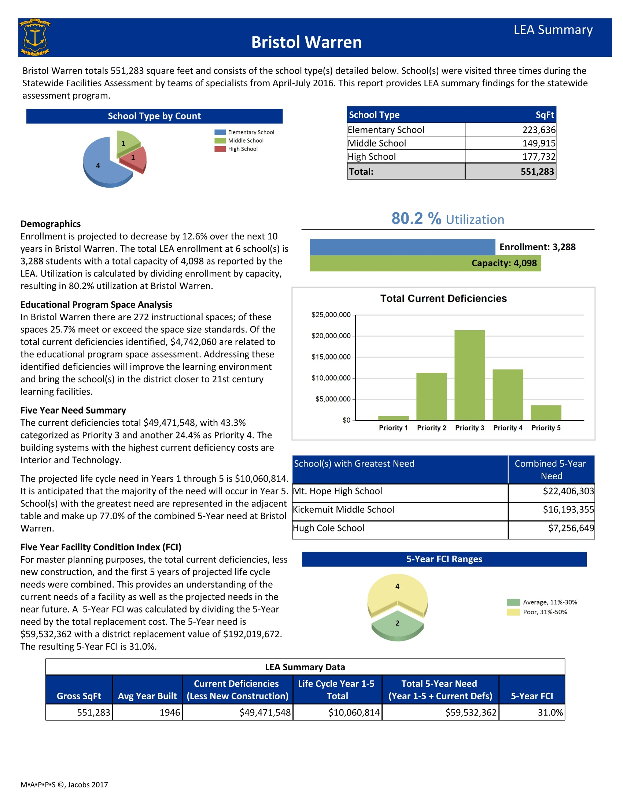

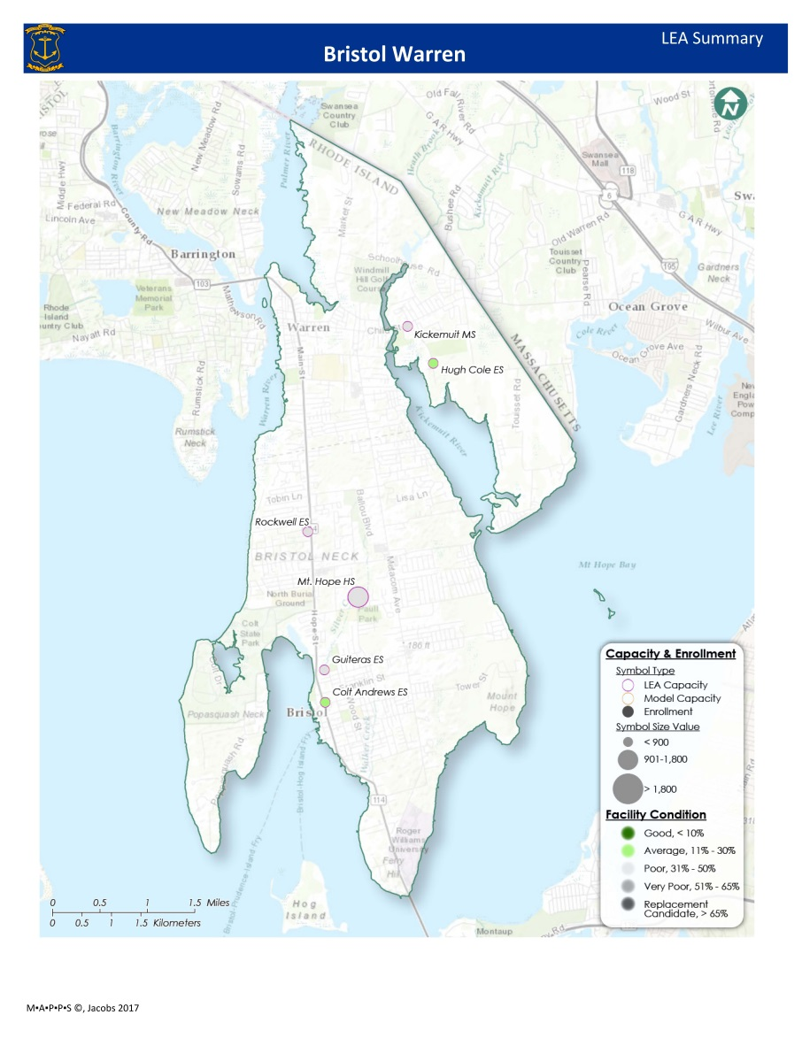

Slide 10
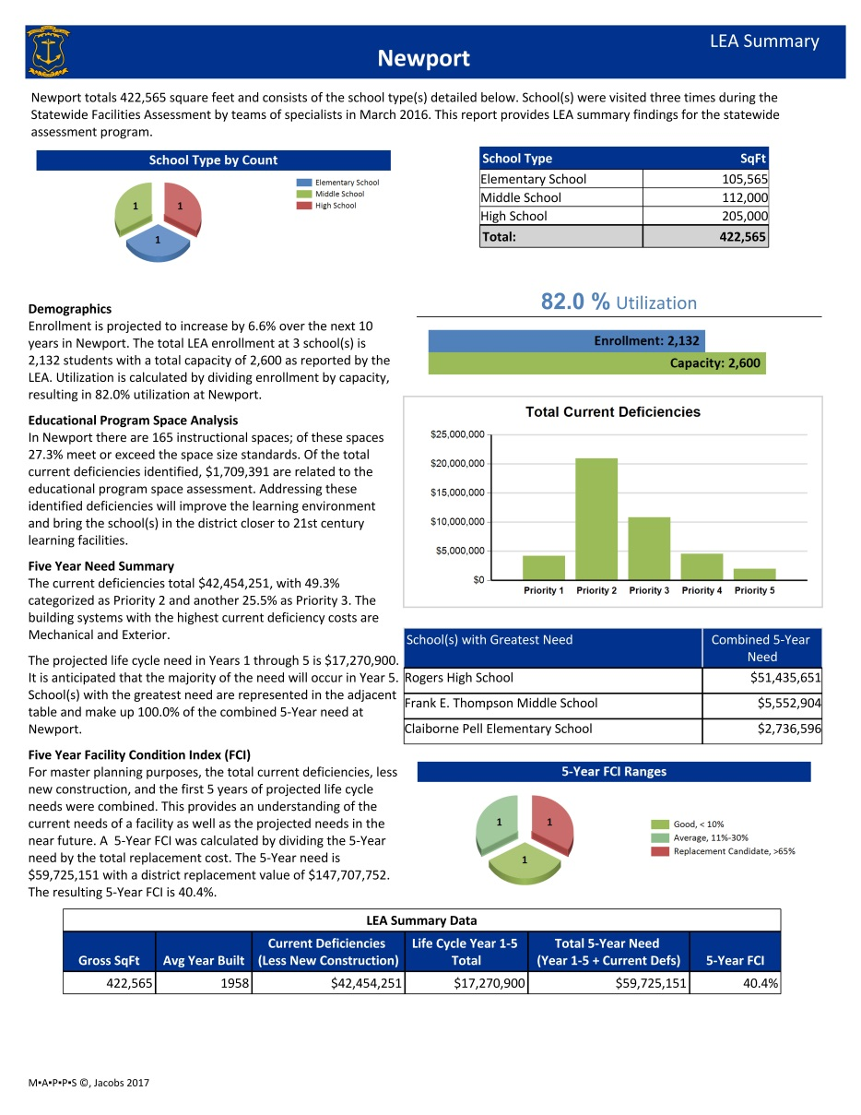
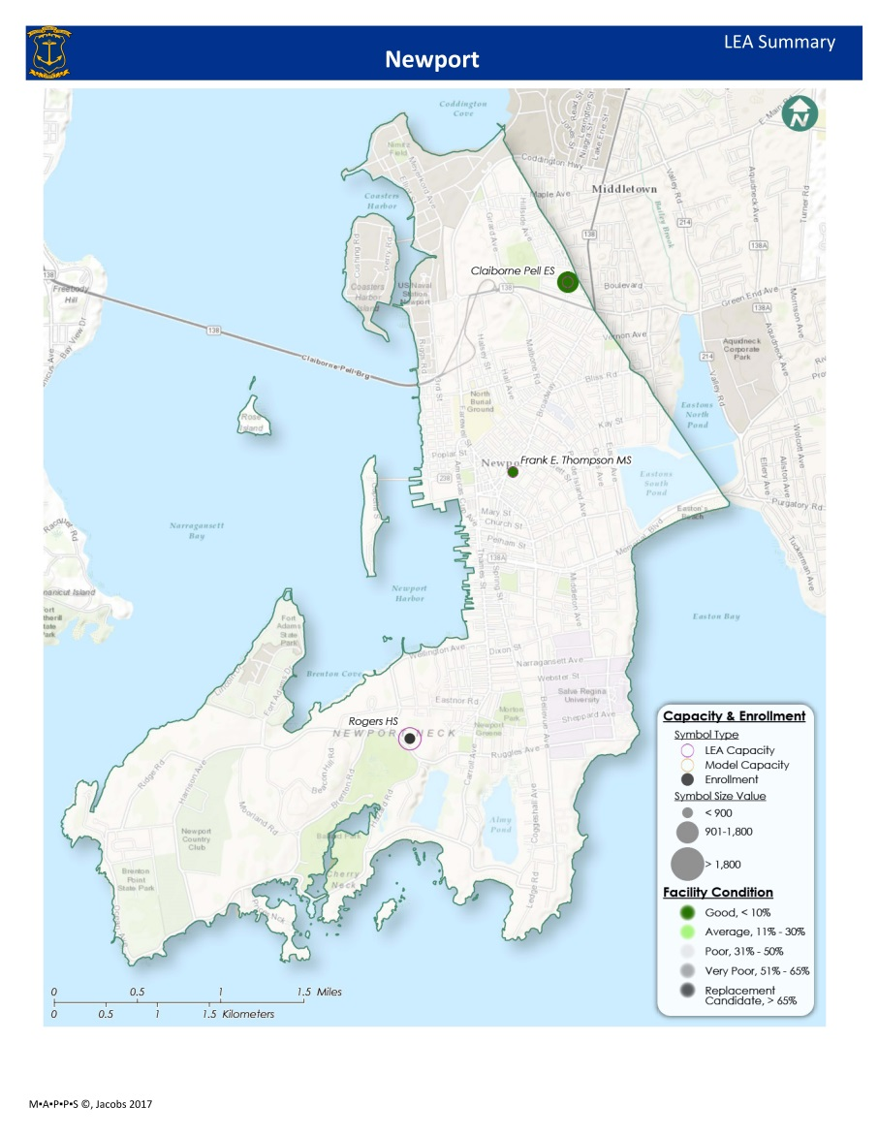

Slide 11
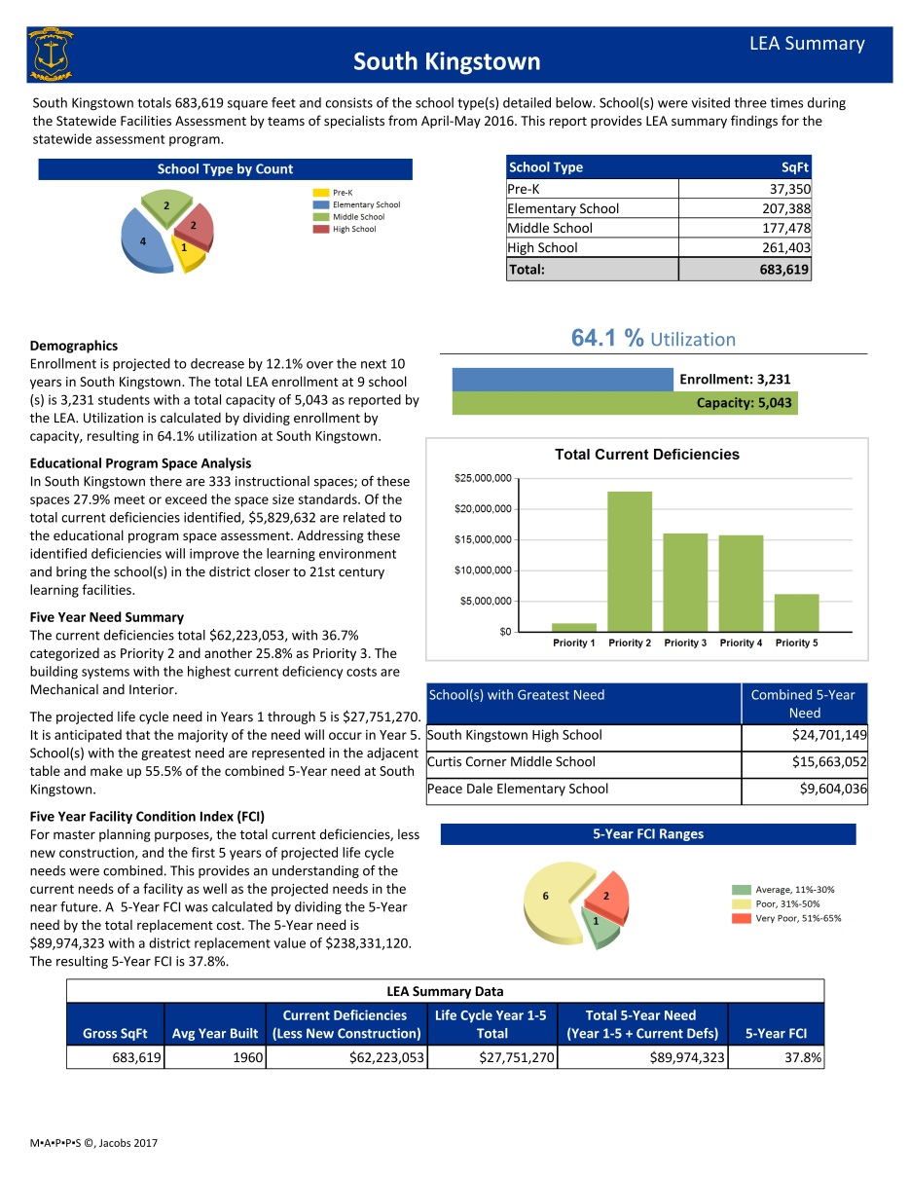
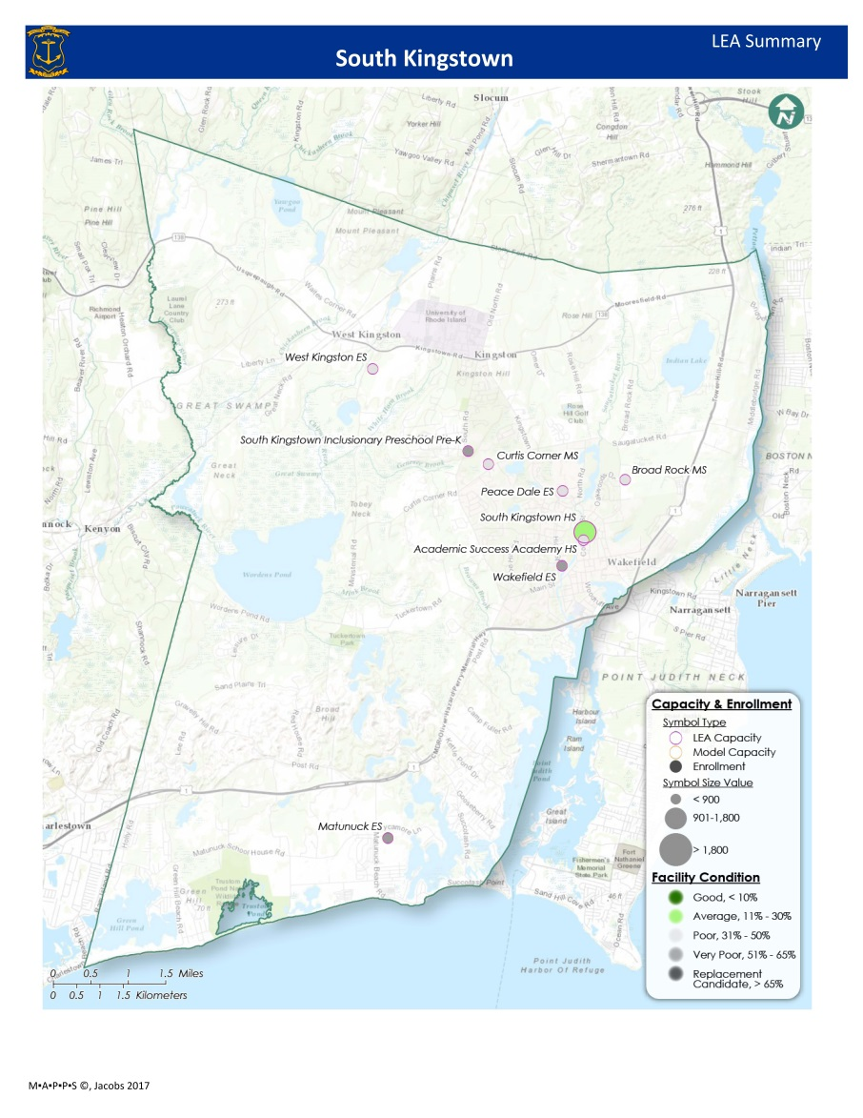

Slide 12
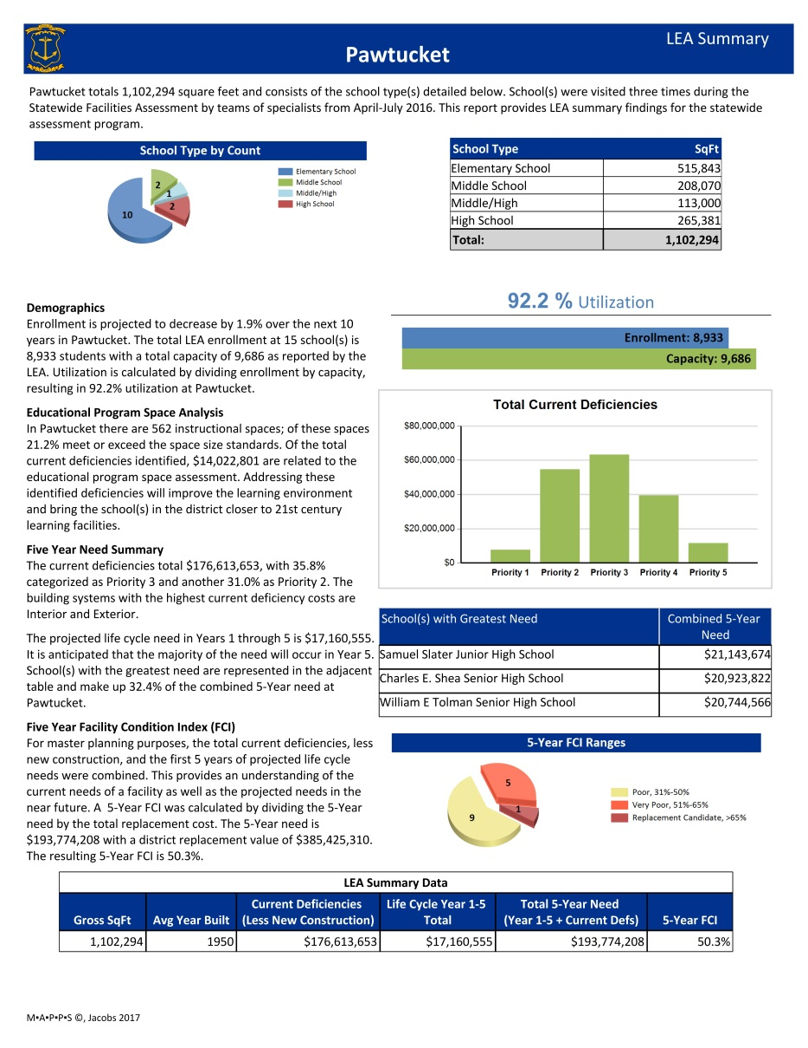
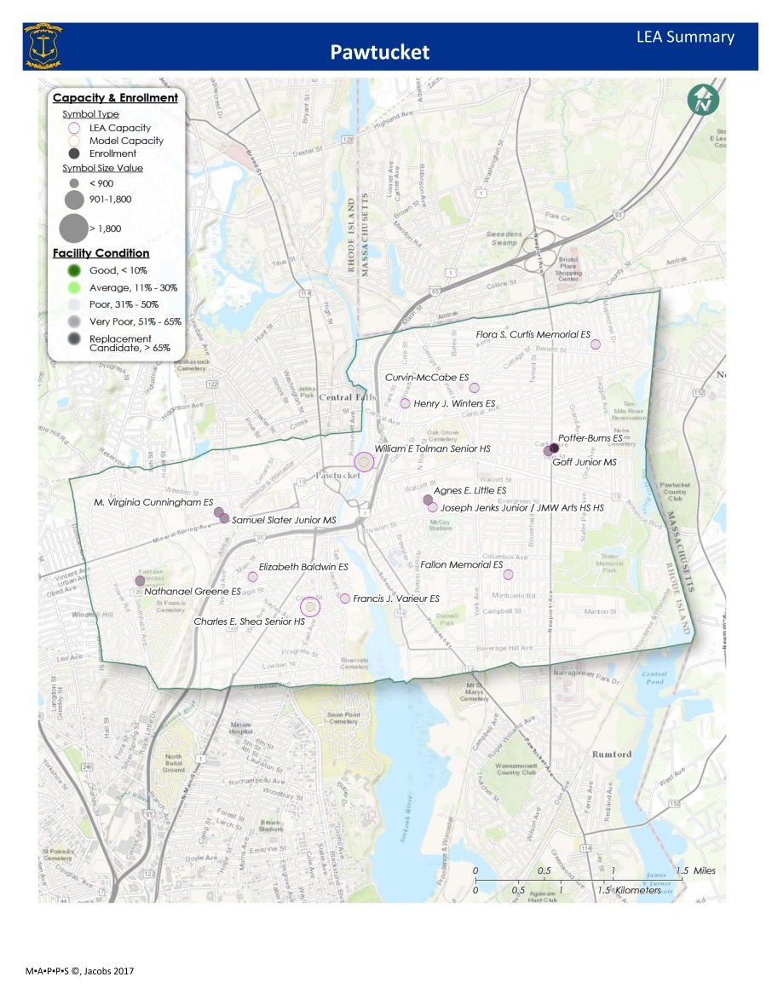

Slide 13
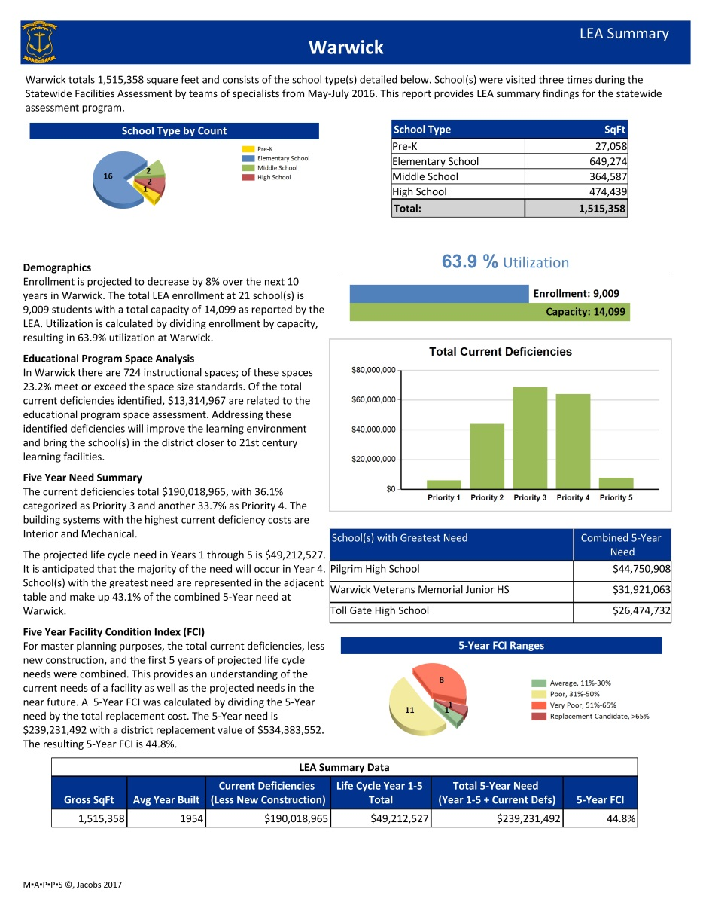
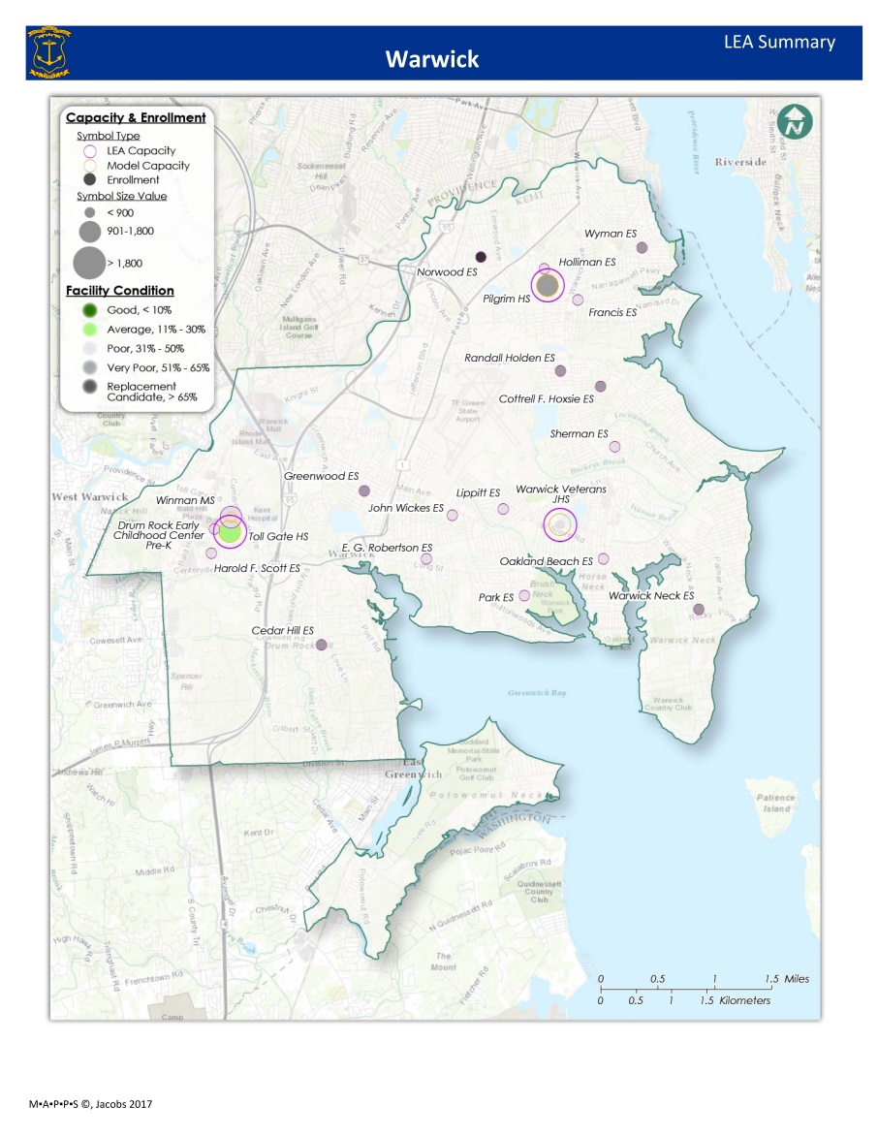

Slide 14
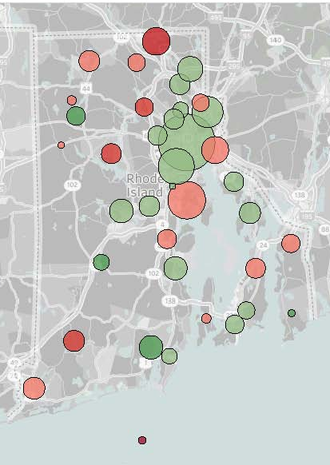

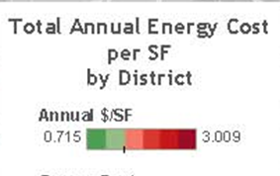
Energy Analysis
  Schools in RI spend $33.6 million annually
  Six primary opportunities to save money
    Converting to LED lighting
    Installing building automation systems
    Installing solar photovoltaics
    Utilizing ground source heat pumps and solar hot water
    Pressurizing buildings (ERVs/DOAS)
    Converting to Solar Hot Water

Slide 15

Assessment Data Quality Review Process
  March 2016 Kick off Meeting at RIDE
  Assessments performed from March to July 2016
    Teams oriented to RIDE procedures and protocols
    Assessment teams provided data collection tools and checklists for consistency
    Data collected and stored in a database system to maintain consistency and integrity
  Internal Quality Procedures
    Data uploaded every night for quality assurance staff to process
    Queries run to check for consistency and accuracy

Slide 16
LEA Quality Review Process
  Three opportunities to provide feedback via RIDE Maps
    October, January, and May
  Websurvey tool to provide additional feedback
  Notes provided by LEA’s were reviewed and incorporated as appropriate
    Deficiency priorities and space standards were consistently applied to maintain data integrity
  Formal responses provided via RIDE Maps

Slide 17
Assessment Data Addendum
  Feedback can provide by JacobsReport@ride.ri.gov
  Report updated via Addenda’s
  Addenda's will be reported SBA website

Slide 18

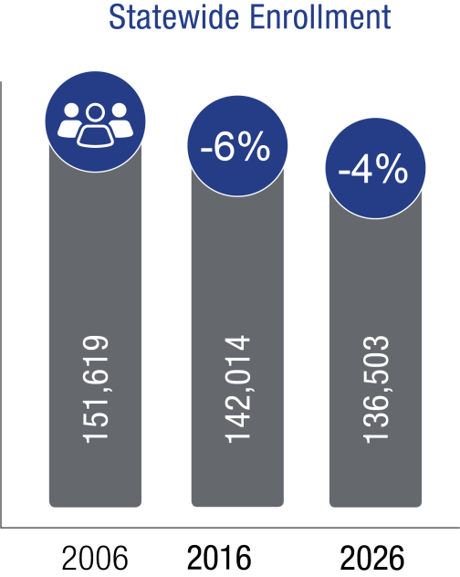
Demographics
  Enrollment has been decreasing over the past 20 years
  Enrollment projected to decline 4% over the next 10 years
  Students have 24% less square feet per student than state standards recommend

Slide 19
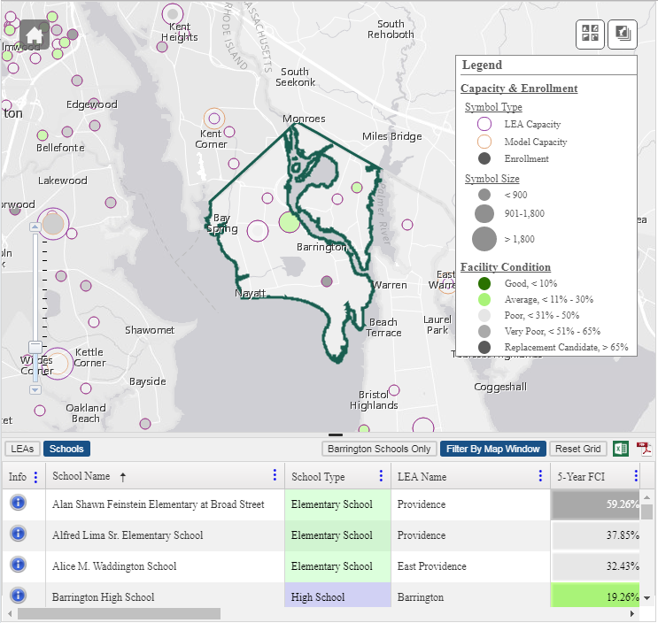
New SBA Website
Facility Data & Information
Capabilities
Toggle between LEA’s and Schools map and data grid
Export data to excel or pdf
Filter and sort data based on selected column values
Customize columns of data to view
View LEA Summary Reports

Slide 20
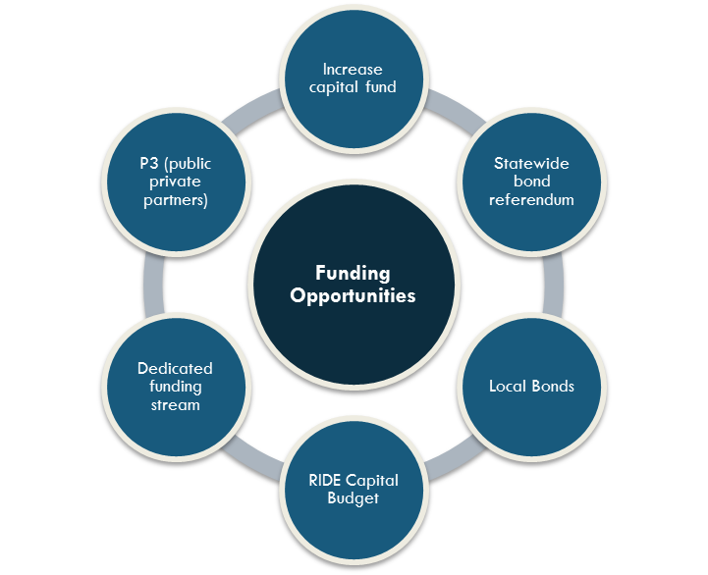
FISCAL STRATEGIES FOR CONSIDERATION
  Lower the Minimum Share Ratio
    Return the minimum share ratio to 30% and cap the maximum at 80%
    Resulting savings of at least $1M annually, beginning in FY 2022, could be redirected to fund additional projects.
  Allocate Additional Construction Aid
    Returning School Construction Aid to FY2016 amount would allow for $75 million of SBA Capital funded projects over 5 years
  Request Statewide Bond
    Need for critical repairs exceeds current funding allocation
    Invest strategically in school environments

Slide 21

FISCAL STRATEGIES FOR CONSIDERATION
  Develop Exceptional Needs Program
    Allocate funding to financially distressed LEAs to assist with health and safety facility needs
    Exclusive Capital Fund for loans or progress payments
  RIDE Capital Budget Requests
    Target programmatic improvements (CTE, STEAM)
  Establish a Dedicated Funding Stream
    Aid in bridging the gap between current funding and the need in Rhode Island’s public schools

Slide 22


Jacobs Recommendations for Consideration Justification
  Significant effort to bring RI public schools to a condition that ensures students have safe, comfortable, and healthy learning environments
  Statewide enrollment projected to decrease by four percent over the next 10 years
  Finding acceptable methods of funding based on sound planning principles
  Identify key educational programs for investment

Slide 23
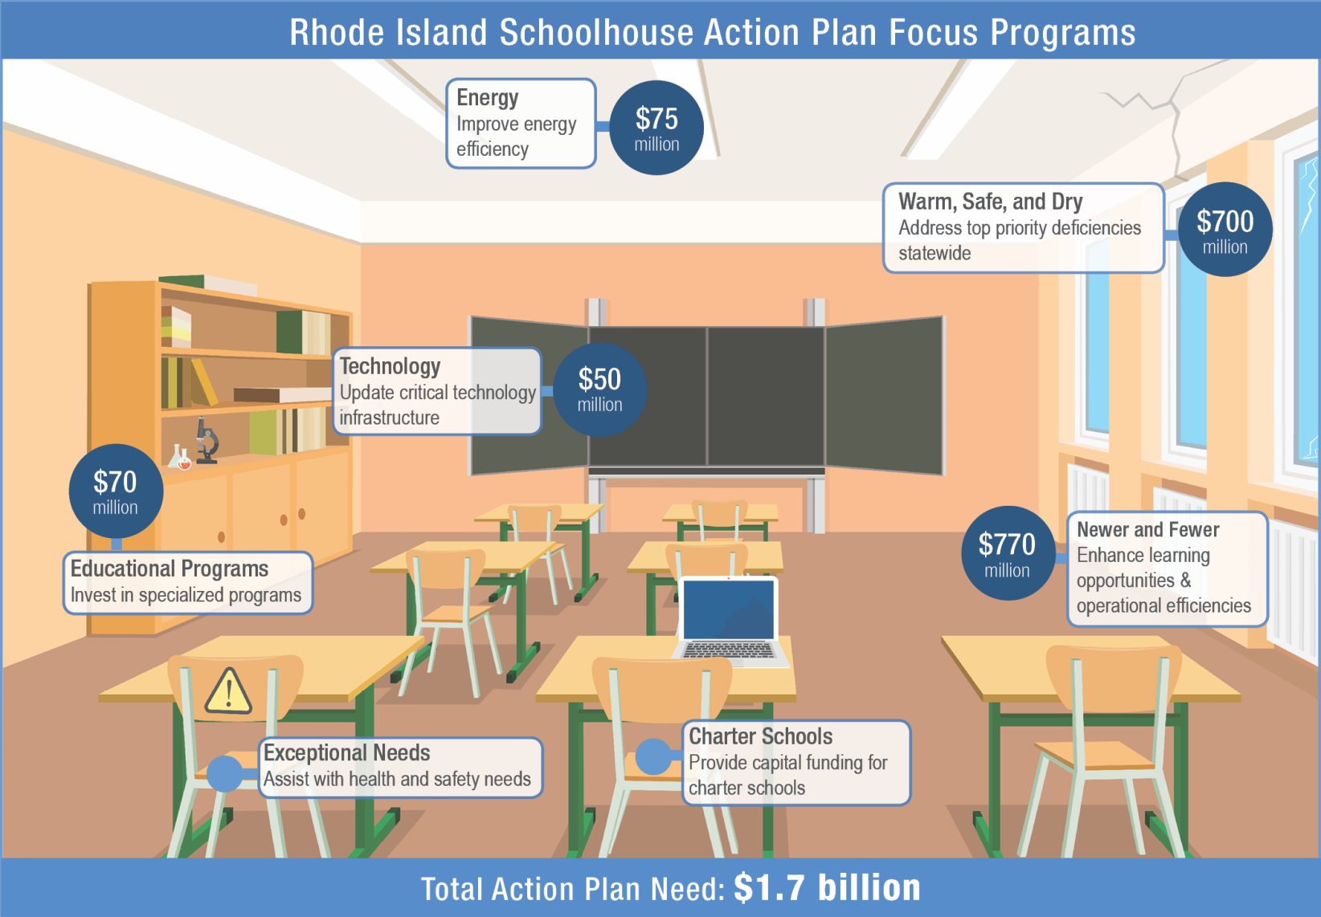

Slide 24
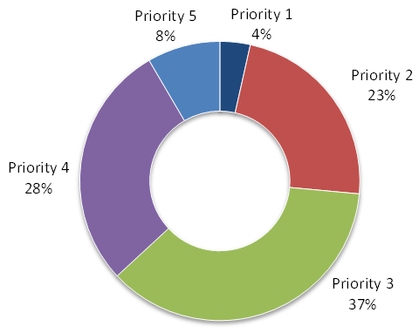
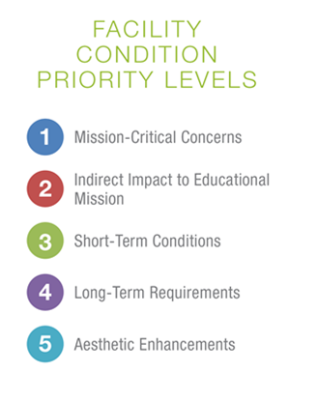
FOCUS PROGRAMS FOR CONSIDERATION
  Warm, Safe, and Dry
    Invest in all top priority condition items in schools not being replaced
    Encourage LEAs to use a revolving Capital Reserve Fund
  Newer and Fewer
    Invest in building newer, fewer schools to provide modern learning environments
  Educational Programs
    Invest in Early Childhood, Career & Technical, and STEAM programs

Slide 25

FOCUS PROGRAMS FOR CONSIDERATION
  Energy
    Investment in energy conservation measure focus on:
      LED lighting,
      Energy Recovery Unit/Dedicated Outside Air Systems, and
      Building Automation Systems
  Technology & Furniture, Fixtures, and Equipment
    Focus on campus-wide technology infrastructure needs
  Charter Public Schools
    Assist in bridging the gap between leasing and owning facilities

Slide 26

STRATEGIC RECOMMENDATION
  Prioritization of School Construction Projects
    Informed by statute and regulations will result in an objective and methodical prioritization of funding
  Encourage LEAs to Establish and Use Capital Reserve Funds
    Projects funded by capital reserve funds can be approved and reimbursed more quickly than bond projects
  Facility Innovation
    RIDE can provide model facility programs to LEAs as a “kit of parts” to expedite the creation of innovative school design
  Establish Community Engagement Process
    Provide guidance based on industry best practices

Slide 27
STRATEGIC RECOMMENDATION
  Robust Facility Master Plan Process
    Continue process for LEAs engaging in major renovations
  Establish Adequacy Standards
    Establish Standards in compliance with the BEP
  Provide Additional Staff to SBA
    Staff would monitor the operations side of school facilities
  Streamline Procurement
    Prequalify vendors to assist LEAs in order to expedite the procurement process

Slide 28
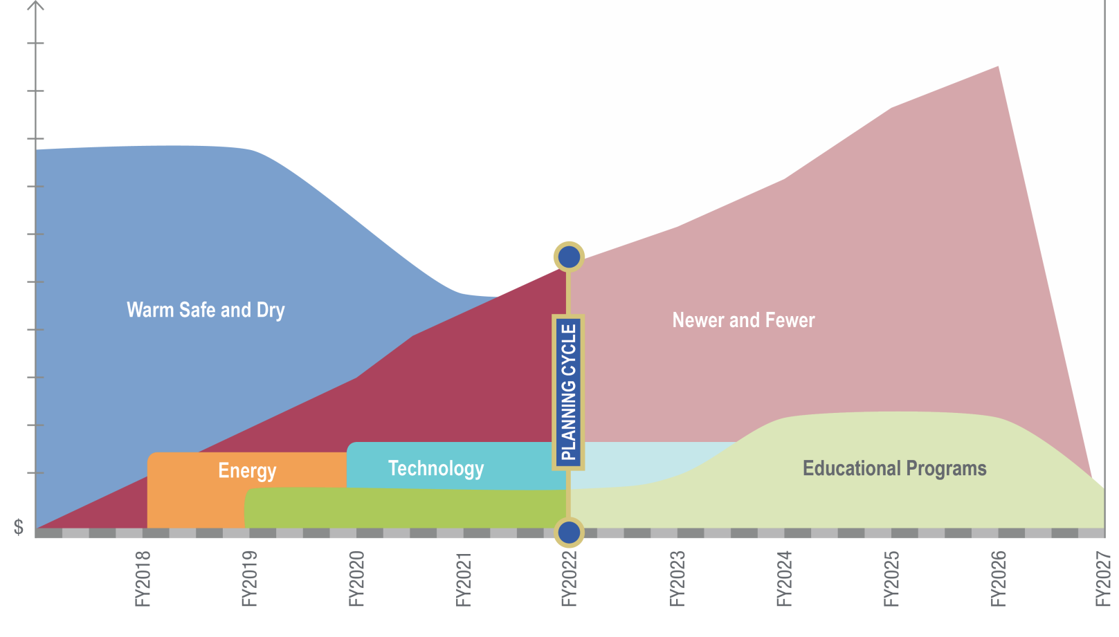
Rhode Island Schoolhouse Recommendations Timeline

Slide 29

Rhode Island Schoolhouse
Jacobs Recommendations for Consideration
  Assist stakeholders in making decisions
  Working within fiscal realities of the state budget
  Strategically and effectively spend available facility funding
  Provide student opportunities for learning to occur in healthy, safe environments
  Provide potential for learning spaces to be updated to 21st century learning environments
The best long-term investment strategy in facilities is based on the interplay of school condition and size. Based on the assessment, opportunities have been identified to target high-value investments.

Slide 30
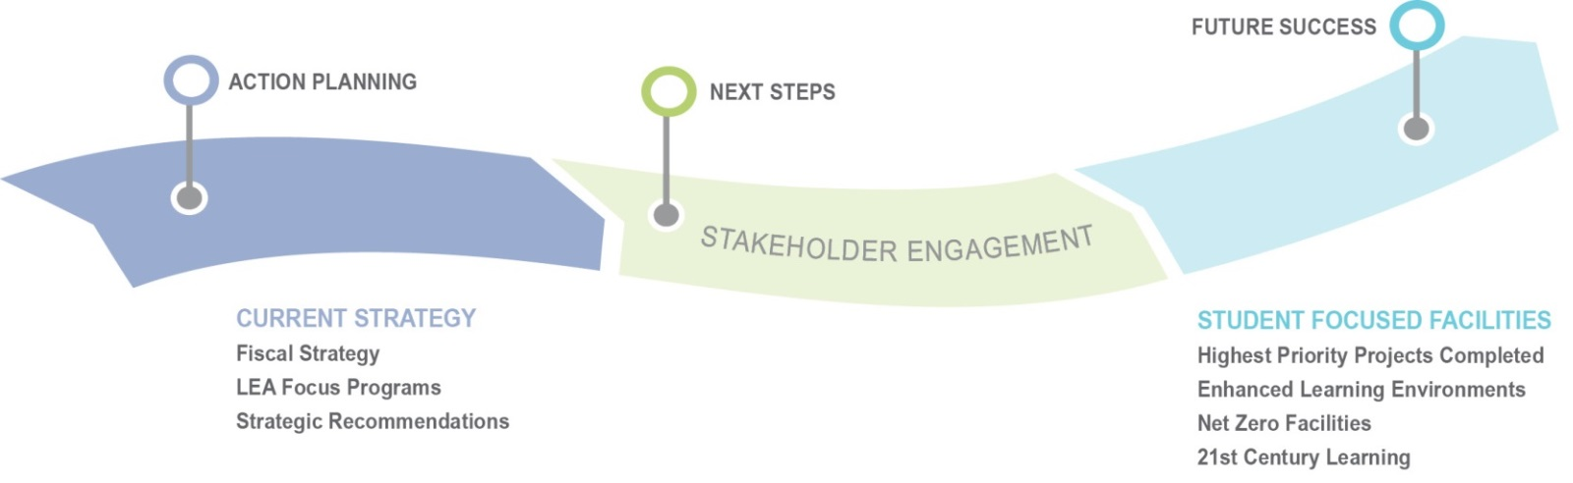
Engage Stakeholders
  Leverage Facility Condition Assessment and Jacobs Recommendations for Consideration to engage Stakeholders
  Collaborate on a Solution
  Community Engagement Briefings
    On-site presentations and work sessions
EDUCATE AND ENGAGE STAKEHOLDERS
Superintendents
School Board Committees
Communities
Stakeholder engagement is important to the success of the Action Plan for Consideration and ultimately positive outcomes for the students of Rhode Island

Slide 31
Community Technical Briefing Sessions
31
  Monday, September 18
    4:00-5:30pm, Bristol, Mt Hope High School Auditorium
    6:00-7:00pm, Newport, Pell Elementary School Cafeteria
  Tuesday, September 19
    5:30-7:00pm, South Kingstown, SK High School
  Wednesday, September 20
    4:00-5:30pm, Pawtucket, Jencks Middle School Auditorium
    6:00-7:30pm, Warwick, Pilgrim High School Cafeteria
Stakeholder engagement is important to the success of the Action Plan for Consideration and ultimately positive outcomes for the students of Rhode Island

