Slide 1
RICAS Mathematics: Understanding Released Items & Student Work Samples
Winter 2019
Notes:
Welcome to the RICAS Mathematics Informational Session.
Susan Pagliaro and Chris Castillero Mathematics Specialists, Office of Instruction, Assessment & Curriculum

Slide 2
Agenda
RICAS Resources
Released Items
Metadata
Student Work
Notes:
Our agenda for this presentation will walk us through some of the RICAS resources including:
Released Items
Metadata for those items
Student Work samples for constructed response released items

Slide 3
RICAS Resource Center
http://ricas.pearsonsupport.com/
Notes:
We begin, by viewing the RICAS Resource Center home page. The re you will find PearsonAccessNext, Training, Tech Set Up, Test Administration Manuals, and Student Tutorials.
For RICAS Mathematics instructional purposes we recommended using the Student Practice Tests and Released Items. The latter allows you to access student work samples via the RICAS Resource Center.
Please note, since Rhode Island is purchasing the MCAS assessment, some resources may contain the MCAS branding.

Slide 4
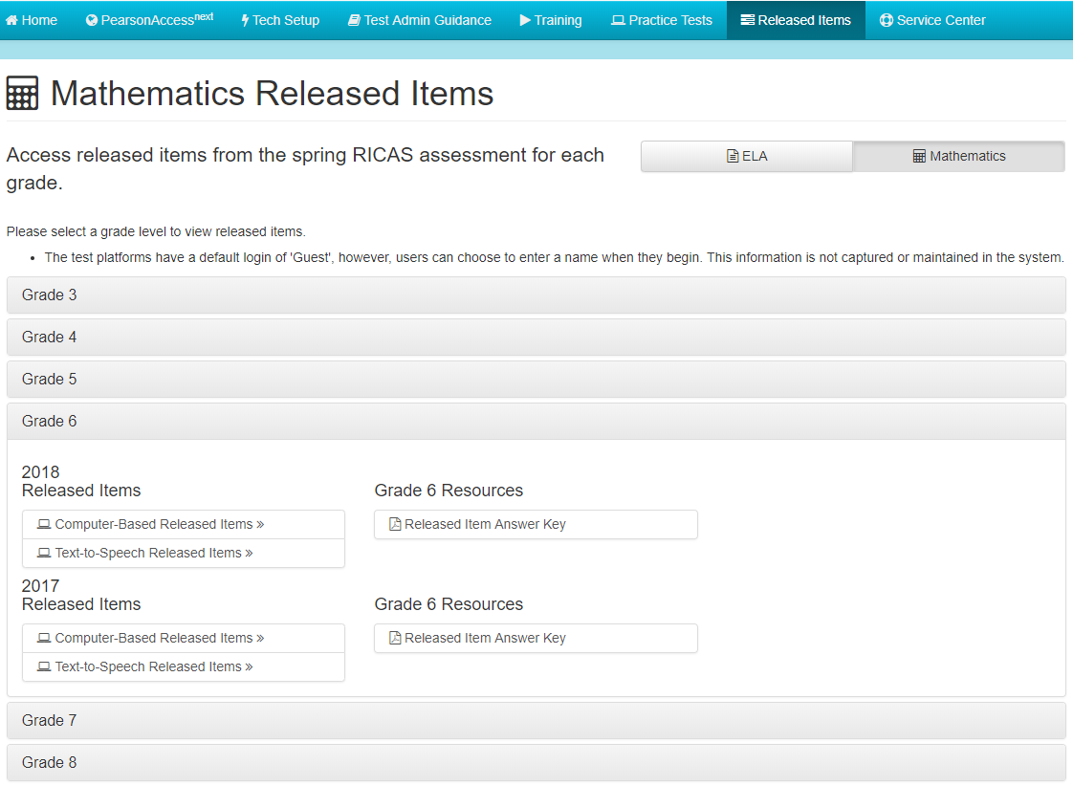
Released Items
http://ricas.pearsonsupport.com/released-items/math/
Notes:
Currently, a limited number of released items are available for the RICAS assessment. They are from 2017 and 2018.
This screen shot illustrates the manner in which to access grade level Computer-Based Released Items, including Text-to-Speech Released items.
Also included is the Released Items Answer Key. This document provides information about each released item from the computer-based test, including: The CBT item number from the actual operational assessment, the ePAT number which refers to the position of the item in the released item set for the given year, reporting category, standard assessed, item type, item description, and correct answer. Similar but more limited Information about unreleased operational items is also given in the latter part of the document.
Computer-based released items located within the RICAS Resource Center
http://ricas.pearsonsupport.com/released-items/math/
Released paper-based version
http://www.doe.mass.edu/mcas/2018/release/

Slide 5
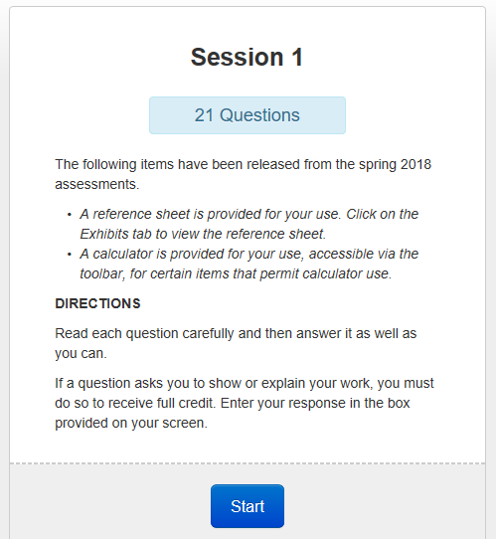
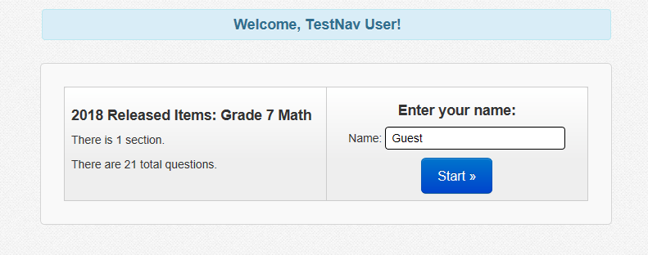
Entry Screens to the CBT Released Items
http://ricas.pearsonsupport.com/released-items/math/
Notes:
There will be a sign-in screen and a direction screen before you get to the mathematics items.

Slide 6
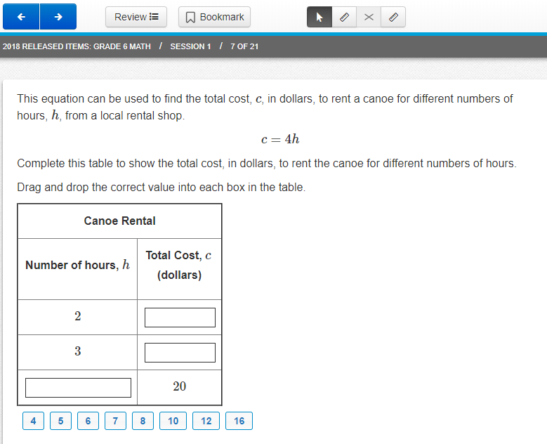
Released Items
http://ricas.pearsonsupport.com/released-items/math/
Notes:
Here you see a 2018 released item for Grade 6. This is an example of one of the technology enhanced items students experience on RICAS.
Encourage students and teachers to use these released items and the Practice Tests to familiarize themselves with RICAS items, expectations, and item formatting. Working with these resources gives everyone an opportunity to interact with the computer-based items on TestNav8.

Slide 7
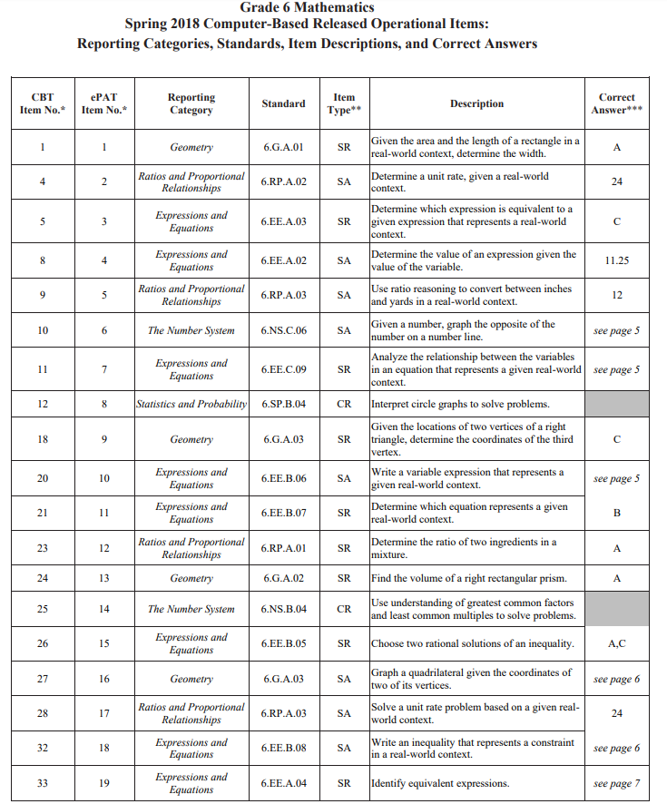
Released Items – Metadata
http://ricas.pearsonsupport.com/resources/released-items/math/RICAS_2018_Gr6_Math_ePATs_documents_final.pdf
Notes:
Answers and other metadata for each released item can be found by clicking on the grade level Resources button – in this case grade 6.
As you read across the table, you can see there is information on:
CBT Item Number
EPAT Item Number
RICAS Reporting Category
Standard
Item Type
Item Description
Correct Answer (for Selected Response and Short Answer)
A quick review of this grade 6 metadata shows:
There were 21 items released
8 in the reporting category of Expressions and Equations
6 in Ratios and Proportional Relationships
4 in Geometry
2 in the Number System
1 in Statistics and Probability
2 Constructed Responses (CR)
9 Short Answer (SA)
10 Selected Response (SR)
Educators may find these Metadata documents helpful when completing any item analysis for the 2018 RICAS assessment.

Slide 8
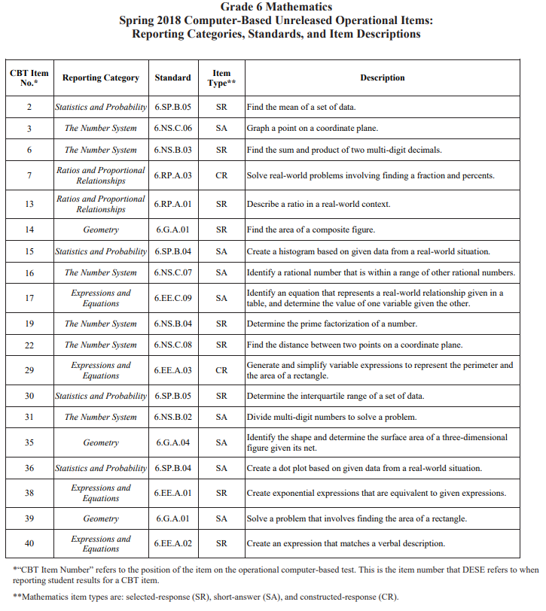
Unreleased Items – Metadata
http://ricas.pearsonsupport.com/resources/released-items/math/RICAS_2018_Gr6_Math_ePATs_documents_final.pdf
Notes:
As you scroll through the metadata document, you come upon a second table, this one for the unreleased operational items. Categories of data are basically the same except these items do not have an ePAT number, nor are the correct answers disclosed. However, knowing the description and standard number from the items is helpful when analyzing your classroom data.

Slide 9
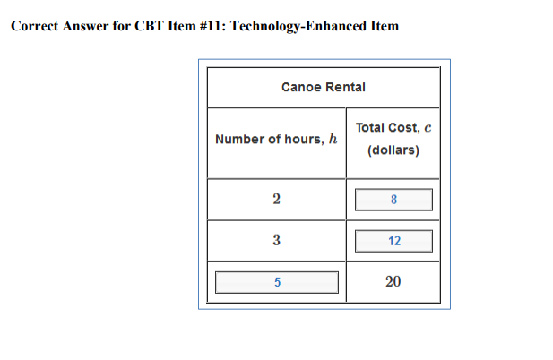
Metadata - CBT Released Items
http://ricas.pearsonsupport.com/resources/released-items/math/RICAS_2018_Gr6_Math_ePATs_documents_final.pdf
Notes:
Continuing to scroll down, screen shots of the technology enhanced items illustrate the correct responses. In this case, the shaded boxes illustrate the correct values that were dragged and dropped into the table.

Slide 10
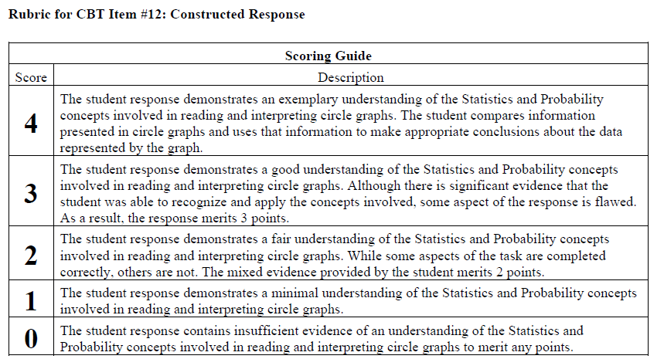
Metadata - Scoring Guides
http://ricas.pearsonsupport.com/resources/released-items/math/RICAS_2018_Gr6_Math_ePATs_documents_final.pdf
Notes:
The final pieces of information included in these documents are item specific scoring guides for all released constructed response items. Here we see a guide for grade 6 CBT Item #12, a Statistics and Probability item. The guides make concrete references to the standard assessed and some guidance on what is expected of student work for each score point.
In a moment, we will see how to access samples of student work associated with each released constructed response item.

Slide 11
Released Items - Student Work
Student Work Samples
Notes:
To find Student Work Samples we return to the Released Items home page of the RICAS Resource Center. After clicking the button indicated by the blue arrow on the slide, you will land on a page of the Massachusetts Department of Elementary and Secondary Education website.

Slide 12
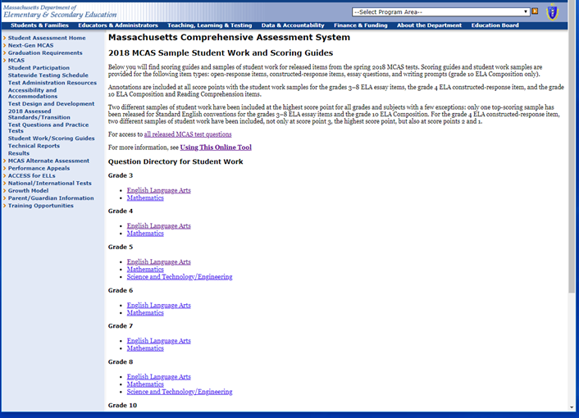
Sample Student Work & Scoring Guides
Notes:
This is a screen shot of that landing page.
Links to student work samples for both RICAS mathematics and ELA are present on the page. Additionally, there is a link to access all past and present MCAS released items and a link to a tutorial titled "Using This Online Tool".
The red arrow is pointing to the link for grade 6 mathematics student work samples for 2018.
Sample Student Work:
http://www.doe.mass.edu/mcas/student/2018/
Using this Online Tool includes:
http://www.doe.mass.edu/mcas/student/2018/about.html
Scoring Overview:
http://www.doe.mass.edu/mcas/scoring.html

Slide 13
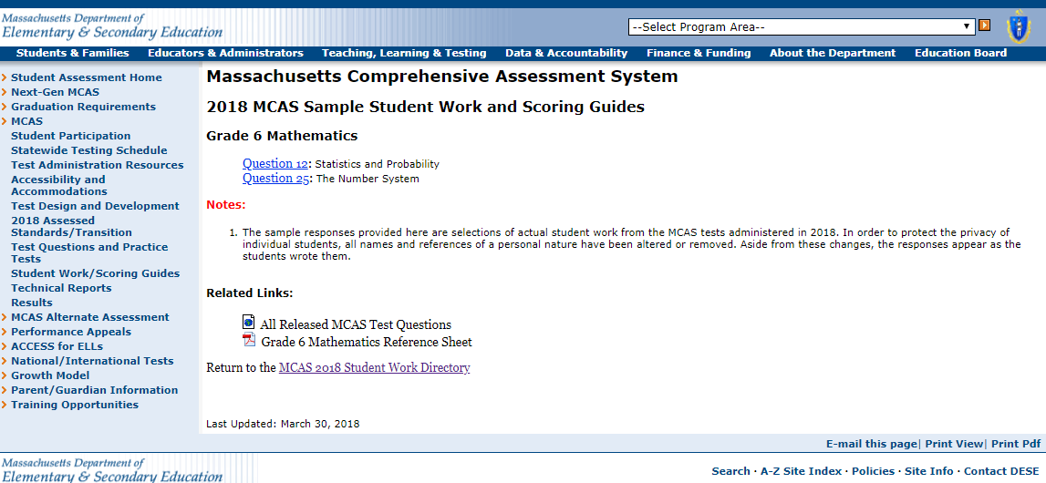
Sample Student Work by Question
Notes:
Two constructed responses are released for each grade level per administration year. The red arrow is pointing to the link to open the student work samples for the Statistics and Probability item previously mentioned. A link to the second item is also present as well as other related links.
http://www.doe.mass.edu/mcas/student/2018/question.aspx?GradeID=6&SubjectCode=mth

Slide 14
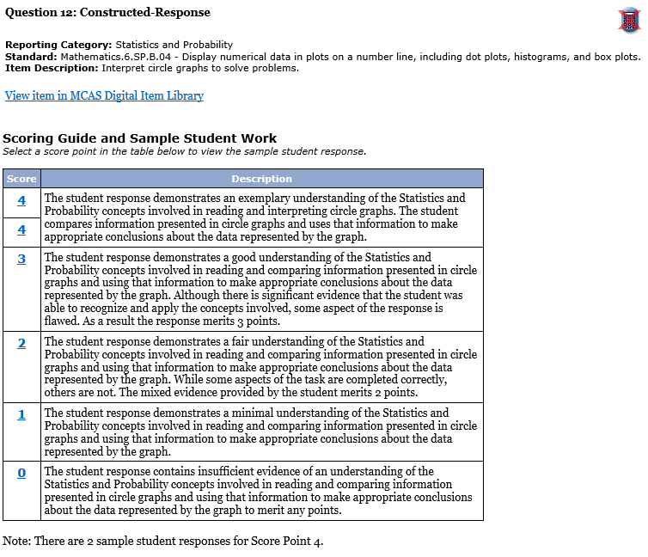
Sample Student Work & Scoring Guides
Notes:
Opening the link, we immediately see the Scoring Guide for the item as well as other identifying data, including calculator status. The red arrow points to the crossed out calculator, thus indicating a calculator was not allowable for the standard administration.
This version of the scoring guide is exactly the same as the one we previously saw, but it has the added feature of hyperlinks at each score level. Clicking on the blue score numbers brings you to the student work samples.

Slide 15
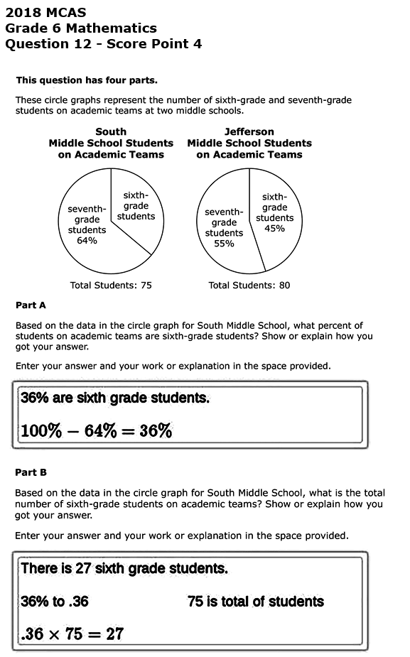
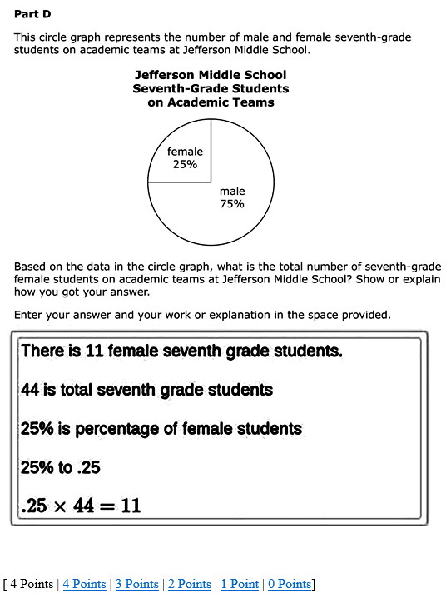
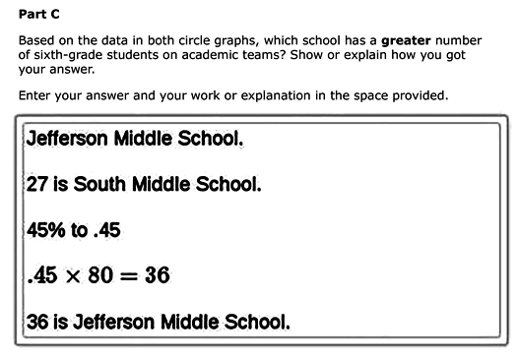
Sample Student Work & Scoring Guides
Notes:
This screen shot is one of the two student samples provided for a score of 4. There are convenient links to papers at each of the other score points at the bottom of the response, as indicated by the red arrow.

Slide 16
RICAS Assessments Webpage
Notes:
During this presentation we have reviewed how to access RICAS released items, metadata for these items, and samples of student work for constructed response released items. These are a sampling of the RICAS resources available. We encourage you to visit the RICAS Assessments web page on the RIDE site to view other resources including Mathematics Test Design, grade level Fact Sheets,
Reference Sheets, and grade level Assessment Tables and Achievement Level Descriptors.
http://www.ride.ri.gov/InstructionAssessment/Assessment/RICASAssessments.aspx#39551515-test-design-mathematics-information

Slide 17
QUESTIONS ?
Please direct all correspondence to: ​
assessment@ride.ri.gov ​
In the subject line of the inquiry include: ​
RICAS Mathematics: Released Items & Sample Student Work
Notes:
Thank you for your time and attention. We hope the information we shared is helpful.
Should you have additional questions about RICAS, please email assessment@ride.ri.gov
In the subject line please type RICAS Mathematics - Released Items and Sample Student Work.

