Slide 1
RICAS Mathematics Informational Session
Winter 2019
Notes:
Welcome to the RICAS Mathematics Informational Session.

Slide 2
Agenda
RICAS Test Design
RICAS Resources
RICAS Achievement Levels and Descriptors
Questions
Notes:
During this session we will provide you with information about the RICAS test design and the resources that are currently available to support you and your students to transition to RICAS. We will also review the achievement levels for RICAS and the content specific descriptors for mathematics.

Slide 3
RICAS Overview
RICAS - the acronym used for the Rhode Island Comprehensive Assessment System
Replacement for PARCC in grades 3 – 8
Not administered in high school
Online assessment delivered through TestNav8
Test Window
Mathematics: April 2 – May 24, 2019
ELA: April 1 – May 3, 2019
Notes:
RICAS is the acronym we use to refer to the new state assessment – the Rhode Island Comprehensive Assessment System.
It replaces the PARCC assessment and will be administered to students in grades 3 – 8. Students will take the test that corresponds to their grade level. Of special note, all grade 8 students will take the grade 8 test even if they are enrolled in an Algebra I course this year.
The assessment will be delivered online using the TestNav8 platform. This is the same platform students used for the PARCC assessment. Paper forms are only available as an accommodation.
The testing window for mathematics this year begins on April 2 and runs to May 24. The ELA window is from April 1 to May 3.

Slide 4
Mathematics Sessions
Grade | Session 1* | Session 2*
3 | non-calculator – 90 minutes | non-calculator – 90 minutes
4 | non-calculator – 90 minutes | non-calculator – 90 minutes
5 | non-calculator – 90 minutes | non-calculator – 90 minutes
6 | non-calculator – 90 minutes | non-calculator – 90 minutes
7 | non-calculator – 90 minutes | calculator – 90 minutes
8 | non-calculator – 90 minutes | calculator – 90 minutes
*These are suggested times only; students can continue testing as long as they are working productively.
Notes:
Each grade has two mathematics sessions. In grades 3 – 6 both of these sessions are non-calculator. In grades 7 and 8 the first session is non-calculator and the second session is calculator active. It is important to note that grade 6 no longer has a calculator session as it did in PARCC. CLICK
The suggested time for each session is 90 minutes. However, any student is eligible for extended time if they are working productively.

Slide 5
Test Composition
Each student test will include a mix of common and matrix items (equating and/or field test).
Only the common operational items serve as the basis for a student’s score.
Matrix items are included to test new questions for future administrations OR to ensure statistical comparability between scores on different forms of the test.
Notes:
As was the case with past assessments, each student’s test will be comprised of common and matrix items. Common items are those items on which a student’s score is based. Matrix items, which include field test and equating items, are embedded in the test but do not count towards a student’s score. Matrix items are included to try out new questions or to ensure statistical comparability between different forms of the test.

Slide 6
Item Types
Item Type | Point Value | Grades
Multiple Choice (MC): Students select one correct answer from several answer options. | 1 | 3 - 8
Multiple Select (MS): Students select more than one correct answer from among several answer options. | 1 | 3 – 8
Short Answer/Fill-in-the-Blank (SA/FIB): Students construct a short written response, typically only a word or number. | 1 | 3 – 8
Technology Enhanced (TE): Students answer questions using technology such as drag-and-drop or hot spots (on the computer-based test only). | 1 1 or 2 | 3 4 - 8
Constructed Response (CR): Students write a response to a multi-part item that includes calculations and explanations to a problem or set of problems. | 3 4 | 3 4 - 8
Notes:
This table outlines the different types of items, and the possible points for each of those item types, that will be used on RICAS. These item types – multiple choice, multiple select, short answer/fill-in-the-blank, technology enhanced, and constructed response - are the same as those students experienced on PARCC. However, please note some of the point values differ slightly. For instance, technology enhanced items are now worth one or two points.

Slide 7
Number of Common Items per Test
Grade | Number of 1-Point Items | Number of 2-Point Items | Number of Constructed Response Items | Total Points on Test
3 | 36 | 0 | 4 | 48
4 - 8 | 34 | 2 | 4 | 54
In addition to common operational items, students will take a matrix portion of the test.
Number of items will vary by grade
Types of items will vary by grade
Matrix items do not count towards a student’s score
Notes:
This table outlines the number of common items, those that count towards a students score, on the tests by grade level and point value.
You can see that the grade 3 test is slightly shorter and does not contain any two-point items. The number of common constructed response items for each grade level is the same – 4 items.
The number and types of matrix items will vary by grade. Again, these do not count towards a student’s score.

Slide 8
Multiple Choice Item
Notes:
Lets briefly look at examples of the different item types.
Here is an example of a grade 5 multiple choice item with an answer key of C.

Slide 9
Multiple Select Item
Notes:
This grade 8 multiple select item has two correct options - B and C. CLICK
Please note, the square boxes before the answer options are a visual clue to students that this is a multiple select item and not a multiple choice item which have circles before their answer options.

Slide 10
Short Answer/Fill-in-the-Blank
Notes:
Fill-in-the-blank items only require a student to enter a numerical response. The appropriate label is included in the text of the item CLICK and in most instances next to the FIB box CLICK, as is the case in this grade 6 item.
(240 square inches – answer key)

Slide 11
2-Point Technology Enhanced Item
Notes:
This two-point technology enhanced item requires a student to graph three points in Part A. Part B is multiple choice.

Slide 12
Drop-Down Technology Enhanced Item
Notes:
This drop-down item requires a student to make three selections for a total of one point. If any of the symbols are incorrect, the student does not receive any credit for the item.

Slide 13
Drag-and-Drop Technology Enhanced Item
Notes:
This drag-and-drop item is also worth one point. The directions cue a student that draggers may be used more than once or not at all.

Slide 14
Histogram Technology Enhanced Item
Notes:
In histogram items, students are able to stretch and shrink bars to match the given data.

Slide 15
Grades 3 – 5 Math Only Equation Editor Item
Notes:
Some 1- and 2-point items require a student to enter their answer in a Math Only Equation Editor. A palette of symbols is provided and there are restrictions as to what can be entered into the answer space.
Student directions are very specific. CLICK In this case, the student is asked to provide an answer in fraction form and they are reminded to only enter a fraction.
The EE palette shown in this grade 3 practice item is used by students in grades 3 – 5. The Math Only Equation Editor always appears below the answer space.

Slide 16
Grades 6 – 8 Math Only Equation Editor Item
Notes:
Here is an example of the upper grades Math Only Equation Editor. CLICK Please note that by clicking on the down arrow the student is able to access 12 more symbols.

Slide 17
Grades 3 – 5 Math and Text Equation Editor Item
Notes:
Constructed response items make use of the Math and Text Equation Editor. Students are able to enter extended responses into the answer space in order to demonstrate their work or provide an explanation. This palette will always appear to the right of the answer space.

Slide 18
Grades 6 – 8 Math and Text Equation Editor Item
Notes:
The palette for grades 6 through 8 is more extensive than that for the lower grades. It includes math symbols, as illustrated here, but can also be expanded to display symbols for relations and geometry. CLICK
Once again, this palette is always displayed to the right of the answer space.

Slide 19
Reporting Categories Grades 3 - 5
Align to the domains for each grade level, not sub-claims
Reasoning and modeling are not specifically called out as reporting categories
Reporting Category Percentages (+/-5%) for Grades 3 - 5
 | Grade 3 | Grade 4 | Grade 5
Operations & Algebraic Thinking | 30% | 20% | 15%
Number & Operations in Base Ten | 15% | 20% | 30%
Number & Operations – Fractions | 20% | 30% | 25%
Measurement & Data | 25% | 20% | 20%
Geometry | 10% | 10% | 10%
Notes:
Reporting categories are content specific for RICAS. They align to the domains of the grade level and not sub-claims as was the case for PARCC. However, while reasoning and modeling are not specifically reported on, these practices are still embedded in RICAS items.
This table details the percentage of points – plus or minus 5% - that is attributed to each domain for grades 3 – 5. For example, CLICK Number and Operations – Fractions accounts for about 30% of the grade 4 test.

Slide 20
Reporting Categories Grades 6 & 7
Align to the domains for each grade level, not sub-claims
Reasoning and modeling are not specifically called out as reporting categories
Reporting Category Percentages (+/-5%) for Grades 6 & 7
 | Grade 6 | Grade 7
Ratios & Proportional Reasoning | 20% | 20%
The Number System | 20% | 20%
Expressions & Equations | 30% | 25%
Geometry | 15% | 15%
Statistics & Probability | 15% | 20%
Notes:
This table represents the percentages for grade 6 and 7. CLICK For both of these assessments, the greatest percentage of points falls within the domain of Expressions and Equations.

Slide 21
Reporting Categories Grade 8
Align to the domains for each grade level, not sub-claims
Reasoning and modeling are not specifically called out as reporting categories
Reporting Category Percentages (+/-5%) for Grade 8
 | Grade 8
The Number System and Equations & Expressions | 40%
Functions | 20%
Geometry | 30%
Statistics & Probability | 10%
Notes:
And finally, here is the table for grade 8. CLICK Please note that the domains of the Number System and Expressions & Equations have been combined for this test map. You will recall that the clusters under Expressions and Equations represent major work of the grade while the Number System cluster is supporting content.

Slide 22
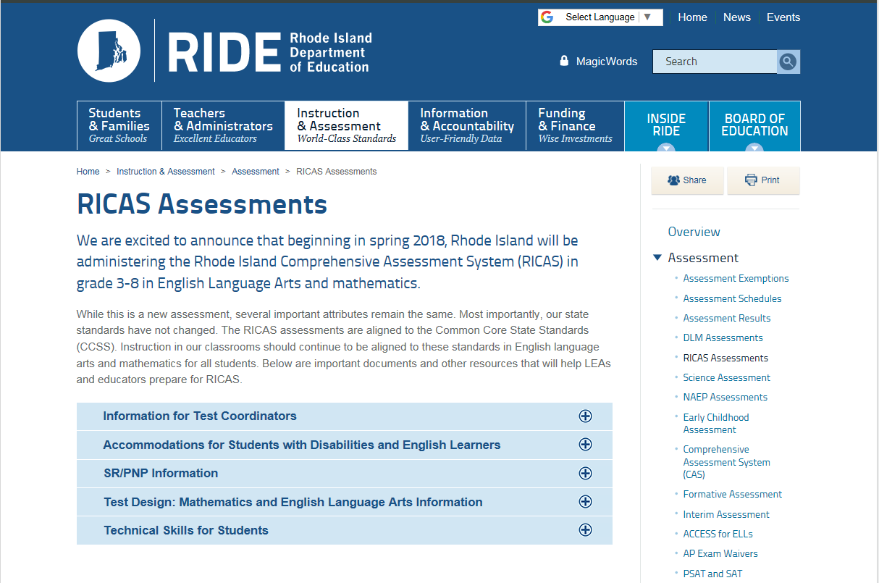
RICAS Assessments Webpage
Grade Level Fact Sheets
http://www.ride.ri.gov/InstructionAssessment/Assessment/RICASAssessments.aspx#39551515-test-design-mathematics-and-english-language-arts-information
Notes:
A synthesis of all of the information presented so far can be found in the grade level fact sheets housed on the RICAS Assessment page of the RIDE website.
Also stored on this page is information for test coordinators, guidance on PNPs and accommodations, and ELA test maps.

Slide 23
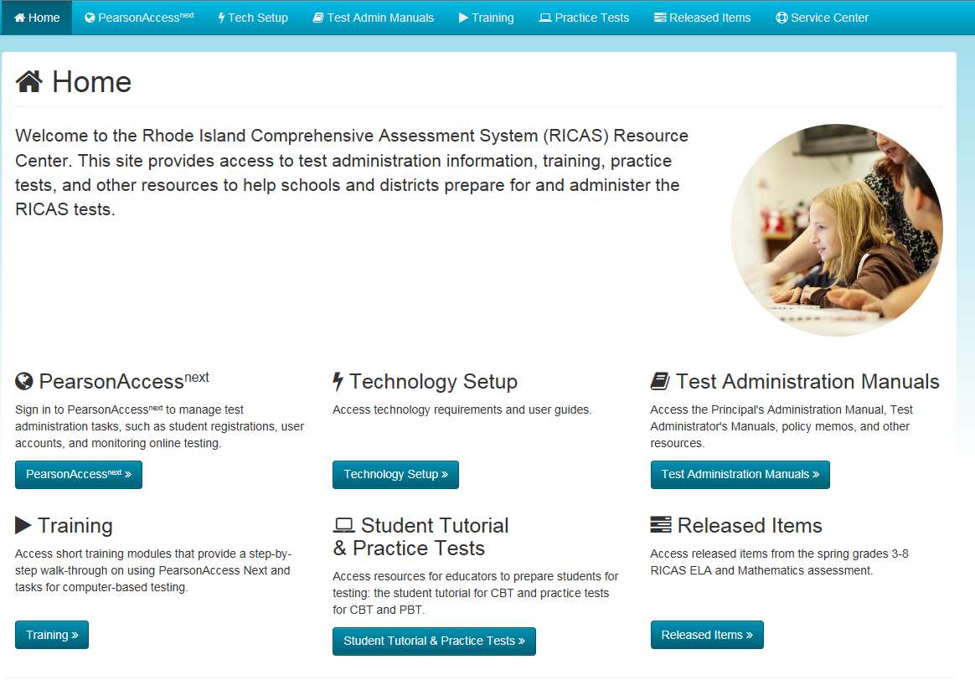
RICAS Resource Center
http://ricas.pearsonsupport.com/
Notes:
The RICAS Resource Center is the go to site for all things RICAS – from PearsonAccessNext to student tutorials.
Please note for the 2017- 2018 school year, some resources may contain the MCAS branding.

Slide 24
Standard Online Tools
Highlighter
Bookmark feature
Test review screen
Answer eliminator
Magnifier
Line reader
Notes:
As previously mentioned, students will be taking the assessment on the TestNav8 platform. Several tools are standard on this platform:
The ability to highlight text
The ability to bookmark an item as a reminder to come back to it later in the testing session
Access to a test review screen which shows a student which items they have completed and which items they have not
The ability to magnify text or graphics in an item
Use of a line reader to facilitate reading

Slide 25
Measuring Tools
Inch ruler
Centimeter rule
Single degree protractor
Notes:
Both inch and centimeter rulers are available to students on the online platform. Students are able to reposition these rulers as needed. Inch rulers are broken down into 1/8 and ¼ inch increments. Students can use the magnifying tool to help them read the rulers. It is anticipated the practice tests and tutorials will be updated in the near future to include the protractor which is marked off in single degrees.

Slide 26
Standard Reference Sheets
Available to students on the testing platform
Available for grades 5 – 8
Can be shared with students throughout the year
Posted on RIDE website
http://www.ride.ri.gov/InstructionAssessment/Assessment/RICASAssessments.aspx
Notes:
Students in grades 3 – 8 will have access to standard mathematics reference sheets on TestNav 8. Clean paper copies can also be given to students during testing.
To facilitate students’ familiarity with this resource, we recommend that teachers share them with their students throughout the school year.

Slide 27
Supplemental Reference Sheets
Available only as an accommodation to students with an IEP or 504
Must be documented in a student’s plan prior to testing
Available for grades 3 – 8
Information may be deleted to customize for an individual student
http://www.ride.ri.gov/InstructionAssessment/Assessment/RICASAssessments.aspx#39551514-accommodations-for-students-with-disabilities-and-english-learners
Notes:
RICAS also has supplemental reference sheets available for students with IEPs or 504s in grades 3 – 8. These do not appear on the testing platform and must be printed out for a student.
Most of these documents are more than one page and may have features that are not needed by all students. RIDE recommends experimenting with which features, if any, a student may need and then creating a customized version of the resource for testing and in-class use.
The need for the supplemental reference sheet must be documented in a student’s plan, and only a clean copy can be given to the student during testing.

Slide 28
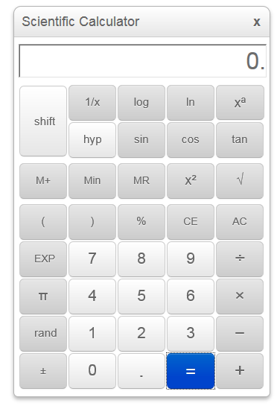
Calculator Guidelines
Calculators are provided on the testing platform during Session Two for grades 7 and 8.
Grade 7 and 8 students may also be given a handheld calculator, preferably one that is equivalent to the online instrument.
Grade 6 students no longer have access to a calculator during the standard administration.
For the full calculator policy go to http://www.ride.ri.gov/InstructionAssessment/Assessment/RICASAssessments.aspx#39551555-calculator-policy
Grade 7
5-Function
Grade 8
Scientific
Notes:
As previously mentioned, the grade 6 test no longer has a calculator session.
Calculators are available on TestNav8 for all grade 7 and 8 students during session two of their tests. Grade 7 students will use an online five-function calculator, and grade 8 students will use a scientific calculator.
Equivalent handheld versions of each grade-level calculator may be provided to 7th and 8th grade students during testing.
For the full policy, please visit our website at the link provided.
Note: The current practice tests and tutorials will be updated in the near future to include these calculators.

Slide 29
Technology Skills
The Technology Skills for RICAS Assessments document details the current span of technology skills students will need at each grade level to navigate TestNav8.
Practice with the testing platform is available through theTestNav8 Student Tutorial. http://ricas.pearsonsupport.com/student/
http://www.ride.ri.gov/Portals/0/Uploads/Documents/Instruction-and-Assessment-World-Class-Standards/Assessment/RICAS_TechTools_2018.pdf
Notes:
In that the RICAS assessment will be administered online, students should have a bank of technology skills in place. The bulk of these are most likely acquired through their day to day interactions with technology, but there may be some navigation skills specific to the Test Nav8 platform. These may range from the ability to access such tools as the magnifier and line reader to interacting with the Equation Editor. The Technology Skills for RICAS Assessments details specific skills student should have in place to successfully navigate the platform. Additionally, tutorials for the TestNav8 platform are available through the RICAS Resource Center.

Slide 30
Equation Editor Resources
Explains some of the essential functions of the Equation Editor
Grade band specific versions for 3 – 5 and 6 – 8
Can be shared with students throughout the year
Unmarked copy can be shared with students during testing
Available at http://ricas.pearsonsupport.com/student/
Notes:
Earlier in the presentation we saw the Math Only and the Math and Text versions for grades 3-5 and 6-8 of the Equation Editor. There are guides available through the RICAS Resource Center to help students understand the different features of the Equation Editors. Here you see a portion of the guidance for grades 3 – 5, but there is also a document for grades 6 – 8.

Slide 31
Equation Editor Resources
Provides the name for each key on the Math Only and Math and Text Equation Editors
Grade band specific versions for 3 – 5 and 6 – 8
Can be shared with students throughout the year
Unmarked copy can be shared with students during testing
Available at http://ricas.pearsonsupport.com/student/
Notes:
Also available are Equation Editor Symbol Key documents, an example is shown on the screen, that provide the name of each of the symbol keys.
Students may be provided with clean copies of any of these documents during testing, and we encourage you to share them with them throughout the year.

Slide 32
Released Items – Computer Scored
Computer-based released items released items can be accessed through the RICAS Resource Center. http://ricas.pearsonsupport.com/released-items/math/
Paper-based versions of the items can be accessed through the Massachusetts DOE site. http://www.doe.mass.edu/mcas/2018/release/
Notes:
There is a limited number of released items currently available for RICAS.
Students can interact with the computer-based released items on TestNav8 through the RICAS Resource Center.
Teachers can print paper versions of the items by going to the Massachusetts DOE website.

Slide 33
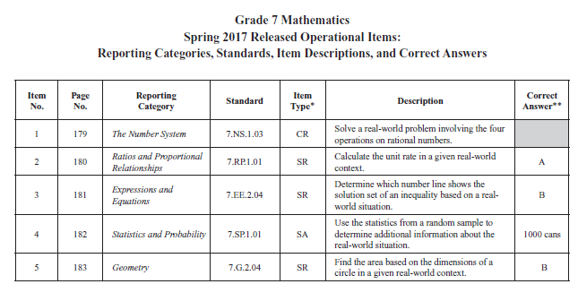
Released Items – Metadata
Notes:
The paper versions of the released items include metadata about each item. Included in the metadata are CLICK
Reporting category CLICK
Standard CLICK
Item type CLICK
Item description CLICK
And answer key where applicable

Slide 34
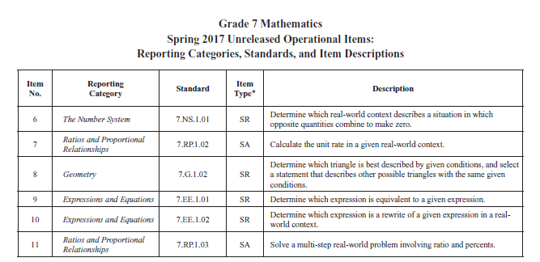
Unreleased Items – Metadata
Notes:
Also included in the paper-based item packet is a table giving metadata for the unreleased common items, a portion of which is shown here for grade 7.

Slide 35
Released Items – Hand Scored
Scoring guides and samples of student work for constructed response items can be accessed through the Question Directory for Student Work on the Massachusetts DOE site. http://www.doe.mass.edu/mcas/student/2018/
Directions for using the online tool for the scoring guides and student work are also provided. http://www.doe.mass.edu/mcas/student/2018/about.html
Notes:
Constructed response items are hand scored. They are currently available only through the Question Directory for Student Work on the Massachusetts DOE website.
Directions are given on how to access items through the directory.

Slide 36
Released Items – Scoring Guides
Notes:
The information provided with hand-scored released items includes a scoring guide and samples of student work at each score point – usually two samples at the top score point. CLICK
Sample papers can be viewed by clicking on the blue numbers in the left-hand column.

Slide 37
Released Items – Scoring Guides
Score | Description
4 | The student response demonstrates an exemplary understanding of the Number and Operations in Base Ten concepts involved in finding whole-number quotients of whole numbers with up to 4-digit dividends and 2-digit divisors and illustrating and explaining calculations by finding equations. The student writes a division equation and uses division to find and justify solutions to a real-world problem.
4
Reporting Category: Number and Operations in Base Ten 5.NBT.B.6: Find whole-number quotients of whole numbers with up to four-digit dividends and two-digit divisors, using strategies based on place value, the properties of operations, and/or the relationship between multiplication and division. Illustrate and explain the calculation by using equations, rectangular arrays, and/or area models.
Notes:
The language in the score guides intentionally matches the language used in the standards, as you can see by comparing the text highlighted in red. This example makes the comparison between the description for a score point 4 paper and the standard. This text is repeated in the description for each score point level.

Slide 38
Released Items – Scoring Guides
Score | Description
4 | The student response demonstrates an exemplary understanding of the Number and Operations in Base Ten concepts involved in finding whole-number quotients of whole numbers with up to 4-digit dividends and 2-digit divisors and illustrating and explaining calculations by finding equations. The student writes a division equation and uses division to find and justify solutions to a real-world problem.
4
3 | The student response demonstrates a good understanding of the . . . Although there is significant evidence that the student was able to recognize and apply the concepts involved, some aspect of the response is flawed. As a result the response merits 3 points.
2 | The student response demonstrates a fair understanding of the . . . While some aspects of the task are completed correctly, others are not. The mixed evidence provided by the student merits 2 points.
1 | The student response demonstrates a minimal understanding of the . . .
0 | The student response contains insufficient evidence of an understanding of the . . . to merit any points.
Notes:
This abbreviated scoring guide, where the red text in score 4 has been replaced by an ellipsis for the other scores 4 CLICKS, emphasizes the language used to describe the level of performance exhibited by papers at different score points.
The description for the highest score point, in this case 4 points, concludes with a statement about what the student did to earn the top score. CLICK (The student writes a division equation and uses division to find and justify solutions to a real-world problem.)
The descriptions for the remaining score points are more general in nature. They do no cite specific flaws in a student paper. (For example: The student demonstrates a good understanding – although there is significant evidence that the student was able to recognize and apply the concepts involved, some aspect of the response is flawed . . .)
This structure is fairly standard for all score guides varying only according to the content assessed and the number of score points for an item.
Unlike PARCC released items, RICAS items will not include item specific rubrics, suggested responses, or annotated pieces of student work.

Slide 39
Supplemental Assessment Tables
Designed to provide educators with expanded assessment information for specific standards on RICAS
Similar in structure to the PARCC evidence tables
Tables include:
Additional examples or interpretations of how a standard may be assessed
Explicit references to the footnotes in the CCSS
Definitions of terms relevant to RICAS that do not appear in the CCSS glossary
Grade level specific
Notes:
RIDE has created Supplemental Assessment Tables to provide educators with expanded assessment information for some standards which may include:
Additional examples of how a standard may be assessed
Augmented interpretations of a standard
Definitions not in the CCSS glossary
Their structure is very similar to the PARCC evidence tables as we will see on the next slide.

Slide 40
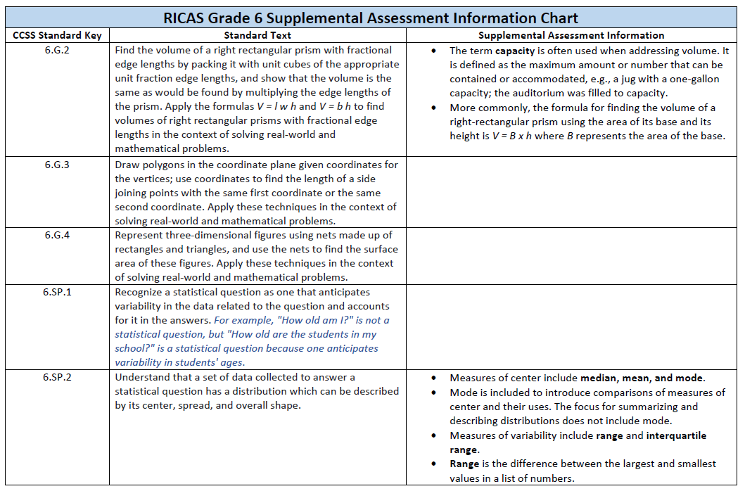
Supplemental Assessment Tables
Notes:
Here is a page from the grade 6 table. Let’s look at 6.SP.2 as an example. CLICK
The standard says – Understand that a set of data collected to answer a statistical question has a distribution which can be described by its center, spread, and overall shape.
Additional information for the purposes of RICAS are:
Measures of center include median, mean, and mode.
• An explanation is given to why mode is included and the limitations surrounding it Don’t read this -(Mode is included to introduce comparisons of measures of center and their uses. The focus for summarizing and describing distributions does not include mode.)
• The measures of variability assessed for this standard include range and interquartile range.
• And a definition for range is provided Don’t read this (Range is the difference between the largest and smallest
values in a list of numbers.)

Slide 41
Achievement Levels
Four levels of achievement
Exceeding Expectations
Meeting Expectations
Partially Meeting Expectations
Not Meeting Expectations
Massachusetts teachers and other educators participated in a standard setting meeting in August of 2017
Recommended cut scores for achievement levels
Offered feedback on the achievement level descriptors
http://www.doe.mass.edu/mcas/tech/
Notes:
Student performance on RICAS will be classified by achievement level based on a student’s scaled score. The four levels are:
Exceeding Expectations
Meeting Expectations
Partially Meeting Expectations
Not Meeting Expectations
Brief explanations for each of these classifications can be found on our website.
As a point of interest, teachers and other educators in Massachusetts met to establish cut scores for levels of achievement and to comment on the achievement level descriptors. A detailed description of the process used can be found in an executive summary of the standard setting meeting found at the provided link.

Slide 42
Achievement Level Descriptors
Detail the knowledge and skills students demonstrate at each level for:
Domains of the Grade
Conceptual Understanding and Procedural Knowledge
Problem Solving
Mathematical Reasoning
Mathematical Communication
Helpful resource to teachers when formatively assessing student performance throughout the year
Notes:
Achievement level descriptors for mathematics have been created to paint a more detailed picture of what student performance would look like for exceeding, meeting, or partially meeting expectations.
Descriptions are given for the domains of the grade as well as:
Conceptual Understanding and Procedural Knowledge
Problem Solving
Mathematical Reasoning
Mathematical Communication
These descriptors may serve as a helpful resource to gauge a student’s level of performance throughout the year.

Slide 43
Achievement Level Descriptors
http://www.ride.ri.gov/InstructionAssessment/Assessment/RICASAssessments.aspx#39551515-test-design-mathematics-information
Notes:
Here is a one set of descriptors for grade 4 in the domain of Operations and Algebraic Thinking.
Note the gradations in expectations as you move through each level of the chart. For example when comparing the second bullets in each column: CLICK
A student who partially meets expectations is able to solve multiplication and division word problems with no specified method CLICK
A student who meets expectations is able to solve these problems by using a drawing or equation CLICK
A student who exceeds expectations is able to use an equation to represent a problem and to justify their solution with estimation
All students demonstrate some level of achievement for the grade 4 standards in the first cluster of the domain of Operations and Algebraic Thinking, but they do so to different degrees and to different aspects of the standards.
Both the Supplemental Assessment Table and the Achievement Level Descriptors can be found at the link on the bottom of this slide.

Slide 44
Contact Information
Name | Responsibility | Email | Phone
Susan Pagliaro | RICAS Mathematics | susan.pagliaro@ride.ri.gov | 222-2644
Christopher Castillero | RICAS Mathematics | christopher.castillero@ride.ri.gov | 222-8458
Heather Heineke | RICAS Accommodations | heather.heineke@ride.ri.gov | 222-8493
Colleen O’Brien | RICAS ELA | colleen.obrien@ride.ri.gov | 222-8474
Phyllis Lynch | Director of Instruction, Assessment, and Curriculum | phyllis.lynch@ride.ri.gov | 222-4693
For general questions, please email assessment@ride.ri.gov.
Notes:
Thank you for your time and attention today. We hope the information we shared is helpful.
Should you have additional questions about RICAS, please feel free to reach out to Chris or I as well as any of our colleagues at RIDE.

