Slide 1
Curriculum training slides

Slide 3
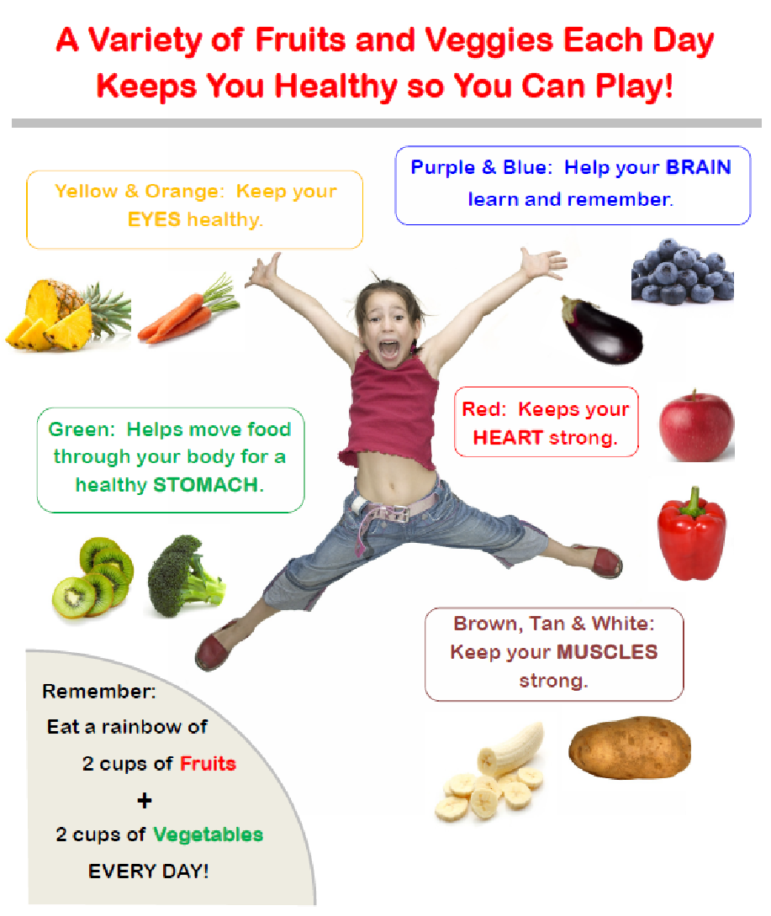

Slide 4
Local Food Trivia!

Slide 5
How many farms are there in Rhode Island?
50
120
700
1200+
Notes:
Answer: D → fun fact: 700 of the 1200+ farm grow food

Slide 6
What is the number one agricultural product in Rhode Island?
Notes:
Answer: turf/grass

Slide 7
Which of the following can grow in Rhode Island?
Corn
Peaches
Watermelon
Okra
Tomatoes
Only corn & tomatoes
All of the above
Notes:
Answer: G

Slide 8
Which of the following can I grow in my classroom?
Radishes
Lettuce
Peas
Beams
Herbs
All of the above
Notes:
Answer: F

Slide 9
Planting in the Classroom
Learning how to grow food and what it needs to survive and thrive!
Notes:
Optional 15-20 minute activity with teachers, 30-45 minute activity with students

Slide 10
Introduction
You don’t need a garden or a farm to grow food!
Many foods grow well indoors and will grow all year round.
Check what grows seasonally in your area to decide what seeds to plant with your students
Materials Needed:
Soil
Seeds
Pots/Cups
Popsicle sticks
Spray bottle or watering can
Markers

Slide 11
Instructions
Fill cups or pots 2/3 of the way full with potting soil
Chose a vegetable or herb to plant.
Using a finger, make a few small holes and place one seed in each.
The back of the seed packet will indicate how dep the seeds should be planted
Cover the seeds with another spoonful of soil.
Label the plants by writing the vegetable or herb planted and name of gardener on a popsicle stick
Water and store somewhere with direct sunlight.

Slide 12
HELP or HINDER?
Phrases that HELP:
Encourage children to try new foods by pointing out their sensory appeal
Teach children to recognize when he or she is full.
Help the child feel like he or she is making the choice.
Phrases that HINDER:
Teach the child to eat for your approval or love.
Use words that can teach the child to ignore fullness.
Use food as a reward, which makes some foods seem better than others.
Teach the child to eat to feel better instead of to eat when hungry.
Comfort/rewards should be given with hugs and talks, not food.
Notes:
We just discussed some phrases that parents and caregivers may say during meal times or in other situations where food may play a role.
Some of those phrases- the AUTHORITATIVE ones- help a child develop healthier eating patterns. Other phrases- like the UNINVOLVED, AUTHORITARIAN, AND PERMISSIVE ones- hinder a child’s relationship with food. Let’s look at this concept a little closer, because what we say about food/eating and how we say it can really impact children’s eating habits. [Read slide]
Let‘s take a look at some more phrases. You will see a phrase pop up on the screen. Work with your team to decide if it HELPS or HINDERS and show the corresponding side of your paddle.
PASS OUT PADDLES

Slide 13
You didn’t eat enough of your lunch.
or
Hinder
?
Help
Notes:
Kids need to decide how hungry they are, and when they are full. Forcing kids to eat beyond when they’re full can teach them to overeat.

Slide 14
Do you want to try a little bit? If you don’t like it, you don’t have to finish it.
or
Hinder
?
Help
Notes:
This phrase removes the pressure kids sometimes feel in trying something new, knowing that they don’t necessarily have to eat it all if they don’t like it.

Slide 15
Jenny, look at your friend. She ate all her squash.
or
Hinder
?
Help
Notes:
Avoid comparing one child’s eating with another child’s. Even children of the same age and size can have very different appetites.

Slide 16
We can try these peppers again another day. Next time do you want to try them raw?
or
Hinder
?
Help
Notes:
Leave the door open to having kids try the food again, even if they didn’t like it the first, second, or sixth time around! Try offering veggie in different ways- raw with dip, cooked, mixed into mac & cheese, etc.

Slide 17
That’s great that you’re trying a new food today. Let me know how you like it.
or
Hinder
?
Help
Notes:
Recognize when students go out of their comfort zone and try a new food. Ask for feedback on the food. It’s okay if they don’t like it every time, and they’ll feel good that you care about their opinion.

Slide 18
I won’t give you any carrots because I know you don’t like them.
or
Hinder
?
Help
Notes:
Everyone, kids included, can learn to like new foods. Continue offering an item, even if the child has refused it before. Tell them that their taste buds change as they grow!

Slide 19
These radishes are very crunchy!
or
Hinder
?
Help
Notes:
Talking about the color, texture, or smell of a food can get kids interested enough to taste them.

Slide 20
I don’t like cantaloupe either but you should eat it because it’s good for you.
or
Hinder
?
Help
Notes:
Everyone, kids included, can learn to like new foods. Continue offering an item, even if the child has refused it before. Tell them that their taste buds change as they grow!

Slide 21
Maybe you’ll decide to try the spinach next time.
or
Hinder
?
Help
Notes:
Talking about the color, texture, or smell of a food can get kids interested enough to taste them.

