Slide 1

Welcome to the CACFP Meal Pattern Requirements Training – Meat/Meat Alternate Section
Notes:
SAY:
Welcome to the CAFCP Meal Patterns training. This training session will cover the updated CACFP meal pattern requirements surrounding the meat/meat alternate component.

Slide 2

Training Materials
www.theicn.org/cacfpmp
Notes:
This powerpoint as well as additional training materials can be found at the website listed on the screen. Additional training materials will be available through the RIDE child nutrition programs website.

Slide 3

Child & Adult Meal Pattern Requirements Overview
Wider varieties of protein options
Greater varieties of vegetables and fruits
More whole grains
Less added sugar and saturated fat
Notes:
SAY:
The USDA has made some policy updates to the child and adult meal patterns, which will go into effect October 1, 2017. The updated child and adult meal pattern requirements, which were published in April of 2016, focus on ensuring children and adults have access to healthy, balanced meals throughout the day. Specifically, the changes provide:
Wider varieties of protein options
Greater varieties of vegetables and fruits
More whole grains
Less added sugar and saturated fat
Today we will focus on these changes as they relate to the meat/meat alternate component.

Slide 4
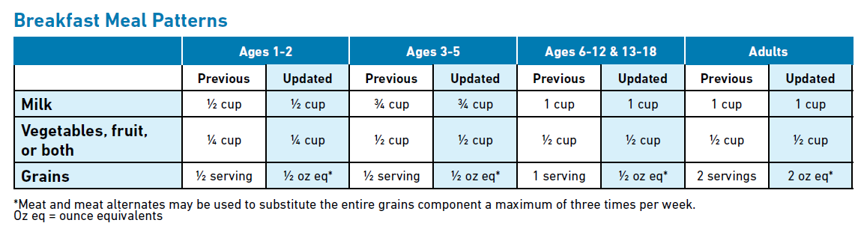
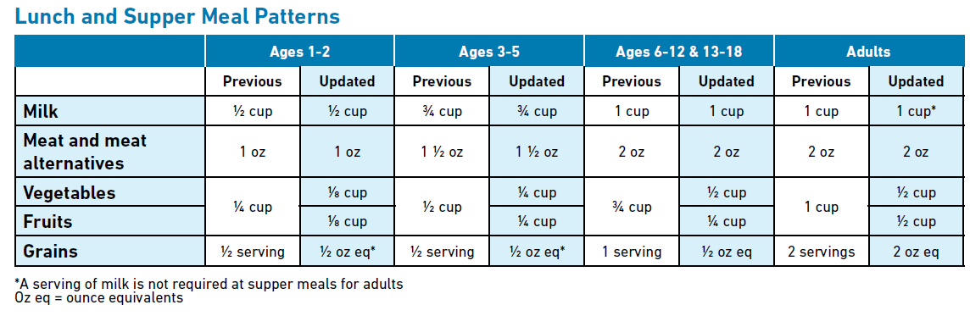
Notes:
The updated meal patterns continue to dictate the required components and minimum portion sizes that must be served as part of a reimbursable meal for each meal period. As you can see from this comparison chart, there have been no major changes to the meat/meat alternate component in terms of meal service and portion size. Meat/Meat alternates are still required as part of a reimbursable lunch.
Note, that though the meat/meat alternate component is not required at breakfast, the updated meal pattern does allow the substitution of a meat/meat alternate for the entire grains component up to three time per week at breakfast. We will discuss this flexibility later in this training.

Slide 5
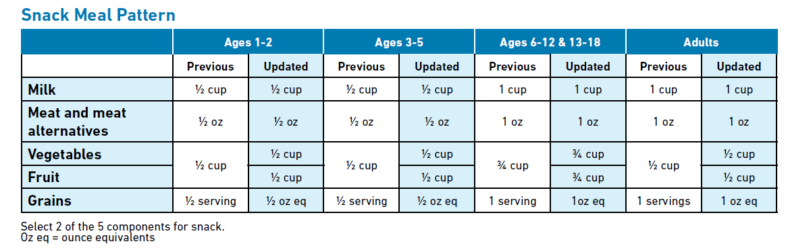
Notes:
MMA continue to be an optional component that may be included as part of a reimbursable snack, provided that the minimum serving size is met.

Slide 6
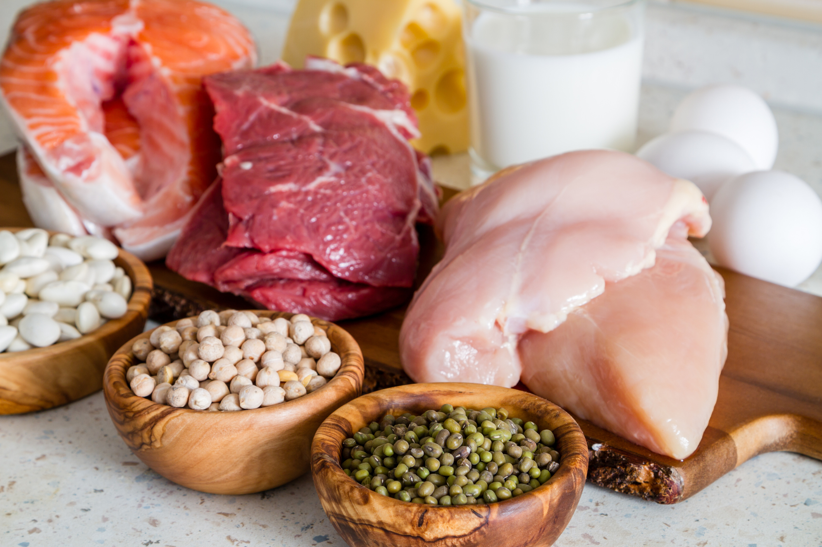
Meat/Meat Alternates (M/MA) Overview
M/MA may be served in place of the entire grains component at breakfast a maximum of three times per week
Tofu credits as a meat alternate
Yogurt, including soy yogurt, credits as a meat alternate
Notes:
There are three requirements noted in the updated meal pattern requirements for the meat/meat alternates component:
Meat/meat alternates may be served in place of the entire grains component at breakfast a maximum of three times per week. Tofu credits as a meat alternate.
Yogurt, including soy yogurt, credits as a meat alternate.
Let’s begin by exploring meat and meat alternates during breakfast.

Slide 7
M/MA Meal Requirements
Breakfast: May be served in place of the grains component a maximum of 3 times per week
Increases variety on the menu
Allows more flexibility when planning menus
Notes:
The first update focuses on adding variety to the breakfast menu using meat and meat alternates. During the breakfast meal, you may now choose to serve a meat or meat alternate in place of the grains component a maximum of three times per week. This change is merely an option to allow greater variety to the breakfast menu.

Slide 8
Crediting Guidelines
Serving m/ma in place of grains:
  1 oz of m/ma credits as 1 serving of grains
Menu Example:
  Cheese Omelet (Credits as the m/ma)
  Fruit
  Milk
Notes:
When serving a meat or meat alternate in place of grains at breakfast, 1 ounce of meat/meat alternate credits as 1 serving of grains. For example, a program could serve a cheese omelet with fruit and milk at breakfast. In this example, the omelet is a creditable meat/meat alternate that is used to meet the grains component requirement for the breakfast meal. No additional grain is needed for this reimbursable breakfast meal.
Some centers will choose to serve a meat/meat alternate in addition to a grain at breakfast. This is always acceptable as long as the minimum serving size of the three required components (milk, fruit/veg, and grain) are met.

Slide 9

Using Tofu
Credit as a m/ma for child & adult meals
  Does not credit toward reimbursable meals for infants
Must be commercially prepared tofu & soy yogurt
Must be easily recognized as meat substitute
  Creditable: Tofu sausage
  Not creditable: Tofu noodles
Notes:
The updated meal pattern requirements now allow tofu and soy yogurt to credit for all or part of the meat/meat alternates component for child and adult meals only. They are not creditable for infant meals.
There are three requirements for using tofu and soy yogurt. First, it must be commercially prepared; tofu and soy products that are non-commercial or non-standardized are not creditable. Second, it must be easily recognized as a meat substitute. Specifically, children should be able to easily recognize the foods served as part of the meat/meat alternate group. For example, meat substitute products, such as links and sausages, made from tofu, are easily recognizable as a meat substitute. However, tofu noodles are not easily recognizable as a meat substitute. Rather, they imitate the grains component. Another example of non-creditable tofu is when it is used to prepare smoothies, or other dishes, to add texture or improve nutrition. It would not credit toward the meat alternates component because it is not easily recognized as a meat substitute.

Slide 10
Using Tofu (cont.)
Must meet protein requirement:
  5 grams of protein per 2.2 ounces (¼ cup) by weight
Request a Child Nutrition Label or Product Formulation Statement
Notes:
Second, it must contain 5 grams of protein per 2.2 ounces (1/4 cup) to equal 1 ounce of the meat/meat alternate. This information can be found by reading the Nutrition Facts Label on products when it is just tofu. However, if it is a combination tofu or soy products, a Child Nutrition (CN) Label or product formulation statement is required to verify the food item contains the minimum protein requirement.

Slide 11

“Yogurt must contain no more than 23 grams of total sugars per 6 oz…”
Notes:
The next update for the meat/meat alternates component focuses on yogurt. As we discussed in the previous lesson, yogurt is a meat alternate, and it is often used as a snack item. However, because it can be a source of added sugar, the updated meal patterns require yogurt, including soy yogurt, to contain no more than 23 grams of total sugars per 6 ounces for child and adult meals. You can use the same methods featured in the previous lesson to determine if yogurt products are within the sugar limit.

Slide 12

Using Yogurt
Use commercial yogurt products only
Soy yogurt is a dairy-free option
4 oz credits as 1 oz of meat alternate
Adults only:
  Yogurt may be used as a milk substitute or meat alternate
Notes:
When planning menus and incorporating yogurt, there are a few key points to remember. First, the updated meal pattern requirements now allow soy yogurt as a dairy-free option for children and adult meals. In addition, 4 ounces of yogurt, including soy yogurt, credits as 1 ounce of meat alternate. Also, remember yogurt may credit as a meat alternate or as a milk substitute for adults only. However, it may not credit for the milk component and the meat alternates components in the same meal for adults.

Slide 13

Non-Creditable Yogurt Products
Frozen yogurt
Drinkable yogurt
Homemade yogurt
Yogurt flavored products
Yogurt bars
Yogurt covered fruits & nuts
Yogurt in commercially prepared smoothies
Notes:
Items such as frozen yogurt, drinkable yogurt, homemade yogurt, yogurt flavored products, yogurt bars, yogurt covered fruits and nuts, yogurt in commercially prepared smoothies, or similar products are not creditable on the CACFP.

Slide 14
Yogurt & Added Sugar
Some have higher sugar content than others
Must contain no more than 23 grams of total sugars per 6 oz
  Applies to all age groups
Notes:
Although yogurt is a great source of protein, some yogurts have significantly more sugar than others. To promote healthy habits from the start, the updated meal pattern requirements limit the amount of sugar creditable yogurts may contain. Under the updated meal patterns, yogurt must contain no more than 23 grams of sugars per 6 ounces.
There are two methods for determining if the yogurt meet the sugar limit. To illustrate how to use both methods, turn in your Participant’s Workbook to the handouts: Nutrition Facts Label and Yogurt and Sugar Guide.

Slide 15

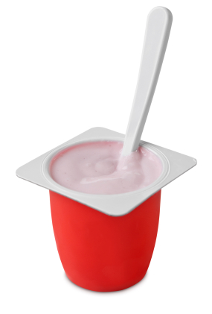
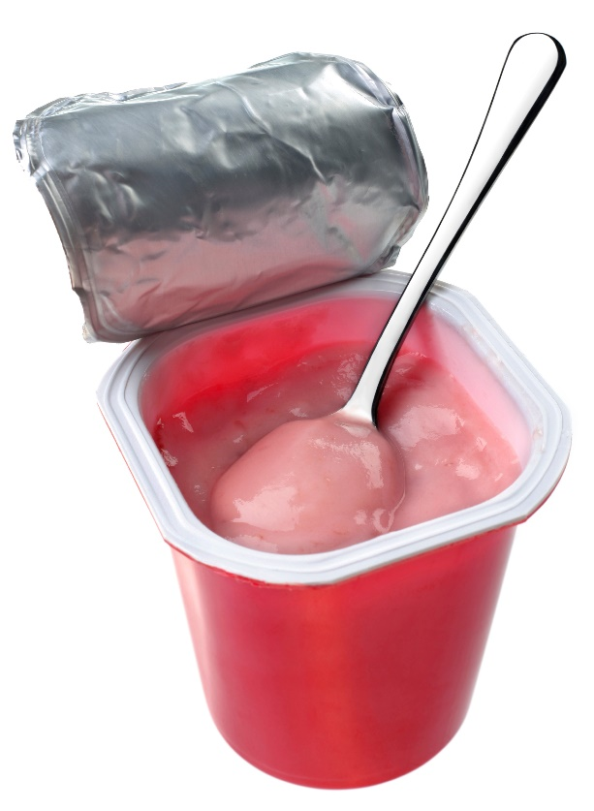
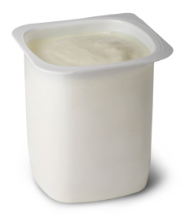

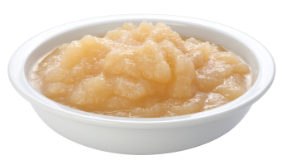




Find a yogurt with less sugar, or try plain and…
…mix in fruit for flavor!
=
=
=
6 oz plain yogurt
6 oz strawberry yogurt
2 tsp natural sugar
6 oz fruit “whipped” yogurt
6 tsp sugar
(4 added, 2 natural)
8 tsp sugar
(6 added, 2 natural)
Notes:
Yogurt is often loaded with sugar. For example… (show strawberry yogurt)
All yogurt does have natural sugar, as depicted here by the cows, so even plain yogurt will have “sugars” listed on the nutrition label. However, many also have quite a bit of added sugar as well.
(show “whipped” yogurt) Here’s another example of a “whipped” yogurt that has 6 tsp of added sugar in a 6 oz serving. That would definitely NOT meet the CACFP guidelines!
Find a flavored yogurt that meets the guideline, or try serving plain yogurt… with fruit mixed in for flavor. Stirring in applesauce, canned peaches, frozen berries, or sliced banana adds natural sweetness that kids love.

Slide 16
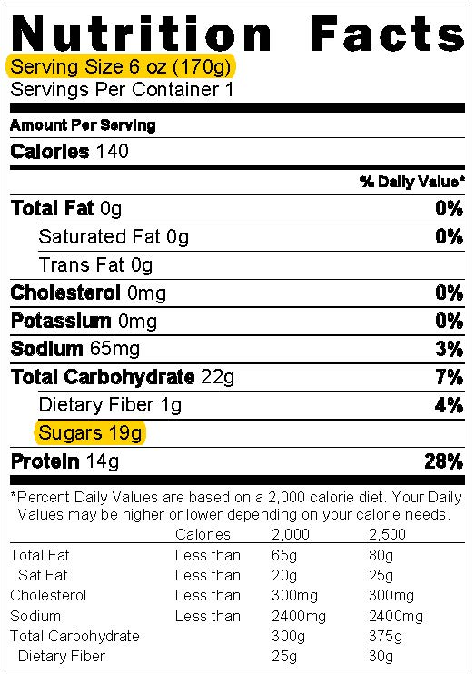
Key Terms
Serving Size
  Number of servings in a package
  Unit: ounces, cups, per container, etc.
Sugars or Total Sugars
  Amount per serving
  Means the same thing
Notes:
When reading Nutrition Facts Labels for yogurt to determine if it meets the sugar requirements, there are two key terms to look for: Serving Size and Sugars or Total Sugars. The serving size is the number of servings in a food package, and they are provided in units, such as ounces, cups, or container. The serving size is also provided in grams in parenthesis.
The sugars or total sugars states the amount of sugar in grams per serving. It is important to note that the new label lists total sugars and added sugars instead of just “sugars.” This change shows the total amount of natural sugars and added sugars the product contains. However, when reading new labels for yogurt, always use the total sugar amount.

Slide 17
Yogurt: Method #1 Chart
Yogurt Sugar Limits
Serving Size (Ounces) | Serving Size (Grams) | Sugar Limits
2.25 ounces | 64 grams | 0-9 grams
3.5 ounces | 99 grams | 0-13 grams
4 ounces | 113 grams | 0-15 grams
5.3 ounces | 150 grams | 0-20 grams
6 ounces | 170 grams | 0-23 grams
8 ounces | 227 grams | 0-31 grams
Notes:
The first method is the easiest and the fastest way for determining if a yogurt item meets the sugar limit requirement. This method features a chart with the common sizes of yogurt and the pre-calculated sugar limit for each size. The chart has three columns: Serving Sizes (Ounces), Serving Sizes (Grams), and Sugar Limits.
The first column, Serving Sizes (Ounces) is used for when a yogurt’s Nutrition Fact Label lists the serving size in ounces, such as 6 ounces or 8 ounces. The second column, Serving Sizes (Grams), is used when the Nutrition Fact Label’s serving size is not in ounces, but in cups, containers, or other units. In situations such as these, you can use the number in parenthesis, the grams, to determine if the yogurt is within the sugar limit. The third column lists the sugar limits for each serving size. Let’s review how you might use this chart to determine if a yogurt item meets the sugar requirement.

Slide 18
Example #1: Serving Size in Ounces
Step 1: Find the Nutrition Facts Label on the package
Step 2: Identify the serving size: 6 oz
Step 3: Find the amount for Sugars: 19 grams
Notes:
There are four steps to identifying if a yogurt meets the requirements using this method.
First, find the Nutrition Facts Label on the package. We will use the label noted on the handout to illustrate how to use this method.
Next, identify the serving size in ounces. Common sizes might include 2.25, 3.5, 4, 5.3, 6, or 8 ounces. The Serving Size for this yogurt item is 6 ounces.
Then, find the amount for Sugars. It is below the “Total Carbohydrate” line. The amount for Sugars for this yogurt item is 19 grams.

Slide 19
Example #1: Serving Size in Ounces (cont.)
Yogurt Sugar Limits
Serving Size (Ounces) | Serving Size (Grams) | Sugar Limits
2.25 ounces | 64 grams | 0-9 grams
3.5 ounces | 99 grams | 0-13 grams
4 ounces | 113 grams | 0-15 grams
5.3 ounces | 150 grams | 0-20 grams
6 ounces | 170 grams | 0-23 grams
8 ounces | 227 grams | 0-31 grams
Step 4: Find the Serving Size in the chart
Serving size: 6 oz
Total sugars: 19 grams
Notes:
Lastly, find the Serving Size in the chart below. Then, look in the column labeled Sugar Limit for the identified serving size. Remember, the serving size is 6 ounces and the total amount for sugar is 19 grams.
According to the chart, for a 6 ounce serving, the sugar limit is 23 grams of total sugars. Therefore, this item is creditable because the sugar amount, 19 grams, is between the sugar limit of 0 and 23 grams.

Slide 20
Example #2: Serving Size in Grams
Yogurt Sugar Limits
Serving Size (Ounces) | Serving Size (Grams) | Sugar Limits
2.25 ounces | 64 grams | 0-9 grams
3.5 ounces | 99 grams | 0-13 grams
4 ounces | 113 grams | 0-15 grams
5.3 ounces | 150 grams | 0-20 grams
6 ounces | 170 grams | 0-23 grams
8 ounces | 227 grams | 0-31 grams
Serving size:
1 container (170g)
Sugars:
19 grams
Notes:
As mentioned, sometimes you may find yogurt that do not list the serving size in ounces, but in cups or containers. For instance, the yogurt label lists “1 cup (170 grams)” as the serving size and “19 grams” for sugar. Using the middle column in the Yogurt Sugar Limits chart, this product would be credible because a product with 170 grams per serving size must have between 0-23 grams to be within the sugar limit requirements.

Slide 21
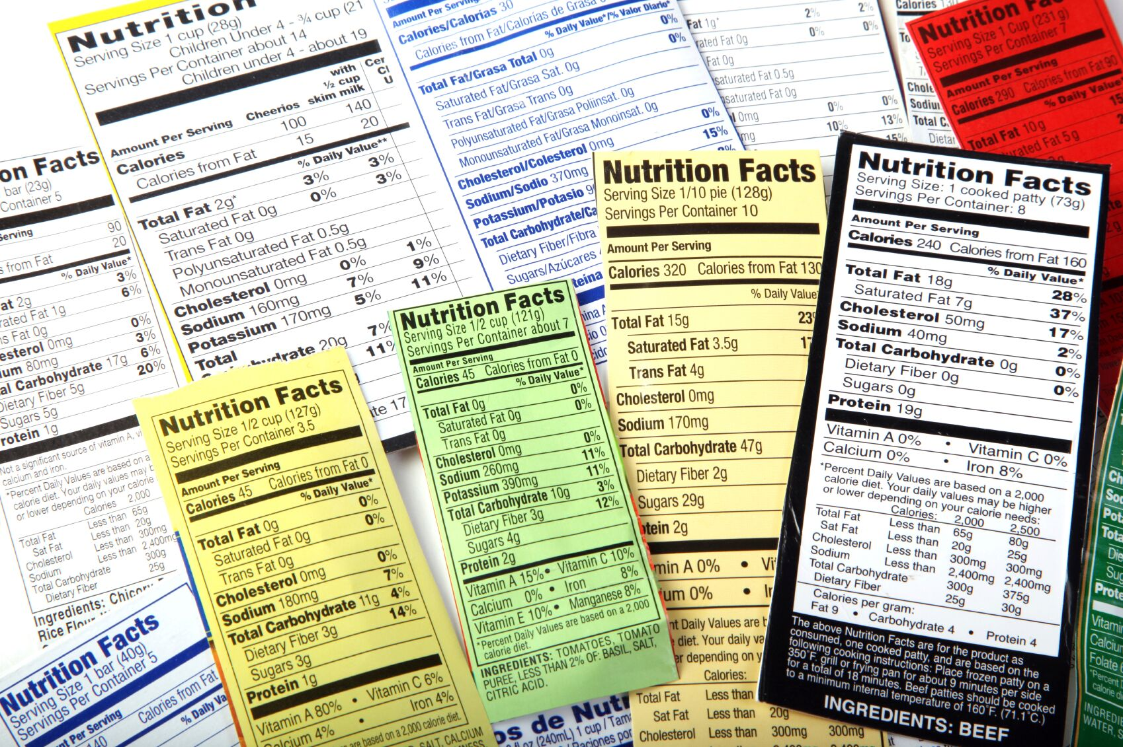
Yogurt: Method #2 Calculation
Designed for serving sizes not listed on the chart
Calculate the total amount of sugar per ounce or gram to determine if the yogurt item is within the threshold
  Serving Size in Ounces Threshold
    23 ÷ 6 = 3.83
  Serving Size in Grams Threshold
    23 ÷ 170 = 0.135
Notes:
The second method is used when a yogurt’s Nutrition Facts Label lists a serving size that is not featured on the Sugar Limit’s Chart. For these yogurts, you will need to calculate the total amount of sugar per ounce to determine if the yogurt is within the sugar limit. When the serving size is in ounces and the answer to the calculation is 3.83 or less, then the yogurt is within the sugar limit. For yogurts that do not list the serving sizes in ounces, but in other units, you will need to calculate the total amount of sugar per gram. When the serving size is in grams and the answer is below 0.135, the yogurt is creditable.
The threshold for serving sizes in ounces was determined by dividing 23 by 6, which equals 3.83, while the threshold for serving sizes in grams was determined by dividing 23 by 170, which equal 0.135.

Slide 22
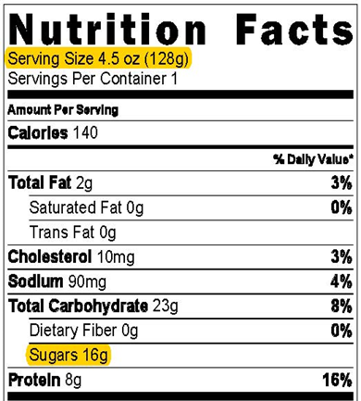
Example #1: Serving Size in Ounces
Step 1: Find the Nutrition Facts Label
Step 2: Identify the Serving Size: 4.5 oz
Step 3: Find the amount for Sugars: 16 g
Notes:
Yogurt method #2 has two examples. First, calculating serving sizes in ounces. There are five steps for identifying if a yogurt meets the requirements using this method:
First, find the Nutrition Facts Label on the package.
Next, identify the Serving Size on the Nutrition Facts Label in ounces. This yogurt has a Serving Size of 4.5 ounces.
Then, find the amount for Sugars. The amount for Sugars for this item is 16 grams.

Slide 23
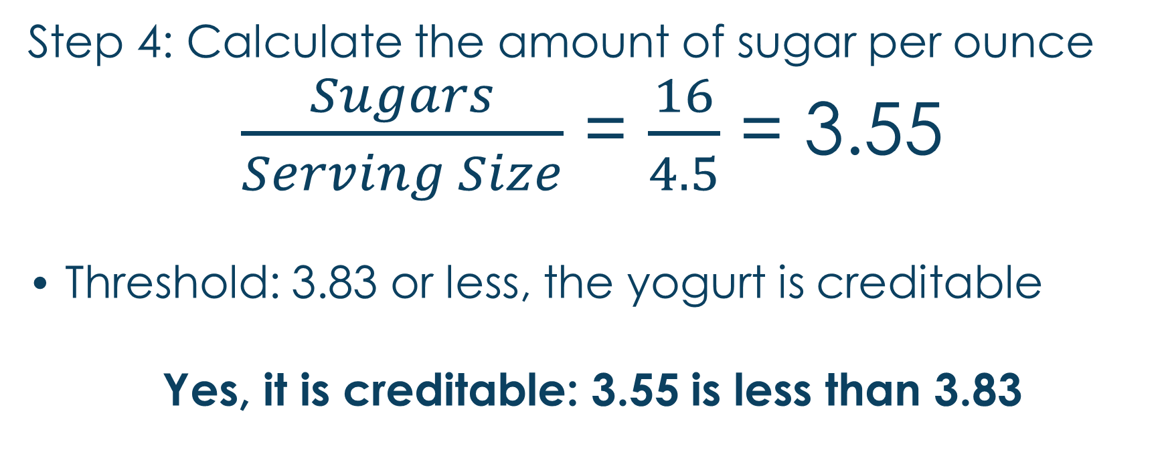
Example #1: Serving Size in
Ounces (cont.)
Step 4: Calculate the amount of sugar per ounce
$\frac{Sugars}{Serving Size}$ = $\frac{16}{4.5}$ = 3.55
Threshold: 3.83 or less, the yogurt is creditable
Yes, it is creditable: 3.55 is less than 3.83
Notes:
The next step requires that you calculate the amount of sugar per ounce. To complete this step, divide the Sugars number by the Serving Size number. In this example, it would be sixteen divided by four point five which equals three point fifty-five (16/4.5 = 3.55).
When the serving size is in ounces, the threshold is 3.83. After you divide the Sugars by the Serving Size, if the answer is below 3.83, the yogurt is within the sugar limit and it is creditable. However, if it is above the threshold, then this item is not creditable. In this example, the answer is 3.55; therefore, it is below 3.83, making it creditable.

Slide 24
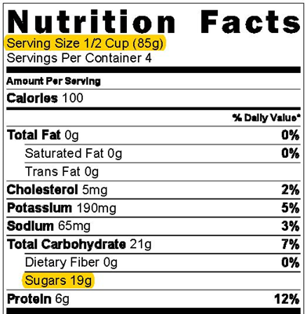
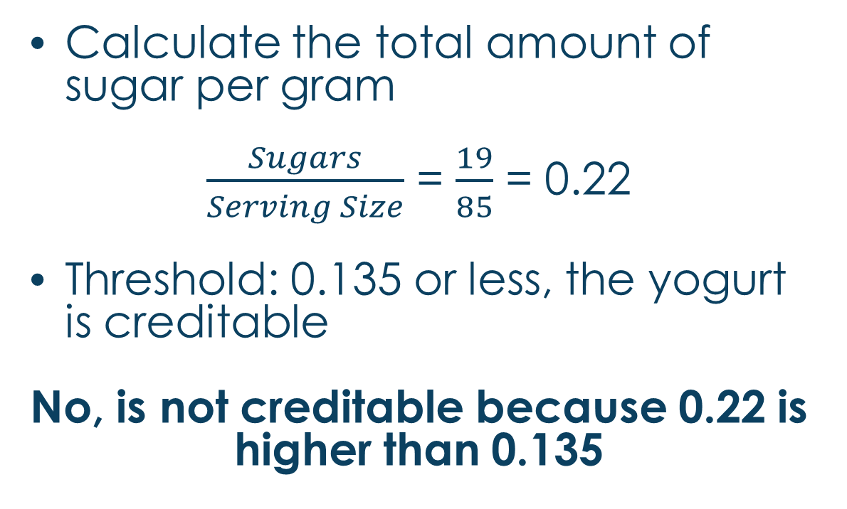
Example #2: Serving Size in Grams
Calculate the total amount of sugar per gram
$\frac{Sugars}{Serving Size}$ = $\frac{19}{85}$ = 0.22
Threshold: 0.135 or less, the yogurt is creditable
No, is not creditable because 0.22 is higher than 0.135
Notes:
The second example for Yogurt method # 2 focuses on serving sizes not in ounces. As we previously learned, some yogurts may not list the serving size in ounces, but in cups or containers. In these situations, always use the grams number located inside the parenthesis. For example, the yogurt label lists “1/2 cup (85 grams)” as the serving size and “19 grams” for Sugars. In this example, 85 grams is not listed on the yogurt sugar limit chart; therefore, you would divide 19, the total Sugars number by 85, the Serving Size number in Grams, and the answer is 0.22 (19/85=0.22). Based on the threshold of 0.135, this item would not credit because 0.22 is higher than 0.135.

Slide 25
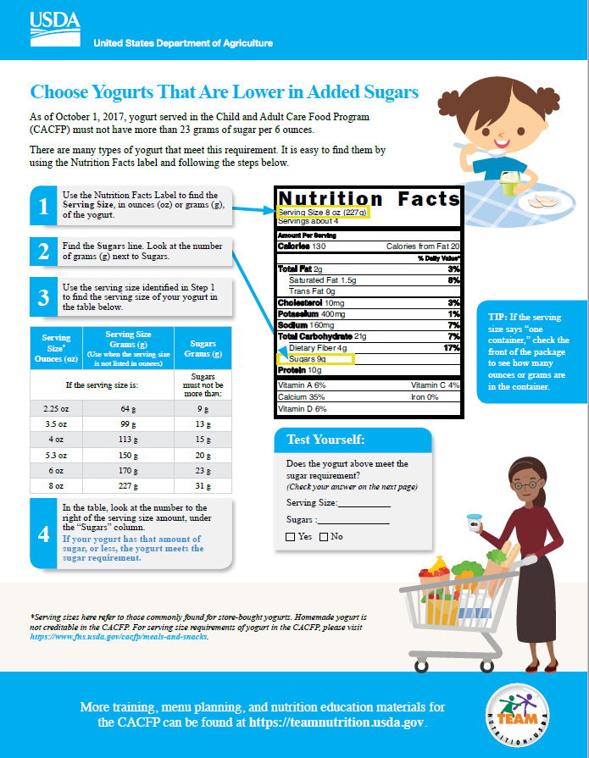
Notes:
The USDA has developed a helpful one page flyer to assist providers in determining if their yogurt options meet the CACFP sugar requirements. This handout contains an expanded serving size/sugar limit chart and can be found on the RIDE Child Nutrition Program website.

Slide 26
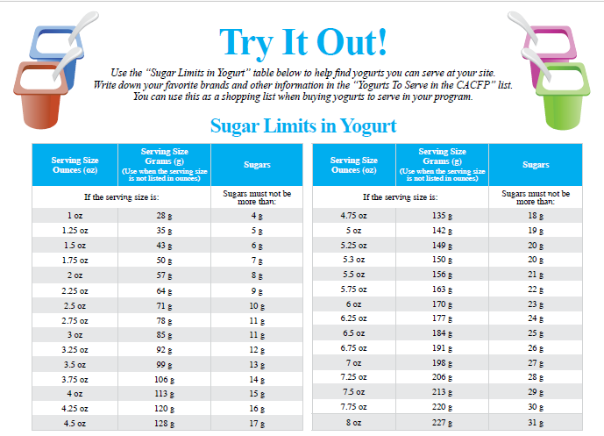

Slide 27
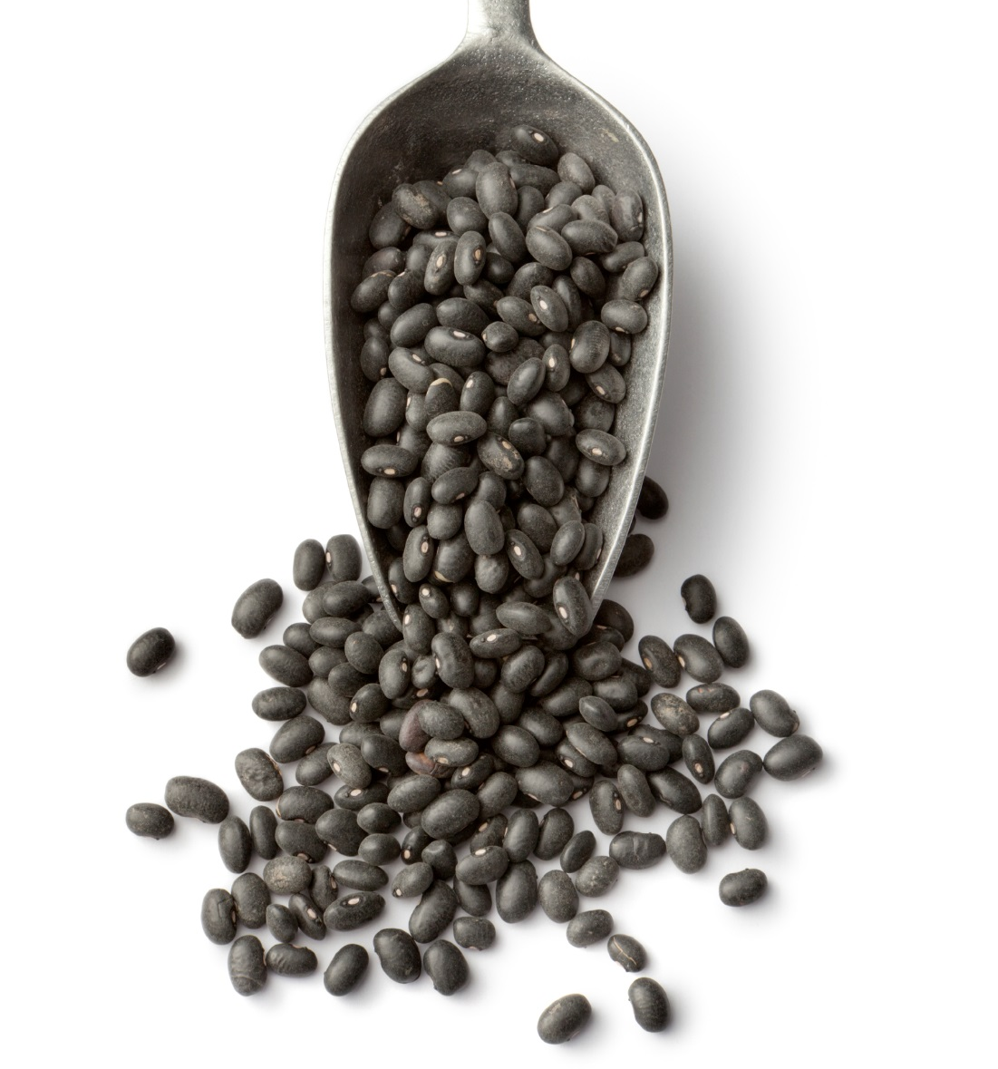
Other M/MA
Nuts & seeds
Dry beans and peas
Eggs
Cheeses
Notes:
It is important to note that nuts and seeds, dry beans, peas, eggs, and cheeses may continue to be used to meet all or part of the meat/meat alternates component.

Slide 28

Optional Best Practices
Notes:
Now that we’ve discussed all of the required changes under the new CACFP meal pattern, we’ll move on to talk about some optional best practices that your center may consider implementing as part of the menu revision process.

Slide 29
Best Practices & the CACFP
Designed to further improve the nutritional quality of all meals
Optional, but highly encouraged
  Ensures children & adults get optimal benefits from meals
Non-compliance does not cause:
  Meal disallowance
  Serious deficiency finding
Notes:
In addition to the revision of the CACFP meal pattern requirements, USDA developed best practices that build on the meal pattern requirements to further improve the nutritional quality of all meals. The best practices reflect recommendations from the Dietary Guidelines for Americans and the National Academy of Medicine.
The best practices are optional. However, USDA highly encourages all CACFP centers and day care homes to implement these best practices in order to ensure children and adults are getting the optimal benefit from the meals served. Failure to comply with the best practices cannot result in a meal disallowance or a serious deficiency finding.

Slide 30
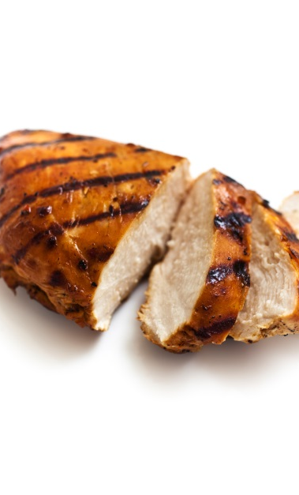
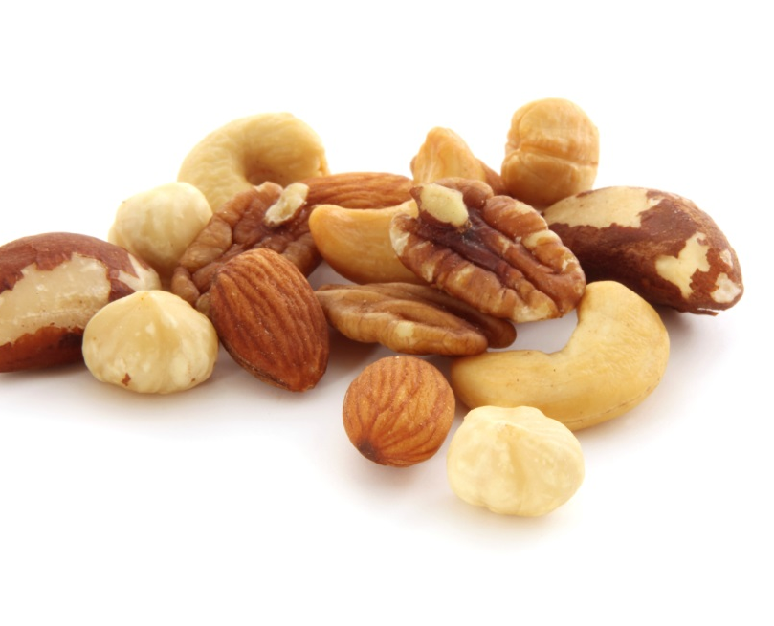
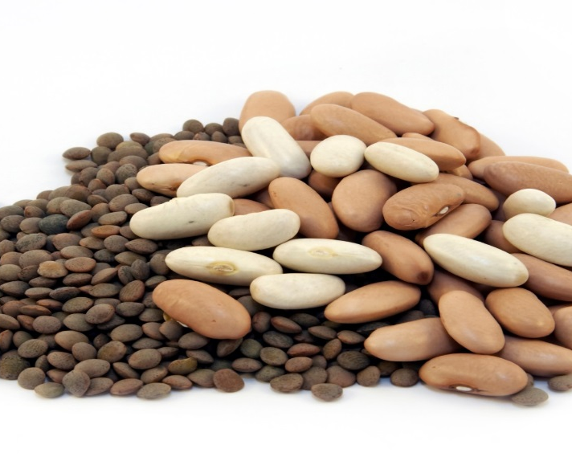
Meat/Meat Alternates
Serve only lean meats, nuts, & legumes
Notes:
As we previously mentioned, meat/meat alternates are great sources of protein and many other essential nutrients such as vitamins B and E, calcium, and magnesium. They are also good sources of zinc and iron. However, eating too many processed meats and high-fat proteins increases the risk of obesity and other health issues. Therefore, USDA encourages all CACFP sites to serve only lean meats, nuts, and legumes.

Slide 31
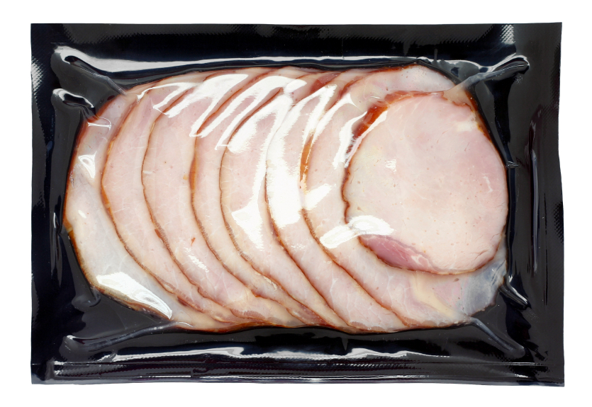
Processed Meats
Limit processed meats to one serving per week
Preserved by smoking, curing or salting, or with the addition of chemical preservatives
Common examples: bacon, bologna, luncheon meat
Notes:
When serving meats, limit serving processed meats to no more than one serving per week. A processed meat is any meat preserved by smoking, curing or salting, or with the addition of chemical preservatives. Processed meat includes salami, bologna and other luncheon meats, hot dogs, pepperoni, and bacon.

Slide 32

Cheese
Serve only natural cheeses & low-fat or reduced-fat cheeses
Common examples:
  Low-fat cottage cheese
  Reduced-fat string cheese
  Reduced-fat cheddar cheese
Notes:
When serving cheeses, serve only natural cheeses and choose low-fat or reduced-fat cheeses. Some examples might include low-fat cottage cheese, reduced-fat string cheese, or reduced-fat cheddar cheese. Make sure that the label does not list “imitation cheese,” “cheese food,” or “cheese product” as these foods do not count towards a reimbursable meal.
You can find additional information on the Tips for Offering More Nutritious Proteins handout in your Participant’s Workbook.

Slide 33

Best Practices Action Plan
Builds on the meal pattern requirements
Shows your commitment to those in your care
Establish & implement a plan
CACFP
Notes:
As we have discussed, the best practices are designed to build on the meal pattern requirements. Although they are not required, implementing the best practices shows your commitment to going the extra mile to ensure those in your care are provided nutritious meals. Fortunately, implementing the best practices can be made easy when you establish a plan and put it into action. Whether you choose to implement these best practices or not, your center should develop an overall action plan for implementing the new meal pattern. Having a clear plan will help you and your staff to understand the requirements and ensure compliance throughout the menu planning, shopping, preparation and meal serving process.
This concludes the CACFP meal pattern training session on the grains component. Remember, this webinar only covers the requirements relating to meat/meat alternates; for information on the remaining meal pattern updates and requirements, please visit the RIDE child nutrition website and access the additional CACFP meal pattern modules that are available.
If you have any questions regarding this training, or any other CACFP-related questions, please reach out to one of the RIDE child nutrition program specialists.

