Slide 1
Module 4: Student Learning Objectives (SLOs)
Asynchronous
Notes:
Please note that Support Professionals will set Student Outcome Objectives (SOOs) instead of SLOs. Please see our Support Professional training for more information on SOOs and evaluating SPs.

Slide 2
Module 4: Intended Outcomes
By the end of this module, you will:
Understand the anatomy of a Student Learning Objective (SLO)
Understand the process for reviewing and approving SLOs
Use the SLO Quality Review Tool against a sample SLO to determine approvability

Slide 3
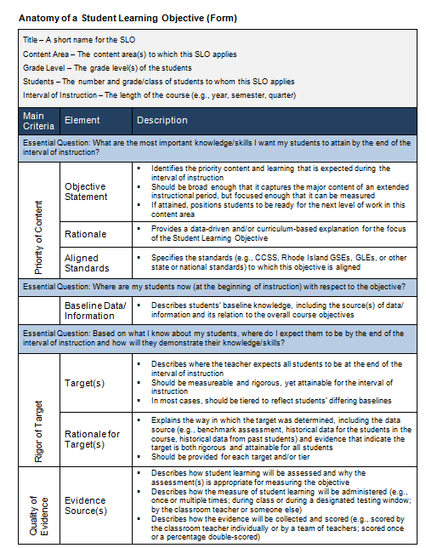
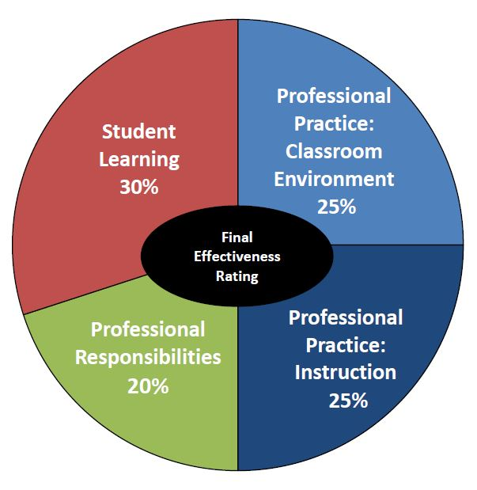
Student Learning Objectives (SLOs)
SLOs
Notes:
As you see, student learning accounts for 30% of an educator’s Final Effectiveness Rating. Please note that this module will focus on the original SLO, as this is still the most widely used student learning measure in the RI Model. Organizationally, it makes the most sense to take you through understanding the original SLO, first, before unpacking the new options for student learning. Understanding SLOs will provide the foundation and framework through which we will begin to build – and extend – our knowledge of the different ways a teacher’s effectiveness can be measured through student learning. Therefore, Module 5 will delve into flexibilities for student learning.

Slide 4
The Anatomy of SLOs
Today, we’ll focus on the three primary areas of SLOs:
Priority of Content
Rigor of Target(s)
Quality of Evidence
Notes:
Here is an image of page 19 in the Teacher guidebook. The anatomy of an SLO includes three major sections, which will focus our training for this section. The first is priority of content, where you’ll find your objective statement, rationale, standards, and baseline data. Once the objective statement is written and aligned, then the educator will set targets and provide a rationale as to why these targets are most appropriate for these students. Finally, the educator will denote which evidence sources will be used to show students’ progress toward the targets set in order to reach the objective statement. Let’s start at the beginning, and see how objective statements are constructed.

Slide 5
SLO/SOO Decision Tree
Page 28 in Teacher Guidebook
Notes:
This page helps educators determine whether or not they will craft SLOs or SOOs, depending on their direct relationship to student learning. Here, we can see that the majority of teachers will set SLOs, while most often, SPs will set Student Outcome Objectives (SOOs). Please note that SOOs are covered in the Support Professional training, as the vast majority of teachers only set SLOs.

Slide 6
SLOs in Rhode Island
Student Learning Objectives (SLOs) are long-term, measurable academic goals that educators set for their students. They should focus on priority content, be measured by appropriate sources of evidence, and include specific targets for student mastery or progress. They are used as a measure of student learning by all educators participating in the Educator Evaluation System.
Respects the diversity of all grades, subjects, and courses
Written by educators for their own students
Tied directly to the teaching and learning happening in every teacher’s individual classroom
Reflects the most important content and skills students should learn
Improving student learning is at the center of all our work.
Teachers have the greatest school-based impact on student learning.
Research shows that student learning improves when teachers set goals.
SLOs recognize and encourage the work that excellent teachers are already doing in their classrooms.
Notes:
It’s amazing how many misunderstandings there are about Student Learning Objectives, and a big part of your role as a building administrator is going to be helping your staff by correcting these misunderstandings. We’re going to start with the definition of an SLO (read). RI could have gone in the direction of so many other states, who chose to utilize state-wide standardized tests for all teachers. Instead, RI wanted a process that <<read the four bullets on the left>>. Part of the reasoning behind SLOs are that <<read through four boxes on right>>.

Slide 7
Three Key Takeaways:
SLOs should be focused on the student learning in specific content areas and grade levels.
SLOs should be integrated with the most important work of districts and are not an “add-on”.
Goal-setting is an important part of effective teachers’ on-going practice.
Notes:
READ

Slide 8
Writing SLO Objective Statements
Educators should:
Examine & review standards within their curriculum
Determine priority of content
Write an objective statement
Check the scope or grain-size
Notes:
Refer to p. 19 in Teacher Guidebook. Teachers should consider these questions before they write their objective statement.
What are the most important skills I want my students to attain by the end of the interval of instruction?
What standard(s) align with the prioritized learning?
Is the objective statement broad enough to capture learning within an extended instructional period, and focused enough to be measured?

Slide 9
Examining Objective Statements Activity
The next four slides each contain an SLO Objective Statement. Your job is to read through each to determine its clarity and scope.
Note any adjustments you would suggest before approval by answering in the space provided on the handout.
Notes:
When looking at an objective statement you’re really trying to answer two big questions:
(1) Is the Obj. Statement clear in articulating the content or skills students should achieve (this is making sure it’s clear but also that it actually articulates what students are going to know or be able to do)?
(2) Is the scope of the Objective Statement broad enough to capture the most important course content or skills (this is getting the scope, but also a little of the fit – if the art teacher is writing an SLO about math, then it’s not the right fit – most likely it might be considered too narrow, because while math will come up in their curriculum and teaching it’s not the essential focus of that content area)?
Please note that these are all out of context and that, there might be circumstances in which data or the interval of instruction makes narrow objective statements acceptable, etc. The purpose is to get comfortable asking questions about objective statements and developing a basic understanding of clarity and scope.

Slide 10
SLO Objective Statement #1
Objective Statement: (Elementary) Students will improve their overall proficiency in mathematics.
Is the objective statement clear in articulating the content or skills students should achieve? (this is making sure it’s clear but also that it actually articulates what students are going to know or be able to do.) | Clear Not clear enough
Is the scope of the objective statement broad enough to capture the most important course content or skills? (If the focus is too narrow it might be possible to teach it in a unit, but it will not be a central focus for students throughout the interval of instruction. If the focus is too broad it is not a targeted objective that is measurable. If the target is met, students should have the essential knowledge and/or skills necessary for success in the next grade, level of instruction, or will have narrowed a critical gap.) | Too broad Acceptable Too narrow
Notes:
After reading SLO Objective Statement #1, determine clarity and scope by filling out handout, accordingly.

Slide 11
SLO Objective Statement #2
Objective Statement: (Middle School) All Gr. 6-8 students who scored Substantially Below Proficient on the beginning-of-year mathematics pretest (86 students) will reach Nearly Proficient or above by the end-of-year post-test.
Is the objective statement clear in articulating the content or skills students should achieve? (this is making sure it’s clear but also that it actually articulates what students are going to know or be able to do.) | Clear Not clear enough
Is the scope of the objective statement broad enough to capture the most important course content or skills? (If the focus is too narrow it might be possible to teach it in a unit, but it will not be a central focus for students throughout the interval of instruction. If the focus is too broad it is not a targeted objective that is measurable. If the target is met, students should have the essential knowledge and/or skills necessary for success in the next grade, level of instruction, or will have narrowed a critical gap.) | Too broad Acceptable Too narrow
Notes:
After reading SLO Objective Statement #2, determine clarity and scope by filling out handout, accordingly.

Slide 12
SLO Objective Statement #3
Objective Statement: (High School) Students will develop an understanding of the major events and eras of American history (as defined by the curriculum units). Through close reading and expository writing, students will analyze how cycles of conflict and cooperation affected different groups of people and shaped our modern society.
Is the objective statement clear in articulating the content or skills students should achieve? (this is making sure it’s clear but also that it actually articulates what students are going to know or be able to do.) | Clear Not clear enough
Is the scope of the objective statement broad enough to capture the most important course content or skills? (If the focus is too narrow it might be possible to teach it in a unit, but it will not be a central focus for students throughout the interval of instruction. If the focus is too broad it is not a targeted objective that is measurable. If the target is met, students should have the essential knowledge and/or skills necessary for success in the next grade, level of instruction, or will have narrowed a critical gap.) | Too broad Acceptable Too narrow
Notes:
After reading SLO Objective Statement #3, determine clarity and scope by filling out handout, accordingly.

Slide 13
SLO Objective Statement #4
Objective Statement: (Elementary) Students will increase their fluency.
Is the objective statement clear in articulating the content or skills students should achieve? (this is making sure it’s clear but also that it actually articulates what students are going to know or be able to do.) | Clear Not clear enough
Is the scope of the objective statement broad enough to capture the most important course content or skills? (If the focus is too narrow it might be possible to teach it in a unit, but it will not be a central focus for students throughout the interval of instruction. If the focus is too broad it is not a targeted objective that is measurable. If the target is met, students should have the essential knowledge and/or skills necessary for success in the next grade, level of instruction, or will have narrowed a critical gap.) | Too broad Acceptable Too narrow
Notes:
After reading SLO Objective Statement #4, determine clarity and scope by filling out handout, accordingly.

Slide 14
Part I: SLO Objective Statement Activity
Complete your responses for the each of the four SLO Objective Statements in Part I on the handout provided.
Continue onto the next section of this module.

Slide 15
Baseline Data Scenarios
Scenario 1
Grades 9-12
Scenario 2
Grades K-5
Scenario 3
Grades 6-8
The following three slides each contain baseline scenarios by grade span. Select the scenario for the grade span in which you mostly work. After reading the scenario, be sure to capture your answers to the related questions on the handout.

Slide 16
Scenario #1 (gr. 9-12)
When you sit down with Mr. Jacobs, a Biology teacher, to talk about his SLOs, he says that he does not have any baseline data. As he puts it, this is the first Biology course his 9th graders have taken and the students matriculate from three different middle schools. There is no standardized 8th grade Science curriculum in your district, so his students may have learned different things last year. What guidance would you give him? What could he use as sources of baseline data/information?
What guidance would you give him? What could he use as sources of baseline data/information?
Notes:
Read and complete the handout (if this scenario is applicable.)

Slide 17
Scenario #2 (gr. K-5)
Ms. Palmer and Mrs. Gray are your two 4th grade teachers. They come to you because they are overwhelmed by the amount of information they have on their incoming students. In addition to students’ official records and state assessment scores, the 3rd grade teachers have passed on writing and Social Studies portfolios, EOY reading levels, and detailed comments on each child’s behavior, interests, strengths, and areas for improvement. They don’t know where to begin. What guidance would you give them? How can this information be useful to them as they write their SLOs?
What guidance would you give them? How can this information be useful to them as they write their SLOs?
Notes:
Read and complete the handout (if this scenario is applicable.)

Slide 18
Scenario #3 (gr. 6-8)
Mrs. Scotto teaches French I to sixth graders at your middle school. She does not understand why she has to include baseline data in her SLO because none of her students speak any French at the beginning of the interval of instruction. How would you describe the purpose of baseline data/information to Mrs. Scotto and what recommendations might you give for possible sources that would be of use to her?
How would you describe the purpose of baseline data/information to Mrs. Scotto and what recommendations might you give for possible sources that would be of use to her?
Notes:
Read and complete the handout (if this scenario is applicable.)

Slide 19
Part II: Baseline Scenario Activity
Complete your responses for the one baseline data scenario in Part II that aligns with your primary grade span.
Continue onto the next section in this module.

Slide 20
The Anatomy of SLOs
Today, we’ll focus on the three primary areas of SLOs:
Priority of Content
Rigor of Target(s)
Quality of Evidence
Notes:
This next section will focus on the Rigor of the Target(s). This piece is critical – if rigorous targets are not set, then can you really know the extent to which students have learned?

Slide 21
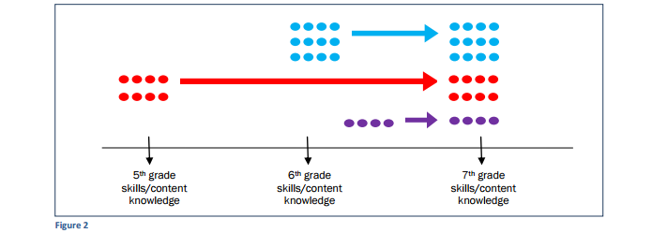
Setting Rigorous Targets for Student Learning
Proficiency/
Mastery-Based Targets
Notes:
This is a 6th grade math class with 24 students. This figure shows what can happen when one mastery target is set for all students. In this example, the target appears to be rigorous and attainable for the blue group, but it does not seem feasible that the red group would completely close their learning gap in a single year. Additionally, if these targets were met, the purple group would make little progress and lose the advanced status they started with.

Slide 22
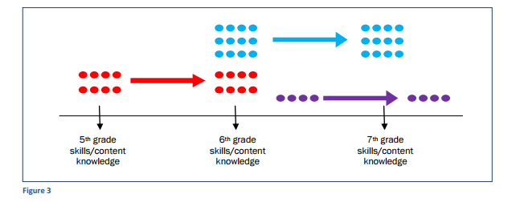
Setting Rigorous Targets for Student Learning
Common Goal of One Year’s Worth of Growth
Notes:
This figure illustrates an example of an SLO with a common goal that all students make about a year’s worth of learning. While this might be rigorous and attainable for some students, it sets the expectation that the red group, which is currently behind grade level, will not make any progress toward narrowing the achievement gap. In fact, in the example below the achievement gap will have widened for the red group.

Slide 23
Setting Rigorous Targets for Student Learning
Meaningfully Differentiated Targets: Rigorous Yet Attainable
Notes:
In the figure above, the group of students in blue began the year with the prerequisite skills and knowledge for 6th grade. Their targets would get them to a place where they could demonstrate preparedness for 7th grade skills and content knowledge. The students in red who arrived a year behind their on-level peers had targets that would narrow their learning gap. In this case it might have been unattainable to expect students to completely close the gap, but if they reach their targets and make a similar amount of growth the following year they will be able to eliminate the achievement gap and reach proficiency. The four students in purple who started the year with more advanced skills and content knowledge had targets that were comparable in growth to the blue students, setting the expectation that they will improve by a year’s worth of learning. If the purple group met their target they would maintain their above grade level status.

Slide 24
Sample Target #1
Students will show growth between the pre-assessment and post-assessment.
What, if anything, is concerning about this target? Please explain on the accompanying handout.
Notes:
What, if anything, is concerning about Sample Target #1? Please explain on the accompanying handout.

Slide 25
Sample Target #2
All students will show 25% growth between the first and fourth benchmark assessments.
Notes:
What, if anything, is concerning about Sample Target #2? Please explain on the accompanying handout.

Slide 26
Sample Target #3
75% of students will move one level on the performance rubric.
Notes:
What, if anything, is concerning about Sample Target #3? Please explain on the accompanying handout.

Slide 27
Sample Target #4
Students who scored 1 or 2 on the rubric will increase their overall score to 3 (Proficient).
Students who scored a 3 on the rubric will increase their overall score to 4 (Above Proficient).
Students who scored a 4 on the rubric will maintain their score of 4 (Above Proficient).
Notes:
What, if anything, is concerning about Sample Target #4? Please explain on the accompanying handout.

Slide 28
Sample Target #5
All students will move up one group.
Students are tiered based on their baseline performance into five groups:
substantially below proficient (8 students); below proficient (5 students); near proficient (5 students); proficient (4 students); above proficient (2 students).
Notes:
What, if anything, is concerning about Sample Target #5? Please explain on the accompanying handout.

Slide 29
Setting Targets: Issues-in-Review
1. Unclear targets
Students will show growth.
2. Percentages
Students will show 25% growth versus 75% of students will show growth
3. Maintenance targets
Students performing above grade level will continue to perform at grade level.
4. Setting targets too low
Students will improve 1 point on the rubric…
5. Not using meaningful tiers
In equal groups, students will…
Notes:
This summarizes the kinds of issues that evaluators will experience related to setting targets. Keep all of these in mind as they approve SLOs, which become even more apparent when we revisit this in the spring, and see that the targets for some SLOs were set way too low.

Slide 30
Part III: Setting Targets
Complete your responses to each of the five sample in Part III. Continue onto the next and final section in this module.

Slide 31
The Anatomy of SLOs
Today, we’ll focus on the three primary areas of SLOs:
Priority of Content
Rigor of Target(s)
Quality of Evidence
Notes:
At this point, please view the remainder of this module in Presentation mode to facilitate engagement with the activity, and to hide the ‘answer view.’

Slide 32
Quality of Evidence
Some open-ended questions to consider when reviewing the quality of your evidence are:
What types of assessments are used in the classroom and school? Where are there overlaps? Where are there gaps?
What assessments are best to measure the intended learning? Worst?
What is the appropriate time between assessments to allow for informing daily practice and providing feedback to students based on the data?
How many assessments are needed to make a determination about student learning?
Part IV: Why is the quality of evidence critical in determining whether or not students met their target(s)? Please explain.
Notes:
Please read through the four questions for consideration when reviewing the quality of evidence. Then please answer the question in the box on the accompanying handout.

Slide 33
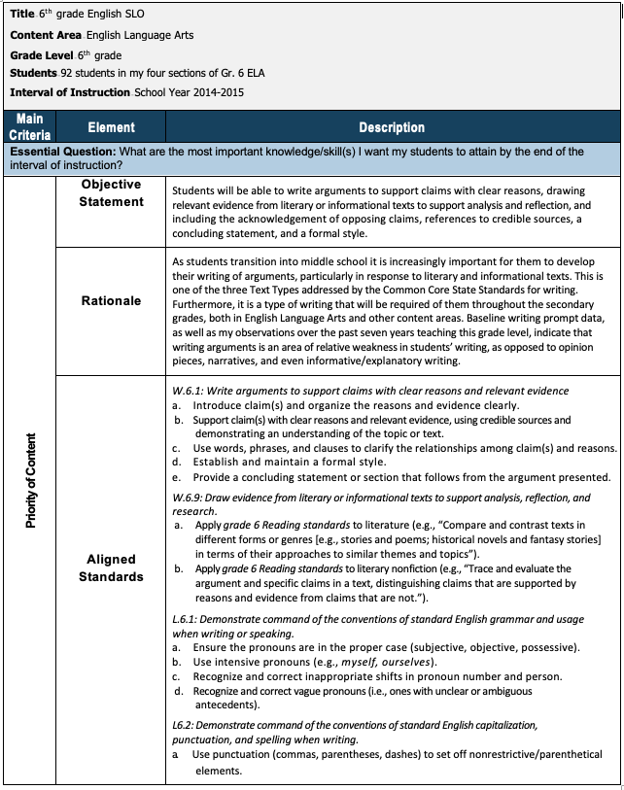
Approving SLOs Activity
Review SLO Handout
Review Slides
34 - 36
Complete SLO Quality Review Tool
Notes:
You are likely all familiar with SLOs at this point. We encourage you to take a few moments to first review the SLO Quality Review Tool which provides prompts and questions that capture the content you learned in this presentation previously. Answering these questions will help you through the process of approving an SLO for your teachers.
This next section will afford you the opportunity to practice approving an SLO using our SLO Quality Review Tool. You will need:
SLO Example (Gr. 6 ELA)
SLO Quality Review Tool
Approximately 30 min. to complete this activity

Slide 34
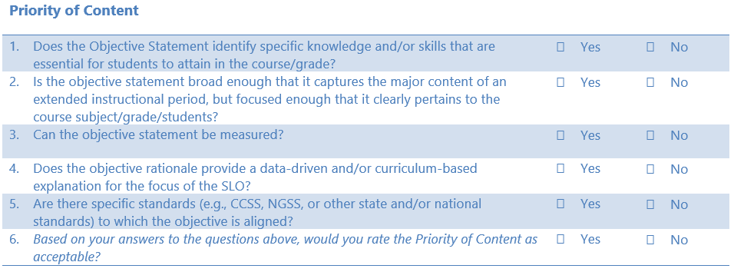
Approving SLOs Activity: Priority of Content
Notes:
Each year we use this example with new evaluators and there is some debate over some of the questions in the SLO QRT. This is an important reminder that this process is not an exact science, and in many ways, it is helpful to have a colleague to ask questions, push your thinking, and to calibrate. This is especially important for complementary evaluators who will work together to complete one person’s evaluation.
While the Priority of Content is acceptable overall, it’s important to note the following areas to suggest improvement(s):
#3: You could argue that the objective statement is a bit too broad because it includes so many components. If this were a new teacher, you might suggest focusing on fewer areas in this obj. stmt. and making adjustments accordingly.
#4: Assuming this is an experienced teacher, the rationale is acceptable. Again, to the point in #3, there might be an opportunity to hone in the focus for a less experienced teacher in this context as this educator emphasizes their “seven years of teaching” in this context. Again – there is room to have conversation with the teacher when you are unclear on aspects of the SLO.
Once the Priority of Content is approvable, move onto the Rigor of Target.

Slide 35
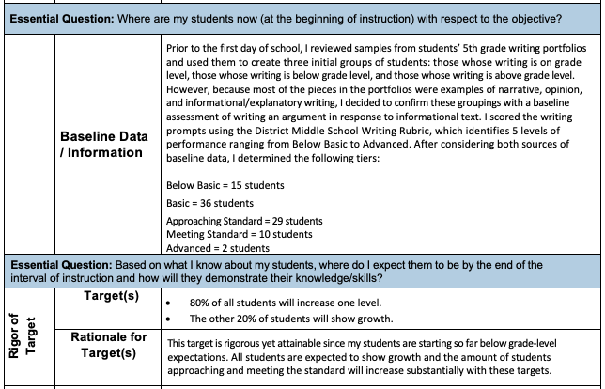
Approving SLOs Activity: Rigor of Target
Notes:
In this section, you’ll note that there are areas to provide this teacher with some support through a conversation. This could happen at the BOY conference where you ‘workshop’ the SLO together as it is workable, but needs attention in the following ways:
#8: While all students are accounted for using the categories on the baseline assessment, what will the teacher do with the two “Advanced” students who are exceeding grade-level expectations at the start (see #9)?
#9: While 100% of students are accounted for, it’s unclear how the “increase [of] one level” would be enough growth to close the achievement gap. In other words, if “Below Basic” improve one level, they would end the year at “basic,” which is still below grade-level. Additionally, how much growth will the other 20% of students achieve? How will the “Advanced” students grow if they’re starting above grade level? This needs to be clearer in this section.
#10: Based on the statements above, the rationale is not a valid claim based on the data used to set these targets. Needs to rework this section before approving.
In real time, if this section were not approvable, you would ‘stop’ your review and go back to the educator to make revisions. For the purpose of this activity, let’s continue to Quality of Evidence.

Slide 36
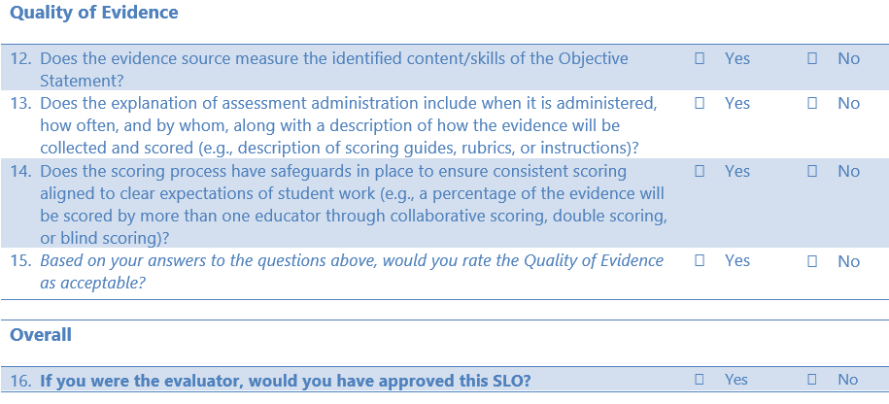
Approving SLOs Activity: Quality of Evidence
This SLO has a good foundation to build upon; it’s close! So work with this teacher to resolve each area to be sure it is a solid example before approving.
Notes:
In the final section, you can see there is a point of clarity needed:
#12: The evidence source comes from the first weeks in June. While it would be helpful to review this summative assessment of students’ writing, what is happening at the beginning and mid-points throughout the year to measure students’ progress? You should want to see multiple evidence sources to ensure that the data provided in an EOY assessment doesn’t end up being “too late” to help students achieve their intended targets.

Slide 37
Part V: Approving SLO Activity
Complete the SLO approval activity in Part V using your SLO Quality Review Tool. Reflect on the questions posed on the handout.
Once Parts I-V are completed on your handout, submit to edeval@ride.ri.gov for proof of completion of this module.
Notes:
At this point, now that you have completed all activities in Module 4, we invite you to check your answers against ours for Parts I-IV in the Module 4 Answer Key located in the Module 4 playlist.

