Slide 1
Rhode Island Alternate Assessment System
November 6, 2019
Heather Heineke, Office of Instruction, Assessment, and Curriculum
Carlin, Danner, EdD., Office of Student, Community, and Academic Supports
Rhode Island Department of Education

Slide 2
AGENDA
Welcome and introduction
Using Evidence and Data to Drive Decision-Making
Developing IEP Goals and Objectives
How to Select Accommodations
Overview of DLM and Essential Elements
Overview of Eligibility Criteria for Alternate Assessment
Overview of the ESSA 1% Rule

Slide 3
Using Evidence and Data to Drive Decision-Making
Notes:
Throughout this presentation we will be reviewing the data necessary to make a variety of decisions.

Slide 4
Using Data and Evidence to Make Decisions
Data and evidence collected as part of routine IEP development and maintenance should be used for:
developing and monitoring progress toward IEP goals and objectives
determining instructional accommodations and modifications
determining which accommodations are appropriate for state assessments
determining eligibility for the alternate assessment
Decisions should be clearly linked to the evidence and data collected for that student.
Multiple sources of data should also be used.
Notes:
As you already know, data is an essential component of the IEP process. It should be used to create IEP goals/objectives, determine instructional and testing accommodations/modifications, and to determine eligibility for the alternate assessment. By creating these "data stories" for students from multiple sources of materials, we are creating a clear understanding of how the student is performing and what they might need to improve

Slide 5
Sources of Evidence and Data
1. Observational Evidence:
teachers
service providers
family members in settings outside of school
2. Academic Assessment Evidence and Data:
examples of instructional objectives and materials
work samples and data on progress from both school- and community-based instruction
classroom work samples and data
state assessments
district-wide alternate assessments
reading assessments
academic achievement tests
language assessments (ACCESS or Alternate ACCESS)
3. IEP information, including:
present levels of academic achievement, areas of need, goals, and short-term objectives
transition plans
considerations for students with specific communication needs or modes (from multiple data sources)
considerations for students who may be learning English as a second or other language.
4. Evaluations, including:
Adaptive behavior assessments
Informal assessments
Psychological assessments and evaluations, including information associated with IQ tests, including initial or 3-year reevaluations.
Speech and communication assessments
Notes:
This list is not exhaustive of the possible data used for IEPs. It should be noted that psychological assessments and evaluations, including information associated with IQ tests. It is important to not use the IQ score as a qualifying measure but to use the descriptive information in the evaluation on what the student can and cannot do.

Slide 6
The Importance of Using Multiple Data and Evidence Sources
It is important to have multiple sources of evidence in order to make the most appropriate decision for a student for two reasons:
It prevents decision-making that relies on only one type or source of information.
It provides a more complete picture of how the student is learning and interacting in several different settings and under different circumstances.

Slide 7
TURN AND TALK!
Use the next five minutes to complete the spreadsheet we provided to record the evidence/data you use in your district and decide which category (or categories) it fits in to.
Observational,
Academic,
Evaluation (psych, ed, etc),
Other IEP Information
Discuss the following with your district colleagues and those at your table:
Is there an area(s) where data or evidence is missing? An area(s) that has a lot of data collected?
Is there an area(s) where only one type of data or evidence is collected?

Slide 8
Developing IEP Goals and Objectives
Notes:
As you already know data is an integral process for developing IEP goals and objectives for the IEP. We will quickly review what this could look like because this information will help to inform alternate assessment decisions.

Slide 9
CONVERSATIONS THAT MUST HAPPEN FOR EVERY STUDENT WITH AN IEP
It is important that the discussion of what the child needs is framed around how to help the child do the following:
be involved in and make progress in the general curriculum;
be educated with and participate in educational activities with other children with disabilities as well as nondisabled children in a meaningful way;
LEAs are responsible for ensuring this is clear and reflected in the student’s IEP.
Notes:
The IEP should be a clear picture of the student. When thinking about the relationship between differently abled students and the general education students how much the student was considered to participate in the general education setting should be considered. When students are not include there should be specific data and reasoning behind this decision which should be included in the IEP.

Slide 10
DEVELOPMENT OF THE IEP
To help decide what special education and related services the student needs, generally the IEP team will begin by looking at the following:
the child's evaluation results, state testing, classroom tests, work samples, interviews, progress monitoring, and checklists given to establish the student's eligibility
observations by teachers, parents, paraprofessionals, related service providers, administrators, and others,
This information will help the team describe the student's "present levels of educational performance." In other words, how the student is currently doing in school. Knowing how the student is currently performing in school will help the team develop annual goals to address those areas where the student has an identified educational need.
Notes:
To begin the IEP writing process the initial or 3 year re-eval should be considered, state and classroom testing, work samples, interviews with the student, progress monitoring data, and checklists should be considered. This along with observations by teachers, parents, paraprofessionals, related services providers, administration, and other should be considered. All of this information is helpful in creating the present levels of performance that will provide a clear picture of how the student is currently performing.

Slide 11
Goal Writing: Task Analysis/What is the skill being asked of the student?
The Present Levels and Area of Need set the stage for goal writing by providing the appropriate data from multiple sources. It acts as a funnel of information to inform the goals that will be created. It should be noted that the IEP is not a curriculum for the student but part of a systematic intervention process.
Case managers should choose one skill to begin and ask themselves:
What sub-skills are needed to achieve this goal?
How can these subskills be made into manageable objectives that the student can accomplish throughout the year?
Can the goal be achieved within the year?
Has the goal been continued from year to year? Should it be broken down further to ensure the student sees success?
If there are no subskills associated with the goal, what percentage of accuracy and/or number of trials will give that student success?
Notes:
This information should act as a funnel to inform goal/objective writing. When revising goals, case mangers should consider the questions outlined on this slide.

Slide 12
Turn and Talk!
In your spreadsheet, put a check next to each type of data used to inform decision-making in each area.
Discuss the following questions with your district colleagues and those at your table:
Is the type of evidence or data used varied?
Is there a reliance on one or two types of data?
Is there data or evidence that isn’t used that should be considered in developing goals and objectives?

Slide 13
How to Select Accommodations
Notes:
Selecting accommodations should also be a process that uses data .

Slide 14
Classroom Accommodation Selection
After teaching the use of an accommodation there should be observational and trial data with an accuracy component to determine if an accommodation is successful.
On the other hand, the accommodation should not be a crutch that the student is not encouraged to grow academically.
It is important to keep in mind that as the student is seeing success with an accommodation and the special educator is encouraging the student to use the accommodation in a less invasive way with more independence.
Some questions to ask case managers:
Are the accommodations in the IEP historical?
Is there empirical evidence that demonstrated that the accommodation is necessary?
Is there room to improve independence?
Is there productive struggle happening for the student with accommodations?
Notes:
There is a balance between over accommodating and under accommodating. Because of this balance, it is essential to ensure special educators are using data to make these decisions. Observational data can be collected and the accuracy of the assignment calculated with and without the accommodation. Also it should be considered if the student could use a less invasive form of an accommodation and still be successful. Having an accommodation placed in an IEP requires instruction for the student in order to fully understand how to use the accommodation and when it would be useful. Because our goal should be to increase the independence of the student. These questions should be considered.

Slide 15
Testing Accommodation Selection
Data should be used to inform testing accommodations as well.
All accommodations used during classroom assessments should be considered for state testing.
These accommodations should be:
Identified in the IEP
In line with state assessment accommodations
Allow the student to demonstrate their independence to the best of their ability
Familiar to the student prior to testing

Slide 16
THREE FALLACIES AND TWO MISUNDERSTANDINGS ABOUT ACCOMMODATIONS AND STATE ASSESSMENTS
The “We Do X Every Day During Instruction” Fallacy. While accommodations should be used by the student every day, that doesn't mean include replicating instructional strategies during testing.
The “Just In Case” Fallacy: I added everything he might need "Just in Case“.
The “Extended Time” Fallacy: If I give extra time to all students, they will get more answers correct.
Not reading the accommodations documents to fully understand the accommodations for the tests being given.
Waiting too long to figure out what the student’s needs are OR waiting too long to figure out how the accommodations will work on the test:
AT doesn't work with the test platform
Not enough time to practice on the online platform with accommodations
Accommodation is not in the IEP
Notes:
Accommodations should be used during instruction, therefore all instructional supports should be provided during testing:
“All of my students use spell checkers when they are writing in class so why can’t they have them during the test?”
“The teachers read the math problems during instruction every day so all of the students need the math test read out loud.”
Including accommodations in the IEP "Just in Case" the student needs it.
Extended time will help low-performing students get more answers correct.
Only good instruction will help students get more answers correct.
Accommodations will not take the place of good instruction.
Educators misunderstand what is required of the student to manage those accommodations on the test.
Waiting too long to figure out what the student’s needs are for the test.
AT doesn't work with the test platform
Not enough time to practice on the online platform with accommodations
Accommodation is not in the IEP

Slide 17
Using Evidence to Make Accommodations Decisions for State Assessment
In most cases, decisions about what a student will need during state assessments will be fairly straightforward.
However, for some accommodations, what evidence to use may not be so straightforward:
Extended Time
Read aloud for mathematics or science
Calculator use on non-calculator section of the test
How would you evaluate whether or not a student would benefit (or has benefitted) from one of those accommodations?

Slide 18
Turn and Talk! (Option1 slide)
Discuss the following questions with your district colleagues and those at your table:
Is the type of evidence or data used varied?
Is there a reliance on one or two types of data?
Is there data or evidence that isn’t used that should be considered in deciding which classroom accommodations/modifications would be most beneficial?
Is there data or evidence that could be used to evaluate how beneficial an accommodation or modification is for a student?

Slide 19
Overview of DLM and the Essential Elements

Slide 20
Overview of the DLM
Learning Map
Contains the individual skills that students need to master an Essential Element (or standard). Each skill is linked to multiple other skills. Individual skills are not separate from one another but become the basis for more complex skills.
Nodes
Each individual skill on the Learning Map is called a Node.
Nodes are linked together to show possible ways a student can learn an Essential Element.
Are designed to help teachers find access points to develop instructional plans.
Linkage Level
Nodes are grouped to show the steps a student might take towards learning an essential element. There is a beginning (easiest) skill and then it increases in difficulty with the last skill being the most complex. Each step is called a linkage level.
There are five linkage levels (skills) for each Essential Element.
Notes:
The Learning Map provides the larger structure of skills and knowledge that the DLM assesses. Each point on that learning map represents a single skill. Each point is called a node.
Each Essential Element has a “mini-map” made up of nodes, or skills, that are arranged from a beginning skill to a more complex skill. Each level of complexity is called a linkage level. There are five linkage levels for each Essential Element.

Slide 21
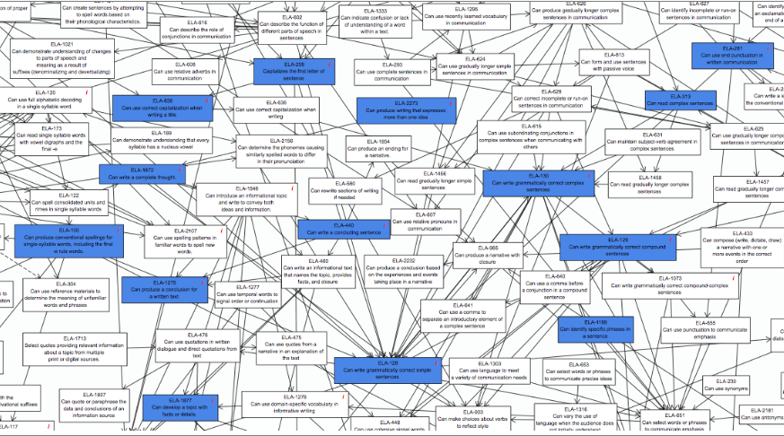
Learning Map Models
Notes:
Shown here is one small portion of the learning map for ELA. Each rectangle is a node. It is not important that the nodes are not legible here. This view is shown simply to point out the multiple arrows between nodes representing the multiple pathways of learning and that skills are connected to one another, each skill supporting and touching another. These nodes are organized into smaller, mini-maps, that are more useful for teachers to use when designing instructional plans for students and for measuring the Essential Elements.

Slide 22
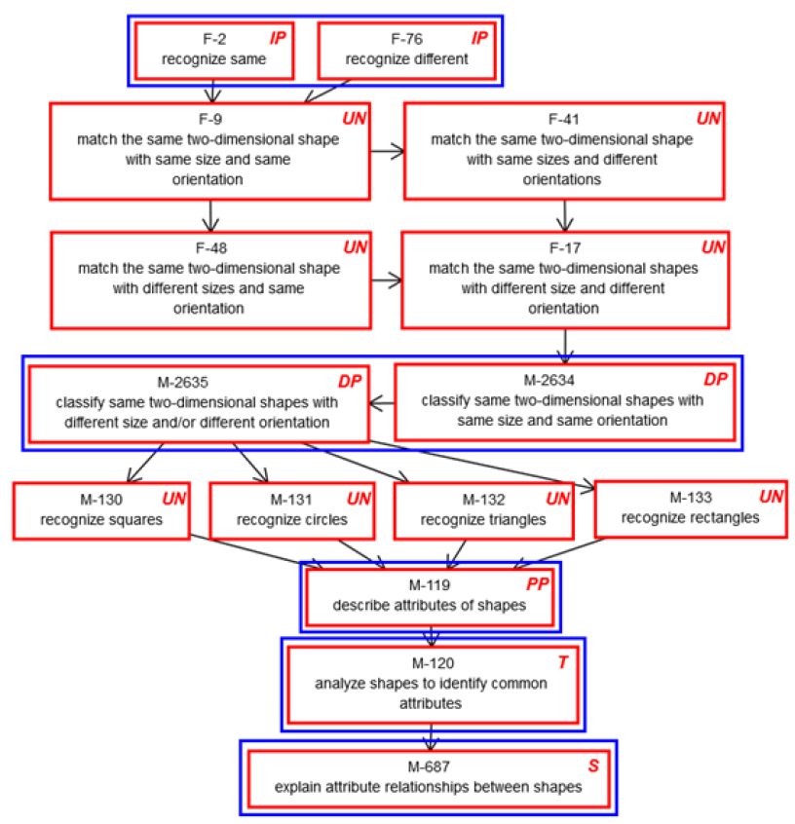
Sample Mini-Map for Mathematics: M.EE.5.G.1-4

Slide 23
Sample Mini-Map for Mathematics
F-2 IP
recognize same
F-76 IP
recognize different
Initial Precursor Nodes (IP)

Slide 24
Sample Mini-Map for Mathematics
DP
M-2635 DP
Classify same two-dimensional shapes with different size and/or different orientation
M-2634 DP
Classify same two-dimensional shapes with same size and/or same orientation
Distal Precursor Nodes (DP)

Slide 25
Sample Mini-Map for Mathematics
M-119 PP
describe attributes of shapes
Proximal Precursor Nodes (PP)

Slide 26
Sample Mini-Map for Mathematics
M – 120 T
analyze shapes to identify common attributes
Target Node (T)

Slide 27
Sample Mini-Map for Mathematics
M-687 S
Explain attribute relationships between shapes
Successor Node (S)

Slide 28
Sample Mini-Map for Mathematics
Untested Nodes (UN)

Slide 29
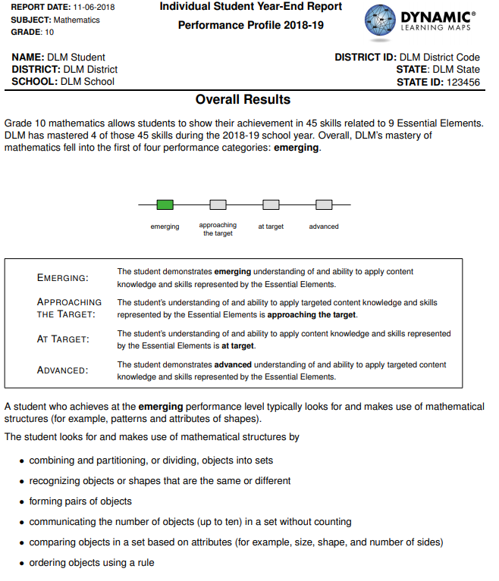
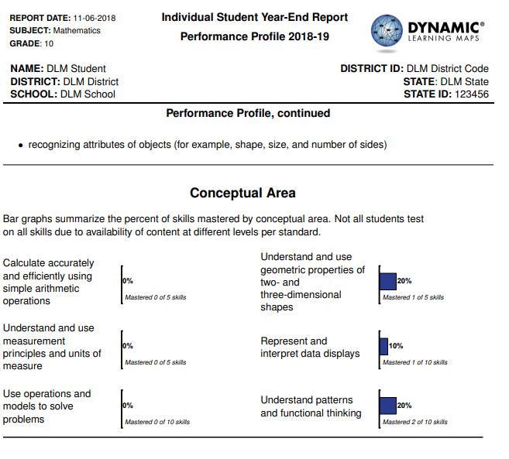
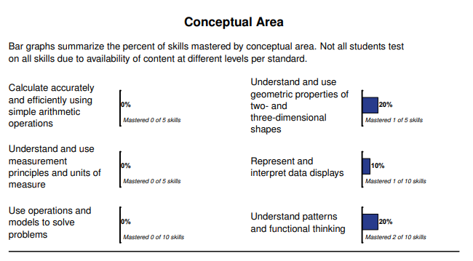
DLM Student Score Report

Slide 30
Scoring
Linkage Level | Number of Testlets | Skill | Scoring
Initial Precursor | 1 | 1 | 1 skill
Distal Precursor | 1 | 1 | 2 skills
Proximal Precursor | 1 | 1 | 3 skills
Target | 1 | 1 | 4 skills
Successor | 1 | 1 | 5 skills
Notes:
If they don't master a linkage level, they drop one linkage level for next testlet but they would drop down two for scoring because they didn't show mastery at either linkage level.

Slide 31
Scoring
Number of Essential Elements Tested:
1 - Calculate accurately and efficiently
1 - Understand and use measurement
2 - Use operations and models
1 - Understand and use geometric properties of two-and three-dimensional shapes
2 - Represent and interpret data displays
2 – Understand patters and functional thinking
9 TOTAL Essential Elements
Each Essential Element tested has five skills:
1. Initial Precursor
2. Distal Precursor
3. Proximal Precursor
4. Target
5. Successor
5 TOTAL SKILLS per Essential Element
9 x 5 = 45 skills

Slide 32
Notes on DLM SCORING
Teachers complete the First Contact Survey and Personal Needs Profile.
These two surveys determine which Linkage Level the students begins testing at.
If a student gets all test items correct, but remains at a low linkage level, they will not reach proficient.
The scoring system will assume that students who are at the Target level, also mastered the lower linkage levels and those skills will be counted as correct.

Slide 33
DLM Performance 2018 and 2019
 | Number of Students | % Emerging | % Approaching Target | % At Target or Advanced
ELA
2018 | 998 | 55% | 22% | 23%
2019 | 966 | 55% | 21% | 24%
Math
2018 | 998 | 67% | 22% | 11%
2019 | 956 | 68% | 20% | 12%
Science
2018 | 403 | 58% | 26% | 16%
2019 | 420 | 58% | 27% | 15%

Slide 34
Resources
For District and School Administrators
Educator Portal reports (school rosters, district reports, student reports)
RIDEMap: RI Assessment Data Portal
Information on proficiency levels, next year we plan to have individual student data on essential elements.
www.ride.ri.gov/riaa: Link to applying for test development committees (educator input is an important component of test development and the development of instructional materials). Test administration materials.
For Teachers (www.ride.ri.gov/riaa)
Essential Elements documents and test specifications
Links to released testlets and practice testlets
Links to applying for test development committees (all organized by DLM)
Links to training modules on essential elements and instructional strategies

Slide 35
Overview of Eligibility Criteria for Alternate Assessments

Slide 36
THE THREE ELIGIBILITY CRITERIA
Student has a disability, or disabilities, that significantly impacts cognitive function and adaptive behavior.
As documented in the IEP, the student’s present levels of academic achievement indicate their ability to make progress through the alternate achievement standards (EEs) and the short term objectives include skills and concepts reflected in the steps found in the alternate achievement standard (EEs) learning maps, and the annual academic goals are closely aligned to grade-level alternate achievement standards.
The student is unable to apply academic, life, and job skills in home, school, and community without intensive, frequent, and individualized instruction and supports in multiple settings.

Slide 37
CRITERIA 1

Slide 38
CRITERIA 1: STUDENT HAS A SIGNIFICANT COGNITIVE DISABILITY
Student has a disability, or disabilities, that significantly impacts cognitive function and adaptive behavior.
In other words….
The student has a disability or multiple disabilities that prevents them from participating in a meaningful way in the standard academic classes and coursework
the student’s disability (or disabilities) causes dependence on others for many, and sometimes all, daily living needs, and the student is expected to require extensive ongoing support in adulthood.
Notes:
The first criteria: Student has a disability, or disabilities, that significantly impacts cognitive function and adaptive behavior. This means that the student may have one or more disabilities that prevents them from participating in standard academic classes and course work. That a student is deaf or hard-of-hearing, blind or visually impaired, has limited or no use of their arms, legs, hands, or has poor motor skills, are not considered disabilities that should be used in evaluating whether or not a student would meet this criteria. The disability, or disabilities, that should be considered here include those that affect their cognitive functioning and adaptive behavior.
A note on communication: A student may lack adequate communication abilities for a variety of reasons. Because it may be difficult to understand what a student is trying to communicate, it may cause an error in finding a student eligible for the alternate assessment. Without the ability to express their needs, wants, and what they know, it is impossible to know what they understand. While communication ability is not part of the criteria for alternate assessment, it is important that all students have access to an effective communication system they will use. While lack of a communication system may make the eligibility decision difficult, the absence of a communication system alone is not reason enough to find a student eligible for the alternate assessment.

Slide 39
WHAT IS COGNITIVE ABILITY?
WHAT IT IS: How the brain functions/processes events and surroundings and interacts with others and their environment
WHAT IT IS NOT: Not physical challenges such as: feeding tubes, wheelchair use, visual or hearing impairments, ability (or inability) to use their body independently, medical challenges such as seizures, degenerative diseases
The role communication plays in determining cognitive ability:
Students who cannot, won't, or don't have a robust communication method do not automatically qualify for the alternate assessment.
Example: eye gaze; limited use of their body
Consider the student's interactions with their surroundings and others, not just communication ability

Slide 40
CRITERIA 2

Slide 41
CRITERIA 2: INSTRUCTION AND LEARNING GOALS
As documented in the IEP, the student’s present levels of academic achievement indicate their ability to make progress through the alternate achievement standards (EEs) and the short term objectives include skills and concepts reflected in the steps found in the alternate achievement standard (EEs) learning maps, and the annual academic goals are closely aligned to grade-level alternate achievement standards.
In other words…
the student has access to the Common Core State Standards and the Next Generation Science Standards.
the student is working on learning standards that have been substantially modified due to the severity of the disability (e.g., the Essential Elements that are part of the Dynamic Learning Maps alternate assessments).
Life and job skills that are appropriate and challenging for this student are also included.
Notes:
As documented in the IEP, the student’s present levels of academic achievement indicate their ability to make progress through the alternate achievement standards (EEs) and the short term objectives include skills and concepts reflected in the steps found in the alternate achievement standard (EEs) learning maps, and the annual academic goals are closely aligned to grade-level alternate achievement standards. In order to accomplish this, there should be a clear picture in the present levels that is data driven which demonstrates that the student's ability is within the realm of Essential Elements.

Slide 42
CRITERIA 3

Slide 43
Criteria 3: Applying Skills in Multiple Settings
The student is unable to apply academic, life, and job skills in the home, school, and community without intensive, frequent, and individualized instruction and supports in multiple settings.
In other words…
What the student needs in order to learn is extensive, repeated, and individualized instruction from teachers and others.
The types of materials needed in order for the student to learn are significantly customized for that specific student.
How the student demonstrates what they know and can do requires substantially different materials and supports, including those supports that help a student communicate.
Notes:
This criteria references the level of difficulty a student may have learning and may be, more than the other criteria, the hallmark of students who benefit from taking the alternate assessment. While every student, regardless their disability status, may be challenged when learning particular content or skill, a student eligible for the alternate assessment may need a level of very intense, repetitive instruction over the course of many weeks, months, or, in some cases, years, before they achieve mastery.
What this means is that students who are eligible for the alternate assessment typically have a lot of trouble generalizing skills and knowledge from setting-to-setting and from one circumstance to another. In evaluating evidence for this criteria, Teams should consider the types of skills and knowledge that the student is have difficulty transferring from one setting to another. Teams should look for many skills, both academic skills and life skills, that the student needs consistent, intensive reminding, repeating, and reteaching in order to learn and to maintain.
Students who are eligible for the alternate assessment also require extensive modifications to classroom materials. Typical materials may not be able to isolate specific skills or content that the student is working on. The alteration of materials for a student being considered for the alternate assessment is vastly different from their typical peers. Tools that are modified to mitigate the effects of a student’s physical or sensory disability do not fall into this category even though materials often take these challenges into account.

Slide 44
WHAT ARE FUNCTIONAL SKILLS?
Definition of functional skills: Skills that allow the student to take care of themselves physically, mentally, and emotionally, including interpersonal skills. Functional academic skills are skills used in everyday life (ex. Reading signs, instructions, emergency numbers, etc. and knowing the contexts in which to utilize them.)
Evaluating functional skills:
Holistic skill set, not looking for a discreet/checklist set of skills.​
Does not include any physical disabilities/limitations the student may have.​
Examples of possible evidence:
Independent Living Questionnaire
Student Summary Sheet
Observations of parents/caretakers/teachers

Slide 45
The Importance of Appropriate Evidence
It is important to have multiple sources of evidence in order to make the most appropriate decision for a student for two reasons:
It prevents decision-making that relies on only one type or source of information.
It provides a more complete picture of how the student is learning and interacting in several different settings and under different circumstances.
The following slides outlines the types of evidence and information most helpful for making these decisions as well as that information and data that is not, under any circumstances, to be used to make an eligibility decision.

Slide 46
Warning Signs
Indications that a student does not meet the criteria OR you need to take another look at their eligibility.

Slide 47
When to reconsider eligibility for the alternate assessment
You need to revisit the student’s eligibility status if you find the following:
The student received a score on a general education state assessment.
Their primary disability category is a learning disability, speech/language, blindness/visual impairment, or other health impairment
The reason provided as to why the student qualified is that:
“they are in a life skills, self-contained, alternate assessment class”, or
anything having to do with “behaviors” as the primary issue, or
“they have an IQ of…”, or
“they scored in the ___ percentile of the X test”, or
“they can’t communicate”
“they are ____” (fill in with a disability category).
They take a content-area class in a general education setting with their typical peers without significant supports and modifications.
They are slightly below, or even at, grade level in one content area.
The student never took the alternate assessment and then, in middle or high school, they do.

Slide 48
BAD DATA: What not to use to make an eligibility decision
Disability category
Poor attendance or extended absences, for any reason.
Poor performance on the general education academic assessments.
English Language Learner (EL) status.
Impact of the student’s test scores on the accountability score of the school and/or LEA.
Location of special education services in more restrictive settings
Amount of time receiving special education services
Variety of services received
Behavior issues, including test anxiety
Administrator decision
Notes:
By following this process and using the evidence form, then these factors never come into the conversation – they aren't needed.

Slide 49
Turn and Talk!
Discuss the following questions with your district colleagues and those at your table:
Is the type of evidence or data used varied across categories?
Is there a reliance on one or two types of data?
Is there data or evidence that isn’t used that should be considered when making eligibility decisions?
Is the data used for eligibility decisions also used to inform IEP development?

Slide 50
Documentation of Evidence Form

Slide 51
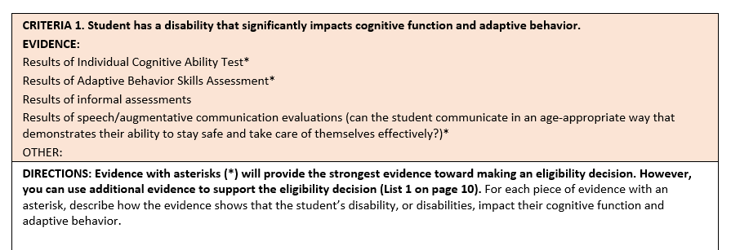
NEW OPTIONAL DOCUMENTATION OF EVIDENCE FORM
The criteria is given along with possible evidence to evaluate whether or not a student is eligible to meet the criteria. NOTE: LEAs can add specific evidence/data that they expect to see being used to make eligibility decisions.
This section is where teachers can cite specific page numbers, section of reports, and data that addresses the criteria. They can attach the page(s) from the IEP and evidence they use.

Slide 52
CRITERIA 2
This section is where teachers can list or attach the page in the IEP that has the academic and functional performance descriptions and the EEs they will be addressing throughout the year. Again, teachers can attach pages from the IEP directly to this form.
Notes:
Actual attachment of IEP pages – NOT "See IEP"
Acquiring skills; especially academic skills
Look at functional skills in how they affect the student's ability to learn academic concepts; especially abstract academic concepts and their ability to generalize.

Slide 53
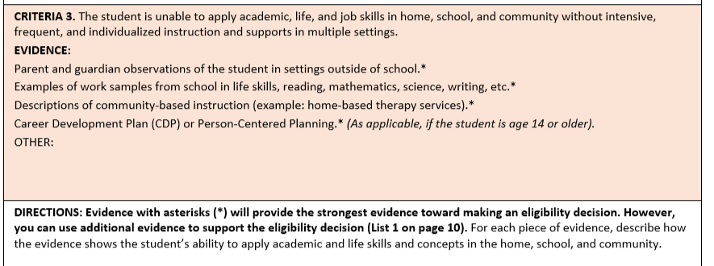
CRITERIA 3
This section is where teachers can cite and reference data, page numbers of reports, quotes from reports, etc. that align to criteria 3.
Notes:
Application of skills

Slide 54
OVERVIEW OF IEP TEAM ASSURANCES FORM

Slide 55
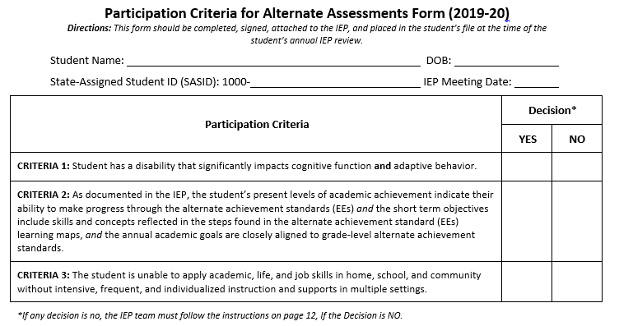
PARTICIPATION CRITERIA FOR ALTERNATE ASSESSMENTS FORM (2019-20) IEP Team Guidance (page 8)
Notes:
This is a simpler form and does not include a place to list specific evidence. The Documentation Form is where IEP Teams can list the evidence they use and align that evidence to the specific criteria.

Slide 56
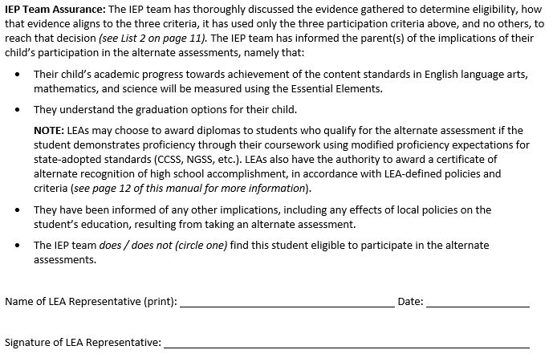
IEP TEAM ASSURANCES (2019-20)
Notes:
When explaining to parents about graduation options: explain the differences in graduation requirements such whether or not the student will get a diploma when they graduate, if there are specific requirements such as an exit portfolio or other presentation or credit/course requirements that students would have meet and how those requirements will be modified for their needs.

Slide 57
Overview of the ESSA 1% Rule

Slide 58
Overview: Goals and Outcomes of Alternate Assessment
To include students with significant cognitive disabilities in assessment and accountability.
To ensure that standards-based skills and content are taught at levels that are meaningful and challenging.
To determine which knowledge and skills students have learned.
To provide information to schools and parents/guardians on the achievement of students with significant disabilities (i.e., what they can do).
Notes:
All states are required to assess students with disabilities, including students with the most significant cognitive disabilities, and to include them in accountability calculations. In other words, the academic progress of students with significant cognitive disabilities is important in determining the overall performance of schools and districts across the country. The goals and outcomes of the alternate assessment program are the same as for any other state test given to any other student: to ensure that standards-based skills and content are taught at levels that are meaningful and challenging and to determine which knowledge and skills students have learned. Given information about what students know and can do, educators can make changes in programs and instruction that increase learning for students.

Slide 59
Overview: The Outcome of ESSA
To ensure all students receive appropriate access to the general education curriculum and are given every opportunity to learn.
Notes:
The one major outcome of the ESSA one percent rule is to ensure that all students, regardless of disability status, income level, or race/ethnicity receive access to the general education curriculum. Access to the general education curriculum looks different for every student. However, even for students with significant cognitive disabilities, access to the curriculum is essential because without it, no student can or will make progress towards mastering any of the skills or knowledge required for a fulfilling life outside of school.
ESSA outlines many requirements for states and LEAs that I will cover later in this presentation but the over-arching goal is to ensure appropriate educational opportunities for each student enrolled in our schools.

Slide 60
Every Student Succeeds Act (ESSA): The One Percent Rule for Statewide Alternate Assessments
“The total number of students assessed in a subject using an alternate assessment aligned with alternate academic achievement standards…may not exceed 1% of the total number of students in the state who are assessed in that subject.”
LEAs may exceed 1%, but only under these conditions:
They are a small LEA: Between 0 and 1,000 students enrolled; K-12.
They are a specialized LEA serving students with disabilities; Rhode Island School for the Deaf is the only LEA in RI that fits this category
States may not exceed 1%, but may request a one-year waiver, if 95% of students were assessed.
Notes:
Prior to Congress passing ESSA, there were no requirements for IEP teams to be formally trained on how to apply or interpret the criteria for participating in the alternate assessments. This led to many different interpretations and resulted in some places over-identifying students for these tests. In order to address this issue, ESSA requires that IEP teams be trained, that parents be notified of the potential impact of the eligibility decision on their child’s education, and to document that districts have applied the criteria appropriately to all students being considered for the alternate assessment.
States are required to test all students in mathematics, English language arts, and science. The only way an LEA may be able to test more than 1% of students is if the LEA submits a waiver to the SEA (to the state). There will more on the waiver process for LEAs a little later in the presentation.
As we discussed last year, LEAs may exceed the one percent but only under two conditions. One is that LEA’s total enrollment is very small – between zero and 1,000 students in grades K-12. This would mean that finding a few students eligible would push the LEA over the 1% threshold.
The other reason is that the primary purpose of the LEA is to provide specialized programs for students with disabilities. The only LEA in Rhode Island meeting that criteria is the Rhode Island School for the Deaf.
However, while LEAs may apply for a waiver from the state, states may not exceed the 1% cap unless they also request a waiver from the US Department of Education. However, states may only request a waiver if 95% of all Rhode Island’s students were assessed. This is the same 95% participation rate that all schools must meet for accountability purposes.

Slide 61
LEA REQUIREMENTS
LEAs must do the following:
Ensure that all Alternate Assessment Criteria are applied correctly.
Provide in-person training on the Eligibility Criteria, and any other necessary topics, to IEP Teams (including LEA representatives) who have students either taking or being considered for, the DLM.
Have a process by which the district reviews eligibility decisions to ensure that appropriate evidence and data was used.
Ensure that parents understand the ramifications of having their student qualify for the alternate assessment. IEP Assurances Form
Address any disproportionality in any subgroup taking the alternate assessment.
Notes:
The LEA requirements on this slide will all be included as section in the action plans LEAs over 1% will be required to submit.

Slide 62
IMPLEMENTING THE REQUIREMENTS
Ensure the IEP Team Assurances Form is signed and included in student records.
Read the 2019-20 IEP Team guidance document on the RIDE site at www.ride.ri.gov/dlm.
Convene IEP Teams for students for whom eligibility is in question and review the evidence used to make the determination.
Calculate the percent of students your LEA will assess using the DLM alternate assessments coming up in April, 2019.
ELA, mathematics, and science
Include students in outplacement schools
Review Student Data:
Student Information System, Enrollment Census, and Special Education Census for accuracy (including students attending outplacement schools).
Complete the Action Plan document and submit to RIDE
2019-20 Template will be released in December and due to RIDE at the end of February.
Notes:
The first step to take is to find out if your LEA will be likely to exceed the one percent threshold for the alternate assessment. Use the calculation slide earlier in this presentation to gather the necessary information and determine if your LEA may exceed the one percent threshold. If your LEA is likely to, someone in your LEA must complete the One Percent Justification Form by March 23, 2018. Once we receive your application for a waiver, we will review that information and discuss any extenuating circumstances before we approve or deny the application. There will be more guidance coming on this aspect of the process at a later date.
Also, from this point forward, as IEP Team meetings are scheduled, you can use this recorded presentation for training if you wish. IEP Teams where students clearly do not meet the criteria for the alternate assessment do not need to view this presentation. IEP Teams for students who are already on the alternate assessment or where there are questions about whether the student does or does not meet the criteria, must view this presentation.
The same applies to the IEP Team Assurances Form. If a student is being considered for the alternate assessment, that form must be signed and included in the student's records.
It is also important that educators and parents of students with disabilities are aware of the accommodations available on all statewide assessments. There are many ways to combine accommodations and test supports during testing that can increase access for students. All of our state assessments also have a Unique Accommodations Form that can be completed for any accommodation not specifically named in the accommodations manual. If you have any questions, please do not hesitate to ask.

Slide 63
1% CALCULATION CALCULATED FOR EACH CONTENT AREA SEPARATELY
DLM: Total assessed students* in grades 3, 4, 5, 6, 7, 8,11
100
% assessed
DLM, RICAS, SAT: Total assessed* students in grades 3, 4, 5, 6, 7, 8, and 11
* Includes students enrolled in your LEA who took any of the state assessments in an outplacement school either within or outside of Rhode Island. Calculations for the science would include students who took the DLM science test and students who took the NGSA.
Notes:
This slide shows how we calculated the percentage of students who tested using the alternate assessment for each LEA. We performed these calculations after we received the testing files for the DLM, RICAS, and SAT assessments.
The formula on this slide is fairly straightforward. RIDE used the number of students who took the DLM assessments, by content area, across the tested grade levels and divide that number by the total number of students in the LEA who took each content area assessment. Remember:
Grade 10 students are not be included since no alternate assessment is given at that grade level.
Students who took the DLM, or any other state assessment, who were tuitioned by your LEA to an outplacement school, were also included.

Slide 64
LEAS GROUPED BY PERCENT OF STUDENTS ASSESSED USING ALTERNATE ASSESSMENTS
State Alternate Assessment Rate:
2018: 1.3%
 | Number of LEAs
% | 2018
0.0 | 22*
0.1 – 0.5 | 2
0.6 – 1.0 | 7
1.1 – 1.5 | 15
1.6 – 2.0 | 6
2.1 + | 6
* These LEAs do not have students taking the alternate assessment.
Notes:
This chart shows the number of LEAs at various participation rates. There are 22 LEAs that did not have any students taking the DLM last year and there are nine LEAs who are either at 1.0% or below. These LEAs will not have to submit an action plan to RIDE. However, the majority of RI LEAs, 27 in total, are above the 1% cap. Twelve LEAs have rates at or above 1.6%.

Slide 65
2016-17 AND 2017-18 COMPARISON OVERVIEW
 | 2016-17 | 2017-18
Total number of students | 76,476 | 75,169
Total number of students assessed using AA | 900 | 994
Percent of students assessed using AA | 1.2% | 1.3%
Number of LEAs exceeding the 1% cap | 26 | 27
Total number of LEAs that increased number of students assessed using DLM from the previous year. | -- | 24
Notes:
This slide compares 2016-17 school year to the 2017-18 school year. You can see the overall number of students tested in grades 3-8 and 11 decreased and yet the number of students taking the alternate assessments increased by almost 100 students. This, of course, increased the percent of students taking the alternate assessment from 1.2% to 1.3%. The number of LEAs over the 1% didn’t change too much but what is surprising is that 24 of those 27 districts increased the total number of students taking the DLM last year. This is explored further on the next slide.

Slide 66
Wrap-Up: Share with the Group
Are there areas where more evidence or data might be needed?
Are there areas where one or two pieces of evidence or data are being used?
What is the process your district uses to determine if the appropriate steps were taken by the IEP team to ensure students:
Have IEP goals and objectives supported by evidence?
Have accommodations supported by evidence?
Are identified correctly for the alternate assessment?
Includes identifying students in order to revisit their eligibility for DLM.

