Slide 1
UNDERSTANDING THE ELIGIBILITY CRITERIA AND MAKING A DECISION
March 18, 2019
Rhode Island Department of Education and the Pawtucket School Department
Notes:
To ensure that all IEP Team members determine eligibility for the alternate assessment in a standardized way, ESSA requires that IEP Teams be trained each year on the alternate assessment criteria. This part of the presentation follows the IEP Team Guidance on Eligibility for Alternate Assessment document closely and includes page numbers where information from the slides can be found. The IEP Team Guidance on Eligibility for Alternate Assessment can be found on the RIDE website at www.ride.ri.gov/RIAA

Slide 2
ELIGIBILITY WORKSHOP AGENDA
Welcome and introduction
Review of handouts
Process of developing an IEP
Role and responsibilities of LEA representatives on IEP Teams
Overview of 1% Rule
Overview of Eligibility Criteria
Review and discussion of Sample IEP and Criteria Activities
Essential Elements
Appropriate Evidence List
IEP Team Assurances Form
Graduation requirements
Wrap-up and Questions

Slide 3
FIVE BELIEFS FOR AN EFFECTIVE IEP TEAM MEETING
Connections to CCR IEP Five Beliefs:
High Expectations: IEP team members’ hopes and dreams for the student embrace college and career readiness. IEP team discussion reflects belief that the student is able to learn new skills that improve access, engagement, and progress in early childhood/grade level standards and expectations.
Culturally Responsive Practices: Student-led IEP team meetings promote student voice and culturally responsive practices that respect the unique identity of the student abilities, race, gender, language, and culture.
Student Relationships: The IEP team includes members who have a positive relationship with the student and family.
Family and Community Engagement: Parents and student share data and information about the student’s strengths and current functional performance at home and in the community.
Collective Responsibility: Each team member provides information about the student’s unique strengths and needs in the areas in which they work with the student.

Slide 4
RESPONSIBILITIES OF THE LEA REPRESENTATIVE AT IEP TEAM MEETINGS
IDEA identifies the LEA representative (principals/school or district administrators) as someone who:
Is qualified to provide, or supervise the provision of, specially designed instruction to meet the unique needs of children with disabilities;
Is knowledgeable about the general education curriculum; and
Is knowledgeable about the availability of resources of the public agency.*
Ensures staff are supported and held accountable for IEP implementation.
Reviews/discusses the IEP and all related evidence prior to the IEP team meetings to ensure there is adequate evidence to make an eligibility decision.
IDEA, 34 CFR 300.321(a)94)

Slide 5

THE IEP TEAM

Slide 6
IMPORTANCE OF THE REGULAR EDUCATOR
There must be a regular educator at every IEP team meeting. This teacher must be someone that is familiar with the student, regardless of if they are providing direct instruction to the student. It is strongly recommended that the regular education teacher has seen the student in their natural environment and that they can contribute to the IEP meeting with ideas/support for goals and objectives that align with the general education curriculum and/or support for how to include the student with their peers.

Slide 7
DEVELOPMENT OF THE IEP
To help decide what special education and related services the student needs, generally the IEP team will begin by looking at the following:
the child's evaluation results, such as classroom tests and individual tests given to establish the student's eligibility,
observations by teachers, parents, paraprofessionals, related service providers, administrators, and others,
This information will help the team describe the student's "present levels of educational performance“. In other words, how the student is currently doing in school. Knowing how the student is currently performing in school will help the team develop annual goals to address those areas where the student has an identified educational need.

Slide 8
SPECIAL FACTORS THE IEP TEAM MUST CONSIDER
Depending on the child, the IEP team needs to consider what the law calls special factors to ensure that the IEP meets all of the child’s needs. These include:
If the child’s behavior interferes with their learning or the learning of others, the IEP team will consider strategies and supports to address the child’s behavior.
If the child is an English learner, the IEP team will consider the child’s language needs as these needs relate to his or her IEP.
If the child is blind or visually impaired, the IEP team must provide for instruction in Braille or the use of Braille, unless it determines after an appropriate evaluation that the child does not need this instruction.
If the child has communication needs, the IEP team must consider those needs.
If the child is deaf or hard of hearing, the IEP team will consider his or her language and communication needs. This includes the child’s opportunities to communicate directly with classmates and school staff in his or her usual method of communication (for example, sign language).
The IEP team must always consider the child’s need for AT devices and services.
Notes:
None of these special factors would qualify a student for alternate assessment specifically. These are areas that must be addressed in the IEP goals.

Slide 9
WHAT MUST BE INCLUDED IN AN IEP FOR A STUDENT ELIGIBLE FOR ALTERNATE ASSESSMENT?
It is important that the discussion of what the child needs is framed around how to help the child do the following:
be involved in and make progress in the general curriculum;
be educated with and participate in educational actives with other children with disabilities as well as nondisabled children in a meaningful way;
LEAs are responsible for ensuring this is clear and reflected in the student’s IEP.

Slide 10
LEA Requirements of the 1% Rule

Slide 11
Overview: Goals and Outcomes of Alternate Assessment
To include students with significant cognitive disabilities in assessment and accountability.
To ensure that standards-based skills and content are taught at levels that are meaningful and challenging.
To determine which knowledge and skills students have learned.
To provide information to schools and parents/guardians on the achievement of students with significant disabilities (i.e., what they can do).
Notes:
All states are required to assess students with disabilities, including students with the most significant cognitive disabilities, and to include them in accountability calculations. In other words, the academic progress of students with significant cognitive disabilities is important in determining the overall performance of schools and districts across the country. The goals and outcomes of the alternate assessment program are the same as for any other state test given to any other student: to ensure that standards-based skills and content are taught at levels that are meaningful and challenging and to determine which knowledge and skills students have learned. Given information about what students know and can do, educators can make changes in programs and instruction that increase learning for students.

Slide 12
Overview: The Outcome of ESSA
To ensure all students receive appropriate access to the general education curriculum and are given every opportunity to learn.
Notes:
The one major outcome of the ESSA one percent rule is to ensure that all students, regardless of disability status, income level, or race/ethnicity receive access to the general education curriculum. Access to the general education curriculum looks different for every student. However, even for students with significant cognitive disabilities, access to the curriculum is essential because without it, no student can or will make progress towards mastering any of the skills or knowledge required for a fulfilling life outside of school.
ESSA outlines many requirements for states and LEAs that I will cover later in this presentation but the over-arching goal is to ensure appropriate educational opportunities for each student enrolled in our schools.

Slide 13
Every Student Succeeds Act (ESSA): The One Percent Rule for Statewide Alternate Assessments
“The total number of students assessed in a subject using an alternate assessment aligned with alternate academic achievement standards…may not exceed 1% of the total number of students in the state who are assessed in that subject.”
LEAs may exceed 1%, but only under these conditions:
They are a small LEA: Between 0 and 1,000 students enrolled; K-12.
They are a specialized LEA serving students with disabilities; Rhode Island School for the Deaf is the only LEA in RI that fits this category
States may not exceed 1%, but may request a one-year waiver, if 95% of students were assessed.
Notes:
Prior to Congress passing ESSA, there were no requirements for IEP teams to be formally trained on how to apply or interpret the criteria for participating in the alternate assessments. This led to many different interpretations and resulted in some places over-identifying students for these tests. In order to address this issue, ESSA requires that IEP teams be trained, that parents be notified of the potential impact of the eligibility decision on their child’s education, and to document that districts have applied the criteria appropriately to all students being considered for the alternate assessment.
States are required to test all students in mathematics, English language arts, and science. The only way an LEA may be able to test more than 1% of students is if the LEA submits a waiver to the SEA (to the state). There will more on the waiver process for LEAs a little later in the presentation.
As we discussed last year, LEAs may exceed the one percent but only under two conditions. One is that LEA’s total enrollment is very small – between zero and 1,000 students in grades K-12. This would mean that finding a few students eligible would push the LEA over the 1% threshold.
The other reason is that the primary purpose of the LEA is to provide specialized programs for students with disabilities. The only LEA in Rhode Island meeting that criteria is the Rhode Island School for the Deaf.
However, while LEAs may apply for a waiver from the state, states may not exceed the 1% cap unless they also request a waiver from the US Department of Education. However, states may only request a waiver if 95% of all Rhode Island’s students were assessed. This is the same 95% participation rate that all schools must meet for accountability purposes.

Slide 14
LEA REQUIREMENTS GOING FORWARD
LEAs must do the following:
Ensure that all Alternate Assessment Criteria are applied correctly:
The IEP contains evidence that proves the student has a significant cognitive disability as defined in RIDE guidance. Criteria 1.
Students found eligible for the alternate assessment are being actively instructed using the Essential Elements (which are aligned to the CCSS and the NGSS). Criteria 2.
The IEP contains evidence that the student is unable to apply academic, life, and job skills in the home, school, and community. Criteria 3.
That parents understand the ramifications of having their student qualify for the alternate assessment. IEP Assurances Form
Provide in-person training on the Eligibility Criteria, and any other necessary topics, to IEP Teams (including LEA representatives) who have students either taking or being considered for, the DLM.
Address any disproportionality in any subgroup taking the alternate assessment.
Notes:
The LEA requirements on this slide will all be included as section in the action plans LEAs over 1% will be required to submit.

Slide 15
IMPLEMENTING THE REQUIREMENTS
Ensure the IEP Team Assurances Form is signed and included in student records.
Read the new IEP Team guidance document on the RIDE site at www.ride.ri.gov/riaa.
Training information for LEA teams will be announced in December
Convene IEP Teams for students for whom eligibility is in question and review the evidence used to make the determination.
Calculate the percent of students your LEA will assess using the DLM alternate assessments coming up in April, 2019.
ELA, mathematics, and science
Include students in outplacement schools
Review Student Data:
Student Information System, Enrollment Census, and Special Education Census for accuracy (including students attending outplacement schools).
Complete the Action Plan document and submit to RIDE
Notes:
The first step to take is to find out if your LEA will be likely to exceed the one percent threshold for the alternate assessment. Use the calculation slide earlier in this presentation to gather the necessary information and determine if your LEA may exceed the one percent threshold. If your LEA is likely to, someone in your LEA must complete the One Percent Justification Form by March 23, 2018. Once we receive your application for a waiver, we will review that information and discuss any extenuating circumstances before we approve or deny the application. There will be more guidance coming on this aspect of the process at a later date.
Also, from this point forward, as IEP Team meetings are scheduled, you can use this recorded presentation for training if you wish. IEP Teams where students clearly do not meet the criteria for the alternate assessment do not need to view this presentation. IEP Teams for students who are already on the alternate assessment or where there are questions about whether the student does or does not meet the criteria, must view this presentation.
The same applies to the IEP Team Assurances Form. If a student is being considered for the alternate assessment, that form must be signed and included in the student's records.
It is also important that educators and parents of students with disabilities are aware of the accommodations available on all statewide assessments. There are many ways to combine accommodations and test supports during testing that can increase access for students. All of our state assessments also have a Unique Accommodations Form that can be completed for any accommodation not specifically named in the accommodations manual. If you have any questions, please do not hesitate to ask.

Slide 16
1% CALCULATION CALCULATED FOR EACH CONTENT AREA SEPARATELY
DLM: Total assessed students* in grades 3, 4, 5, 6, 7, 8,11
100
% assessed
DLM, RICAS, SAT: Total assessed* students in grades 3, 4, 5, 6, 7, 8, and 11
* Includes students enrolled in your LEA who took any of the state assessments in an outplacement school either within or outside of Rhode Island. Calculations for the science would include students who took the DLM science test and students who took the NGSA.
Notes:
This slide shows how we calculated the percentage of students who tested using the alternate assessment for each LEA. We performed these calculations after we received the testing files for the DLM, RICAS, and SAT assessments.
The formula on this slide is fairly straightforward. RIDE used the number of students who took the DLM assessments, by content area, across the tested grade levels and divide that number by the total number of students in the LEA who took each content area assessment. Remember:
Grade 10 students are not be included since no alternate assessment is given at that grade level.
Students who took the DLM, or any other state assessment, who were tuitioned by your LEA to an outplacement school, were also included.
We carried out this calculation for ELA and mathematics for the 2017-18 school year. The LEA 1% assessed on DLM is available on the ride website on the DLM webpage.

Slide 17
LEAS GROUPED BY PERCENT OF STUDENTS ASSESSED USING ALTERNATE ASSESSMENTS
State Alternate Assessment Rate: 1.3%
% | Number of LEAs
0.0 | 22*
0.1 – 0.5 | 2
0.6 – 1.0 | 7
1.1 – 1.5 | 15
1.6 – 2.0 | 6
2.1 + | 6
* These LEAs do not have students taking the alternate assessment.
Notes:
This chart shows the number of LEAs at various participation rates. There are 22 LEAs that did not have any students taking the DLM last year and there are nine LEAs who are either at 1.0% or below. These LEAs will not have to submit an action plan to RIDE. However, the majority of RI LEAs, 27 in total, are above the 1% cap. Twelve LEAs have rates at or above 1.6%.

Slide 18
2016-17 AND 2017-18 COMPARISON OVERVIEW
 | 2016-17 | 2017-18
Total number of students | 76,476 | 75,169
Total number of students assessed using AA | 900 | 994
Percent of students assessed using AA | 1.2% | 1.3%
Number of LEAs exceeding the 1% cap | 26 | 27
Total number of LEAs that increased number of students assessed using AA from 2016-17 | -- | 24
Notes:
This slide compares 2016-17 school year to the 2017-18 school year. You can see the overall number of students tested in grades 3-8 and 11 decreased and yet the number of students taking the alternate assessments increased by almost 100 students. This, of course, increased the percent of students taking the alternate assessment from 1.2% to 1.3%. The number of LEAs over the 1% didn’t change too much but what is surprising is that 24 of those 27 districts increased the total number of students taking the DLM last year. This is explored further on the next slide.

Slide 19
Eligibility Criteria

Slide 20
THE THREE ELIGIBILITY CRITERIA
Student has a disability, or disabilities, that significantly impacts cognitive function and adaptive behavior.
REVISED: As documented in the IEP, the student’s present levels of academic achievement indicate their ability to make progress through the alternate achievement standards (EEs) and the short term objectives include skills and concepts reflected in the steps found in the alternate achievement standard (EEs) learning maps, and the annual academic goals are closely aligned to grade-level alternate achievement standards.
The student is unable to apply academic, life, and job skills in home, school, and community without intensive, frequent, and individualized instruction and supports in multiple settings.

Slide 21
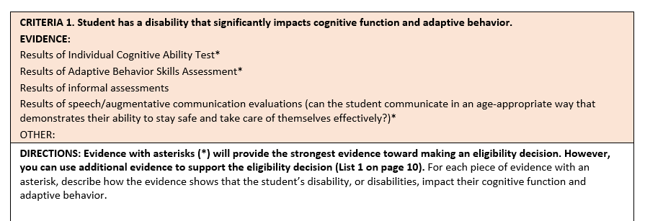
NEW OPTIONAL DOCUMENTATION OF EVIDENCE FORM
The criteria is given along with possible evidence to evaluate whether or not a student is eligible to meet the criteria.
This section is where teachers can cite specific page numbers, section of reports, and data that addresses the criteria. They can attach the page(s) from the IEP and evidence they use.

Slide 22
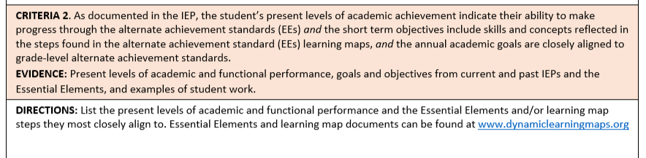
CRITERIA 2
This section is where teachers can list or attach the page in the IEP that has the academic and functional performance descriptions and the EEs they will be addressing throughout the year. Again, teachers can attach pages from the IEP directly to this form.
Notes:
Actual attachment of IEP pages – NOT "See IEP"
Acquiring skills; especially academic skills
Look at functional skills in how they affect the student's ability to learn academic concepts; especially abstract academic concepts and their ability to generalize.

Slide 23
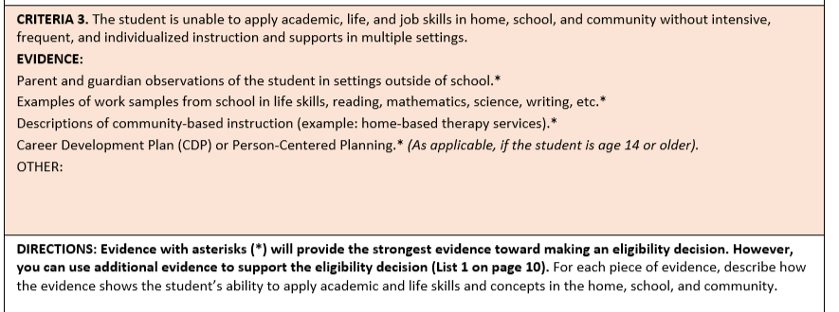
CRITERIA 3
This section is where teachers can cite and reference data, page numbers of reports, quotes from reports, etc. that align to criteria 3.
Notes:
Application of skills

Slide 24
CRITERIA 1

Slide 25
CRITERIA 1: STUDENT HAS A SIGNIFICANT COGNITIVE DISABILITY
Student has a disability, or disabilities, that significantly impacts cognitive function and adaptive behavior.
In other words….
The student has a disability or multiple disabilities that prevents them from participating in a meaningful way in the standard academic classes and coursework
the student’s disability (or disabilities) causes dependence on others for many, and sometimes all, daily living needs, and the student is expected to require extensive ongoing support in adulthood.
Notes:
The first criteria: Student has a disability, or disabilities, that significantly impacts cognitive function and adaptive behavior. This means that the student may have one or more disabilities that prevents them from participating in standard academic classes and course work. That a student is deaf or hard-of-hearing, blind or visually impaired, has limited or no use of their arms, legs, hands, or has poor motor skills, are not considered disabilities that should be used in evaluating whether or not a student would meet this criteria. The disability, or diabilities, that should be considered here include those that affect their cognitive fuctioning and adaptive behavior.
A note on communication: A student may lack adequate communication abilities for a variety of reasons. Because it may be difficult to understand what a student is trying to communicate, it may cause an error in finding a student eligible for the alternate assessment. Without the ability to express their needs, wants, and what they know, it is impossible to know what they understand. While communication ability is not part of the criteria for alternate assessment, it is important that all students have access to an effective communication system they will use. While lack of a communication system may make the eligibility decision difficult, the absence of a communication system alone is not reason enough to find a student eligible for the alternate assessment.
Adaptive behavior means that the student’s cognitive disability or disabilities affects every aspect of the student’s life and will likely require the student to rely on others for many, and in some cases, all of their daily living needs. The disabilities that the student has are not expected to resolve at some point but will likely require supports well into adulthood.

Slide 26
WHAT IS COGNITIVE ABILITY?
WHAT IT IS: How the brain functions/processes events and surroundings and interacts with others and their environment
WHAT IT IS NOT: Not physical challenges such as: feeding tubes, wheelchair use, visual or hearing impairments, ability (or inability) to use their body independently, medical challenges such as seizures, degenerative diseases
The role communication plays in determining cognitive ability:
Students who cannot, won't, or don't have a robust communication method do not automatically qualify for the alternate assessment.
Example: eye gaze; limited use of their body
Consider the student's interactions with their surroundings and others, not just communication ability

Slide 27
STUDENT EXAMPLE - Zack
4th grade
specialized ASD classroom within a small setting in a public elementary school
enjoys school and has good attendance but is frequently tardy.
IEP addresses needs in the following areas: reading, writing, math, social/emotional needs, communication (SLP) and OT.
significantly below grade levels in all areas.
has an FBA to address his behaviors; he has made excellent progress within this setting.
Recently began using a low-tech communication book and iPad for communication; this has decreased negative behaviors.
receives ABA therapy, HBTS, and PASS services in the home weekly.
participates in multiple groups at the Autism Project to learn socially acceptable behaviors.
always has adult assistance in his environment outside of school.
has great difficulty when leaving a preferred task to transition to a non-preferred task. These instances increase negative behaviors.
Enjoys doing tasks within the classroom and he enjoys positive reinforcement.
Take 10 minutes and read Zack’s IEP and evidence.

Slide 28
GUIDED ACTIVITY
Work with a partner to evaluate the evidence in the sample IEP to write a narrative for criteria 1 and make a decision on if the student meets or doesn't meet this criteria.

Slide 29
CRITERIA 2

Slide 30
CRITERIA 2: INSTRUCTION AND LEARNING GOALS
As documented in the IEP, the student’s present levels of academic achievement indicate their ability to make progress through the alternate achievement standards (EEs) and the short term objectives include skills and concepts reflected in the steps found in the alternate achievement standard (EEs) learning maps, and the annual academic goals are closely aligned to grade-level alternate achievement standards.
In other words…
the student has access to the Common Core State Standards and the Next Generation Science Standards.
the student is working on learning standards that have been substantially modified due to the severity of the disability (e.g., the Essential Elements that are part of the Dynamic Learning Maps alternate assessments).
Life and job skills which are appropriate and challenging for this student are also included.
Notes:
As documented in the IEP, the student’s present levels of academic achievement indicate their ability to make progress through the alternate achievement standards (EEs) and the short term objectives include skills and concepts reflected in the steps found in the alternate achievement standard (EEs) learning maps, and the annual academic goals are closely aligned to grade-level alternate achievement standards.

Slide 31
WHAT ARE FUNCTIONAL SKILLS?
Definition of functional skills: Skills that allow the student to take care of themselves physically, mentally, and emotionally, including interpersonal skills. Functional academic skills are skills used in everyday life (ex. Reading signs, instructions, emergency numbers, etc. and knowing the contexts in which to utilize them.)
Evaluating functional skills:
Holistic skill set, not looking for a discreet/checklist set of skills.​
Does not include any physical disabilities/limitations the student may have.​
Examples of possible evidence:
Independent Living Questionnaire
Student Summary Sheet
Observations of parents/caretakers/teachers
Notes:
Discussion, then review examples from the sample IEP, then show blank forms.

Slide 32
WHAT ARE THE ESSENTIAL ELEMENTS?
Essential Elements
Your role:
Know where to find EEs online.
Be able to analyze the present levels of performance and the connection to the EEs.
Be comfortable enough to ask questions of the teacher.

Slide 33
GUIDED ACTIVITY
Work with a partner to evaluate the evidence in the sample IEP to write a narrative for criteria 2 and make a decision on if the student meets or doesn't meet this criteria.

Slide 34
CRITERIA 3

Slide 35
Criteria 3: Applying Skills in Multiple Settings
The student is unable to apply academic, life, and job skills in the home, school, and community without intensive, frequent, and individualized instruction and supports in multiple settings.
In other words…
What the student needs in order to learn is extensive, repeated, and individualized instruction from teachers and other.
The types of materials needed in order for the student to learn are significantly customized for that specific student.
How the student demonstrates what they know and can do requires substantially different materials and supports, including those supports that help a student communicate.
Notes:
Criteria 3: The student is unable to apply academic, life, and job skills in the home, school, and community without intensive, frequent, and individualized instruction and supports in multiple settings.
This criteria references the level of difficulty a student may have learning and may be, more than the other criteria, the hallmark of students who benefit from taking the alternate assessment. While every student, regardless their disability status, may be challenged when learning particular content or skill, a student eligible for the alternate assessment may need a level of very intense, repetitive instruction over the course of many weeks, months, or, in some cases, years, before they achieve mastery.
What this means is that students who are eligible for the alternate assessment typically have a lot of trouble generalizing skills and knowledge from setting-to-setting and from one circumstance to another. In evaluating evidence for this criteria, Teams should consider the types of skills and knowledge that the student is have difficulty transferring from one setting to another. Teams should look for many skills, both academic skills and life skills, that the student needs consistent, intensive reminding, repeating, and reteaching in order to learn and to maintain.
Students who are eligible for the alternate assessment also require extensive modifications to classroom materials. Typical materials may not be able to isolate specific skills or content that the student is working on. The alteration of materials for a student being considered for the alternate assessment is vastly different from their typical peers. Tools that are modified to mitigate the effects of a student’s physical or sensory disability do not fall into this category even though materials often take these challenges into account.

Slide 36
Guided Activity
Work with a partner to evaluate the evidence in the sample IEP to write a narrative for criteria 3 and make a decision on if the student meets or doesn't meet this criteria.
Read for 5-10 minutes, discuss with your partner which evidence supports criteria 3 and whether or not the student meets the criteria, then we will share out as a group. After discussion, complete criteria 3 of the Eligibility Criteria Sheet; include specific examples of how the student does or does not meet the criteria.
Handouts:
Eligibility Criteria Sheet
Sample IEP: read the present levels of performance, Student Summary Sheet, parent questionnaire
Notes:
Talk about their responsibility as LEA representatives in being able to see that the EEs and present levels of performance align. If they don't align, then they need to ask the teacher why he/she selected the EEs.

Slide 37
The Decision
Based on your evaluation of the evidence and what you wrote in the Criteria Eligibility sheet, does the student qualify for the alternate assessment?
Notes:
Ask if they have questions, if anyone has any doubts, and if they have a decision in mind.

Slide 38
The Importance of Appropriate Evidence
It is important to have multiple sources of evidence in order to make the most appropriate decision for a student for two reasons:
It prevents decision-making that relies on only one type or source of information.
It provides a more complete picture of how the student is learning and interacting in several different settings and under different circumstances.
The following slides outlines the types of evidence and information most helpful for making these decisions as well as that information and data that is not, under any circumstances, to be used to make an eligibility decision.

Slide 39
DO NOT use factors or data in this list to make an eligibility decision
Disability category
Poor attendance or extended absences, for any reason.
Poor performance on the general education academic assessments.
English Language Learner (EL) status.
Impact of the student’s test scores on the accountability score of the school and/or LEA.
Location of special education services in more restrictive settings
Amount of time receiving special education services
Variety of services received
Behavior issues, including test anxiety
Administrator decision
Notes:
By following this process and using the evidence form, then these factors never come into the conversation – they aren't needed.

Slide 40
Warning Signs
Indications that a student does not meet the criteria OR you need to take another look at their eligibility.

Slide 41
When to reconsider eligibility for the alternate assessment
You need to revisit the student’s eligibility status if you find the following:
The student received a score on a general education state assessment.
Their primary disability category is a learning disability, speech/language, blindness/visual impairment, or other health impairment
The reason provided as to why the student qualified is that:
“they are in a life skills class” or
“they are in the self-contained class” or
“they are in the alternate assessment class” or
anything having to do with “behaviors” as the primary issue.
They take a content-area class in a general education setting with their typical peers without significant supports and modifications.
They are slightly below, or even at, grade level in one content area.
The student never took the alternate assessment and then, in middle or high school, they do.

Slide 42
OVERVIEW OF IEP TEAM ASSURANCES FORM

Slide 43
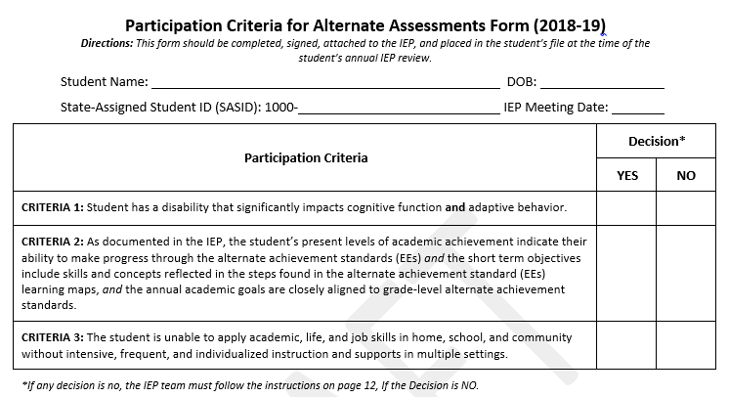
PARTICIPATION CRITERIA FOR ALTERNATE ASSESSMENTS FORM (2018-19)
Notes:
This is a simpler form and does not include a place to list specific evidence. The Documentation Form is where IEP Teams can list the evidence they use and align that evidence to the specific criteria.

Slide 44
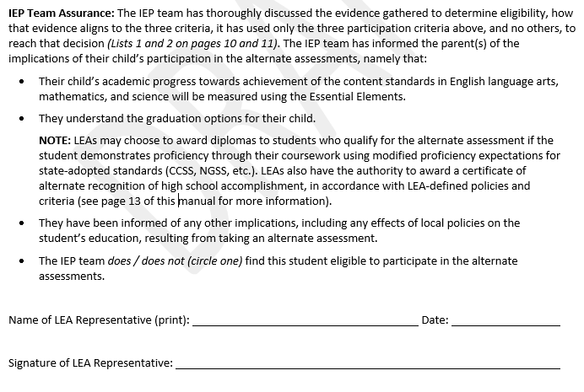
IEP TEAM ASSURANCES (2018-19)
Notes:
When explaining to parents about graduation options: explain the differences in graduation requirements such whether or not the student will get a diploma when they graduate, if there are specific requirements such as an exit portfolio or other presentation or credit/course requirements that students would have meet and how those requirements will be modified for their needs.

Slide 45
Questions for Special Education Directors
Materials to support training of IEP Team members (including parents):
What would you add/remove to train teachers or other IEP Team members?
What other information would you add/remove from the presentation to reflect your district or school?
What additional materials would be helpful to you?
Is any of the information confusing? If so, what sections?
District Support Options: Given that we cannot intensively support all districts and IEP Teams, how can we best support you as special education directors to train IEP Teams and review eligibility decisions?
Notes:
We need to build capacity and understanding as a state around eligibility determinations.

