Slide 1

Preparing Students for College and Careers
Spring 2018 High School Assessments
PSAT 10 and SAT School Day
Advanced Placement
Dual and Concurrent Enrollment
October 17, 2018

Slide 2

Today’s Agenda
2018 PSAT 10 and SAT School Day Assessments:
Technical detail on participation and results
Advanced Placement and Dual and Concurrent Enrollment: Overview on increases in participation
Other College and Career Access Opportunities
Preview timeline of upcoming assessment and accountability releases

Slide 3
Increasing Access to Opportunity
For the third consecutive year, Rhode Island experienced year-over-year growth in participation in advanced, college-level coursework.
Participation increased across the board for Advanced Placement, dual and concurrent enrollment, and the PSAT and SAT assessments

Slide 4
High School Assessments
SAT School Day and PSAT 10
Technical Detail on 2018
Participation and Results

Slide 5
PSAT/SAT Transition: Removing Barriers to College Access for all Students
2015-16
District-provided PSAT and SAT
2016-17
State-provided PSAT and SAT
Included as part of state assessment program
Family or district-funded
State-funded PSAT for 10th grade and SAT for 11th grade students
Increased access for low-income RI students
Limited access to students
Access to all RI students including students with disabilities, low income, English learner, and home-schooled students
RI established achievement levels to meet federal reporting requirements
Expanded supports and accommodations
No changes to College Board accommodations or other testing policies
Student participation increased
Student participation increased over 2016-17 school year
2017-18
No changes to College Board accommodations or other policies

Slide 6

More Students Than Ever Taking the PSAT and SAT
Percentages indicate participation growth between 2016-2017 and 2017-2018 school years
+25.9%
+26.2%
+17.4%
+17.2%

Slide 7
More Students Meeting the
College and Career Readiness Benchmark
Percentages indicate performance growth between 2016-2017 and 2017-2018 school years
+22.4%
+17.6%
+5.3%
+3.0%

Slide 8
PSAT and SAT use the same scale but have different benchmarks for determining College and Career Readiness
If a student scores 480:
SAT: Partially Meeting Expectations
PSAT10: Meeting Expectations

Slide 9
Achieving a mathematics scale score at or above 480 on the PSAT10 is considered on track to be college and career ready
PSAT10 Grade 10 Mathematics Achievement Level Descriptors
On Track to be College and Career Ready
Achievement Level 4: Exceeding Expectations | Achievement Level 3: Meeting Expectations | Achievement Level 2: Partially Meeting Expectations | Achievement Level 1: Not Meeting Expectations
Score Range: 600-760 | Score Range: 480-590 | Score Range: 390-470 | Score Range: 160-380
The student has exceeded the achievement level and demonstrates a thorough understanding of, and ability to apply the mathematics knowledge and skills needed to be on track for college and career readiness and achievement relative to the Common Core Mathematics Content Standards. | The student has met the achievement level and demonstrates an adequate understanding of, and ability to apply the mathematics knowledge and skills needed to be on track for college and career readiness and achievement relative to the Common Core Mathematics Content Standards. | The student has partially met the achievement level and demonstrates an incomplete understanding of, and ability to apply the mathematics knowledge and skills needed to be on track for college and career readiness and achievement relative to the Common Core Mathematics Content Standards. | The student has not met the achievement level and demonstrates a minimal understanding of, and ability to apply the mathematics knowledge and skills needed to be on track for college and career readiness and achievement relative to the Common Core Mathematics Content Standards.
State Average Scale Score is 443

Slide 10
Achieving an English Language Arts scale score at or above 430 on the PSAT10 is considered on track to be college and career ready
PSAT10 Grade 10 English Language Arts Achievement Level Descriptors
On Track to be College and Career Ready
Achievement Level 4: Exceeding Expectations | Achievement Level 3: Meeting Expectations | Achievement Level 2: Partially Meeting Expectations | Achievement Level 1: Not Meeting Expectations
Score Range: 590-760 | Score Range: 430-580 | Score Range: 370-420 | Score Range160-360
The student exceeded grade level expectations and demonstrates a thorough understanding of the knowledge and skills needed to be on track for college and career readiness and achievement relative to the Common Core ELA/Literacy Content Standards | The student has met the grade level expectations and demonstrates adequate understanding of the knowledge and skills needed to be on track for college and career readiness and achievement relative to the Common Core ELA/Literacy Content Standards. | The student partially meets the grade level expectations and demonstrates an incomplete understanding of the knowledge and skills needed to be on track for college and career readiness and achievement relative to the Common Core ELA/Literacy Content Standards. | The student has not met the grade level expectations and demonstrates a minimal understanding of the knowledge and skills needed to be on track for college and career readiness and achievement relative to the Common Core ELA/Literacy Content Standards.
State Average Scale Score is 457

Slide 11
Achieving a mathematics scale score at or above 530 on the SAT is considered college and career ready
SAT Grade 11 Mathematics Achievement Level Descriptors
College and Career Ready
Achievement Level 4: Exceeding Expectations | Achievement Level 3: Meeting Expectations | Achievement Level 2: Partially Meeting Expectations | Achievement Level 1: Not Meeting Expectations
Score Range: 650-800 | Score Range: 530-640 | Score Range: 420-520 | Score Range: 200-410
The student has exceeded the achievement level and demonstrates a thorough understanding of, and ability to apply the mathematics knowledge and skills needed for college and career readiness and achievement relative to the Common Core Mathematics Content Standards. | The student has met the achievement level and demonstrates an adequate understanding of, and ability to apply the mathematics knowledge and skills needed for college and career readiness and achievement relative to the Common Core Mathematics Content Standards. | The student has partially met the achievement level and demonstrates an incomplete understanding of, and ability to apply the mathematics knowledge and skills needed for college and career readiness and achievement relative to the Common Core Mathematics Content Standards. | The student has not met the achievement level and demonstrates a minimal understanding of, and ability to apply the mathematics knowledge and skills needed for college and career readiness and achievement relative to the Common Core Mathematics Content Standards.
State Average Scale Score is 475

Slide 12
Achieving an English Language Arts scale score at or above 480 on the SAT is considered college and career ready
SAT Grade 11 English Language Arts Achievement Level Descriptors
College and Career Ready
Achievement Level 4: Exceeding Expectations | Achievement Level 3: Meeting Expectations | Achievement Level 2: Partially Meeting Expectations | Achievement Level 1: Not Meeting Expectations
Score Range: 630-800 | Score Range: 480-620 | Score Range: 420-470 | Score Range: 200-410
The student has exceeded grade level expectations and demonstrates a thorough understanding of the knowledge and skills needed for college and career readiness and achievement relative to the Common Core ELA/Literacy Content Standards.. | The student has met the grade level expectations and demonstrates adequate understanding of the knowledge and skills needed for college and career readiness and achievement relative to the Common Core ELA/Literacy Content Standards. | The student partially meets the grade level expectations and demonstrates an incomplete understanding of the knowledge and skills needed for college and career readiness and achievement relative to the Common Core ELA/Literacy Content Standards.. | The student has not met the grade level expectations and demonstrates a minimal understanding of the knowledge and skills needed for college and career readiness and achievement relative to the Common Core ELA/Literacy Content Standards.
State Average Scale Score is 487

Slide 13

Summary of Student Performance on PSAT10 and SAT (2018)
English Language Arts
 |  | Percent of Students at Each Achievement Level
 | Number of Students Tested | Not Meeting Expectations | Partially Meeting Expectations | Meeting Expectations | Exceeding Expectations | Percent Achieving College Career Ready Benchmark | Average Scale Score
SAT | 9,718 | 27.6 | 22.5 | 39.3 | 10.6 | 49.9 | 487
PSAT 10 | 10,317 | 19.2 | 23.5 | 46.2 | 11.1 | 57.3 | 457
Mathematics
 |  | Percent of Students at Each Achievement Level
 | Number of Students Tested | Not Meeting Expectations | Partially Meeting Expectations | Meeting Expectations | Exceeding Expectations | Percent Achieving College and Career Ready Benchmark | Average Scale Score
SAT | 9,706 | 33.2 | 36.5 | 23.3 | 7.0 | 30.3 | 475
PSAT 10 | 10,339 | 28.2 | 38.0 | 27.6 | 6.3 | 33.8 | 443

Slide 16
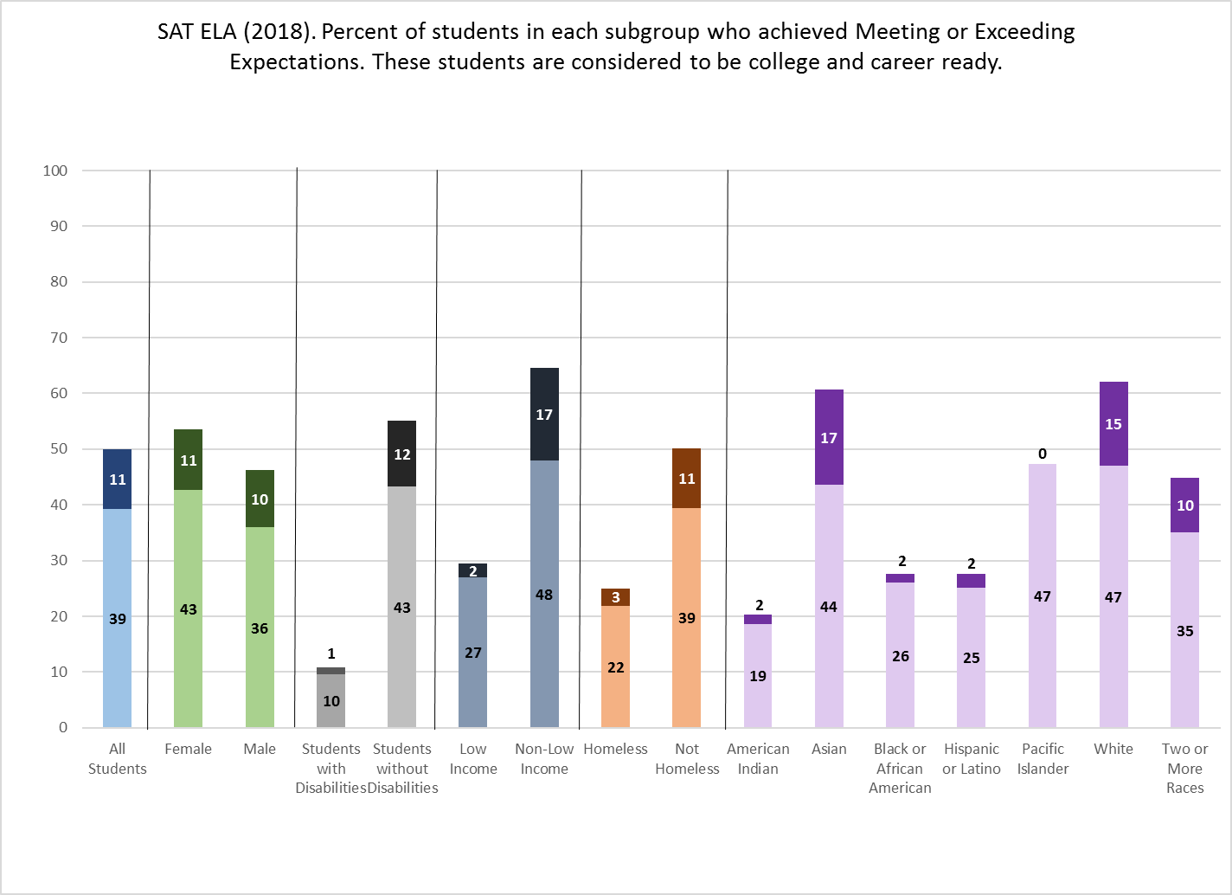

Slide 17
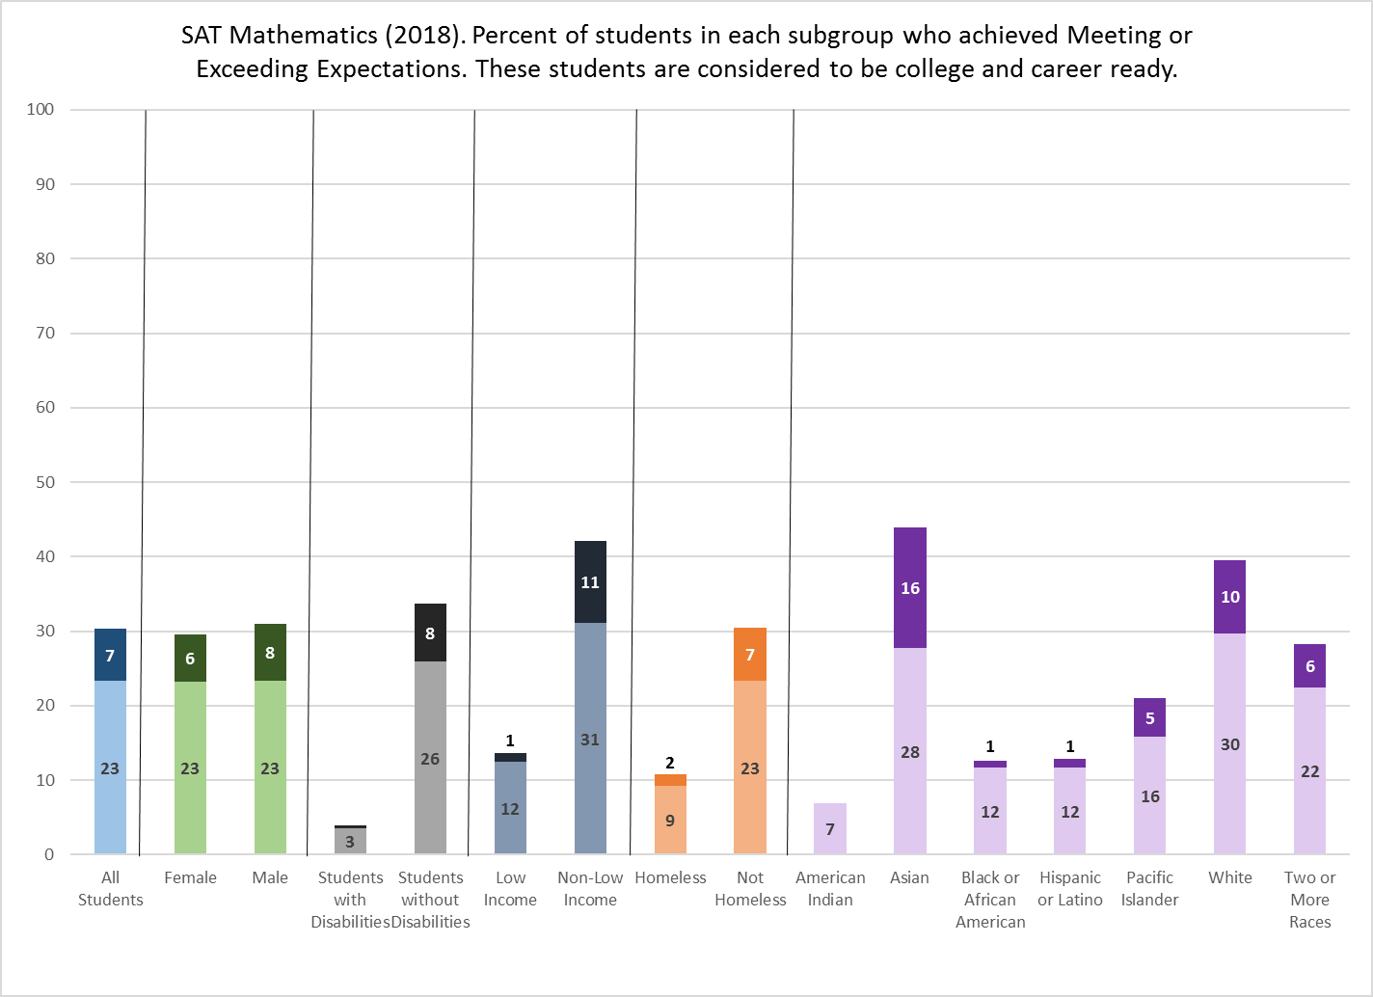

Slide 18
State Assessment
Reporting Requirements
Individual Student Reports
  Students receive a student report directly from the College Board used for college and university applications for admission.
  Students will receive a state assessment report that includes the student’s achievement level, which is not on the College Board report.
    The PSAT 10 and SAT RIDE reports are available in the ISS for download. LEAs may distribute via hard copy or electronically.
Public Reporting
  Data will be publicly reported at the state, district, and school level to allow students, families, and communities to examine and compare performance, including by student sub-group. Results can be accessed on the RIDE website.

Slide 19
Advanced Placement
& Dual and Concurrent Enrollment

Slide 20
Dual Enrollment: Earning College Credits at No Cost to Families
In 2015, Rhode Island made unprecedented investments in the dual enrollment through the creation of the PrepareRI Dual Enrollment Fund. These investments are working and are preparing our children for postsecondary success.
In the 2017-18 school year:
4,472 students participated in dual and concurrent enrollment
More than 7,500 courses completed, earning 26,000 college credits from URI, RIC, and CCRI
Since 2015:
There has been 162% growth in the number of students participating in dual and concurrent enrollment.

Slide 22
Advanced Placement:
Rigorous coursework to prepare for postsecondary education
In the 2017-18 school year:
6,324 public high school students took Advanced Placement exams
1,700 more AP exams were administered compared to the previous year
Rhode Island experienced a 15% year-over-year increase in the number of students receiving a qualifying score of 3 or higher on an AP exam.
Since 2015:
Rhode Island has had a 38% increase in the number of students taking an Advanced Placement exams.
The number of students earning a qualifying score on AP exams has increased by 30%.

Slide 23
2018 AP Participation by Race/Ethnicity -
Students Taking One or More Exam

Slide 25
Reporting Additional
High School Results
Individual Student Reports
  For Advanced Placement, students receive a score report in July, directly from the College Board, used for college and university applications for admission.
  For Dual and Concurrent Enrollment, grades are transmitted directly from the college or university in which the student is enrolled.
Public Reporting
  Data will be publicly reported through Tableau visualization and can be accessed on the RIDE website.

Slide 26
PrepareRI and Other College and Career Access Initiatives

Slide 27
Record Access to Opportunity
Since 2015, Rhode Island has seen:
55% increase in SAT participation
162% growth in dual and concurrent enrollment
38% increase in participation in Advanced Placement
The number of AP computer science exams with qualifying scores has increased from 26 to 235 in just three years
These programs all fall under the umbrella of Prepare Rhode Island (PrepareRI), a statewide initiative, aligned to industry, to prepare all Rhode Island youth with the skills they need to be successful in college and careers.
www.Prepare-RI.org
Beginning in 2022, our system of school accountability will include “Diploma Plus,” which will measure the percent of students who have one or more credential or college credit, including AP, dual and concurrent enrollment, Seal of Biliteracy, and Pathway Endorsements.

Slide 28
Stay Tuned
This is the first of three releases on student and school performance planned for the fall.
The 2017-2018 school year was the first year for administration of the Rhode Island Comprehensive Assessment System (RICAS), the test for students in grades 3 through 8, which is modeled on the MCAS assessment in Massachusetts.
Rhode Island decided to maintain the same academic standards, but transition to a new assessment, in order to forge a stronger partnership with Massachusetts and align our assessment to the high standards of the nation’s leading state for education.
RICAS results will be publicly released later this year.
The RICAS release will be followed by the release of our updated School and District Report Cards under the Every Student Succeeds Act (ESSA), the federal education law, by the end of the calendar year.

Slide 29
APPENDIX

Slide 31
The majority of Rhode Island High Schools’ average scale scores are either in the Meeting Expectations or Partially Meeting Expectations achievement levels
 |  |  | College and Career Ready |  | Not College and Career Ready
 | Total Schools |  | Exceeding Expectations | Meeting Expectations | Partially Meeting Expectations | Not Meeting Expectations
PSAT10 | 63 | ELA | 0 | 39 | 20 | 4
 |  | Mathematics | 0 | 13 | 38 | 12
SAT | 62 | ELA | 0 | 30 | 21 | 11
 |  | Mathematics | 0 | 11 | 34 | 17

