Slide 1
Test Information Distribution Engine (TIDE) and Rosters
Training Module
2021–2022
Copyright © 2021 Cambium Assessment, Inc. All rights reserved.
Notes:
Welcome to the online training module for the Test Information Distribution Engine, also known as TIDE. This training module includes many examples of TIDE’s features. The TIDE User Guide on your state’s portal has additional information about features in your state's version of TIDE.
Please note that your state’s version of TIDE may differ from the images shown in this presentation.

Slide 2
Objectives
Creating Rosters
Notes:
This presentation will
At its core, TIDE is a registration system for users who will access CAI systems and students who will take CAI tests. Users of all CAI systems must be added to TIDE before they can access any CAI system. Students must be added to TIDE before they can test in TDS. Classes must be added in TIDE so Reporting can display scores at the classroom, school, district, and state level. During testing, TIDE users can print test tickets, manage invalidation requests, and monitor test progress. After testing, TIDE users can clean up data and track return shipments of paper testing materials.

Slide 3
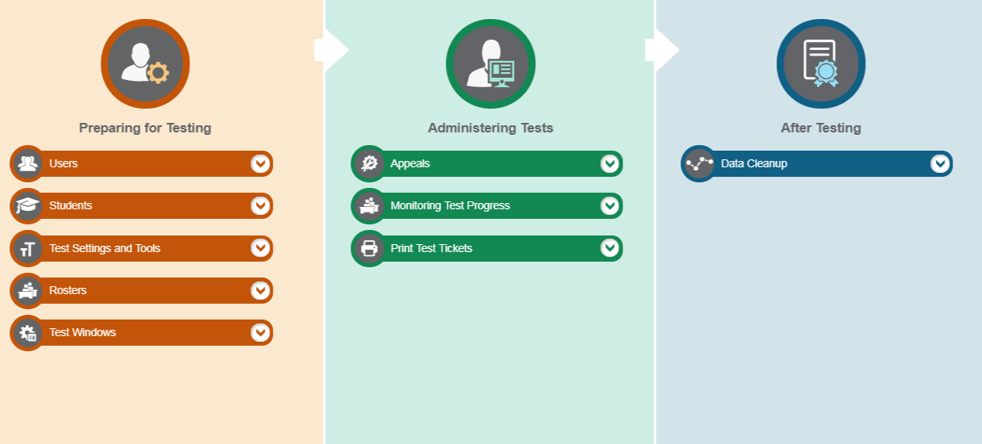
TIDE Home Page
Notes:
The TIDE home page appears after you log in. The home page is designed to reflect the stages of the testing process as directly and simply as possible. Each of TIDE’s three sections lists menus for the tasks available in that section. Tasks associated with Rosters are in the Preparing for Testing section.

Slide 4
TIDE Home Page
Notes:
TIDE can group students into rosters. A roster is a collection of students sharing a similar characteristic who are assigned to a specific teacher. Rosters typically represent classrooms, but they can also be used to group students with special needs or students participating in particular activities or programs. Once scores are calculated, users can visualize how a roster of students performed as a group.

Slide 5
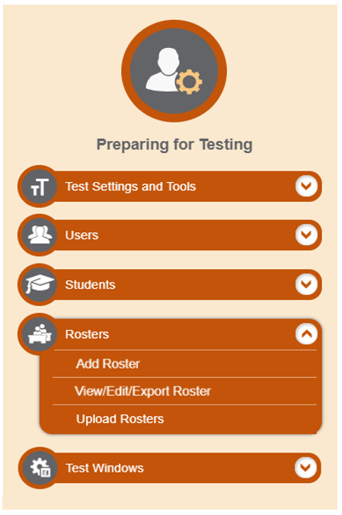
Add Records One at a Time
Notes:
To add rosters one at a time, start on the TIDE home page. In the Preparing for Testing section, choose rosters, then click add.
On the following page, fill out the information, verify its accuracy, and select Save.

Slide 6
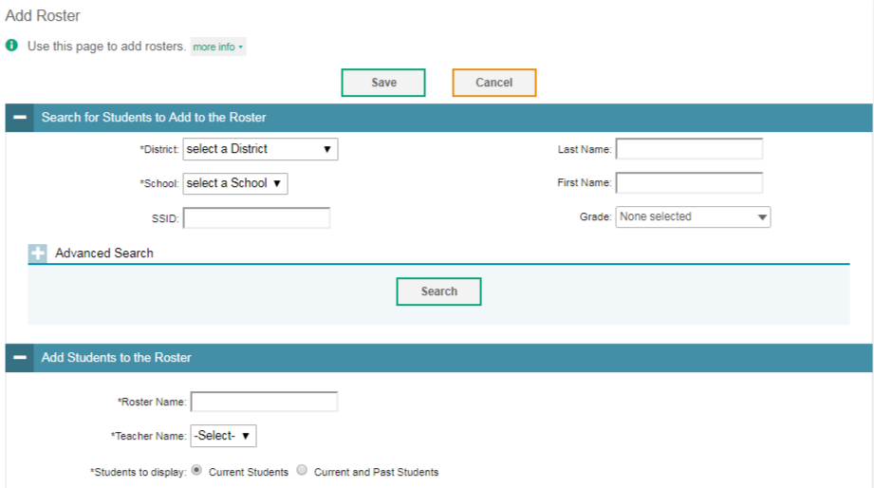
Add Rosters One at a Time
Notes:
The Add Roster page contains two panels, a Search for Students to Add to the Roster panel and an Add Students to the Roster panel.
To search for students, complete the fields under the Search for Students to Add to the Roster panel. The fields marked with an asterisk are mandatory. You can further refine your search by selecting criteria under the Advanced Search section.
Refine the list of available students by completing the fields in the Add Students to the Roster panel. To display current students only, click the Current Students radio button. To display current and past students, click the Current and Past Students radio button. Then click Search.

Slide 7
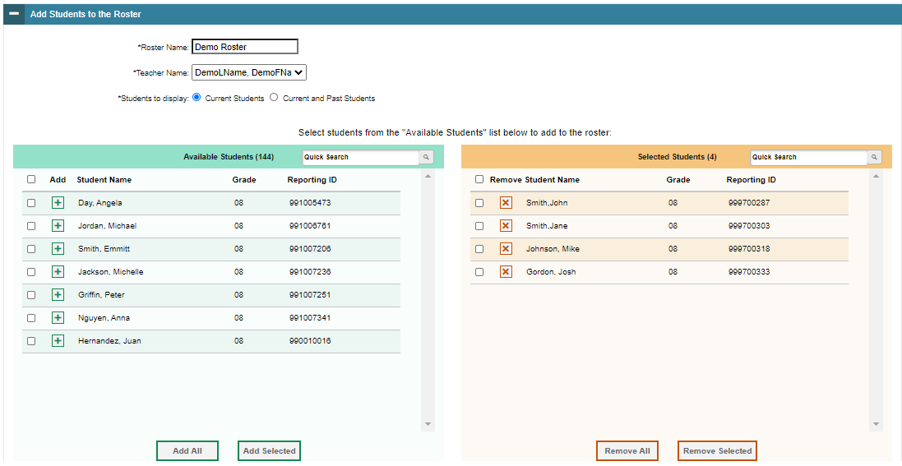
Add Rosters One at a Time, continued
Notes:
In the Add Students to the Roster panel, the students in the left column are available to be added to the roster, and students in the right column are currently in the roster.
First, enter a name for the roster and select the teacher who should be associated with the roster. Select if you want to display Current Students or Current and Past Students.
Next, add students to the new roster. To add a single student to the roster, click the green plus sign next to a student in the left column. You can add multiple students to the roster by marking checkboxes next to the students you want to add and then clicking Add Selected. Add all available students to the roster by clicking Add All.
To remove a single student from the roster, click the orange X next to a student in the right column. You can remove multiple students from the roster by marking checkboxes next to the students you want to remove and then clicking Remove Selected. Remove all students from the roster by clicking Remove All.

Slide 8
Modify Rosters
Notes:
If a roster’s information changes after you’ve added the roster to TIDE, you must edit the roster to match the most up to date information. You can do this by modifying existing rosters one at a time.
Begin on the TIDE homepage. In the Preparing for Testing section, choose the Rosters task, then click View/Edit/Export.

Slide 9
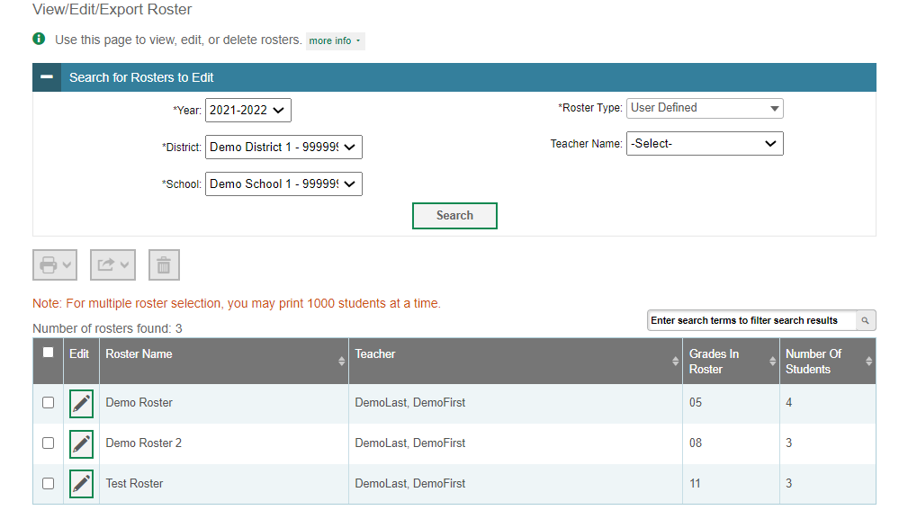
Modify Rosters One at a Time
Notes:
The View/Edit/Export Roster page includes a form for setting selection criteria to retrieve rosters. In this example, the district, school, and roster type criteria are required. Click Search to display a list of rosters matching your criteria.
Print, export, or delete rosters from TIDE by selecting the desired rosters and clicking the Print, Export, or Delete buttons above the search results.
Click the pencil icon next to a roster to view or edit its details. The Edit Roster form will appear. This form is similar to the form used to add rosters, and you may edit the roster name, teacher name, and students to display in the roster in the same way that you would for a new roster.

Slide 10
Upload Rosters
Notes:
You also have the option to add and modify multiple records at once. To upload records, you must be familiar with spreadsheet applications or comma-separated value files. When you upload files to TIDE, records not previously set up will be added and records already set up in TIDE will be modified with the updated content from the upload.
Begin on the TIDE homepage. In the Preparing for Testing section, choose the task for which you want to add or modify records: users, students, or rosters. To explain the four-step upload process, we will use the Upload User function. The steps apply in the same way to Upload Students and Upload Rosters tasks.

Slide 11
Upload Rosters, continued
Notes:
An upload screen will appear where you can download a template file. Once you have downloaded and filled out the template file, return to the upload screen, select Browse, and upload your file to TIDE. Then select Next.

Slide 12
Upload Rosters, continued
Notes:
When you select Next, the upload preview screen will appear. Verify that the information is correct, then select Next.

Slide 13
Upload Rosters, continued
Notes:
TIDE will validate the file and display any errors or warnings according to the legend on the page. Click the orange error icons and blue warning icons in the validation results to view the reason that a field is invalid. If a record contains an error, that record will not be included in the upload. If a record contains a warning, that record will be uploaded, but the field with the warning will be invalid.
To complete the upload, click Continue with Upload.
To upload a different file, click Upload Revised File.
To cancel the upload, click Cancel.
If your file contains a large number of records, TIDE will process it offline and send you a confirmation email when complete. While TIDE is validating the file, do not click Cancel, as TIDE may have already started processing some of the records.
To view a PDF file listing the validation results for the upload file, click Download Validation Report in the upper-right corner.
When the upload is complete, a confirmation page will appear with a message that summarizes how many records were uploaded and how many were excluded.

Slide 14
Upload Rosters, continued
4
Notes:
When the upload is complete, a Confirmation page will appear with a message that summarizes how many records were uploaded and how many were excluded. Click Upload New Files to upload additional files.
You may use the upload records process with other tasks too such as uploading interim grades . Your test menu options vary by state.

Slide 15
Contact Your Help Desk
You can contact the Help Desk for assistance with any technical issues you encounter.
When contacting the Help Desk, please be ready to provide the following information:
Any error messages that are appearing (including codes)
Your operating system and browser information
Your network configuration information
Your contact information for follow-up by telephone or email
Any other relevant information, such as test names or content areas, student IDs, session IDs, and search criteria
For test administration or policy issues, please contact your District Test Coordinator.
Notes:
You can find the TIDE User Guide and other helpful resources on your state assessment portal. However, if you still require assistance with troubleshooting a technical issue, you may also contact your Help Desk. When contacting your Help Desk, please be ready to provide the following information:
Any error messages that are appearing (including codes)
Your operating system and browser information
Your network configuration information
Your contact information for follow-up by telephone or email
Any other relevant information, such as test names or content areas, student IDs, session IDs, and search criteria
For questions about test administration or policy issues, please contact your District Test Coordinator.

Slide 16
Thank You!
Further Information
[State-specific portal URL]
[State-specific help desk]
[State-specific chat info]
Notes:
Thank you for taking the time to view this training module. For additional information, refer to your TIDE User Guide located on your portal or contact the Help Desk.

