Slide 1
Using the NECAP Analysis and Reporting System
February 2013

Slide 2
State Contact Information
State | Name | Phone | E-mail
Maine | Susan Fossett | 207-624-6775 | Susan.Fossett@maine.gov
New Hampshire | Keith Burke | 603-271-3846 | Keith.Burke@doe.nh.gov
Rhode Island | Dr. Kevon Tucker-Seeley | 401-222-8494 | Kevon.Tucker-Seeley@ride.ri.gov
Vermont | Michael Hock | 802-828-3115 | Michael.Hock@state.vt.us

Slide 3
NECAP Service Center 1-877-632-7774 Monday-Friday 8:00 am to 4:00 pm
For assistance, please contact:

Slide 4
FERPA Guidelines
The Family Educational Rights and Privacy Act (FERPA)
Access to individual student results is restricted to:
the student
the student’s parents/guardians
authorized school personnel
Superintendents and principals are responsible for maintaining the privacy and security of all student records.
Authorized school personnel shall have access to the records of students to whom they are providing services when such access is required in the performance of their official duties.
FERPA website: http://www.ed.gov/policy/gen/guid/fpco/ferpa/index.html

Slide 5
Presentation Goals
Present overview of the NECAP Analysis and Reporting System
Review types of reports accessible within the system
Demonstrate the Interactive functionality available in the system to customize reports
Review Supporting Documents
Introduce Account Management

Slide 6
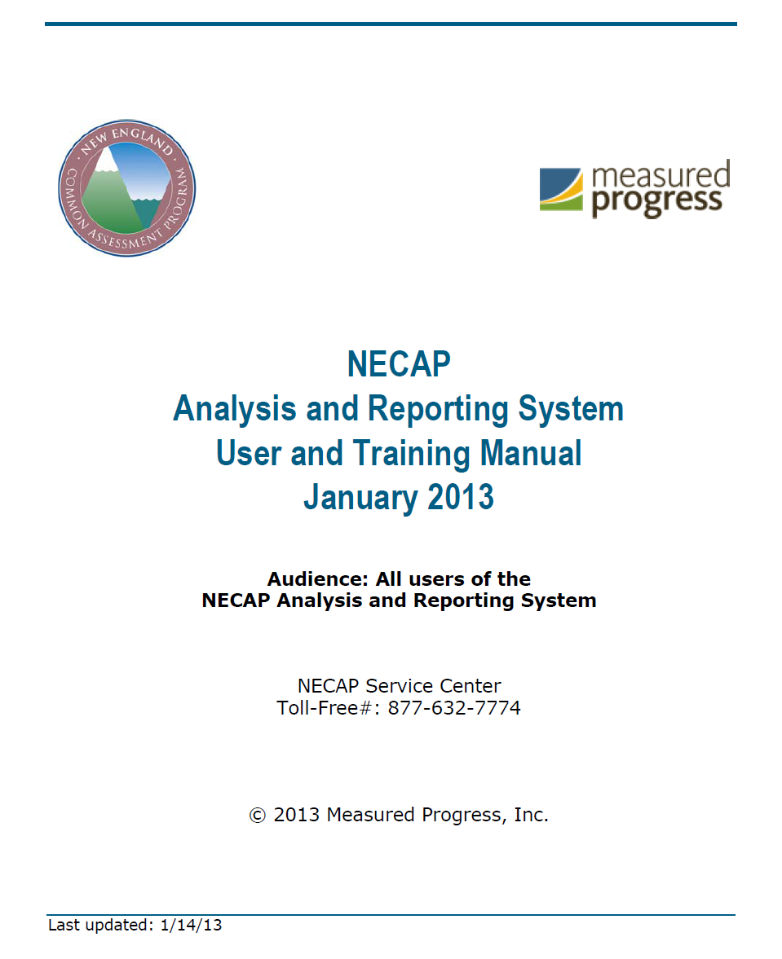
For more information, download:

Slide 7
NECAP Reports available in the system
Reports Tab
Grade Level Results Report (Teaching and Testing Year) School and District level
Student Level Data Files (Teaching and Testing Year) School and District level
Summary Report (Testing Year only) School/District/State level

Slide 8
Accessing Reports

Slide 9
Accessing Reports

Slide 10
NECAP Reports available in the system
Interactive Tab
Item Analysis Report School and District level
Achievement Level Summary School and District level
Released Items Summary Data School and District level
Longitudinal Data Student level

Slide 11
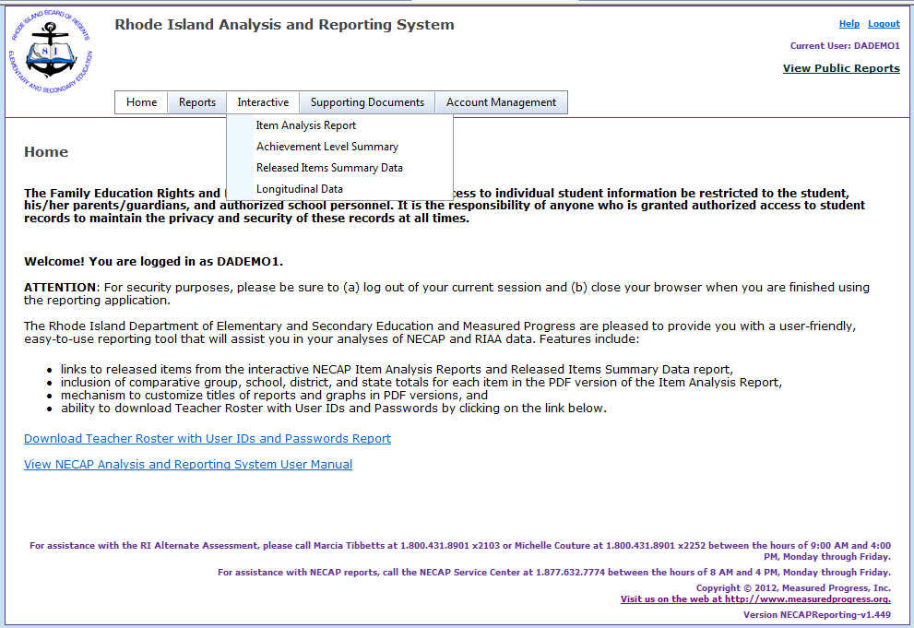
Accessing Interactive Reports

Slide 12
Supporting Documents
Guides & Report Shells
Guide to Using the 2012 NECAP Reports
Guide to Using the 2012 NECAP Science Reports
Sample Student Report Shells (English and Spanish)
Released Item Documents (For each Grade/Content Area)
Released Item Documents
Released Item Support Materials Documents
Released Item Student Work Samples

Slide 13
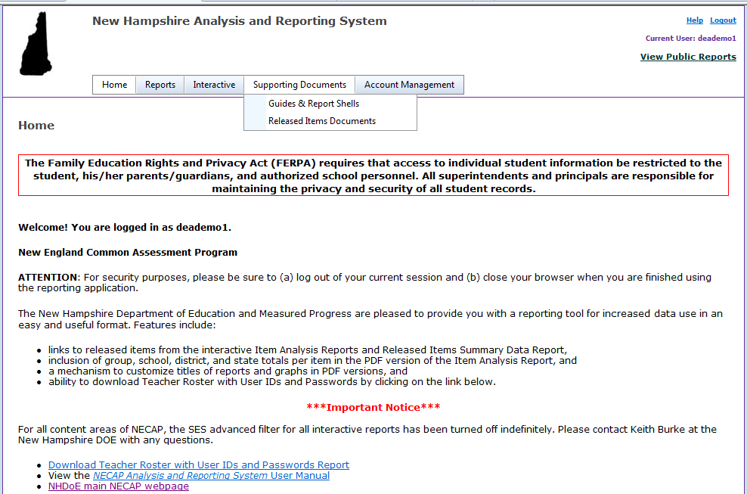
Supporting Documents

Slide 14
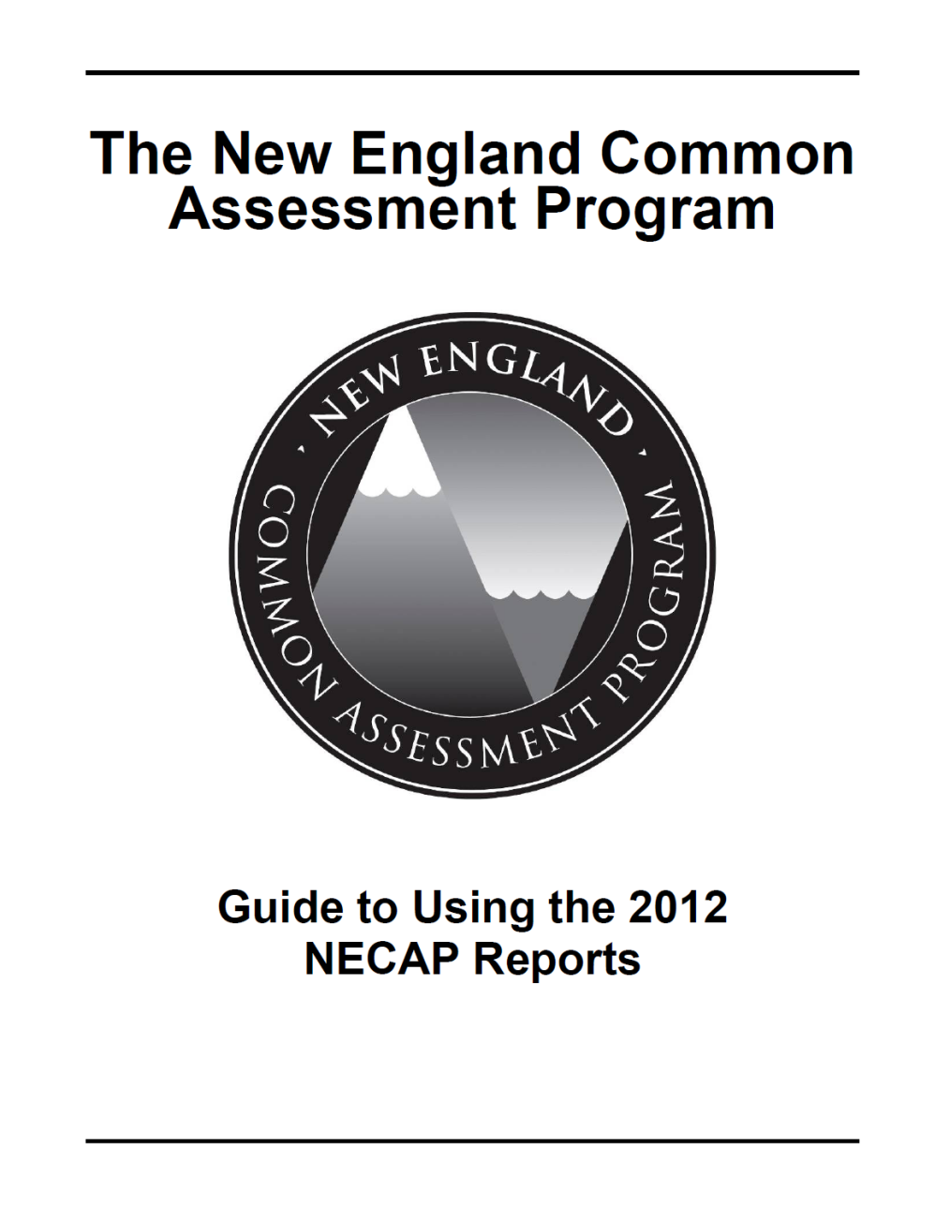
Guide to Using the 2012 NECAP Reports

Slide 15
Account Management
The Account Management menu option is only available to school principals.
Use the Account Management menu to create, add, or delete users accounts; set active users, and assign students to a specific teacher account.
Students may be assigned to multiple users, and student lists can be sorted.

Slide 16
Account Management

