Slide 1

2015 NCSC Alternate Assessment Results in English language arts and Mathematics
Heather Heineke, Assessment Specialist
Office of Curriculum, Instruction, and Assessment

Slide 2
Topics:
Alternate Assessment
  Performance Level Descriptors
  Sample Items for ELA and mathematics
Data from the LCI
  Communication and Expressive Language
  The difference in proficiency levels between general education and alternate assessments
Opportunity to Learn
  Where teachers are confident
  What teachers focus on (and what they don’t) over the grades
  How students are engaged in their learning
  What does this tell us about education for students who take the alternate assessment.

Slide 3
Alternate Assessments by Grade Level
Grade | RIAA Science | MSAA (formerly NCSC)
 | Science | ELA, Math
2 | not tested | not tested
3 | not tested | Yes - Required
4 | Yes - Required | Yes - Required
5 | not tested | Yes - Required
6 | not tested | Yes - Required
7 | not tested | Yes - Required
8 | Yes - Required | Yes - Required
9 | not tested | not tested
10 | not tested | not tested
11 | Yes - Required | Yes - Required
12 | not tested | not tested
Test Window | Sept. 29 – May 3 | March – May

Slide 4
Registration and Training
MSAA (formerly NCSC) (January, 2016)
  in-person training session or
  online, self-paced modules.
  Final quiz required. All educators will take the 2016 quiz; regardless of whether they administered the test in 2015.
  Student registration at district level (Jan-Feb, 2016)
RIAA Science all training is complete; materials are available at www.ride.ri.gov.
  2015-16 RIAA Training Presentation,
  2015-16 RIAA Science Test Administration Manual
  Additional materials relating to three science investigations.
  No quiz required to administer the RIAA Science assessment.
Student registration open now.

Slide 5
Performance Level Setting and Descriptors
Educators from all of the NCSC states participated in performance level setting this summer
NCSC has 4 performance levels. Students at Levels 3 and 4 meet or exceed expectations.
Two Types of PLDs
  Paragraphs for student reports sent to parents
  Detailed charts that contain specific skills and knowledge by level.
    Outline the ways item complexity and text complexity develops across the tiers of items.
Notes:
Click over to the PLD charts in the back of the interpretation guide.

Slide 6
3rd Grade Mathematics Example
Page 14: Mathematics Core Content Connectors (CCC)
CCSS 3.NF.1: Understand a fraction 1/b as the quantity formed by 1 part when a whole is partitioned into b equal parts; understand a fraction a/b as the quantity formed by a parts of size 1/b.
  CCC 3.NO.1l3: Identify the fraction that matches the representation (rectangles and circles; halves, fourths, and thirds, eighths).
Notes:
In Common Core State Standard 3.NF.1, the emphasis is on understanding that fractions are equal parts of a whole. It also says that the whole can be comprised of more than one of those equal parts. For example, 2/3 includes 1/3 and 1/3. To make this more accessible to students taking the alternate assessment, the CCC (core content connector) focuses on the first part of the CCSS standard; that one of something can be divided equally into smaller sections. It also focuses on the most common factions (half, fourth, third, and eighth). However, it does not address the second part of the CCSS at all.

Slide 7
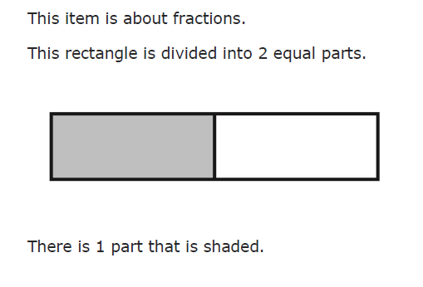
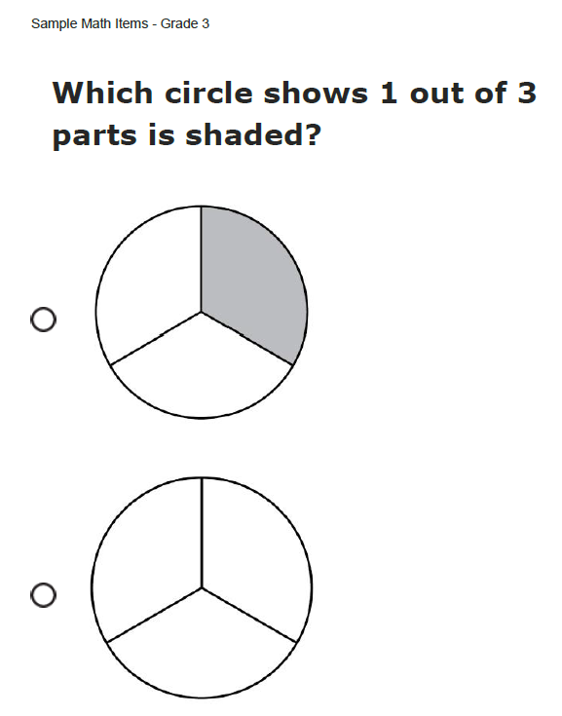
Mathematics Grade 3 Sample Item
This sample item is an example of a lower tier
This item begins with a model telling the student what the item is about:
The model is followed by the item. This item has two answer options instead of three. :
Notes:
The item begins with a model showing the student a rectangle that shows one part of the rectangle is shaded. The test item asks the student to identify the circle that has one part shaded.

Slide 8
6th Grade Mathematics: CCSS and CCC
Page 27: Mathematics Core Content Connectors (CCC)
CCSS 6.RP.1: Understand the concept of a ratio and use ratio language to describe a ratio relationship between two quantities. For example, “The ratio of wings to beaks in the bird house at the zoo was 2:1, because for every 2 wings there was 1 beak.” “For every vote candidate A received, candidate C received nearly three votes.”
  CCC 6.PRF.1c1: Describe the ratio relationship between two quantities for a given situation.
Notes:
The difference between the CCSS and the CCC in this case isn’t very much. In this case, the CCC doesn’t say that students should understand the concept of a ratio, however, in order for a student to adequately describe a ratio, they do need to understand addition and how multiplication and addition are connected. Multiplication: 3 boxes times 2 books for each box gives you six total books.

Slide 9
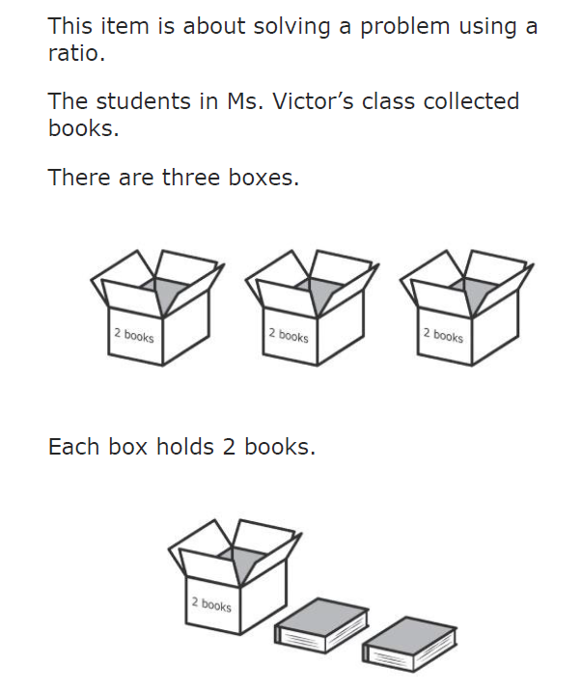
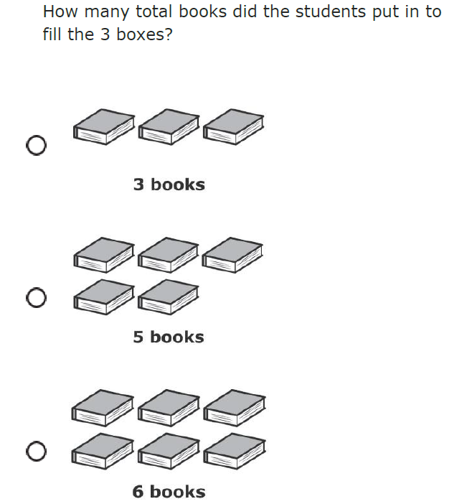
Grade 6 Mathematics sample item
This item begins by telling the student what the item is about. Then it provides a context that includes visual supports:
This item is a continuation of the context and each answer option includes visual supports.
Notes:
This item begins with setting up the scenario of boxes to books; it describes the ratio without using the language of ratios. This is important because the standard said “describe…the ratio relationship”. Many times, when developing test items, what constitutes a “description” or “identification” doesn’t need to include the actual language of the standard. Sometimes test items are written to make students use their knowledge of something in order to arrive at the answer. It may seem like the answer (six books) isn’t really what is being asked by the standard. However, if you know the steps you need to take to solve this problem, you do have know what a ratio is in order to figure it out.

Slide 10
Text Complexity of Reading Passages
Also see Performance Level Charts in Interpretation Guide
Less Complex
More Complex
Most Complex
  Simple sentences
  Commonly used words
  Theme is obvious
  Clear events in order
  Predictable events
  Simple charts and tables
  Answers taken from the text
  Simple and compound sentences
  Some grade level words
  Theme is clear
  Connections between ideas and events presented in order
  Charts and tables
  Answers drawn from the text
  Compound and complex sentences
  Grade level words
  Theme implied
  Connections between a range of ideas and events
  Charts and tables essential to understand text
  Answers inferred from the text
Notes:
This graphic explains characteristics of the reading passages in the sample items from the least complex to the most complex.
The least complex passages have simple sentences, commonly used words, theme is obvious, clear events in order, predictable events, simple charts and tables, and answers taken directly from the text.
The most complex passages have compound and complex sentences, grade level words, theme is implied, connections between a range of ideas and events, charts and tables essential to understand text, and answers inferred from the text.
Note: In this presentation, there are no ELA sample items representing the lowest complexity level. An item at the lowest complexity level has characteristics similar to the math sample items for Grade 3 (sample item 2) on slides 16 and 17 and Grade 11 (sample item 2) on slides 25 and 26.

Slide 11
4th Grade ELA: CCSS and CCC
Page 9: ELA Core Content Connectors (CCC)
CCSS 4.RL 2 Determine a theme of a story, drama, or poem from details in the text; summarize the text.
  CCC 4.RL.k2 Determine the theme of a story, drama, or poem; refer to text to support answer.
CCSS 4.RL 1 Refer to details and examples in a text when explaining what the text says explicitly and when drawing inferences from the text.
  CCC 4.RL.i1 Refer to details and examples in a text when explaining what the text says explicitly.
Notes:
The follow sample reading items are based on these Standards for Grade 4, Grade 8 and Grade 11.
In Grade 4 the item focus is on determining a theme of a story, drama, or poem and refer to text to support an answer, refer to details and examples in text when explaining what the text says explicitly and when drawing inferences from text and refer to details and examples in text when explaining what the text explicitly says.
In Grade 8 the item focus is on identifying the argument and claim that the author makes, cite the textual evidence that most strongly supports an analysis of what the text says explicitly as well as inferences drawn from text, and use two or more pieces of evidence to support inferences, conclusions or summaries of text.
And in Grade 11 the item focus is on using two or more pieces of evidence to support inferences, conclusions, or summaries from text, determining an author’s point of view or purpose in a text in which the rhetoric is particularly effective; analyzing how style and content contribute to the power, persuasiveness or beauty of the text; and determining author’s point of view or purpose in a text.

Slide 12
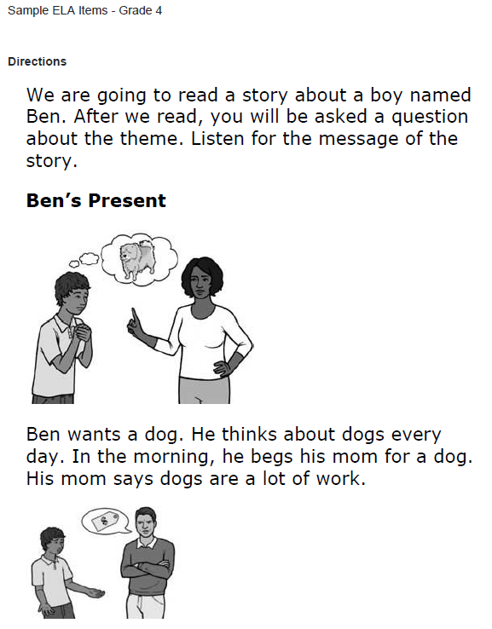
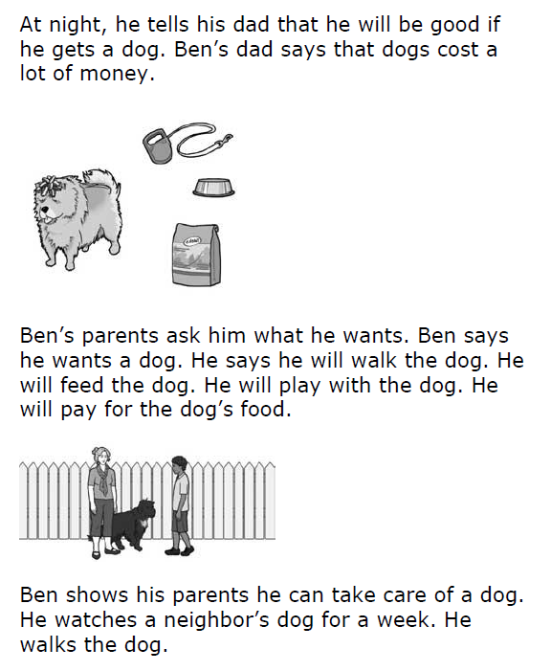
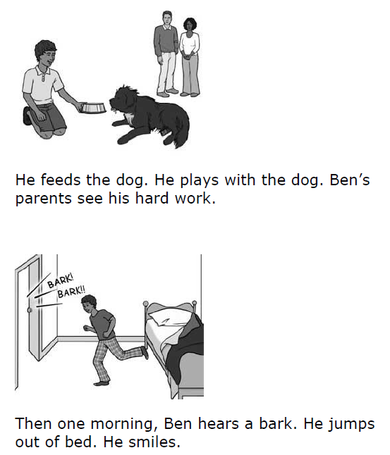
4th Grade Sample Literary Passage
This sample text has simplified language, graphics to aid in understanding, and a simple story line. This passage could also be read out loud if it were included on the test.
Notes:
This is a Grade 4 Reading item.
Sample Item 1. (Read entire item).
This item begins with a statement reminding the student what the item is about. (Theme).
This passage contains simple sentence and visual supports embedded through out the reading passage in order to support the text.
This may be more text than a student is familiar with, the embedded support to read the passage again is an option.

Slide 13
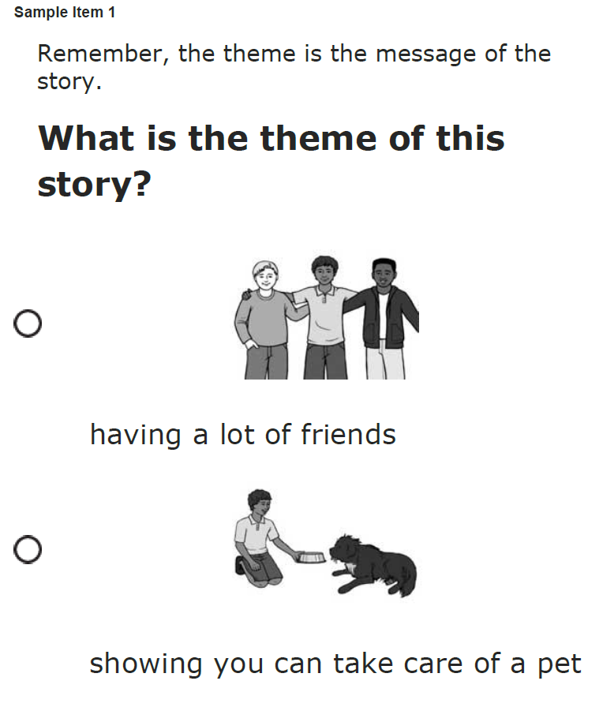
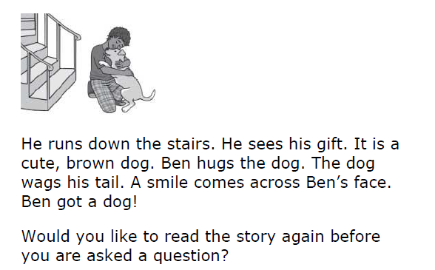
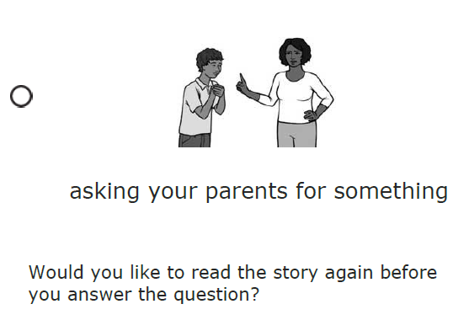
4th Grade Sample Item
A reminder of what the theme of the story is about and three answer options with visual supports.
Every passage, or part of a passage, can be re-read as many times as the student would like.
Notes:
This is a continuation of the previous passage. At the end of the passage the student is asked if they would like the passage reread before a question is asked.
A remember statement is included and defines the theme for the student in this context.
The question is “What is the theme of this story?”
There are three answer options to choose from with visual supports.
The only time a question will appear at the end of the entire passage is when the focus is about the entire passage (i.e., main idea, summary, theme, etc.)
Note: The font style and size are consistent throughout all passages, however for this presentation the font size does not appear the same. And the questions do not appear to the right of the passages. The question and answer options are displayed on separate pages from the passages.

Slide 14
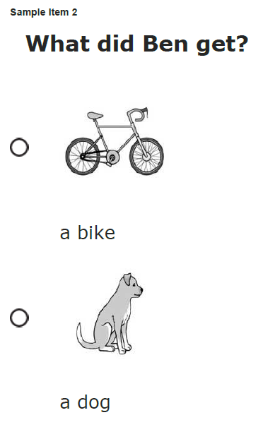
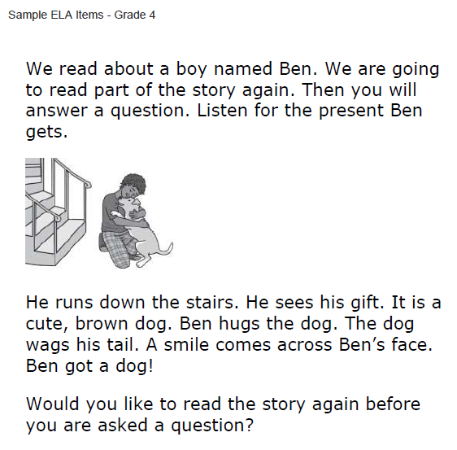
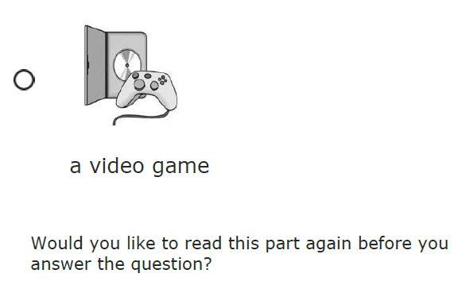
4th Grade Sample Item
Passage part; same passage as previous example
Statement reminding students what the item is about
Three answer options with visual supports.
The student can re-read passage, or have it read to them, as many times as they need.
Notes:
This is a Grade 4 reading item.
Sample Item 2. (Read entire item).
This item is an example of a passage part from the same passage previously shown. The student is directed to part of the passage to answer an item. Just this part is “read” to the student and then a question (s) immediately follows the passage part.
This item begins with a statement reminding the student what the item is about. (About a boy named Ben….Listen for the present Ben gets).
The question is “What did Ben get?”
There are three answer options to choose from with visual supports. The visual supports in the answer options will not be a direct match to any of the visual supports embedded in the passages.
You have now seen 2 items in Grade 4 from the same passage connected to different standards.
Note: Sometimes the answer options are not all on the same page. Sometimes you may need to scroll down or zoom in order to reveal all answer options.

Slide 15
11th Grade Mathematics: CCSS and CCC
Page 35 & 36: ELA Core Content Connectors (CCC)
CCSS 11-12.RI.1 Cite strong and thorough textual evidence to support analysis of what the text says explicitly as well as inferences drawn from the text, including determining where the text leaves matters uncertain.
  CCC: 112.RI.b1 Use two or more pieces of evidence to support inferences, conclusions, or summaries from text.
CCSS 11-12.RI.6 Determine an author’s point of view or purpose in a text in which the rhetoric is particularly effective, analyzing how style and content contribute to the power, persuasiveness or beauty of the text.
  CCC 1112.RI.d1 Determine the author's point of view or purpose in a text.

Slide 16
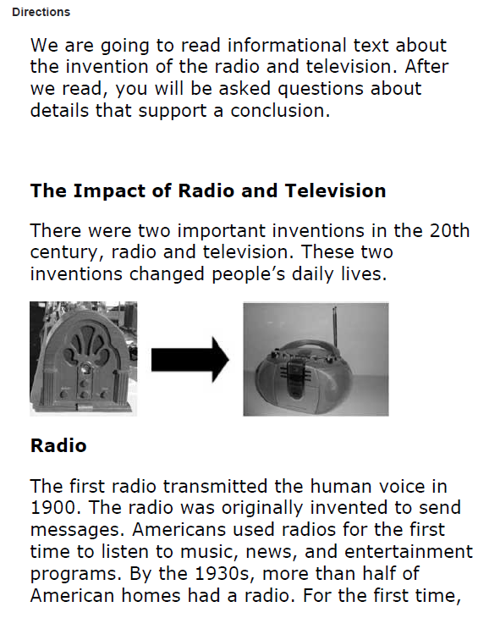
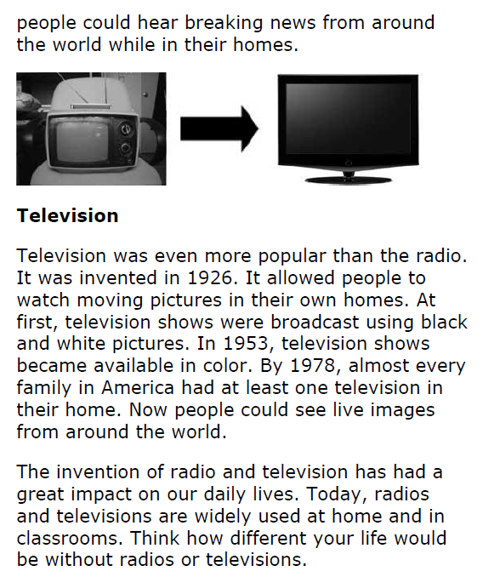

11th Grade Sample Informational Passage
Visual Supports
Statement telling students what they will do after they read the passage.
Compound and complex sentences, some grade level words
Notes:
This is a Grade 11 reading item.
Sample Item 1. (Read entire item).
This item begins with a statement reminding the student what the item is about. (Details that support a conclusion).
Visual supports embedded throughout the reading passage in order to support the text.
This passage contains compound and complex sentences and visual supports embedded throughout the reading passage in order to support the text.
In this passage and in the upper grade levels, Informational Text is a major focus.
A student may need the test paused or resumed at the end of a read through of the entire passage and first question.

Slide 17
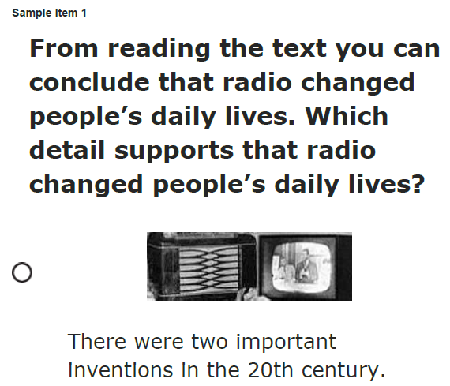
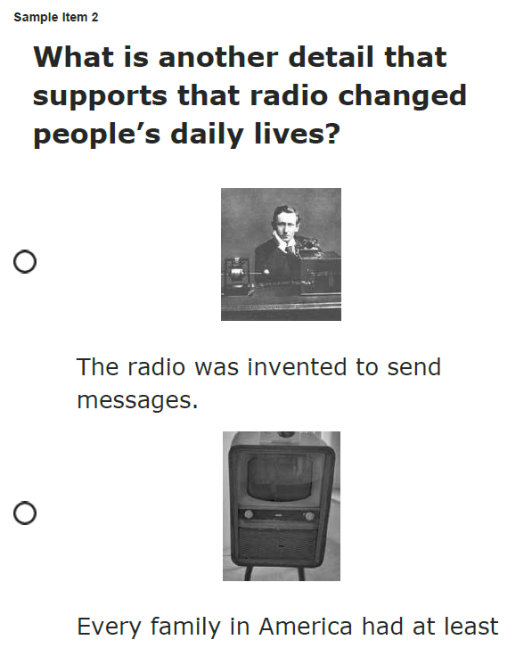
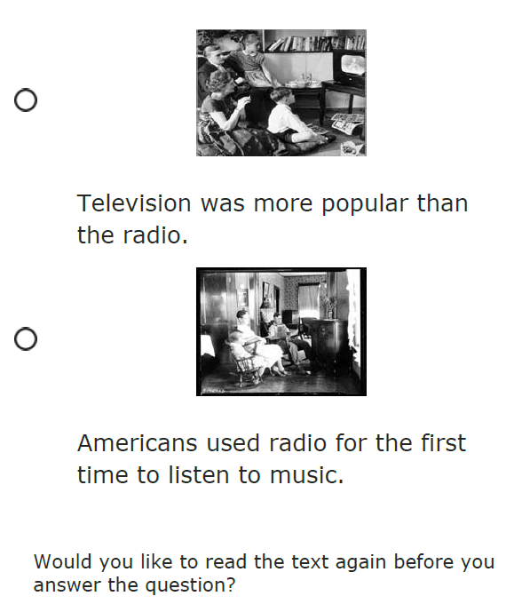
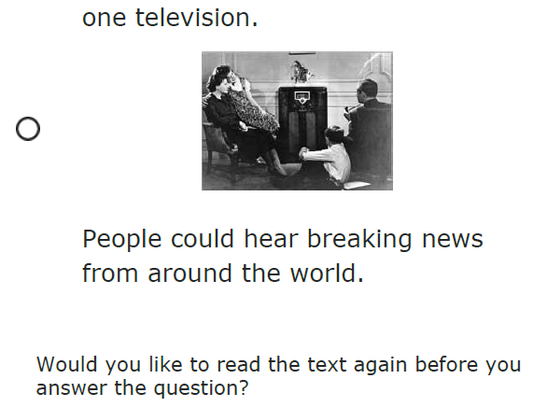
11th Grade Sample Items
Statement reminding students what the item is about
Three answer options with visual supports.
CCC: 112.RI.b1 Use two or more pieces of evidence to support a conclusion.
Notes:
This passage has two questions immediately following the passage.
The question is “Which detail supports that radio changed people’s daily lives?” and “What is another detail that supports that radio changed people’s daily lives?”
There are three answer options to choose from with visual supports. The visual supports in the answer options will not be a direct match to any of the visual supports embedded in the passages.

Slide 18

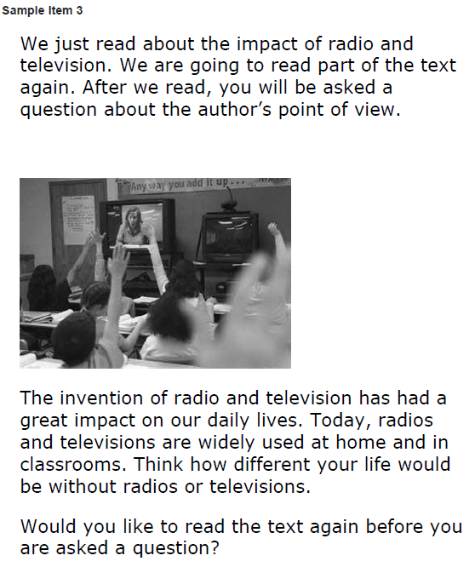
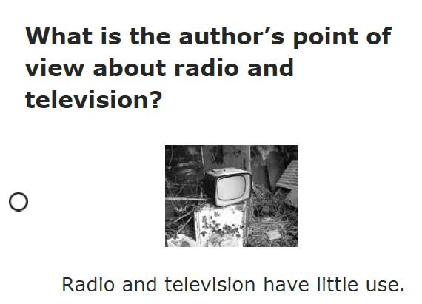
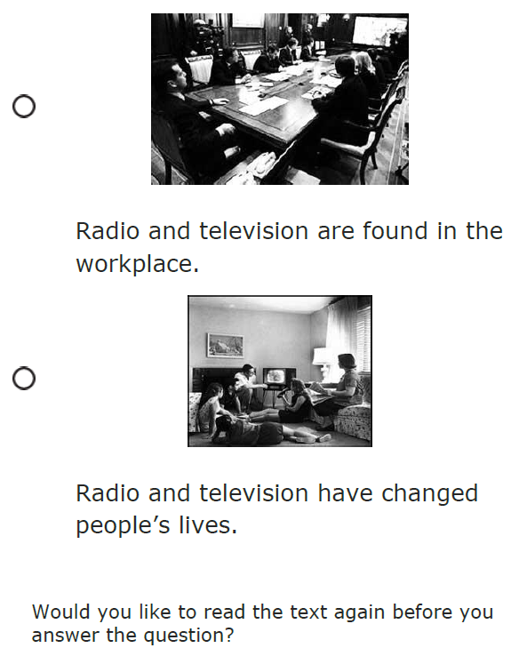
11th Grade Sample Item
Passage part; same passage as previous example
Statement about author’s point of view.
Statement reminding student what the student just read and what the student will be looking for next
  CCC 1112.RI.d1 Determine the author's point of view or purpose in a text.
Three answer options with visual supports.
Notes:
This item is an example of a passage part from the same passage previously shown. The student is directed to part of the passage to answer an item. At the beginning of the passage part, the student is reminded what was just read and after the passage part what the student will be looking for next. (The Author’s point of view).
The question includes a remember statement defining Author’s Point of View in this context.
The question is “What is the author’s point of view about radio and television?”
There are three answer options to choose from with visual supports.

Slide 19
Baseline Data
What do we know about what our students can do?

Slide 20
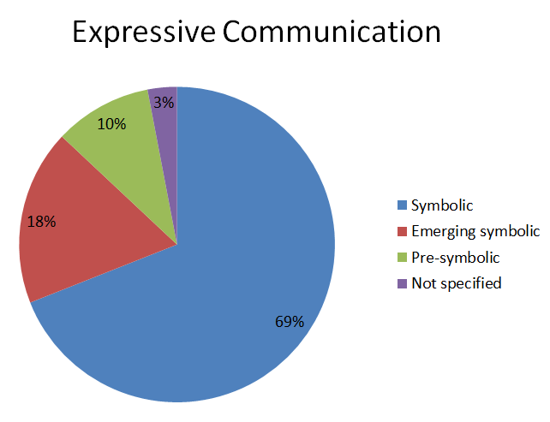
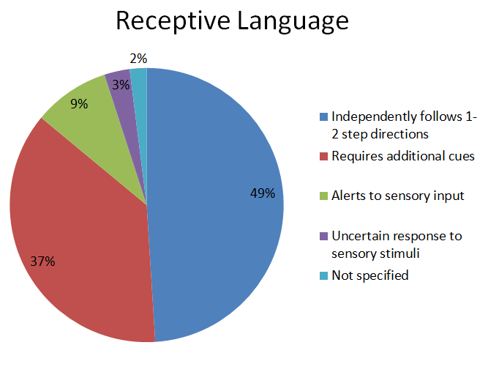
Communication
Notes:
In the areas of Communication:
Expressive: 69% of students can expressively communicate symbolically. 18% are emerging symbolic communicators, 10% are pre-symbolic, and 3% is not specified.
Receptive Communication: 49% of students independently follow 1 - 2 step directions, 37% require additional cues, 9% alert to sensory input, 3% have uncertain responses to sensory stimuli, and 2% not specified.

Slide 21
Teachers in RI reported the following about ELA:
60% of RI students could read some text or braille
3% of RI students read fluently with critical understanding in print or braille;
22% of RI students could read fluently with basic, literal understanding;
35% of RI students read basic sight words, simple sentences, directions, bullets, and/or lists in print or braille;
19% of RI students are aware of text, makes letter distinctions, or tells a story from pictures.
17% of RI students had no observable awareness of print or braille.

Slide 22
Teachers in RI reported the following in the LCI about mathematics:
34% of RI students performed computational procedures with or without a calculator;
30% of RI students could count with 1:1 correspondence to at least 10 or made numbered sets of items;
11% of RI students can count by rote to 5;
16% of RI students had no observable awareness or use of numbers

Slide 23
Expressive Communication
68% of RI students use symbolic language to communicate: Student uses verbal or written words, signs, Braille, or language-based augmentative systems to request, initiate, and respond to questions, describe things or events, and express refusal.
20% of RI students use intentional communication, but not at a symbolic language level: Student uses understandable communication through such modes as gestures, pictures, objects/textures, points, etc., to clearly express a variety of intentions.
9% of RI students communicate primarily through cries, facial expressions, change in muscle tone, etc., but no clear use of objects/textures, regularized gestures, pictures, signs, etc., to communicate.

Slide 24
Receptive Language
21% of RI students independently follow 1-2 step directions presented through words (e.g. words may be spoken, signed, printed, or any combination) and does NOT need additional cues.
54% of RI students require additional cues (e.g., gestures, pictures, objects, or demonstrations/models) to follow 1-2 step directions.
16% of RI students alert to sensory input from another person (auditory, visual, touch, movement) BUT requires actual physical assistance to follow simple directions.
2% of RI students have uncertain response to sensory stimuli (e.g., sound/voice; sight/gesture; touch; movement; smell).

Slide 25
Opportunity to Learn
The following data is from the End of Test Survey from 2015 ELA and mathematics operational tests, which asked teachers a variety of questions about instructional time, accessibility, and frequency with which content is covered during the school year.

Slide 34
Orange: Percent of teachers who find this content accessible to their student.
Blue: Percent of teachers who find this content challenging to teach.
Gray: Percent of teachers who teach this content 7 or more times in the school year

Slide 37
What do we know about the education of our significantly cognitively disabled students?
Teachers are focusing on content that is most comfortable for themselves and their students.
More needs to be done to support teachers in the following areas:
  Statistics & Probability
  Fractions
  Algebra
  Ratios
  Writing an argument
Across the grades, there is a lack of articulated content coverage across grade levels.
Teachers know how to engage students physically and cognitively in instruction.

Slide 38
NCSC Test Results
The following information is confidential and not to be distributed or discussed.

Slide 39
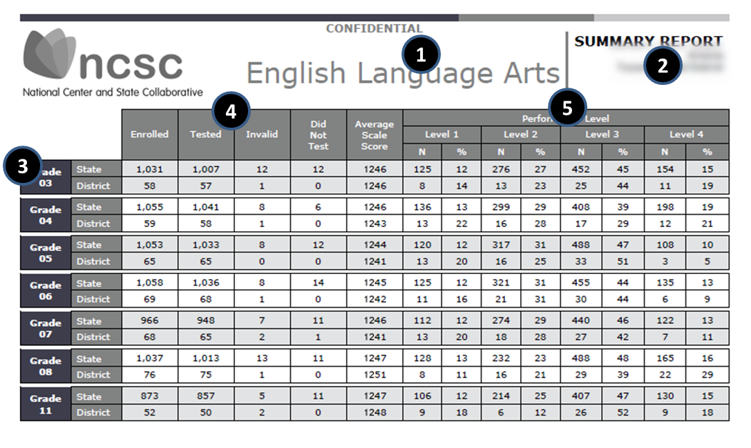
District Summary Report

Slide 40
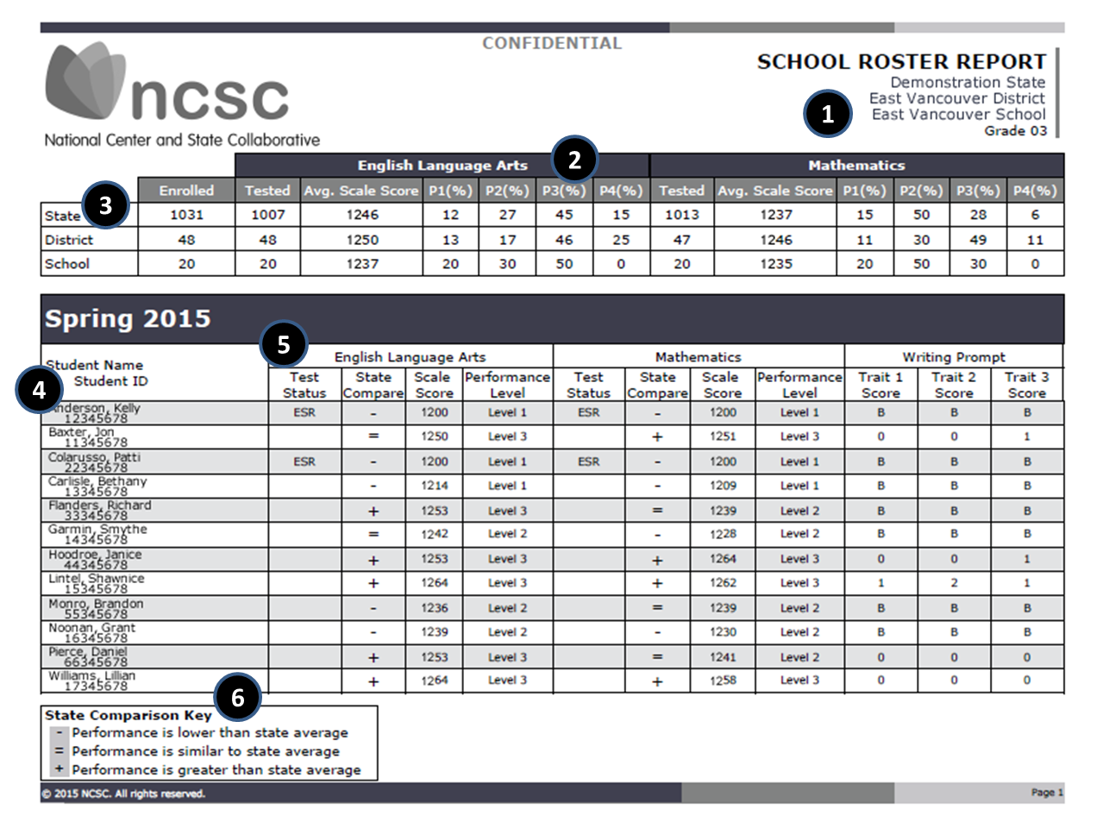

Slide 41
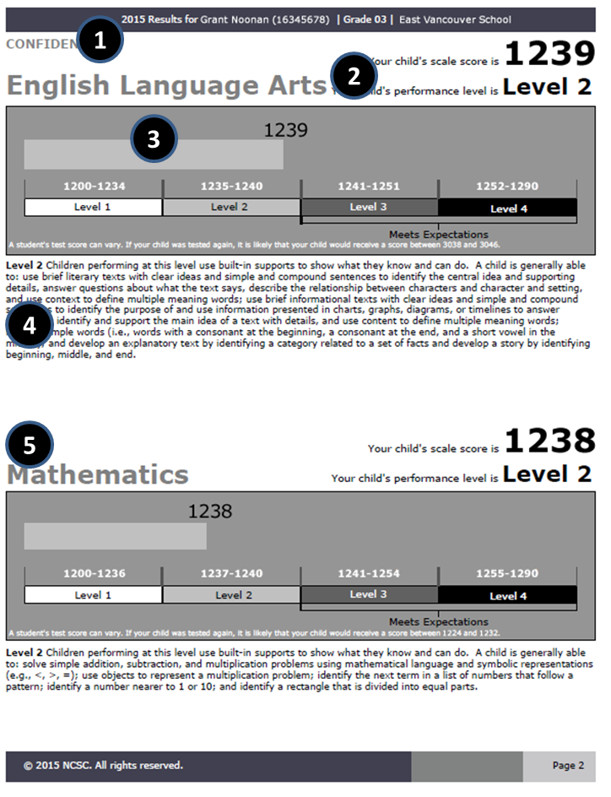

Slide 42
Talking to Parents
NCSC was a new assessment for the 2014-15 school year and we recognize that student achievement may differ between NCSC and RIAA ELA/mathematics/writing.
RIAA ELA/mathematics measured the old Alternate Assessment Grade Span Expectations (AAGSEs) whereas NCSC measures progress toward post secondary options using our new Common Core Connectors; which are aligned to the Common Core State Standards.
We will not compare RIAA results in ELA and mathematics with the results of NCSC because they are different tests that measure different standards.
The NCSC assessments are based on higher learning standards than we have ever had before, and the assessment results will set a new baseline for us and for all states in the new MSAA (Multi-State Alternate Assessment) consortium.
NCSC assessment results should be used along with local assessment results and other information to determine what changes in curriculum and instruction may be needed to support students learning.

Slide 44
NCSC 2015: State Results for ELA. Percent of students at each achievement level
Grade | Ave. Scale Score* | Level 1 | Level 2 | Level 3** | Level 4**
Grade 3 | 1237 (level 2) | 39% | 23% | 23% | 15%
Grade 4 | 1234 (level 1) | 50% | 16% | 27% | 7%
Grade 5 | 1235 (level 2) | 30% | 30% | 26% | 14%
Grade 6 | 1233 (level 2) | 45% | 24% | 14% | 17%
Grade 7 | 1238 (level 2) | 43% | 15% | 27% | 15%
Grade 8 | 1236 (level 2) | 25% | 37% | 21% | 17%
Grade 11 | 1240 (level 2) | 31% | 19% | 35% | 15%
* This is the average score students in Rhode Island received at each grade. The achievement level for that score is in parenthesis.
** Levels 3 and 4 are meeting expectations.

Slide 45
NCSC 2015: State Results for Mathematics. Percent of students at each achievement level
Grade | Ave. Scale Score* | Level 1 | Level 2 | Level 3** | Level 4**
Grade 3 | 1237 (level 1) | 38% | 23% | 30 | 9%
Grade 4 | 1234 (level 2) | 43% | 21% | 23% | 14%
Grade 5 | 1235 (level 2) | 24% | 34% | 34% | 9%
Grade 6 | 1233 (level 2) | 41% | 23% | 14% | 22%
Grade 7 | 1238 (level 2) | 22% | 30% | 29% | 19%
Grade 8 | 1236 (level 2) | 27% | 22% | 23% | 28%
Grade 11 | 1240 (level 2) | 33% | 22% | 25% | 21%
* This is the average score students in Rhode Island received at each grade. The achievement level for that score is in parenthesis.
** Levels 3 and 4 are meeting expectations.

