Slide 1
RICAS ELA: Understanding Released Items & Student Work Samples
Winter 2019
Notes:
Welcome to the RICAS English Language Arts/Literacy Informational Session.
Diane Girard & Colleen O’Brien, Literacy Specialists, Office of Instruction, Assessment & Curriculum

Slide 2
Agenda
RICAS Resources
Released Items
Metadata
Student Work
Notes:
The major agenda item for this webinar is RICAS Resources.

Slide 3
RICAS Resource Center
http://ricas.pearsonsupport.com/
Notes:
The RICAS Resource Center provides PearsonAccessNext, Training, Tech Set Up, Test Administration Manuals & Student tutorials.
For RICAS ELA it is recommended to access: Student Practice Tests and Released Items, including Student Work samples from the RICAS Resource Center.
Please note, since Rhode Island is purchasing MCAS, some resources may contain the MCAS branding.

Slide 4
Released Items
http://ricas.pearsonsupport.com/released-items/ela/
Notes:
Currently, a limited number of released items are available for RICAS – 2017 and 2018. Approximately 50% of the Operational Items were released for ELA this year.
This screen shot shows that for each grade Computer-Based Released Items, including Text-to-Speech Released items are housed here.
Also included is the Released Items Answer Key and Scoring Rubric: This document provides information about each released item from the computer-based test, including: reporting category, standard(s) covered, item type, item description, and correct answer (for selected-response items only). Information about unreleased operational items is also presented here, along with scoring rubrics for both essay questions and short-response questions.
Computer-based released items located within the RICAS Resource Center: http://ricas.pearsonsupport.com/released-items/ela/
Released Paper-Based version: http://www.doe.mass.edu/mcas/2018/release/

Slide 5
Released Items
http://ricas.pearsonsupport.com/released-items/ela/
Notes:
There will be a sign in screen and a direction screen before you get to the passages and items. This is a screen shot example from the 2018 Released Items, Grade 6.
Encourage students and teachers to use these released items to familiarize themselves with RICAS in addition to the Practice Tests. This is an opportunity for everyone to interact with the computer-based released items on TestNav8. Access through the RICAS Resource Center: http://ricas.pearsonsupport.com/released-items/ela/

Slide 6
Released Items – Metadata
Notes:
If you click on the Grade 6 Resources – button you will find the Metadata.
Metadata is provided for Spring 2018 Computer-Based Released Operational Items.
This release includes Reporting Categories, Standards for each item, Item type and description, and Correct Answer.
Example provided: Spring 2018 Grade 6 Computer-Based Released Operational Items
Quick Analysis of this Metadata shows:
12 Items total released
Reporting Category: # questions for Reading, # for Language and # for Writing & Language
Provides the standard alignment of each item
Indicates the Item Type – Important to note: SR= selected-response items (Multiple Choice, Multiple Select, Technology Enhanced Items), CR = constructed response (GRADES 3 & 4 ONLY – short response), ES = essay (Narrative and Text-Based Essay).
**Remember SR = Selected Response and CR = constructed response/short response
Description provides a written snapshot of the what the item asked of students.
Correct Answer for the Selected-Response items (Multiple Choice, Multiple Select, Technology Enhanced Items)
NOTE: These Metadata documents will be helpful when completing any Item Analysis for the 2018 RICAS assessment.

Slide 7
Metadata: Rubrics Included
Notes:
Grade 6 example: http://ricas.pearsonsupport.com/resources/released-items/ela/RICAS_2018_Gr6_ELA_released_items_CBT_final.pdf
Items Metadata also includes the Rubrics used to score specific Short Responses or Essays within the Operational Items.
It should be noted that the Rubrics are provided for both Released and Unreleased Operational Items.
For example, with this 6th grade sample, Items #7 and #24 (ePAT Item #16) were released.
Whereas, Item #15 was not released; however, it used the same rubrics as the released items.

Slide 8
Metadata: Rubric continued
Notes:
Grade 6 example: http://ricas.pearsonsupport.com/resources/released-items/ela/RICAS_2018_Gr6_ELA_released_items_CBT_final.pdf
Items Metadata also includes the Rubrics used to score specific Constructed Responses (grs. 3 & 4 only) or Essays within the Operational Items.
It should be noted that the Rubrics are provided for both Released and Unreleased Operational Items.
For example, with this 6th grade sample, Items #7 and #24 (ePAT Item #16) were released.
Whereas, Item #15 was not released; however, it used the same rubrics as the released items.

Slide 9
Unreleased Items – Metadata
Notes:
Grade 6 example: http://ricas.pearsonsupport.com/resources/released-items/ela/RICAS_2018_Gr6_ELA_released_items_CBT_final.pdf
Unreleased Items Metadata is provided for Operational Items, again identifying Reporting Category, Standard Alignment, Item Type and Descriptions. The Rubrics are also released for the Essays and Constructed Response.
Note: Helpful to review the Description for the Unreleased items as it provides insight along with the standard as to what the item was asking of students, especially once you dig into the student level data.

Slide 10
Released Items: Student Work
Student Work Samples
Notes:
Student Work Samples: http://ricas.pearsonsupport.com/released-items/
MCAS host: http://www.doe.mass.edu/mcas/student/2018/

Slide 11
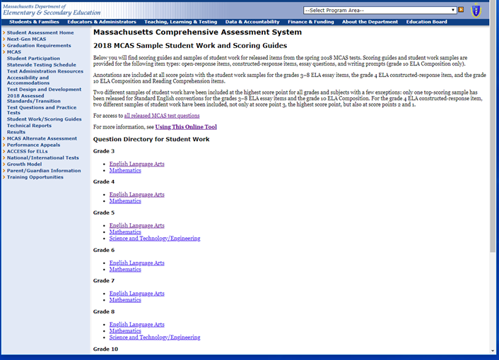
Sample Student Work & Scoring Guides
Notes:
Sample Student Work: http://www.doe.mass.edu/mcas/student/2018/
Scoring Overview: http://www.doe.mass.edu/mcas/scoring.html
Using this Online Tool includes:
How to Access Student Work in the Online tool, including Printing Instruction: http://www.doe.mass.edu/mcas/student/2018/about.html

Slide 12
Sample Student Work by Question
Notes:
Grade 8 example: http://www.doe.mass.edu/mcas/student/2018/question.aspx?GradeID=8&SubjectCode=ela&QuestionTypeCode=or,sr,es,cr
Grade 8 has 2 questions that were released this year! Be sure to check out both Question # 8 and Question # 16.
To view the student work samples please select the hyperlink Question #, for this example: Question 8 or 16 as it will open page with student work samples.

Slide 13
Sample Student Work & Scoring Guides
Notes:
Grade 8 example: http://www.doe.mass.edu/mcas/student/2018/question.aspx?GradeID=8&SubjectCode=ela&QuestionID=61198
Outlines Question #8 Essay
Provides Reporting Categories: Language & Writing along with the item standard alignment at the top of the page.
Provides PDF link to the Reading Selection along with the Item text if you select: View Item in MCAS Digital Item Library
How to find the student work?
Samples are provided for each Score point within the Scoring Guide for Idea Development and the Scoring Guide for Standard English Conventions.
Select the purple /hyperlinked Score point.
An annotation is provided along with the student work sample.

Slide 14
Sample Student Work with Annotations
Notes:
Grade 8 example: http://www.doe.mass.edu/mcas/student/2018/answer.aspx?QuestionID=61198&AnswerID=154093
Provides Annotation and sample of student response to Question # 8 that received a 4 score point.
How to find the student work?
Samples are provided for each Score point within the Scoring Guide for Idea Development and the Scoring Guide for Standard English Conventions.
Select the purple /hyperlinked Score point. Slide example, Selected Score 4 of Item Development for Question #8 (Grade 8).
An annotation explaining the score point for both Idea Development and Standard English Conventions is provided along with the student work sample as demonstrated on this slide.

Slide 15
RICAS Assessments Webpage
Notes:
RIDE “home page” for all RICAS resources.
To access ELA resources, open + for Test Design: English Language Arts.
Stored on this page is information for test coordinators, guidance on PNPs and accommodations, and Test Design for Mathematics.
http://www.ride.ri.gov/InstructionAssessment/Assessment/RICASAssessments.aspx#39551541-test-design-english-language-arts-information

Slide 16
QUESTIONS ?
Please direct all correspondence to: ​
assessment@ride.ri.gov ​
In the subject line of the inquiry include: ​
RICAS: ELA – Released Items & Sample Student Work
Notes:
Thank you for your time and attention. We hope the information we shared is helpful.
Should you have additional questions about RICAS, please email assessment@ride.ri.gov
We will cull all RICAS questions via this email to guide any future work and/or supports regarding RICAS.

