Slide 1
Informational Session for RI Model Districts New Student Learning Options
Office of Educator Excellence & Certification Services
Notes:
Welcome to our information session on the new Student Learning Options for teachers being evaluated under the RI Model Evaluation System. This presentation is intended to provide information for those RI Model districts who are considering using one of the new student learning options starting in the 2019-20 school year. Our hope is that this information will help District Evaluation Committees (DECs) in the decision-making process as to what model, if any, might best suit local context. These new student learning options represent the culmination of the two-year Student Learning Pilot during the 2017-18 and 2018-19 school years.
At this time, we recommend having the following materials on hand, listed below on the same webpage, while reviewing this presentation:
3-page rubric
Student Learning Goals scenario
Embedded Practice scenario

Slide 2
The Student Learning Pilot 2017-19
RI Team publishes reports & guidance to support 18-19 pilot
RI Team supports 9 LEAs with two pilot models
RIDE announces new student learning options for 2019-20
RI Team completes 18-19 pilot & develops virtual modules for new student learning options
RI Team conducts SL Pilot with 10 Partner LEAs
Spring 2019
Winter 2019
SY 2018-19
Pilot Year 2
Summer 2018
SY 2017-18
Pilot Year 1
Notes:
Starting in 2016, RIDE partnered with national and statewide stakeholders who shared an investment in the continuous improvement of educator effectiveness systems. Together, we referred to this group as the “Rhode Island Team,” comprised of RIDE staff, state union leaders, and educators representing different evaluation systems. Specifically, the many conversations in Rhode Island since the inception of educator evaluation in 2012-13 supported the need to look at how student learning can be more authentically and accurately measured outside of the traditional SLO process. Though the SLO has valuable components through which to focus on students’ learning, we recognized that there was an opportunity to innovate alongside RI educators to improve the student learning component of educator evaluation systems, which we consider a valuable and high-quality practice that supports educator effectiveness.
After more than a year of studying national trends and best practices regarding student learning, stakeholder engagement and planning, the Rhode Island team launched the official pilot during the 2017-18 school year. With 11 LEA partners across both the RI Model and Innovation Consortium evaluation systems, traditional public and charter schools, and K-12 educational settings, the RI Team engaged educators and evaluators in convenings, surveys, focus groups, and various communications to better understand the process of measuring student learning more accurately and authentically. Data was collected and shared with our national partners who, in their professional expertise in assessment data, compiled a report which was used to develop guidance for LEAs. Recognizing the importance of confirming the findings from 2017-18, the RI Team conducted a second year of the student learning pilot where findings were corroborated through a similar process, but with a new groups of educators across 9 LEA partners.
In 2019, RIDE published the new student learning options, two of which are new models for student learning: Embedded Practice & Student Learning Goals. In addition, because the process was positively received between the RI Team and partnering LEAs, RIDE intends to publish resources, like this one you’re viewing now, for future LEA teams to engage in similar year-long processes to support the implementation of the new models for student learning.

Slide 3
Pilot participants said the process…
…looked at the whole child instead of just one aspect, or one assessment.
…recognized that all students have talents and…promotes growth.
…promoted team collaboration to explore new ideas that help improve student learning.
…encouraged new ways to develop job-embedded professional learning within the evaluation system.
Notes:
It is important to note that the changes to student learning options were in response to the field who felt change was necessary. In working with 11 LEAs and over 500 participating educators, it was important that the pilot capture feedback directly from those educators and evaluators who were engaging in this new work. These quotes from pilot participants repeatedly noted that these models supported a more collaborative approach to measuring student learning in new ways within the existing practices in their schools. In all, educators felt that these models captured student learning more holistically through flexibility and choice, while evaluators felt that this actually provided a better picture of what educators were doing each day to impact student learning. Through that process, it deepened local conversations about what processes were working well, and which ones needed to be reconsidered to create a more authentic process for teaching and learning through the evaluation system.

Slide 4
Notes:
This is the one-page document that was communicated in the Commissioner’s field memo in March of 2019. Here, we wanted to display the range of options for student learning in order of most structured, the SLO original, to the least structured, Embedded Practice. This section is intended to explain the differences between these options, so you can better understand how your district might consider new options for student learning.
Most notably, these three options are new starting in the 2019-20 school year. These options share in common the flexibilities that were found through the pilot to more authentically align to educators’ daily work. While not the original intent of the student learning pilot, we saw an opportunity to evolve the traditional SLO into a more flexible approach, or “SLO Flex”, which may be a more preferable starting point for districts who want to try a new approach to student learning, while not adopting one of the new student learning approaches and scoring processes. The following slides will talk about the similarities, and differences, between the models to help teams decide what the most appropriate option may be. We also know that for many districts, the original SLO process IS an accurate and authentic measure of a teacher’s impact on student learning, and so in these cases, there’s really no reason to adopt a new approach.

Slide 5
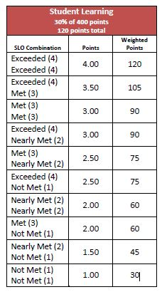
Notes:
Starting with the most familiar, you have SLO Original and the new SLO Flex. In the RI Model, these two options will continue to use the same scoring approach where a minimum of two SLOs are developed per educator, and using the data collected throughout the year as it pertains to the SLO targets, a score is assigned for each SLO. Then, both scores are combined and converted to weighted points to account for the 30% of the Final Effectiveness Rating. In all, the process has not changed regarding scoring. The notable difference between SLO Original, and the SLO Flex are how the SLOs are written. Rather than all students in a class, grade, or content area, teachers may choose a subset of students through which to focus the SLO, which is representative of the work that educators do for all of the students in that class. Moreover, there is more flexibility to make adjustments to targets as teachers use data to make decisions about learning during the year-long time frame. While SLO goals can continue to be year-long, there is also flexibility in the timeframe to consider shorter, and/or multiple cycles of instruction based on local structures, like semesters or trimesters. These two options provide the most structure for capturing student learning as it is most familiar to educators in Rhode Island.

Slide 6
Student Learning 30% of 400 points 120 points total
Evidence of Instructional Processes |  | Demonstrating Instructional Outcomes | Points | Weighted Points
Exceeded (4) | + | Exceeded (4) | 4.00 | 120
Exceeded (4) | + | Met (3) | 3.50 | 105
Met (3) | + | Met (3) | 3.00 | 90
Exceeded (4) | + | Nearly Met (2) | 3.00 | 90
Met (3) | + | Nearly Met (2) | 2.50 | 75
Exceeded (4) | + | Not Met (1) | 2.50 | 75
Nearly Met (2) | + | Nearly Met (2) | 2.50 | 60
Met (3) | + | Not Met (1) | 2.00 | 60
Nearly Met (2) | + | Not Met (1) | 1.50 | 45
Not Met (1) | + | Not Met (1) | 1.00 | 30
Notes:
Next, we have the two new options for student learning: Student Learning Goals and Embedded Practice. These models are less structured when compared to SLOs, and provide new ways of measuring student learning, while seeking the authenticity and accuracy of a teacher’s daily work with students. Primarily, what separates these options from SLO Original and SLO Flex is a different scoring approach. Rather than scoring two individual SLOs, these two models use the new 3e rubric: Demonstrating Instructional Outcomes to score the process of measuring student learning holistically.
The 3e rubric is comprised of two sections: Evidence of Instructional Processes focuses on teacher inputs, while Demonstrating Instructional Outcomes focuses on the outcomes. We will go into further detail later in this presentation related to the 3e rubric, but what is most important to know here is that the holistic scoring process sets these models apart and offers educators and evaluators new opportunities to discuss student data as a driver for instructional outcomes.
In an effort to visualize how the two scores of the 3e rubric will account for the 30%, we’ve developed this table here, which looks similar to the scoring chart for SLOs. It is important to note that while it looks similar, it is the process of scoring the new models for student learning which is different. Instead of getting 2 separate SLO scores, you will combine the score for Evidence of Instructional Processes and the score for Demonstrating Instructional Outcomes which are combined to determine the weighted points. We will talk more about how scores are determined using the new 3e rubric and guidance later in this presentation.

Slide 7
Framing the Student Learning Models
Embedded Practice & SLGs
Authentic Dialogue
Streamlining Evaluation Processes
Valuing Best Practices
Notes:
The initial work of the Rhode Island Team led us to consider guiding principles in order to reimagine models for student learning. These six guiding principles frame the models for student learning, and are rooted in best practices as it relates to the process of teaching and student learning. Students are the top priority. Like SLO Flex, there is an opportunity to identify the needs of an entire class or subset of students as the focal point, providing a more flexible structure through which to showcase student learning. While not all students may be part of the student learning goal, it is understood that this subset of students is representative of the work that the educator does with all students as part of best practice, and meeting individual learning needs. We also considered how a thoughtful choice of one or more content standards aligned to the course of study is appropriate and manageable. It is important to consider the timeframe, which is determined by the model and the district’s evaluation structure, which can include both long- and short-term cycles of instruction. During this agreed-upon timeframe, teachers collect multiple, and varied sources of standards-aligned evidence to drive on-going data discussions between the evaluator and the teacher. These conversations should support the planning and application of various instructional strategies through which expectations for student learning are articulated and monitored. In many cases, because there are flexibilities within the models for student learning, when the data suggests that students’ expectations for learning can be shifted throughout the year, the evaluator and educator should discuss why that is so, and in what ways the educator can continue to shift instructional strategies to improve outcomes.
While each model is framed by these guiding principles, it is also important to recognize that the evaluation process would also benefit from a shift in the approach to student learning. Through various feedback channels over the course of the pilot, we found that the new models for student learning truly offered what teachers and evaluators were asking for:
Focusing on the dialogue that occurs authentically between teachers and evaluators related to student learning and instructional practices
Streamlining the evaluation process by making it feel less like an “add on” to what teachers already do, and using these on-going practices as the driving force behind the model
Valuing the practices that teachers are doing in their classes with more flexibility in the choice of groups of students and durations of cycles of instruction.

Slide 8
Student Learning Goals
Teachers are provided with flexibility to measure a long-term student learning goal while making adjustments to instruction and the expectations based on data collected from shorter cycles of instruction.
Beginning of Year Conference
Data Discussions
Teacher revisits data to determine if instructional strategy is working or if new strategy needs to be put in place or a new focus
Data Discussions
Teacher revisits data to determine if instructional strategy is working or if new strategy needs to be put in place or a new focus
Analyze student BOY date to determine area of need
Set goal(s) focus on a standard(s) according to a subset of students
Middle of Year Conference
End of Year Conference
Analyze student data and self-reflection
Reflect on instructional practices
Reset goals with new/ improved instructional practices
Analyze student learning
Discuss process of setting expectations and adjusting instructional strategies
Use 3e Rubric to determine final score for student learning
Year-long Focus/Goal
Cycle of Instruction
Cycle of Instruction
Cycle of Instruction
Cycle of Instruction
Notes:
The Student Learning Goals or SLGs model, with a similar structure & flexibilities as SLO Flex, uses the holistic scoring process with the new 3e rubric. There are two ways in which to conceptualize SLGs. The first is how most educators have historically used SLOs: they set targets at the beginning of the year based on relevant data for where their students are currently performing and then set tiered targets based on expected outcomes by the end of the year. Educators can use SLGs in much the same way. They would set targets or expectations at the beginning of the year for their subset of students, and then would have actual results scored using the new rubric at the end of the year. The second way to conceptualize SLGs is using both shorter cycles with a year-long focus. In this case, teachers would set an expected year-long goal based on relevant data available at the beginning of the year. They would then engage in a ‘cycle structure’, where teachers will set a short cycle goal that support the year-long focus, and based on data from each cycle, would then adjust the year-long focus accordingly. For a more illustrative understanding, we recommend strongly that you read the accompanying Student Learning Goals Scenario located on the Student Learning page of our website.
In both of these examples, it is critical to note that SLGs uses the new 3e rubric which will we discuss shortly.

Slide 9
Embedded Practice Model
This model leverages the existing work teachers are doing in their classrooms with regard to measuring student learning through short-term cycles of instruction. It highlights on-going data discussions that drive instructional decisions related to the prioritized content area.
Beginning of Year Conference & Data Discussion
Review BOY Data
Discuss learning expectations
Data Discussions
Discuss student progress
End of Year Conference & Data Discussion
Analyze student learning
Middle of Year Conference & Data Discussion
Data Discussions
Plan instructional strategies
Determine measurement
Plan for adjusting instructional strategies
Reflect on student work and self-reflection
Identify trends in student learning
Reflect on instructional strategies to sustain, eliminate or improve
Plan for instruction and measurement
Reflection on student work and self-reflections
Discuss student progress
Plan for adjusting instruction al strategies
Discuss process of setting expectations and adjusting instructional strategies
Identify standard for growth & subset of students
Use 3e Rubric to determine final score for student learning
Cycle of Instruction
Cycle of Instruction
Cycle of Instruction
Cycle of Instruction
Notes:
Embedded Practice Model was by far the most popular model to pilot by our districts in the pilot. This model leverages the existing work teachers are doing in their classrooms with regard to measuring student learning. It prioritizes the use of measures of student learning that are already in use in teachers’ day-to-day classroom practices. It will be helpful to conceive this model through the lens of shorter cycles of instruction. Teachers set expectations for only one cycle at a time (for example, the length of a unit or an RTI cycle) and then set new expectations based on data from the first cycle. This ‘cycle structure’ would continue until the end of the year. In essence, teachers analyze and discuss student data from short cycles of instruction in order to make sound instructional changes that will impact student learning for the next cycle. The evaluator would then holistically score this teacher on the totality of the student learning that occurred using the new rubric. This model, while more informal, requires that teachers be deliberate, intentional, and highly organized in order to communicate that their teaching had impact on their students’ learning. For a more illustrative understanding, we recommend strongly that you read the accompanying Embedded Practice Scenario located on the Student Learning page of our website.
The way to distinguish SLGs from Embedded Practice is that SLGs focus on a year-long goal with or without the support of shorter cycles, and Embedded Practice focuses entirely on shorter cycles with expectations being set for the next cycle.
We will discuss more about whether or not this model is right for your setting but what we can tell you now is that this model necessitates that certain readiness factors are present in order for this model to be successfully implemented.

Slide 10
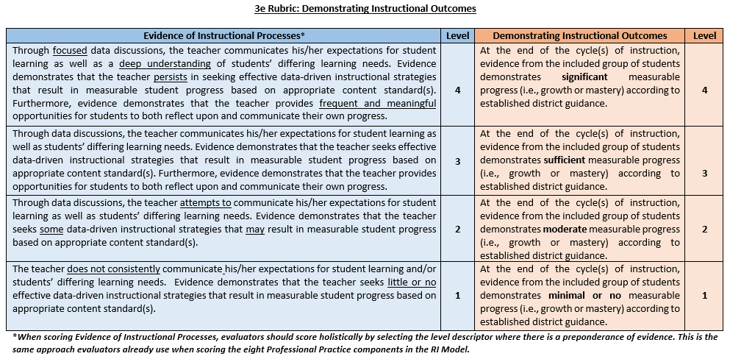
3e Rubric
One score for each side of the 3e rubric
Scored holistically at the end of the year
Criteria for the “Left Side” should be discussed and calibrated
Qualifiers for the “Right Side” need to be defined and calibrated using sample artifacts of student learning
On-going support and communication with RIDE and the Collaborative Team
Notes:
This is the first page of the new 3e rubric guidance that was developed in partnership with the districts in 2017-18. As already mentioned, those educator using either the Student Learning Goals or Embedded Practice models will use the new 3e rubric. We chose the component 3e because like the RI Model, these scores are a result of instructional practices, which “live” in the professional practice Domain 3. Here, you can see that in place of two separate SLO scores, the total 30% of student learning for the RI Model is split into two components: Evidence of Instructional Processes, in blue, which captures the instructional moves that teachers make that lead to student learning, which is captured on the right side, in orange, Demonstrating Instructional Outcomes. In addition to this first page are two supporting guidance pages that guide DECs and local teams in calibrating the qualifiers: significant, sufficient, moderate, and minimal. The process of moving away from the quantified SLO measure toward qualified measures of student learning are adaptive challenges that must be supported throughout the year, not just at the beginning or end. As such, we suggest that time be spent with teams early in the process, and supported by the fall convening module, to discuss and calibrate the left side of the rubric, as well as defining and calibrating the qualifiers for the right side.

Slide 11
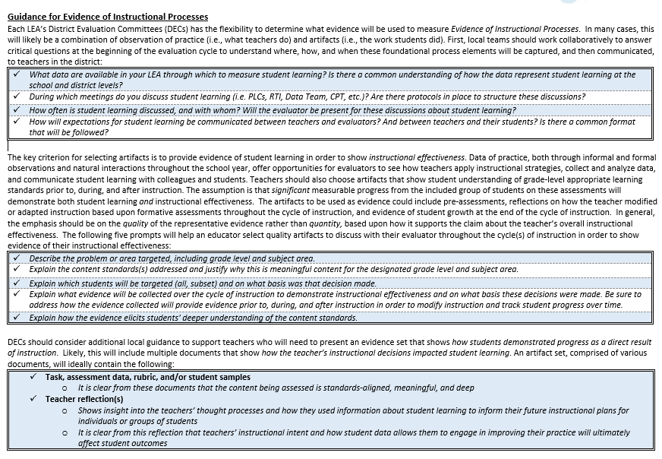
Notes:
This second page of the rubric focuses on critical questions for DECs to answer, codify, and communicate with regard to guidance for discussing the Left Side – Evidence of Instructional Processes. Again, this Left Side of the rubric aims to capture the instructional moves that teachers make that lead to student learning. And so leadership teams should codify the What, When, and How of student-level data so that evaluators and teachers may communicate authentically about student learning. We know there is an intrinsic relationship between a teacher’s inputs and a student’s outcomes and so ensuring opportunities for relevant and available data to be discussed, and expectations to be communicated, is critical for capturing a teacher’s impact on student learning.
In support of observable data, we’ve developed prompts for educators to consider as they select quality artifacts that aim to show evidence of their overall instructional effectiveness. These artifacts will afford evaluators the opportunity – the evidence! – to see how their teachers applied instructional strategies in order to impact student learning <PAUSE FOR READING>
Finally DECs should consider adding additional local guidance around artifact sets – that is, evidence at the end of the cycle of instruction that shows how students demonstrated progress as a direct result of instruction. Evaluators will find this useful as they make decisions about scoring the Left Side of the rubric. <PAUSE FOR READING>

Slide 12
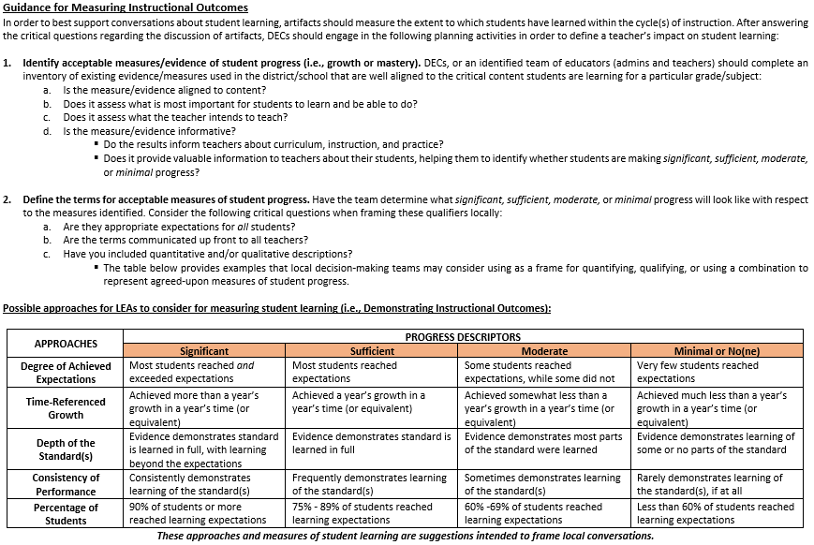
Notes:
Next is Guidance for Measuring Instructional Outcomes. Here we identify some critical steps for DECs to determine acceptable measures or evidence of student progress that will define just how much learning students have made. Additionally, DECs must engage in the important task of first defining, and then communicating what significant, sufficient, moderate or minimal progress actually means. Unlike the scoring of SLOs, measuring a teacher’s impact on student learning using Embedded Practice or Student Learning Goals is entirely a local decision.
This third page of the 3e rubric guidance goes a step further to suggest possible approaches for further defining the qualifiers significant, sufficient, moderate, and minimal. If the district does not wish to pursue quantified measures like the SLO structure, we encourage DECs and local teams to determine which approaches, and their descriptors, will be most helpful in guiding a conversation with educators and evaluators about the way in which student learning will be measured in the “Right” side of the rubric for Demonstrating Instructional Outcomes. A district could choose one or more of these approaches as a way to better clarify how the outcomes will be measured against the descriptors. This is a marked shift from SLOs and as such, should be discussed and planned thoroughly as a school or district before the year begins. As is best practice, and affirmed by those in the pilot, these conversations and communications around measures of student learning should begin with the end in mind, and start as soon as these decisions to implement have been made. This way, educators and evaluators can begin to have data discussions using the terms that most closely align to the way in which learning will be measured.
As a point of clarification, unlike SLOs where teachers develop 2, Embedded Practice and SLGs only require one measure of student learning. So, whether a teacher engages in short cycles or long cycles of instruction, they will be holistically scored at the end of the year on the entire breadth of the amount of progress their students made over the course of the school year.

Slide 13
Mindsets
Infrastructure
Leadership
Implementation Readiness
It is critical that district teams consider the following questions as they relate to readiness to successfully implement a new model for student learning:
Does your district have at least one setting (e.g. school, dept., grade level) that is led by a strong instructional leader?
Do educators in this setting meet regularly to discussing teaching and learning activities as driven by student data?
Would you characterize these educators as reflective practitioners?
Notes:
The two years of the student pilot afforded us an opportunity to consider the important components of making changes to evaluation systems within a school district. Various data points showed that successful implementation required the following components to make the shift to the new models for student learning: Leadership, Infrastructure, and Mindsets. It was clear from the participants who used both models that without one of these three integral parts of the system, there were implementation challenges that arose throughout the process, and ultimately required a shift in structure for the models to more effectively produce intended outcomes. So, we encourage district teams to consider the following prompts as a self-evaluation of readiness to implement the Student Learning Goals or Embedded Practice models.
If, in the case that you’ve answered yes to some or all of these, your team may want to consider further exploration of one or more of the models as an option for part of or a whole school in your district. Some LEAs who have piloted in the past one or two years have gone to scale and adopted a new model for student learning district-wide. In other places, they continued to pilot in the same settings – a school, team, or grade level -- because those settings contained the right leadership, infrastructure and mindsets for the new student learning options to flourish. We cannot stress enough that all three of these readiness indicators should be present in order to successfully implement a new model of student learning.

Slide 14
Critical Discussion Questions for Local Teams
What data are available in your school through which to measure student learning? How are these examples of student learning?
What meetings will be considered ‘data discussions’ within your model?
How often will you meet to discuss data, and with whom? Do evaluators need to be present at all meetings? Explain.
How will you communicate and keep track of these discussions? What preparation is needed for these discussions? Will artifacts of student learning be encouraged, or required?
How will you capture/record expectations for student learning? If so, who will do this?
How will you define the “right” side of the rubric (i.e. ‘significant’, ‘sufficient’, ‘moderate’, etc.) related to measuring student learning?
Notes:
Once a DEC has decided they may be ready to try a new model for student learning in the coming year, we then suggest that teams discuss their answers to the following critical questions. These will be an additional indicator of your district’s readiness to implement a new model for student learning. This is not an exhaustive list of the many questions that educators and evaluators will have in the beginning of this process. Intentionally, we will revisit these questions in the fall and spring convening modules to have local teams reflect on aspects of the process that needed clarification, and areas that worked well to refine implementation. We hoped that through the purposeful design of these questions that you and your team are now able to plan for, and potentially answer these critical questions for implementation, though we recognize not all of them may be answered in the summer months before you’ve had a chance to meet with your educators who will require a full evaluation this upcoming year.
These questions really provide a framework to draw out the authentic practices that are likely already in place from which to develop and evolve within this model. It is critical that all teachers who will be implementing a new model of student learning really know the answers – if there’s one thing we learned from our piloting districts is that everyone needs to be on the same page.

Slide 15
Immediate District Next Steps
Convene DECs or local decision making body to determine whether or not LEA will implement a new model of student learning
Answer critical questions to determine readiness for adopting a new model of student learning; involve as many participating teachers as possible
Communicate with participating teachers the decision points from the critical questions to ensure that all involved are on the same page
Allocate time and resources to ongoing professional learning around these new models
Notes:
For many districts, the DEC may not have been as active the last few years. That said, now is the time to revitalize this local decision-making structure. The DEC, with representation from both labor and management, the DEC is an organizing body that is poised to make the decision of whether or not to adopt either Embedded Practice or Student Learning Goals. For our charter schools who likely have never had a DEC, we recommend convening a team that includes both administrators and teachers. The greater the understanding and buy-in now, the smoother implementation will be.
The next slide will discuss district actions for on-going professional learning around these new models.

Slide 16
Resources & Supports
Mid-Year Conference Toolkit
Spring Convening Module
Fall Convening Module
Discuss Model(s)
BOY Survey
Data Discussion Frames
Collecting Student Learning Artifacts
Create local guidance for the “right side” of the 3e rubric
Set goals and expectations for student learning
EOY Survey
Reflect on processes & student learning artifacts
Assess using 3e scoring rubric & local guidance
Ongoing communication
Notes:
The feedback from each of the pilot years, as the RI Team continued to refine and improve supporting guidance and resources, suggested that it would be helpful to replicate these materials for districts who are considering the use of one or more of these new models for student learning. This presentation is meant for the early summer months, for DECs and district teams to consider their options for the following school year. For those districts who will employ a new model for student learning, the following resources will be available as supports for implementation: [READ SLIDE CONTENTS]. These modules and toolkits will be provided on our Student Learning page of the RIDE website for districts to plan who, when, and where the discussions will take place related to these important components. Throughout the year, we encourage districts to keep an open line of communication with those involved, as such a change to local evaluation processes will give rise to important conversations about student learning. As always, when questions arise, we encourage district leaders to reach out to the RIDE team with questions.
We should also note that beginning this September, we will include these new options for student learning in our new evaluator trainings for districts using the RI Model.

Slide 17
Network
For more information, please visit our
Student Learning webpage
Questions?
Contact RIDE: edeval@ride.ri.gov
Name | District | Email | Model
Ken Duva | Jamestown | duva.ken@jamestownschools.org | Embedded Practice
Jim Erinakes | Exeter-West Greenwich | james_erinakes@ewg.k12.ri.us | Student Learning Goals
Melissa Lourenco | Segue Institute for Learning | melissa.lourenco@segueifl.org | Embedded Practice
Tom Kenworthy | Portsmouth | kenworthyt@portsmouthschoolsri.org | Embedded Practice
On-going support and communication with RIDE and the Collaborative Team
Notes:
We hope this presentation provided you with enough information to start a local discussion about implementing a new model for student learning. If you have additional questions, we encourage you to reach out directly to one of our student learning “ambassadors” who participated in one or more years of the pilot, and have new or improved systems in place for managing this work. In addition, you can email the educator evaluation inbox at ededval@ride.ri.gov with questions about the information in this presentation. Ultimately, the decision to implement is up to your DEC, with consideration for your local bargaining agreement and participants. In this, we should stress that teachers themselves would not ‘elect into’ one of these models, as it should be a thoughtful and informed decision made by the DEC. In the coming months, we will have the fall convening module available on our updated “Student Learning” webpage which you can access above by clicking the link. We also plan to advertise all newly created resources via the Commissioner’s Field Memo. Thanks for your time, and we look forward to seeing how these new models help evolve the conversation about student learning across districts in RI.

