Slide 1
Building Capacity for a Collaborative ENL & General Education Model: A Five-Module Course for School-Based Teams Module 1 An Introduction to the Standards-Based Lesson Tuning Protocol

Slide 2
Course Overview

Slide 3
Welcome
On behalf of the staff at the Rhode Island Department of Education, we would like to welcome you and your colleagues to this module-based online course for supporting Collaborative ENL and General Education.
J. David Sienko
Director of the Office of Students, Community & Academic Supports
Jillian Belanger
Coordinator of English Learner Education
Emily Klein
Education Specialist

Slide 4
Purpose of the Course
By the conclusion of this course, school-level teams should be able to use a standards-based lesson tuning protocol to support high quality integration of the CCSS and WIDA standards into general classroom instruction.

Slide 5
Who Should Take This Course?
Educators interested in learning how to…
INTEGRATE supports for ENL students into daily instruction;
ENHANCE their instructional practice;
BUILD CAPACITY to support ENLs across the school;
FACILITATE collaborative conversations with colleagues.

Slide 6
Who should be on the team?
Educators interested in developing skills to facilitate conversations designed to enhance instructional practices, particularly practices involved with supporting ENLs.
Staff to consider
ENL coordinators
Instructional Coaches and Leaders
Classroom Teachers
Special Education Teachers
ENL Teachers
ENL Coordinators
Aim for 5-7 Individuals
Notes:
Narration: Emphasize facilitators

Slide 7
Overview of Modules
This course is designed to support an inquiry cycle that is divided into five learning modules. Over the course of five modules, teams will become increasingly proficient at using the Standards-Based Lesson Tuning Protocol.
Module 1 – Introduction to the Standards-Based Lesson Tuning Protocol
Module 2 – Analyzing the Focus Standard of a Lesson
Module 3 –Tuning Lesson Elements
Module 4 – Integrating Supports for ENLs
Module 5 – Building Capacity for Routine Collaboration
Notes:
Edits:

Slide 8
Course Expectations
We encourage participants and teams to agree to the following expectations to help ensure a successful experience.
Complete all assigned pre-work before each module.
Plan enough time for each phase of work. We encourage 60-90 minutes for each.
As a team, participate in all of the activities.
Be fully present during each module.
Engage in the collaborative practice between modules – this is the heart of the work!
Notes:
Edits:

Slide 9
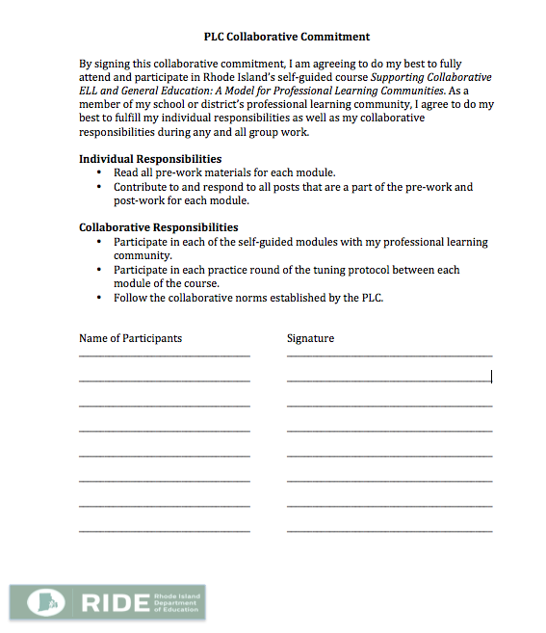
Making a Shared Commitment
Page 1-5a
If you have not already done so, use the PLC Collaborative Commitment document in your booklet to establish a shared commitment to the work.
Notes:
Edits:

Slide 10
Establishing Group Norms Activity
Pages
1-5b
1-5c
Review the Establishing Group Norms Activity in your booklet.
Review the Norms of Collaboration from the Center for Adaptive Schools in your booklet.
What norms would you change, add or remove?
With your colleagues, create and record your own set of group norms for the course.
Record your norms on chart paper and in the space in your booklet so you can refer to them in the future.
Bring the poster to each meeting.

Slide 11
We Welcome Your Feedback
This course is a new resource being provided by the Rhode Island Department of Education. As you take this course, you may have ideas about how to improve it. We welcome all suggestions, big and small.
To expedite the giving of feedback, please use this link to access an electronic form where you can send us your thoughts.
https://goo.gl/2dst6a

Slide 12
Introduction
Module 1

Slide 13
Module 1 Intended Outcomes
By the end of Module 1, participants will:
Have an introductory understanding of the Standards-Based Lesson Tuning Protocol.
Be prepared to use the protocol to begin the first round of lesson tuning as a team.
Notes:
Explain readiness for engaging in protocol between Ms 1 and 2.

Slide 14
What Rhode Island Colleagues Have to Say
The Standards-Based Lesson Tuning Protocol really helps me organize my lessons.
Going through the protocols helps generate ideas we can use to support all students, not just English Learners.
It is so helpful to have a facilitator keep the conversation focused!
I do not need to be an expert to participate in this protocol. It works for everyone, from novice to veteran teacher.

Slide 15
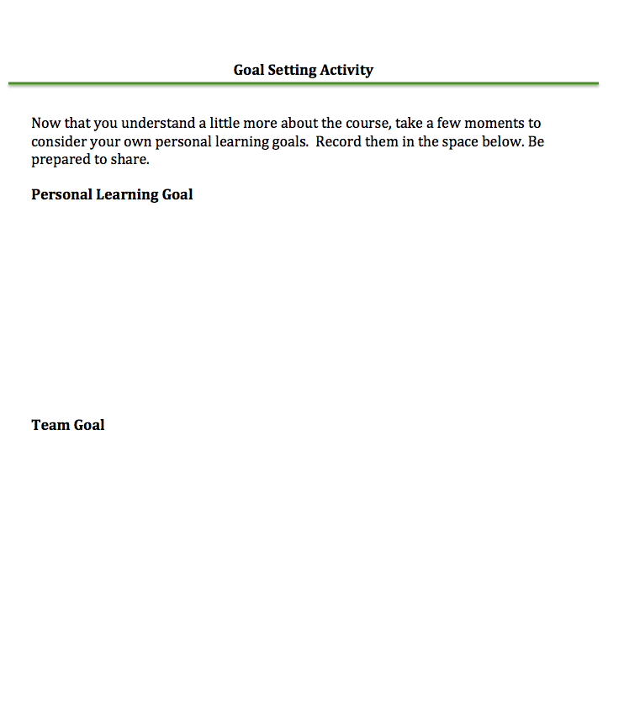
Goal Setting Activity
Pages
1-5d
Open your booklet to the Goal Setting Activity sheet.
Consider and record a personal learning goal for this course.
Share your goals as a team.
Discuss and record a team goal.

Slide 16
Module 1 Agenda
Set personal and team goals for this work
Participate in a text-based discussion
Complete overview of the Standards-Based Lesson Tuning Protocol
Watch and discuss demonstration videos
Schedule 1st round of tuning practice
Prepare for Module 2

Slide 17
The Standards-Based Lesson Tuning Protocol An Overview

Slide 18
Activity: Text-Based Discussion
Pages
1-2c
1-2d
As part of your pre-work for Module 1, you were asked to
Read the article entitled: Protocols: A Facilitator’s Best Friend, and
Complete the Active Reading Organizer
As a group, consider and discuss the following prompts:
What were the big ideas you took from the reading?
How can these ideas support progress towards your personal and team goals?
What experiences have you had using protocols?
What questions are you left with?

Slide 19
The Standards-Based Lesson Tuning Protocol
Pages
1-6a
Determine Roles & Set Norms
Present Materials
Identify Focus for Feedback
Review and Clarify Materials
Analyze the Focus Standard
Tune the Lesson
Reflect and Debrief
Prepare for Next Tuning Session
These are the main steps of the Standards-Based Lesson Tuning Protocol.
What do you think is the purpose of each step?
How do you think each step prepares the group to provide kind and thoughtful feedback?

Slide 20
The Standards-Based Lesson Tuning Protocol
Determine Roles & Set Norms
Present Materials
Identify Focus for Feedback
Review and Clarify Materials
Analyze the Focus Standard
Tune the Lesson
Reflect and Debrief
Prepare for Next Tuning Session
Step 6 is the heart of the protocol.
What do you think is the purpose of each part of Step 6?
How do you think each part of Step 6 prepares the group to provide kind and thoughtful feedback?
Select a Feedback Tool
Silently Read, Analyze and Take Notes
Share Observations of Effective Practice (Praise)
Share and Discuss Feedback

Slide 21
Activity: Read, Discuss, and Record
Pages
1-6a-f
Please read and review all of the following documents
Standards-Based Lesson Tuning Protocol
Focus Standard Unpacking Sheet
Feedback Organizer 1 – Guided Questions
Feedback Organizer 2 – Categories
Feedback Organizer 3 – Praise, Probe Polish
Presenting Teacher Prep Sheet
After everyone has finished reading, share and discuss your observations.

Slide 22
The Tuning Protocol: Steps 1-4
Video Demonstrations

Slide 23
Demonstration Videos
Pages
1-7
During the next series of activities, you will be asked to watch short videos demonstrating the initial steps of the tuning protocol.
Each video can be found on the course’s Youtube channel by clicking on the following link: https://goo.gl/oONSzI
Use the Video Observation Sheet to record your thoughts and observations.
Be prepared to share and discuss your observations and thoughts after each video has finished.

Slide 24
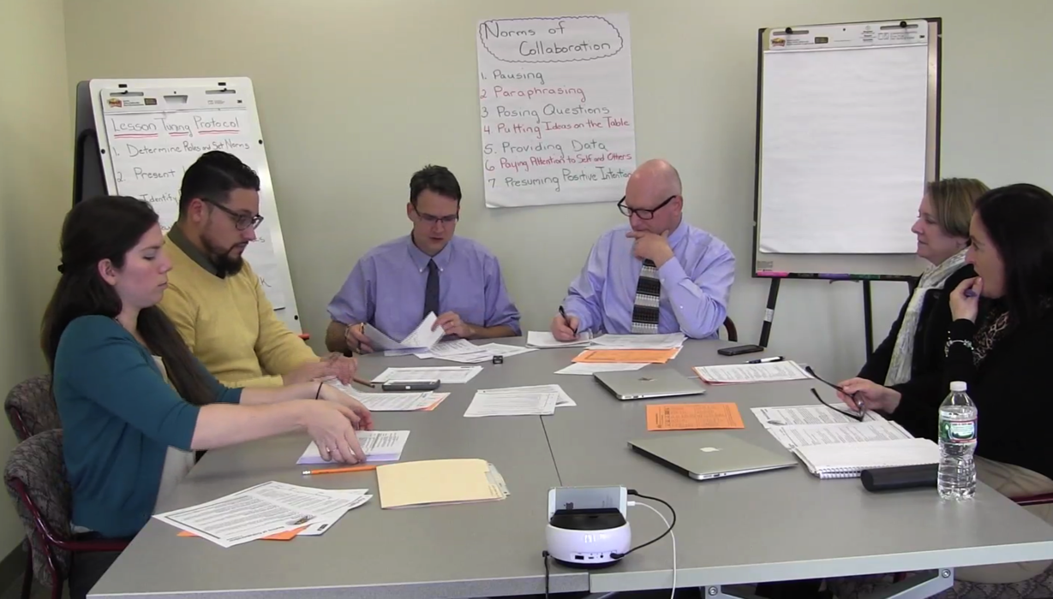
Step 1 - Determine Roles & Norms
Pages
1-7
Clicking on the video will take you directly to the Youtube channel video.

Slide 25
Demonstration Videos
Pages
1-7
Share and Discuss
Anything that stood out to you, and
Anything that left you wondering.

Slide 26
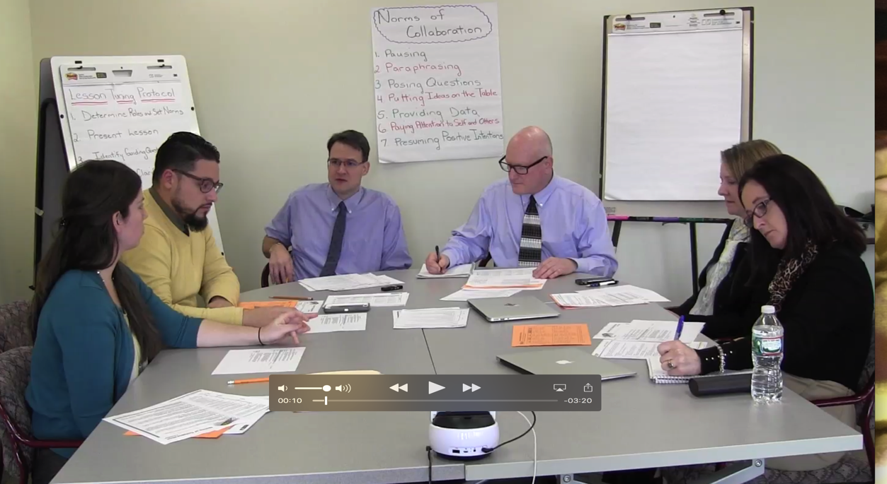
Step 2 - Presenting the Lesson
Pages
1-7
Clicking on the video will take you directly to the Youtube channel video.

Slide 27
Demonstration Videos
Pages
1-7
Share and Discuss
Anything that stood out to you, and
Anything that left you wondering.

Slide 28
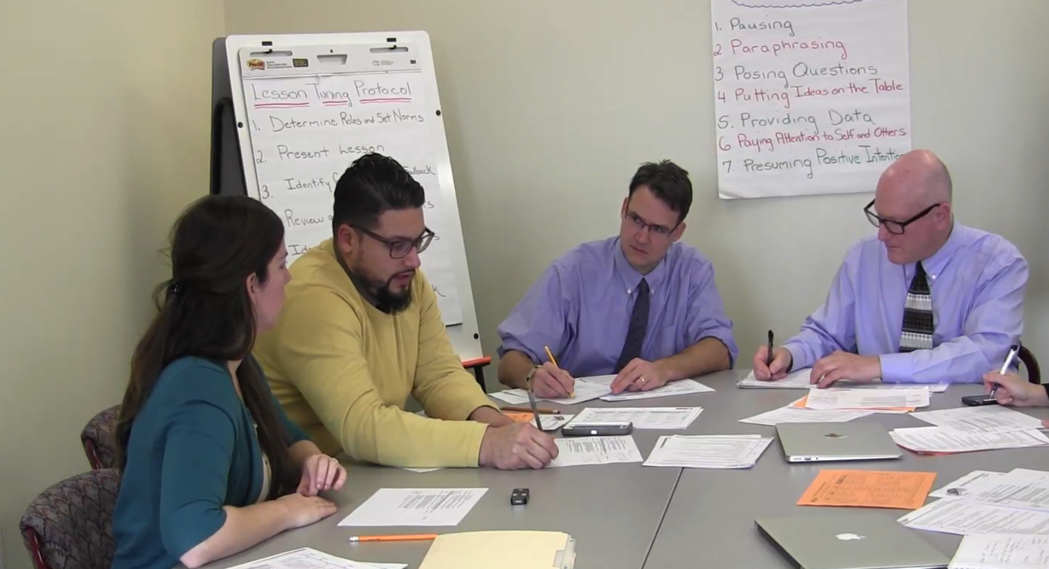
Step 3 - Identifying Focus for Feedback
Pages
1-7
Clicking on the video will take you directly to the Youtube channel video.

Slide 29
Demonstration Videos
Pages
1-7
Share and Discuss
Anything that stood out to you, and
Anything that left you wondering.

Slide 30
Step 4 – Review and Clarify Materials
Pages
1-7
Clicking on the video will take you directly to the Youtube channel video.

Slide 31
Demonstration Videos
Pages
1-7
Share and Discuss
Anything that stood out to you, and
Anything that left you wondering.

Slide 32
Wrapping Up Module 1

Slide 33
What was accomplished in Module 1
Overview of the course
Discussion of the purpose of protocols
Introduction to the Standards-Based Tuning Protocol
Discussion of demonstrations for initial steps in the process of tuning.

Slide 34
Activity
Discuss the intended outcomes for Module 1. To what extent do you feel they were met?
By the end of Module 1, participants will:
Have an introductory understanding of the Standards-Based Lesson Tuning Protocol.
Be prepared to use the protocol to begin the first round of lesson tuning as a team.

Slide 35
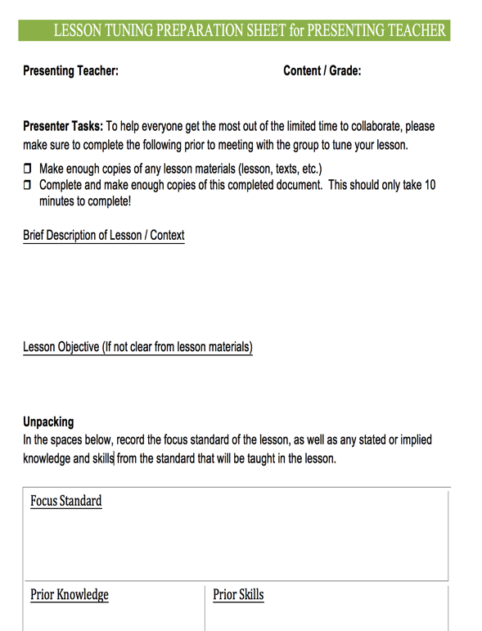
Preparing for Collaborative Practice - Round 1
Pages
1-6f
Clarify the date and time for practicing the tuning protocol.
Determine who the presenting teacher will be to bring a lesson to tune.
Determine who will volunteer to facilitate.
Have the presenting teacher complete the prep sheet prior to meeting.

Slide 36
Preparing for Module 2
All
Complete pre-work reading assignments for Module 2.
Clarify Date, Time and Location
Collaborative Practice
Guided Workshop for Module 2
Materials to Bring
Course Booklet, notes from Round 1 of the collaborative tuning practice.
Bring copies of, or have access to, examples of national or state standards. You will spend time unpacking standards during Module 2.

Slide 37
Summary Statement
The heart of Rhode Island Collaborative ENL and General Education model is for RIDE to provide districts and schools with resources to help build capacity to help all learners succeed – particularly including English Learners and students with disabilities.

