Slide 1
Building Capacity for a Collaborative ENL & General Education Model: A Five-Module Course for School-Based Teams Module 2 Analyzing the Focus Standard of a Lesson

Slide 2
Review of Course Modules
Module 1 – Introduction to the Standards-Based Lesson Tuning Protocol
Module 2 – Analyzing the Focus Standard of a Lesson
Module 3 –Tuning Lesson Elements
Module 4 – Integrating Supports for ENLs
Module 5 – Building Capacity for Routine Collaboration
Notes:
Edits:

Slide 3
Module 2 Intended Outcomes
By the end of Module 2, participants will:
Have a deeper understanding of the importance of reviewing and discussing the focus standard of a lesson prior to tuning, and
Become familiar with a simple process for analyzing and ‘unpacking’ a standard collaboratively.

Slide 4
Module 2 Agenda
Review Group Norms
Debrief the 1st Round of Collaborative Practice
Participate in Text-Based Discussions
Engage in Mini-Presentation
Watch and Discuss Demonstration Video
Schedule 2nd Round of Tuning Practice
Prepare for Module 3

Slide 5
Review Group Norms
Norms of Collaboration
Pay Attention to Self & Others
Pause
Paraphrase
Put Ideas on the Table
Provide Data
Probe
Place inquiry at the Center
Review the Norms of Collaboration or your team’s group norms.
Select a norm to focus on for the day.

Slide 6
Reminder: We Welcome Your Feedback
As mentioned in Module 1, this course is a new resource being provided by the Rhode Island Department of Education. As you take this course, you may have ideas about how to improve it. We welcome all suggestions, big and small.
To expedite the giving of feedback, please use this link to access an electronic form where you can send us your thoughts.
https://goo.gl/2dst6a

Slide 7
Debriefing the Tuning Process
Reflection

Slide 8
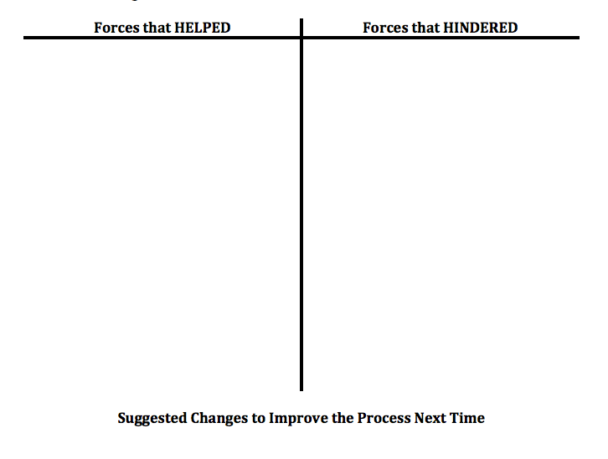
Debriefing the Tuning Process
Pages
2-5
Directions
Use the Debriefing Tool to reflect on your last tuning session.
Identify what HELPED or HINDERED the process.
Share and discuss.
Revise process for next time.
Record changes.

Slide 9
What are Learning Standards?
Text-Based Discussion

Slide 10
Activity: Text-Based Discussion
Pages
2-2a-c
As part of your pre-work for Module 2, you were asked to
Read the Leadership in Action briefs by the New England Secondary School Consortium entitled: What are learning standards? and I want to know more.
Record your notes on the Active Reading Organizer.

Slide 11
Activity: Text-Based Discussion
As a team, consider and discuss the following prompts:
What were the big ideas you took from the reading?
How can these ideas support progress towards your personal and team goals?
What questions were you left with?

Slide 12
A Process for Analyzing & Unpacking Standards
Mini-Presentation

Slide 13
During this portion of the guided workshop, read and discuss each slide as a group. When the entire group is ready, advance to the next slide.

Slide 14
Why do we need a process for unpacking?
In their original form, many standards are…
Vague, and
Dense

Slide 15
Why do we need a process for unpacking?
In their original form, many standards are…
Vague, and
Dense
For example, consider and compare the following math standards.
3.OA.A.3 | 3.OA.B.6
Use multiplication and division within 100 to solve word problems in situations involving equal groups. | Understand division as an unknown factor problem

Slide 16
Why do we need a process for unpacking?
In their original form, many standards are…
Vague, and
Dense
Standard 3.OA.B.6 is much vaguer than 3.OA.A.3. For example, how would a teacher know whether or not a student understands?
3.OA.A.3 | 3.OA.B.6
Use multiplication and division within 100 to solve word problems in situations involving equal groups. | Understand division as an unknown factor problem

Slide 17
Why do we need a process for unpacking?
In their original form, many standards are…
Vague, and
Dense
Discuss: What makes the following standard dense?
CCSS.ELA-LITERACY.RL.6.4
Determine the meaning of words and phrases as they are used in a text, including figurative and connotative meanings; analyze the impact of a specific word choice on meaning and tone

Slide 18
Why do we need a process for analyzing a standard?
A process helps to ensure that…
teachers have a common understanding of the focus standard for a lesson,
the lesson teaches the knowledge and skills defined by the standard, and
teachers involved in tuning a lesson will give accurate and consistent feedback.

Slide 19
The Purpose of Analyzing Standards
The purpose of analyzing the focus standard of a lesson is to clarify the following:
What students need to be able to DO, and
What they need to KNOW in order to do it.

Slide 20
The Process for Analyzing a Standard
Pages
2-6a-b
Identify and record the focus standard in its complete and original form.
Identify the stated and implied knowledge
Identify the stated and implied skills
Determine which knowledge and skills should be taught, and which should have already been mastered.
Consider implications for instruction and assessment.
Note: Use the Focus Standard Unpacking Sheet to record your thoughts and discussion.

Slide 21
A Guided Walk Through
The following slides provide a sample step-by-step analysis of a focus standard. The thoughts recorded were generated by a group of educators like you. This information is also found on page 2-6a in your booklet.
Take a few minutes to read each slide and discuss the decisions that were made. It is okay to disagree. The objective of this activity is to understand the process of analyzing the standard.

Slide 22
The Process for Reviewing a Standard
Pages
2-6a
The following graphic organizer helps record information as a team reads and analyzes a standard. You have copies in your booklet.
Focus Standard
Knowledge | Skills
Implications for Instruction
Implications for Assessment

Slide 23
The Process for Reviewing a Standard
Pages
2-6a
Identify and record the focus standard of a lesson in its complete and original form. The focus standard is the standard a lesson targets or teaches.
CCSS.ELA-LITERACY.RL.6.4 Determine the meaning of words and phrases as they are used in a text, including figurative and connotative meanings; analyze the impact of a specific word choice on meaning and tone.
Knowledge | Skills
Implications for Instruction
Implications for Assessment

Slide 24
The Process for Reviewing a Standard
Pages
2-6a
When writing the standard on a lesson, it is recommended to write the standard in its complete form. Strike through parts of the standard that the lesson is NOT teaching.
CCSS.ELA-LITERACY.RL.6.4 Determine the meaning of words and phrases as they are used in a text, including figurative and connotative meanings; analyze the impact of a specific word choice on meaning and tone.
Knowledge | Skills
Implications for Instruction
Implications for Assessment

Slide 25
The Process for Reviewing a Standard
Pages
2-6a
Identify the stated and implied knowledge in the standard.
CCSS.ELA-LITERACY.RL.6.4 Determine the meaning of words and phrases as they are used in a text, including figurative and connotative meanings; analyze the impact of a specific word choice on meaning and tone.
Knowledge Figurative Language Simile, metaphor, symbolism, foreshadowing Connotative Language Positive – e.g. youthful, stunning, etc. Negative – e.g. cheap, immature, etc. | Skills
Implications for Instruction
Implications for Assessment

Slide 26
The Process for Reviewing a Standard
Pages
2-6a
Identify the stated and implied skills in the standard.
CCSS.ELA-LITERACY.RL.6.4 Determine the meaning of words and phrases as they are used in a text, including figurative and connotative meanings; analyze the impact of a specific word choice on meaning and tone.
Knowledge Figurative Language Simile, metaphor, symbolism, foreshadowing Connotative Language Positive – e.g. youthful, stunning, etc. Negative – e.g. cheap, immature, etc. | Skills Determine meaning of words and phrases Identify figurative language & interpret it Identify connotative language Determine if positive or negative and interpret it.
Implications for Instruction
Implications for Assessment

Slide 27
The Process for Reviewing a Standard
Pages
2-6a
Determine which knowledge and skills should be background and which should be taught. In this example, the bolded text refers to knowledge and skills a teacher decided students should already have.
CCSS.ELA-LITERACY.RL.6.4 Determine the meaning of words and phrases as they are used in a text, including figurative and connotative meanings; analyze the impact of a specific word choice on meaning and tone.
Knowledge Figurative Language Simile, metaphor, symbolism, foreshadowing Connotative Language Positive – e.g. youthful, stunning, etc. Negative – e.g. cheap, immature, etc. | Skills Determine meaning of words and phrases Identify figurative language & interpret it Identify connotative language Determine if positive or negative and interpret it.
Implications for Instruction
Implications for Assessment

Slide 28
The Process for Reviewing a Standard
Pages
2-6a
Consider implications for instruction and assessment
CCSS.ELA-LITERACY.RL.6.4 Determine the meaning of words and phrases as they are used in a text, including figurative and connotative meanings; analyze the impact of a specific word choice on meaning and tone.
Knowledge Figurative Language Simile, metaphor, symbolism, foreshadowing Connotative Language Positive – e.g. youthful, stunning, etc. Negative – e.g. cheap, immature, etc. | Skills Determine meaning of words and phrases Identify figurative language & interpret it Identify connotative language Determine if positive or negative and interpret it.
Implications for Instruction Pre-teach types of figurative and connotative language with examples Students may need a strategy for gathering info and taking notes. ENLs may need additional supports, e.g. word banks, example word lists with translations, texts with passages already highlighted, etc.
Implications for Assessment

Slide 29
The Process for Reviewing a Standard
Pages
2-6a
Consider implications for instruction and assessment
CCSS.ELA-LITERACY.RL.6.4 Determine the meaning of words and phrases as they are used in a text, including figurative and connotative meanings; analyze the impact of a specific word choice on meaning and tone.
Knowledge Figurative Language Simile, metaphor, symbolism, foreshadowing Connotative Language Positive – e.g. youthful, stunning, etc. Negative – e.g. cheap, immature, etc. | Skills Determine meaning of words and phrases Identify figurative language & interpret it Identify connotative language Determine if positive or negative and interpret it.
Implications for Instruction Pre-teach types of figurative and connotative language with examples Students may need a strategy for gathering info and taking notes. ENLs may need additional supports, e.g. word banks, example word lists with translations, texts with passages already highlighted, etc.
Implications for Assessment Students will need to show they can identify AND interpret figurative and connotative language independently.

Slide 30
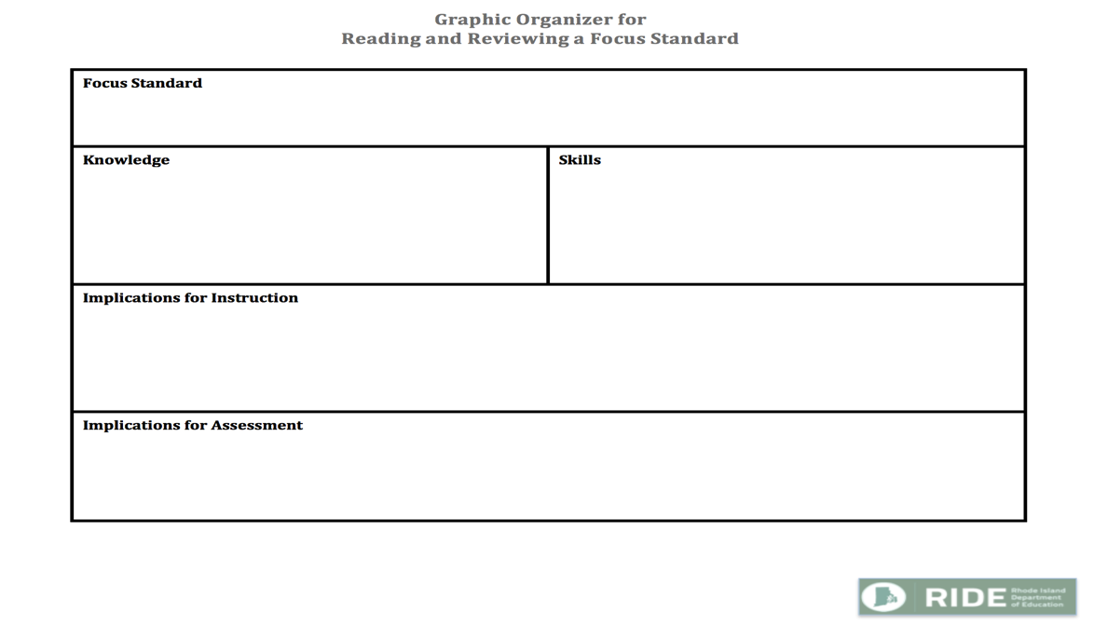
The Process for Reviewing a Standard
Pages
2-6b
Now it is your turn.
Using a standard of your choosing, collaboratively read and analyze it.
Use a blank Focus Standard Unpacking Sheet in your booklet to record your thoughts.
You may want to record your team’s ideas on a piece of chart paper as well.

Slide 31
The Process of Analyzing a Standard in Action
Video Demonstration

Slide 32
Demonstration Video
Pages
2-7
Next, you will watch a video demonstrating the analysis and unpacking of a standard.
As you watch the video, use the Video Observation Sheet to record the following:
Observations
Implications / Interpretations
Questions
Connections to Your Own Work
Be prepared to share and discuss your notes afterwards.

Slide 33
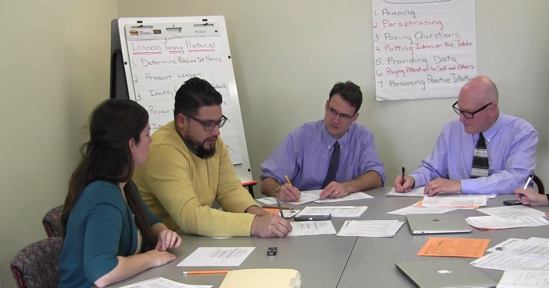
Step 5 – Analyzing the Focus Standard
Pages
2-7
Clicking on the video will take you directly to the Youtube channel video.

Slide 34
Demonstration Videos
Pages
2-7
Share and Discuss
Anything that stood out to you, and
Anything that left you wondering.

Slide 35
Wrapping Up Module 2

Slide 36
What was accomplished in Module 2
Review Group Norms
Debrief the 1st Round of Collaborative Practice
Participate in Text-Based Discussion
Engage in Mini-Presentation
Watch and Discuss Demonstration Video
Schedule 2nd Round of Tuning Practice
Prepare for Module 3

Slide 37
Activity
Discuss the intended outcomes for Module 2. To what extent do you feel they were met?
By the end of Module 2, participants will:
Have a deeper understanding of the importance of reviewing and discussing the focus standard of a lesson prior to tuning, and
Have become familiar with a simple process for reading and ‘unpacking’ a standard collaboratively.

Slide 38
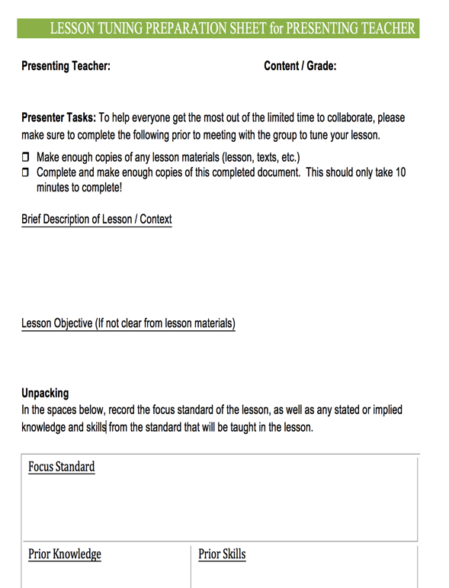
Preparing for Collaborative Practice - Round 2
Pages
2-8a
Clarify date and time for the collaborative practice.
Determine who the presenting teacher will be to bring a lesson to tune.
Determine who will volunteer to facilitate.
Have the presenting teacher complete the prep sheet for presenting teachers prior to meeting.

Slide 39
Preparing for Module 3
All
Complete reading assignments for Module 3.
Clarify Date, Time and Location
Collaborative Practice
Guided Workshop for Module 3
Materials to Bring
Course Booklet, notes from Round 2 of the collaborative tuning practice.

Slide 40
Summary Statement
The heart of Rhode Island Collaborative ENL and General Education model is for RIDE to provide districts and schools with resources to help build capacity to help all learners succeed – particularly including English Learners and students with disabilities.

