Slide 1
Building Capacity for a Collaborative ENL & General Education Model: A Five-Module Course for School-Based Teams Module 3 Tuning the Elements of a Lesson
Notes:
Narration:

Slide 2
Review of Course Modules
Module 1 – Introduction to the Standards-Based Lesson Tuning Protocol
Module 2 – Analyzing the Focus Standard of a Lesson
Module 3 –Tuning Lesson Elements
Module 4 – Integrating Supports for ENLs
Module 5 – Building Capacity for Routine Collaboration
Notes:
Edits:

Slide 3
Module 3 Intended Outcomes
By the end of Module 3, participants will:
Be able to apply an understanding of specific lesson elements to analyze a lesson and provide feedback to colleagues.
Notes:
Explain readiness for engaging in protocol between Ms 1 and 2.

Slide 4
Module 3 Agenda
Review Group Norms
Debrief the 2nd Round of Collaborative Practice
Participate in Text-Based Discussion
Review the Feedback Guides
Engage in a What and Why Analysis Activity
Watch and Discuss Demonstration Videos
Schedule 3rd Round of Tuning Practice
Prepare for Module 4

Slide 5
Review Group Norms
Norms of Collaboration
Pay Attention to Self & Others
Pause
Paraphrase
Put Ideas on the Table
Provide Data
Probe
Place inquiry at the Center
Review the Norms of Collaboration or your group’s preset norms.
Select a norm to focus on for the day.

Slide 6
Reminder: We Welcome Your Feedback
As mentioned in Module 1, this course is a new resource being provided by the Rhode Island Department of Education. As you take this course, you may have ideas about how to improve it. We welcome all suggestions, big and small.
To expedite the giving of feedback, please use this link to access an electronic form where you can send us your thoughts.
https://goo.gl/2dst6a

Slide 7
Debriefing the Tuning Process
Reflection

Slide 8
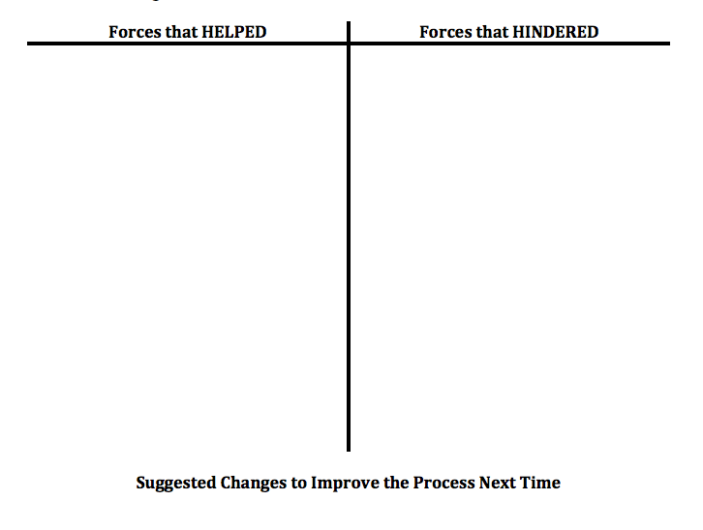
Debriefing the Tuning Process
Pages
3-5
Directions
Use the Debriefing Tool to reflect on your last tuning session.
Identify what HELPED or HINDERED the process.
Share and discuss.
Revise process for next time.
Record changes.

Slide 9
Elements of Effective Lessons
Text-Based Discussion

Slide 10
Activity: Text-Based Discussion
Pages
3-2a-b
As part of your pre-work for Module 3, you were asked to
Read the article entitled: Focusing Formative Assessment on the Needs of English Language Learners.
Complete the Active Reading Organizer.

Slide 11
Activity: Text-Based Discussion
Pages
3-2a-b
3-6a
Please take out the notes you recorded on the active reading organizer. As a team, consider and discuss the following prompts.
What elements of effective lessons did you identify through your reading?
Based on your reading, what are some questions teachers could ask when analyzing a teacher’s lesson plan in order to give constructive feedback?

Slide 12
Analysis of the Procedures for Tuning
Collaborative Activity

Slide 13
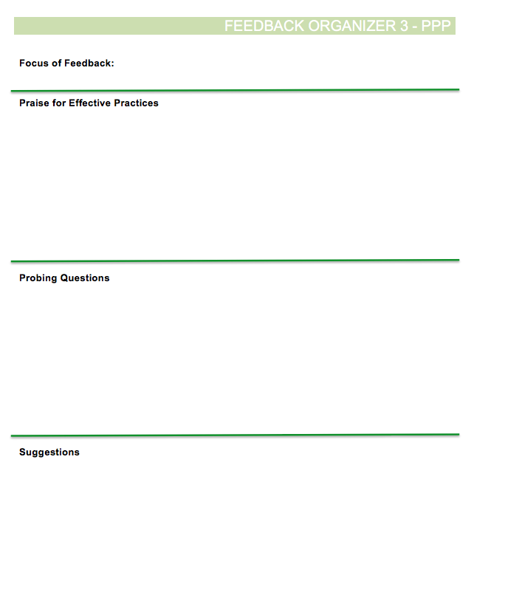
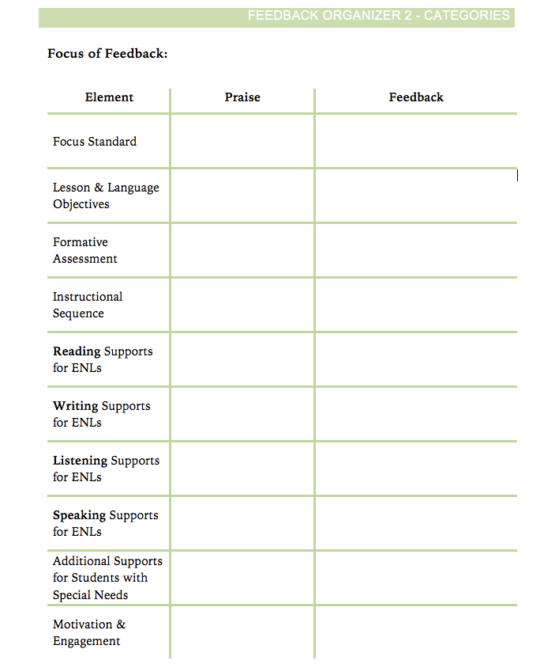
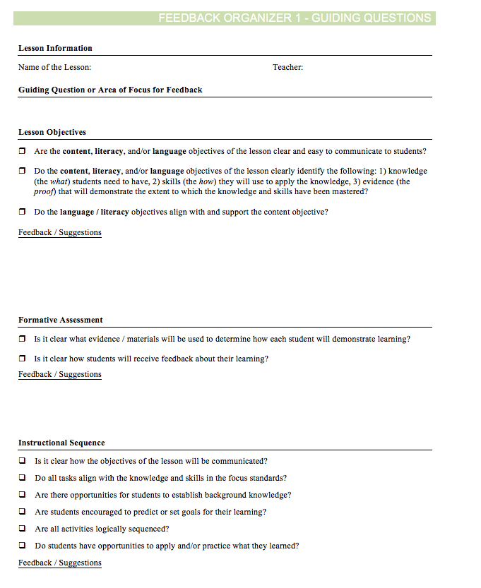
Activity: Review of the Feedback Organizers
Pages
3-8d-f
Directions
Review the three different feedback guides in your course booklet. These guides provide three different options for taking notes during a tuning protocol. You probably explored these during your last two tuning sessions.

Slide 14
Activity: Review of the Feedback Organizers
Pages
3-8d-f
Directions
As a group, discuss the following:
During which step(s) of the tuning process would you use a feedback guide?
What similarities and differences do you observe between the three choices?
In what situations might you use one guide over the others?

Slide 15
Activity: What and Why Analysis
Pages
3-6b
Directions
Open your booklet to the ‘What’ and ‘Why’ Analysis Activity. This is a modified version of Feedback Organizer 1.
Review each element / section of the feedback organizer.
For each element, record your responses to each of the following questions:
What is being looked in the particular lesson element?
Why would this element be important to the lesson?
After everyone has had time to record their thoughts, discuss each element as a group.

Slide 16
Tuning the Lesson Elements
Video Demonstrations

Slide 17
Demonstration Video
Pages
3-7
Next, you will watch four videos of teachers discussing and tuning the elements of a lesson.
As you watch the video, use the Video Observation Sheet to record the following:
Observations
Implications / Interpretations
Questions
Connections to Your Own Work
Be prepared to share and discuss your notes afterwards.

Slide 18
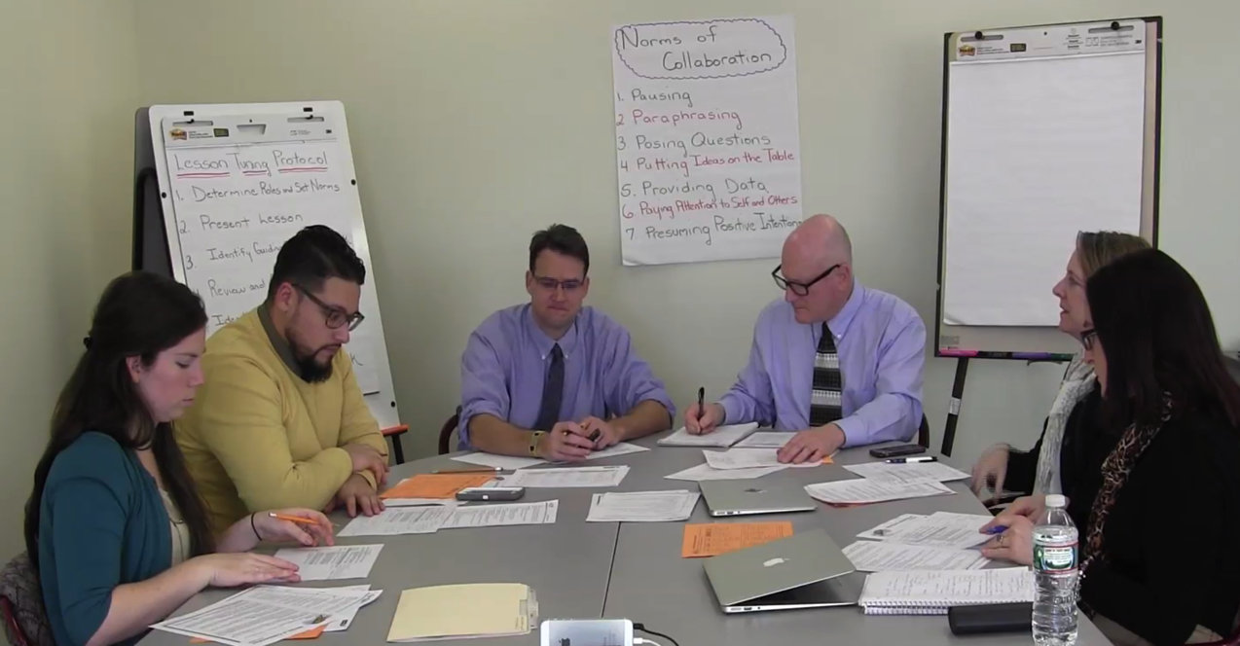
Step6c: Praise of Effective Practices
Pages
3-7
Clicking on the video will take you directly to the Youtube channel video.

Slide 19
Demonstration Videos
Pages
3-7
Share and Discuss
Anything that stood out to you, and
Anything the left you wondering.

Slide 20
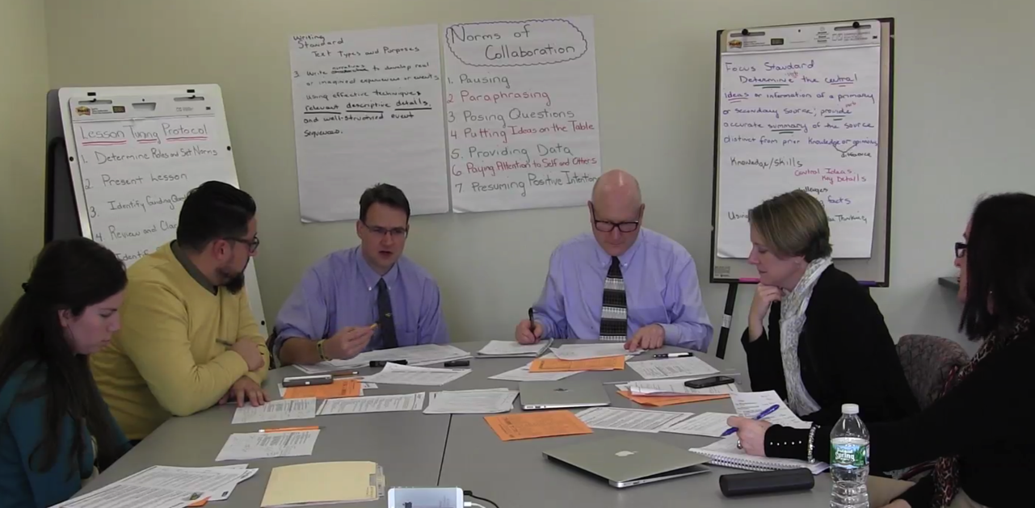
Step6d: Feedback of Lesson Objectives
Pages
3-7
Clicking on the video will take you directly to the Youtube channel video.

Slide 21
Demonstration Videos
Pages
3-7
Share and Discuss
Anything that stood out to you, and
Anything the left you wondering.

Slide 22
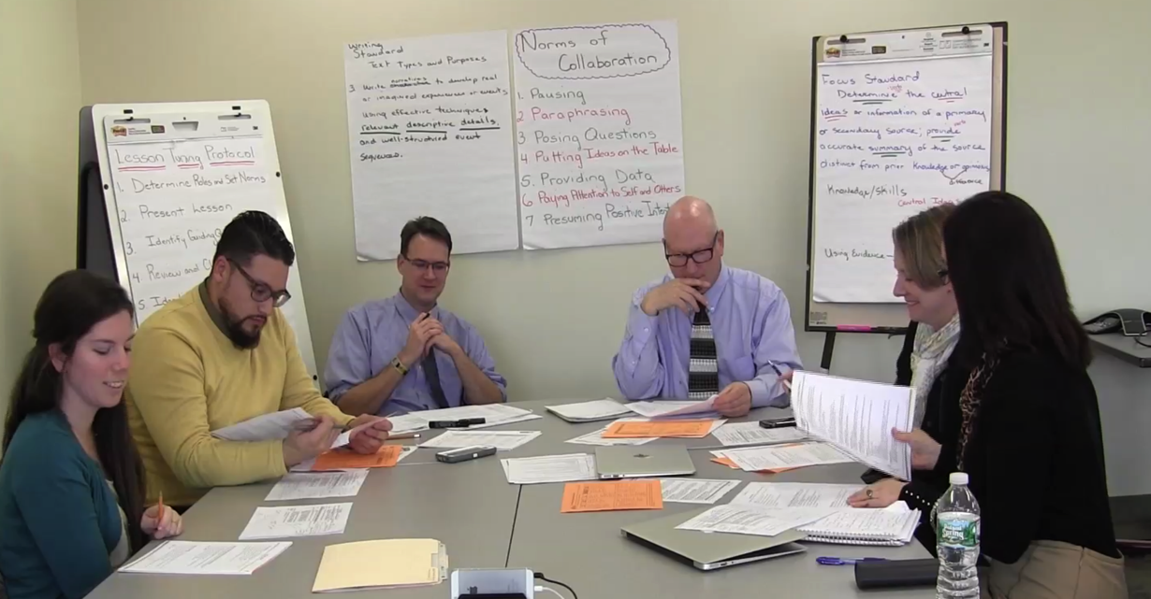
Step 6d - Feedback of Formative Assessment
Pages
3-7
Clicking on the video will take you directly to the Youtube channel video.

Slide 23
Demonstration Videos
Pages
3-7
Share and Discuss
Anything that stood out to you, and
Anything the left you wondering.

Slide 24
Step 6d - Feedback of Instructional Sequence
Pages
3-7
Clicking on the video will take you directly to the Youtube channel video.

Slide 25
Demonstration Videos
Pages
3-7
Share and Discuss
Anything that stood out to you, and
Anything the left you wondering.

Slide 26
Wrapping Up Module 3

Slide 27
What was accomplished in Module 3
Review Group Norms
Debrief the 2nd Round of Collaborative Practice
Participate in Text-Based Discussion
Engage in Feature and Function Activity
Watch and Discuss Demonstration Videos
Schedule 3rd Round of Tuning Practice
Prepare for Module 4

Slide 28
Activity
Discuss the intended outcomes for Module 3. To what extent do you feel they were met?
By the end of Module 3, participants will:
Be able to apply an understanding of specific lesson elements to analyze a lesson and provide feedback to colleagues.

Slide 29
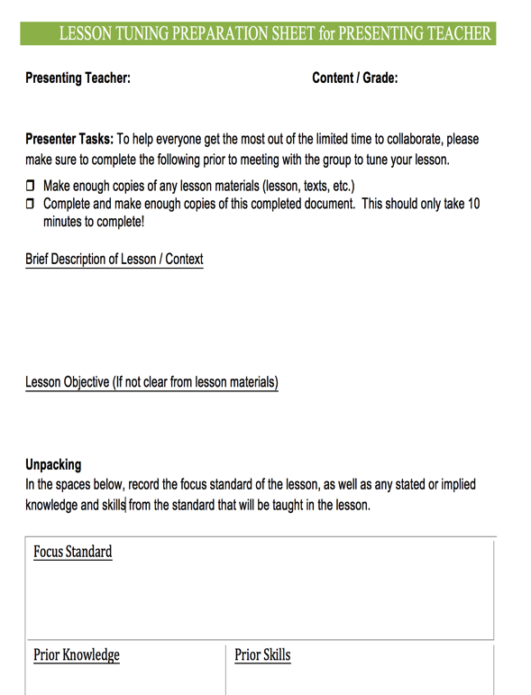
Preparing for Collaborative Practice – Round 3
Pages
3-8a
Clarify date and time for the collaborative practice.
Determine who the presenting teacher will be to bring a lesson to tune.
Determine who will volunteer to facilitate.
Have the presenting teacher complete the prep sheet for presenting teachers prior to meeting.

Slide 30
Preparing for Module 4
All
Complete reading assignments for Module 4.
Clarify Date, Time and Location
Collaborative Practice
Guided Workshop for Module 4
Materials to Bring
Course Booklet, notes from Round 3 of the collaborative tuning practice.

Slide 31
Summary Statement
The heart of Rhode Island Collaborative ENL and General Education model is for RIDE to provide districts and schools with resources to help build capacity to help all learners succeed – particularly including English Learners and students with disabilities.

