Slide 1
How might we reduce chronic absenteeism with behavioral science?
What is the Attendance Tool? And what is the theory behind it ?
1. School Dashboard
2. Nudges to Families
3. State Leaderboard
Easy to read display of school level statistics
Comparison to last year
Charts absences over time
Reminders that raise awareness
Proven effective
Targets parental misunderstanding of absences
Introduces competition
School comparison to state mean and top 10% of schools
Sortable statewide listing of absence rates

Slide 2
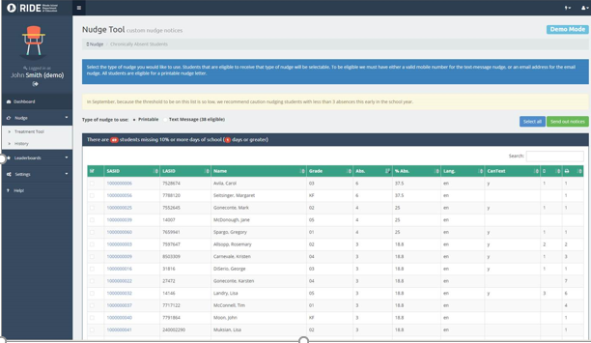
Real time student-level attendance
Each day school leaders can see how many days of school each student has missed in the current year.

Slide 3
Nudge Text Message
The school leader can select which students to nudge. Leaders can select only specific students or can select all students. Text messages to parents are short, positive and compare the student’s attendance to his/her peers.
Notes:
Each phase we will understand challenges and ways to improve:
Delivery
Paper
Text capacity
Parent reaction
Student reaction
LEA/Community reaction
Impact

Slide 4
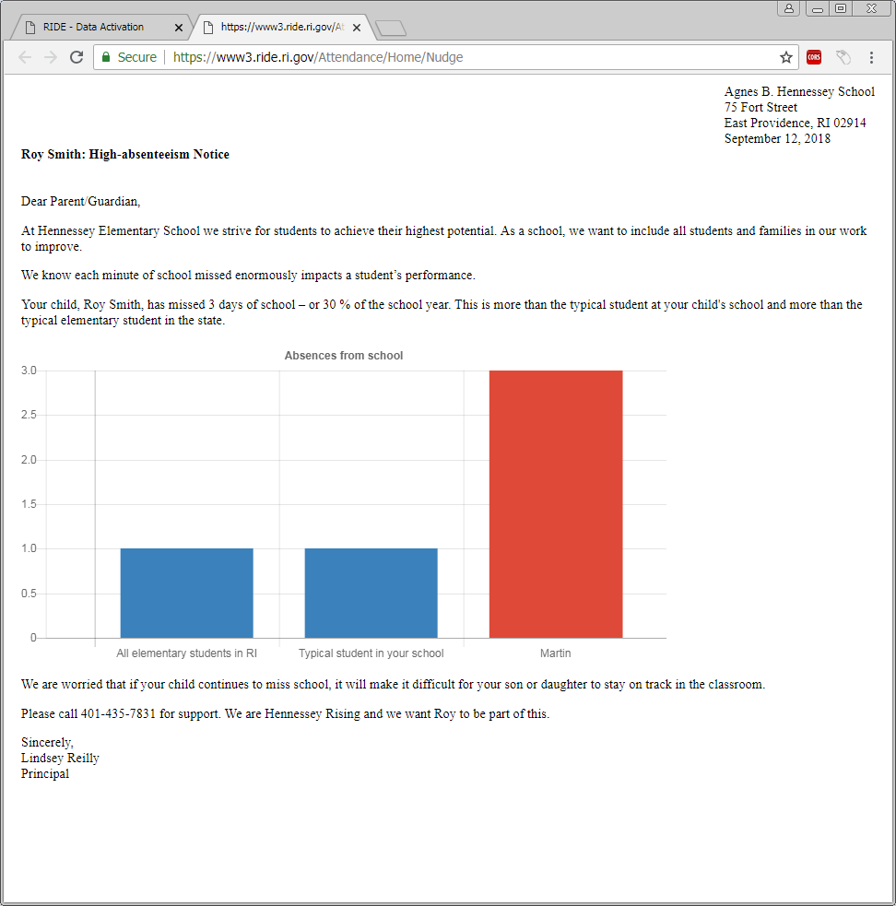
Backpack Letter
Backpack letters compare the student to typical students in the school and the state average. It is similar to the letters sent out by National Grid.

Slide 5
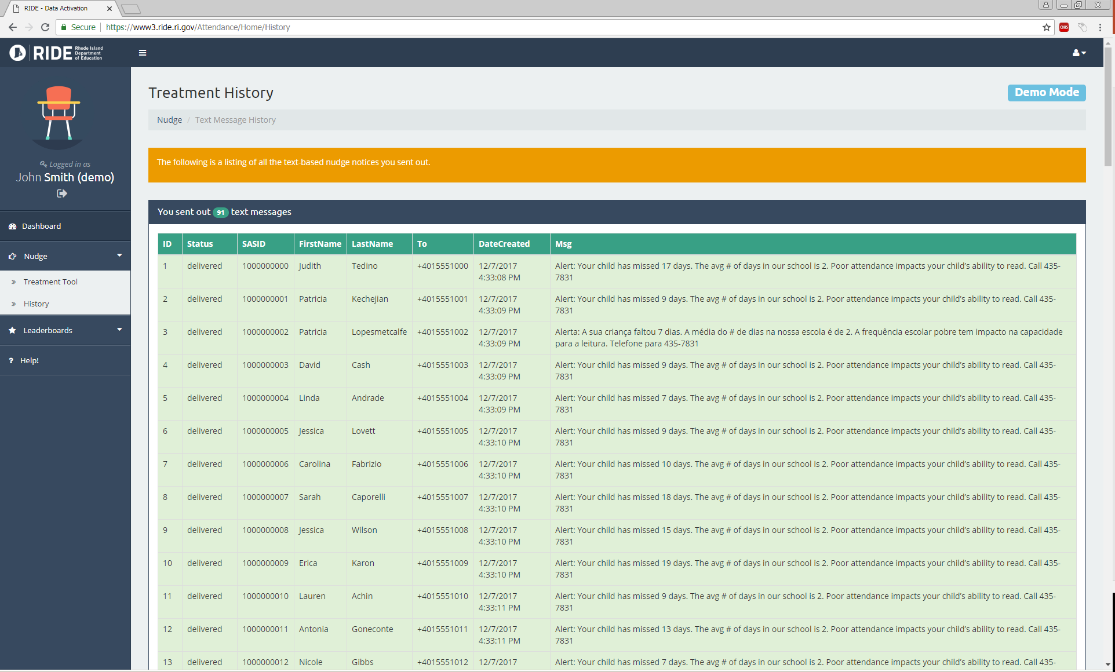
Parent Outreach History
School Leaders have a history of all texts and backpack letters they send throughout the year.

Slide 6
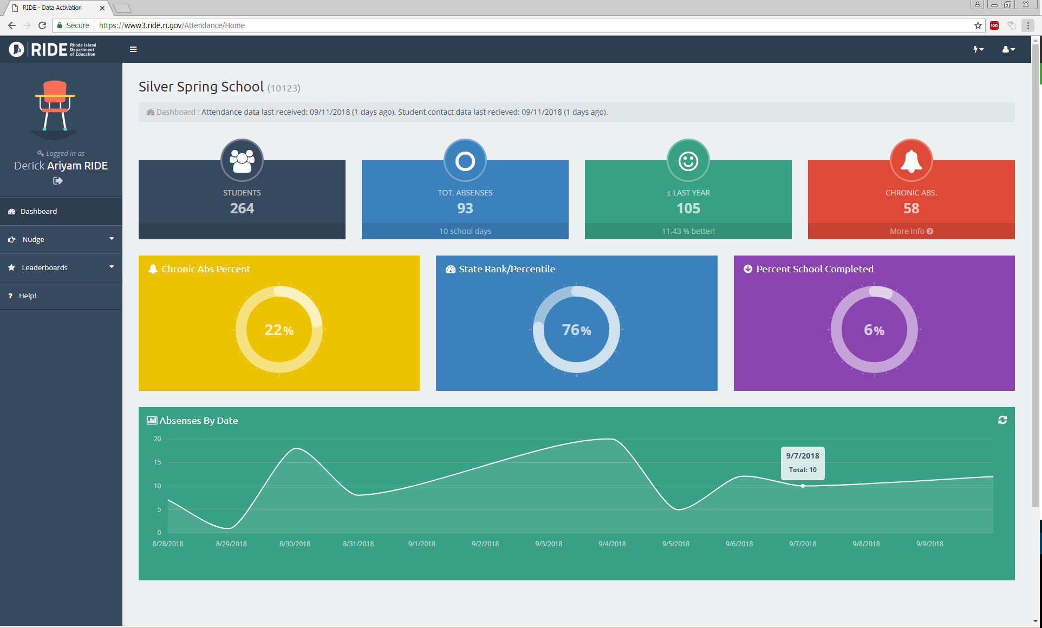
School Attendance Dashboard
A school dashboard allows leaders to compare to last year and to the state. The chart at the bottom shows the number of absences each day so that users can look for attendance patterns.

