Slide 1

SY21-22 Educator Evaluation
Office of Educator Excellence & Certification Services

Slide 2
The Importance of Evaluations and High-Quality Feedback for Educators
Rhode Island is committed to ensuring that all educators receive fair, accurate, and meaningful educator evaluations that provide information that can help improve and refine practice. This commitment is an outgrowth of our recognition of the influence teachers have on student growth and achievement.

Slide 3

Let's Review: SY20-21 LEA Evaluation Options for Teachers & Support Professionals
Option 1: No change; continued with all evaluations as planned.
Option 2: Continued with evaluations for all educators using optional, flexible system requirements:
  Professional Practice: Conducted and scored 2 observations and provide feedback
  Student Learning:
    SLOs/SLO Flex: (1) Require 2, Score 2; (2) Require 2, Score 1; (3) Require 1, Score 1
    EP or SLG models, continue with the model as designed
  Professional Responsibilities: (1) Require 1 PGG; (2) Use school-wide PPG; (3) Use two semester-long PGGs with a check-in at the MOY conference
Option 3: Evaluations for those with Highly Effective/Effective ratings postponed to SY21-22. Those with Developing or Ineffective ratings, non-tenured on performance improvement plans were evaluated in SY20-21.
Notes:
As a reminder, LEAs had the option last year to choose one of these three options for evaluations in SY20-21. Regardless of which option was chosen, LEA data was reported for all educators at the end of SY20-21 with educators being reported as fully evaluated, postponed due to option 3 (No Final Effectiveness Rating), or “cyclical” ( No Final Effectiveness Rating).

Slide 4
SY21-22 LEA Evaluation Options for Teachers & Support Professionals
If you utilized Option 1 or 2 in SY20-21: No Adjustments to the evaluation process needed this year; continue with all evaluations as you would typically in a school year.
If you utilized Option 3 in SY20-21: Conduct evaluations for the following educators:
  All educators whose evaluations were postponed in SY20-21
  Educators who received Developing or Ineffective in SY20-21 evaluation
  Non-tenured educators
You may wish to evaluate all or some educators in the cycle for a SY21-22 evaluation but have the flexibility to postpone HE/E educators to SY22-23 and adjust future caseloads accordingly.
Notes:
If your LEA utilized Option 1 or Option 2 in SY20-21, then there are no changes needed and evaluations can continue as planned for SY21- 22.
If your LEA utilized Option 3 in SY20-21: Conduct evaluations for educators whose evaluations were postponed from SY20-21 along with any educators who received Final Effectiveness Ratings of Developing or Ineffective in SY20-21 and non-tenured educators. Your LEA also has the flexibility to postpone evaluating Highly Effective and Effective educators due for a SY 21-22 evaluation based on their evaluation cycle to SY22-23. If evaluations for Highly Effective and Effective educators are postponed, you may wish to adjust future evaluation caseloads accordingly. LEA data will be reported for all educators at the end of SY21-22 with educators being reported as fully evaluated, postponed due to HE/E (No Final Effectiveness Rating), or “cyclical” ( No Final Effectiveness Rating).

Slide 5
Resetting Evaluation
Important considerations:
Think ahead to the number of evaluations that will need to be completed in SY21- 22 and SY22-23. Consider having new evaluators trained to support current evaluation needs.
Consider how redistributing educators rated Effective and Highly Effective could impact the evaluation caseloads in SY21-22 and beyond. Reconfigure caseloads to address any imbalances, if possible.
Predetermine observation windows that take into account the schedules of educators and evaluators.
Review the Evaluation section of your district's Collective Bargaining Agreement to ensure alignment.

Slide 6
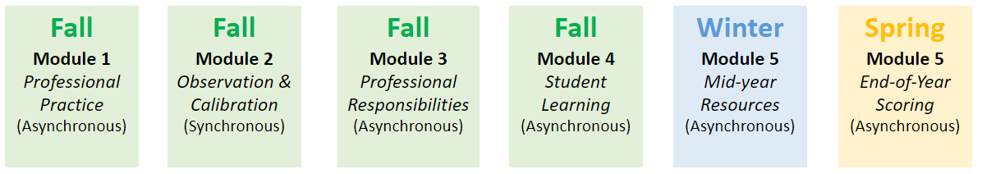
New Educator Evaluator Training
If your district is utilizing new evaluators this year, register for new evaluator training to build an understanding of the R.I. Model of Evaluation and how to engage in educator evaluations.
You can find information on new evaluator training HERE.​
Notes:
RIDE's Educator Evaluator Virtual Learning Academy for new evaluators consists of 5 asynchronous modules and 1 synchronous session in the fall. Please visit the Evaluation page of the RIDE website and select the New Evaluator Training tab to register new evaluators for training. RIDE LEAs who prefer to conduct the traditional 2 day in person training for new evaluators can access both the teacher and support professional materials on the webpage, as well. If you plan on conducting in-person eval training in your district, please feel free to reach out to the Ed Eval Team at edeval@ride.ri.gov. https://www.ride.ri.gov/TeachersAdministrators/EducatorEvaluation/RIModelEvaluationResources.aspx#4114322-2021-22-new-evaluator-training

Slide 7
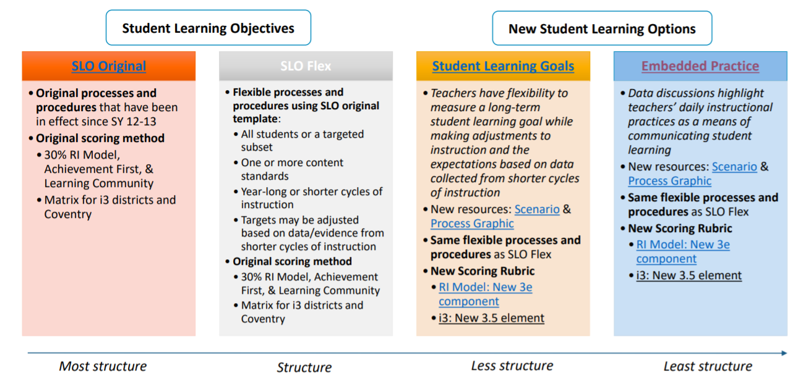
Student Learning Options- Reminder
Learn more here.
Notes:
To address the student learning component of the RIModel Evaluation System, please be reminded of the SLO/SOO Flex Model. The SLO/SOO Flex Model provides a structure for teachers to monitor and assess students’ learning throughout the year, rather than being fixed to a beginning and end point only. With two Options in the SLO/SOO Flex Model, educators are given flexibility to revise student learning targets at the Mid-year OR set SLO/SOOs for shorter cycles of instruction. To learn more, please click the link on the slide above. Learn more about the SLO/SOO Flex Model on the RIDE website: https://www.ride.ri.gov/TeachersAdministrators/EducatorEvaluation/StudentLearning.aspx

Slide 8
SY21-22 LEA Evaluation Options for Building Administrators:
Building Administrators must be evaluated annually
(RIGL § 16-12-11)
Therefore, LEAs are encouraged to review the RI Model’s Evaluation & Support System Multi-year differentiated evaluation cycle for Building Administrators which provides flexibilities for the evaluation process.
Notes:
As a reminder, Building Administrators (BAs) must be evaluated annually, but there are flexibilities that can be utilized if Superintendents/ LEAs would like to implement a multi-year evaluation cycle for BAs. The multi-year differentiated evaluation cycle includes “informal” and “formal” years of activities that are designed to personalize BA’s evaluation experiences. Goals, including SLO(s)/SOO and Professional Growth Goals can span multiple years and include benchmarks. Please keep in mind that new BAs and experienced BAs new to a district should be formally evaluated for at least two consecutive years before meeting local eligibility criteria for the multi-year cycle. If a BA earns a rating of Developing or Ineffective in a formal evaluation year, they are ineligible for an informal evaluation year; in addition, they will need a PIP the following year. Superintendents maintain the right to formally evaluate BAs annually.

Slide 9

Contact Us
Email EdEval@ride.ri.gov with questions, or a request for technical assistance, related to implementing these options in your LEA.

