Slide 1
Innovation Consortium Model EEM Evaluation Data Extract Process for DCAs 2021-2022
Notes:
For any questions regarding setting up and running the extract, please contact pgsupport@frontlineed.com

Slide 2
Important Dates + Guidance
Just like last year, the Final Effectiveness Rating Report (FERR) and related data must first be extracted from EEM by each District Configuration Administrator (DCA) before being uploaded to RIDE’s submission portal via the eRIDE system. The process for setting up the extract template is similar to that of 2020-2021. It is highly recommended that you begin the preparation process now using the following guidance regarding the 2021-2022 evaluation data extract process as soon as possible.
Important Dates
Thursday, June 30, 2022– By this date, all districts must submit and finalize forms for all educators including those on the cyclical process and those not being evaluated for other reasons, including COVID-19 evaluation option #3.
Notes:
For any questions regarding setting up and running the extract, please contact pgsupport@frontlineed.com

Slide 3
Roles
Building administrator –An educator working under a Building Level Administrator certification. This would include school principals, school assistant principals, head of school, etc.
Teacher – An educator working under a teacher certification whose primary responsibilities include instructional planning, managing a classroom environment, and student instruction.
Support professional – An educator, other than a teacher or administrator, who has primary responsibility as an instructional leader, a specialist/consultant, or a related service provider in schools. This would include library media specialists, school nurse teachers, reading specialists/consultants, mathematics specialists/consultants, English as a second language specialists/consultants, instructional leaders, school counselors, school psychologists, speech language pathologists, and school social workers.
Notes:
For any questions regarding setting up and running the extract, please contact pgsupport@frontlineed.com

Slide 4
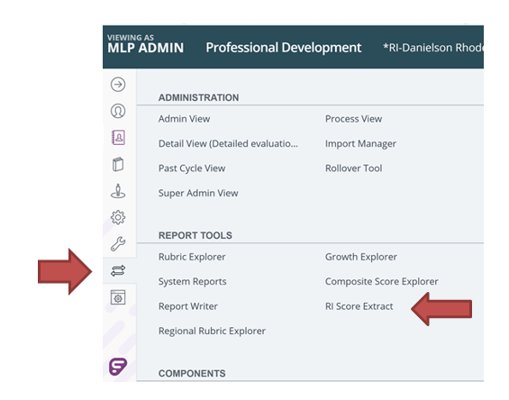
Accessing the Extract tool
To begin this process, click on the two arrows icon, or the ‘Evaluations’ menu, and select the RI Score Extract.
Notes:
For any questions regarding setting up and running the extract, please contact pgsupport@frontlineed.com

Slide 5
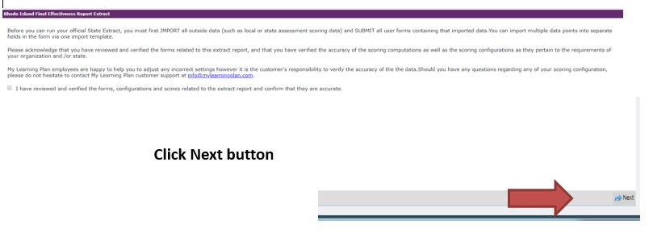
District Verification
Click the check box to confirm that you reviewed and verified the forms, configurations and scores.
Notes:
For any questions regarding setting up and running the extract, please contact pgsupport@frontlineed.com

Slide 6
Step 1 - Creating the Rhode Island Template:
Navigate to the RI Score Extract Tool: Evaluations > Report Tools > RI Score Extract
Click the box on the acknowledgement and click Next
In the Report Template selector, choose New Reporting Template
Name the template RI Extract 21-22
Put in the evaluation cycle dates: 08/01/2021 – 07/01/2022
Click on Save Template
Notes:
For any questions regarding setting up and running the extract, please contact pgsupport@frontlineed.com

Slide 7
Step 2 – Configuring the Extract Template - Teacher:
Select the Teacher section
Select the Teacher type (if you have multiple teacher types select all types)
Map the sources for PPRatingOtherModel:
PPRatingOtherModel: - Select Teacher Final Effectiveness, Teacher Final Effectiveness Report, then Innovation Teacher Final Effectiveness Rating Report, and then PPGR Rating Calculation:
Notes:
For any questions regarding setting up and running the extract, please contact pgsupport@frontlineed.com

Slide 8
Step 2 – Continued: SL Options Teacher (optional)
Map the sources for InstructionalOutcomes, Instructional Processes
InstructionalOutcomes = Select Final Effectiveness Rating Report (SL Options), Final Effectiveness Rating Report, and Demonstrating Instructional Outcomes (right side)
InstructionalProcesses = Select Final Effectiveness Rating Report, Final Effectiveness Rating Report, and Evidence of Instructional Processes (left side)
Notes:
For any questions regarding setting up and running the extract, please contact pgsupport@frontlineed.com

Slide 9
Step 3 - Configuring the Extract Template – Support Professional
Select the Support Professional section
Select the Support Professional type
Map the sources for PPRatingOtherModel
- PPRatingOtherModel – select SP Innovation Final Effectiveness Rating Report, then Innovation SA Final Effectiveness Rating Report, then PPGR Rating Calculation:
Notes:
For any questions regarding setting up and running the extract, please contact pgsupport@frontlineed.com

Slide 10
Step 4 - Configuring the Extract Template – Building Admin:
Select the Building Admin section
Select the Building Admin type
Map the sources for InstructionLeaderRIModel, SiteManagementRIModel, and PRRatingRIModel:
InstructionLeaderRIModel – Select BA Final Effectiveness Rating Report, then Final Effectiveness Rating Report (BA), then Instructional Leadership Sum
SiteManagementRIModel - Select BA Final Effectiveness Rating Report, then Final Effectiveness Rating Report (BA), then Site Management Sum
PRRatingRIModel - Select BA Final Effectiveness Rating Report, then Final Effectiveness Rating Report (BA), then Professional Responsibilities Sum
Notes:
For any questions regarding setting up and running the extract, please contact pgsupport@frontlineed.com

Slide 11
Step 5 - Configuring the Extract Template – All Models:
Select the All Models Section
Select All Model Type(s): Teacher, Building Administrator, and Support Professional
SLO 1 = Select BA Final Effectiveness Rating Report, SP Innovation Final Effectiveness Rating Report, Teacher Final Effectiveness Rating Report, Teacher Innovation Final Effectiveness Rating Report, then **Innovation Teacher Final Effectiveness Rating Report, Final Effectiveness Rating Report (BA), Innovation SA Final Effectiveness Rating Report, Innovation Teacher Final Effectiveness Rating Report, then select SLO/SOO Score # 1 fields
SLO 2 = Select BA Final Effectiveness Rating Report, SP Innovation Final Effectiveness Rating Report, Teacher Final Effectiveness Rating Report, Teacher Innovation Final Effectiveness Rating Report, then **Innovation Teacher Final Effectiveness Rating Report, Final Effectiveness Rating Report (BA), Innovation SA Final Effectiveness Rating Report, Innovation Teacher Final Effectiveness Rating Report, then select SLO/SOO Score # 2 fields
SLO 3 = Select BA Final Effectiveness Rating Report, SP Innovation Final Effectiveness Rating Report, Teacher Final Effectiveness Rating Report, Teacher Innovation Final Effectiveness Rating Report, then **Innovation Teacher Final Effectiveness Rating Report, Final Effectiveness Rating Report (BA), Innovation SA Final Effectiveness Rating Report, Innovation Teacher Final Effectiveness Rating Report, then select SLO/SOO Score # 3 fields
SLO 4 = Select BA Final Effectiveness Rating Report, SP Innovation Final Effectiveness Rating Report, Teacher Final Effectiveness Rating Report, Teacher Innovation Final Effectiveness Rating Report, then **Innovation Teacher Final Effectiveness Rating Report, Final Effectiveness Rating Report (BA), Innovation SA Final Effectiveness Rating Report, Innovation Teacher Final Effectiveness Rating Report, then select SLO/SOO Score # 4 fields
ReasonNoFERRating = Select BA Final Effectiveness Rating Report, SP Innovation Final Effectiveness Rating Report, Teacher Final Effectiveness Rating Report, Teacher Innovation Final Effectiveness Rating Report, then **Innovation Teacher Final Effectiveness Rating Report, Final Effectiveness Rating Report (BA), Innovation SA Final Effectiveness Rating Report, Innovation Teacher Final Effectiveness Rating Report, then select Reason for no Final Effectiveness Rating: fields.
ReasonNoFERRatingOther = Select BA Final Effectiveness Rating Report, SP Innovation Final Effectiveness Rating Report, Teacher Final Effectiveness Rating Report, Teacher Innovation Final Effectiveness Rating Report, then **Innovation Teacher Final Effectiveness Rating Report, Final Effectiveness Rating Report (BA), Innovation SA Final Effectiveness Rating Report, Innovation Teacher Final Effectiveness Rating Report, then select *If Other, please explain: fields.
LongTermSub = Select BA Final Effectiveness Rating Report, SP Innovation Final Effectiveness Rating Report, Teacher Final Effectiveness Rating Report, Teacher Innovation Final Effectiveness Rating Report, then **Innovation Teacher Final Effectiveness Rating Report, Final Effectiveness Rating Report (BA), Innovation SA Final Effectiveness Rating Report, Innovation Teacher Final Effectiveness Rating Report, then select Is this a long-term substitute? fields.
OverallStudentLearningScore = Select BA Final Effectiveness Rating Report, SP Innovation Final Effectiveness Rating Report, Teacher Final Effectiveness Rating Report, Teacher Innovation Final Effectiveness Rating Report, then **Innovation Teacher Final Effectiveness Rating Report, Final Effectiveness Rating Report (BA), Innovation SA Final Effectiveness Rating Report, Innovation Teacher Final Effectiveness Rating Report, then select Overall Student Learning Average Score & Student Learning Matrix fields.
FinalEffectivenessRating = Select BA Final Effectiveness Rating Report, SP Innovation Final Effectiveness Rating Report, Teacher Final Effectiveness Rating Report, Teacher Innovation Final Effectiveness Rating Report, then **Innovation Teacher Final Effectiveness Rating Report, Final Effectiveness Rating Report (BA), Innovation SA Final Effectiveness Rating Report, Innovation Teacher Final Effectiveness Rating Report, then select Final Effectiveness Matrix and Final Effectiveness Rating fields.
Click Save Template
Notes:
Note: For SLO #1-4, there will only be four choices (not five) in the “selection” menu because the Teacher Pilot does not have this form.
For any questions regarding setting up and running the extract, please contact pgsupport@frontlineed.com

Slide 12
Step 5 continued - Configuring the Extract Template – All Models:
Click Next button
Notes:
For any questions regarding setting up and running the extract, please contact pgsupport@frontlineed.com

Slide 13
Save Extracted Data File
You may continue onto the next set of steps to extract the data. This will generate a file that contains the Final Effectiveness Ratings for all your educators.
OR
You may come back another day to only run the extract and generate the file to upload to eRIDE. You will begin with the steps outlined on slides 4, then slide 5. On slide 6, you will select ‘RI Extract 21-22 in the dropdown, and then follow the steps 6 through 11 on the following slides.
Notes:
For any questions regarding setting up and running the extract, please contact pgsupport@frontlineed.com

Slide 14
Step 6 - Review the Forms not Saved/Submitted
“The following are forms that are active within a user’s process and have not yet been saved or submitted. Either inactivate (zero out the instance of that form) or click the form name below to complete the form.”
You can submit right from this screen by clicking the blue form link
Depending on the amount of data, this screen may take a few minutes to populate the information
When finished, click Next
Notes:
For any questions regarding setting up and running the extract, please contact pgsupport@frontlineed.com

Slide 15
Step 7 - Review Forms with Blank Values
“The following forms have been submitted but are missing one or more required values within the submitted form. Click the form name to open and review/resubmit that form with completed values.”
You can click on the form link to populate the missing field.
When finished, click Next.
Notes:
For any questions regarding setting up and running the extract, please contact pgsupport@frontlineed.com

Slide 16
Step 8 - Composite Score Forms that need to be reviewed and resubmitted
“The following forms were submitted, however prior forms that contribute scoring information to the form have been edited. These composite scores may be outdated as a result. Please review the form, edit and resubmit to ensure the latest scoring data is included.”
You can edit and resubmit right from this screen by clicking the blue form link.
When finished, click Next.
Notes:
For any questions regarding setting up and running the extract, please contact pgsupport@frontlineed.com

Slide 17
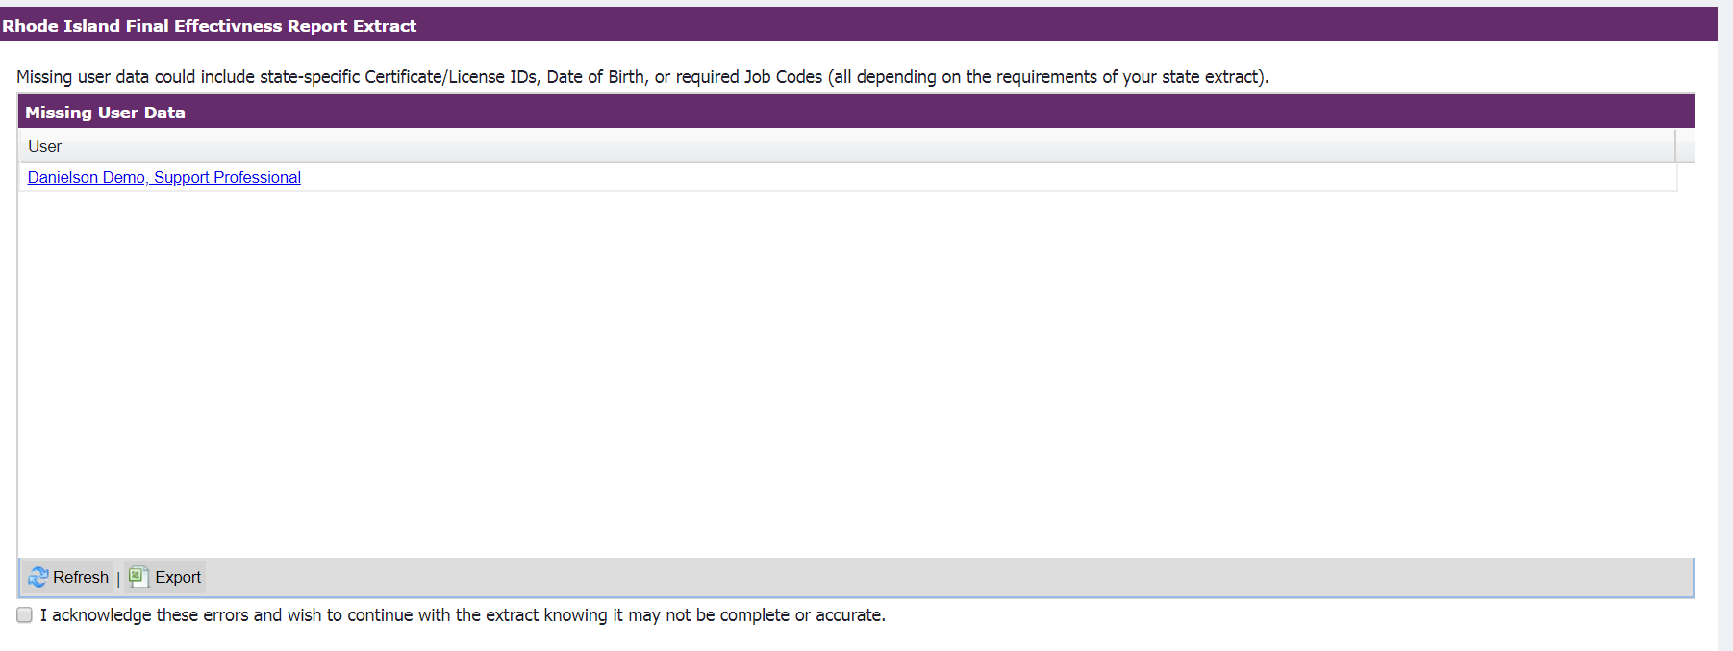
Step 9 - Missing User Data
Missing user data could include (but not limited to) Certificate IDs, SchoolCode when Evaluation Type is Building Administrator, or LongTermSubstitute flag. You can look up an educator’s certificationID at this website: https://ecert.ride.ri.gov/public/
Click on link for the user and populate the missing data.
Notes:
For any questions regarding setting up and running the extract, please contact pgsupport@frontlineed.com

Slide 18
Step 10 – Preview Extract Data
Use this step to review all the data information. When evaluation type is Building Administrator, please be sure that the school code matches the 5-digit school code on the RIDE school directory listing. Look up your school in the RIDE School directory at https://www.ride.ri.gov/StudentsFamilies/RIPublicSchools/SchoolDirectory.aspx
Click “Next” at the bottom right corner to proceed to the next screen to download the extract.
Notes:
For any questions regarding setting up and running the extract, please contact pgsupport@frontlineed.com

Slide 19
Step 11 - Run the Extract
Click on the DOWNLOAD button to retrieve the CSV file.
Note: The file can be downloaded and opened as many times as needed. When ready to upload to RIDE via the PAS, download the file one last time and do not open to preserve file formatting.
Notes:
For any questions regarding setting up and running the extract, please contact pgsupport@frontlineed.com

Slide 20
Save Extracted Data File
Please be sure to save the file in the location of your choice, maintaining confidentiality requirements. The downloaded file must not be opened in Excel as it will change the formatting and lead to errors in upload. If you wish to open the file to review for accuracy, be sure to ONLY open it using Notepad.
Please review guidance on uploading this extracted data file to RIDE’s portal which is located on the Educator Evaluation page of the RIDE website.
Notes:
For any questions regarding setting up and running the extract, please contact pgsupport@frontlineed.com

Slide 21
Submission Process
Educator Evaluation data can be submitted through eRIDE (www.eride.ri.gov) using the Personnel Data Collection. Educator Evaluation is a submission type within the Personnel Data Collection application.
You can review the upload to eRIDE guidance here.
Thursday, June 30, 2022– By this date, all districts must submit and finalize forms for all educators including those on the cyclical process and those not being evaluated for other reasons.
Notes:
For any questions regarding the upload process, please email edeval@ride.ri.gov.

