Slide 1
CNP Connect
Submitting a Monthly Meal Claim for Reimbursement
A Step-by-Step Guide
Seamless Summer Option (SSO)
https://ri.cnpus.com/prod/Splash.aspx
Updated July 2021
Notes:
Hello and welcome to this step by step guide to claiming in CNP Connect. In this webinar we will be specifically reviewing the Seamless Summer Option claiming system. The link to the CNP Connect system is listed on the screen.

Slide 2
In order to receive reimbursement for meals served as part of the Seamless Summer Option (SSO), you will need to submit a monthly claim for reimbursement.
To complete this process you will need: monthly enrollment for all sites, and monthly meal counts for all sites by meal period (i.e. breakfast, lunch, etc.).
Claims for reimbursement must be entered through the CNP connect online system. We ask that all claims be submitted within 10 days after the last service day of the month for which you are claiming.
Please remember: the CNP connect system is compatible with any browser except Internet Explorer.
The following slides will walk you step-by-step through the monthly claim process.
Notes:
Lets note a few important points before we get into it…
In order to receive reimbursement for meals served as part of the Seamless Summer Option (or SSO), you will need to submit a monthly claim for reimbursement…
To do that, you will need some information with you to enter into the system which includes; the monthly enrollment for all sites, and monthly meal counts for all sites by meal period (i.e. breakfast, lunch, etc.).
We ask that all claims be submitted within 10 days after the last service day of the month for which you are claiming.
As a reminder, the CNP connect system is compatible with any browser except Internet Explorer.
And now lets get in to claiming meals under the SSO.

Slide 3
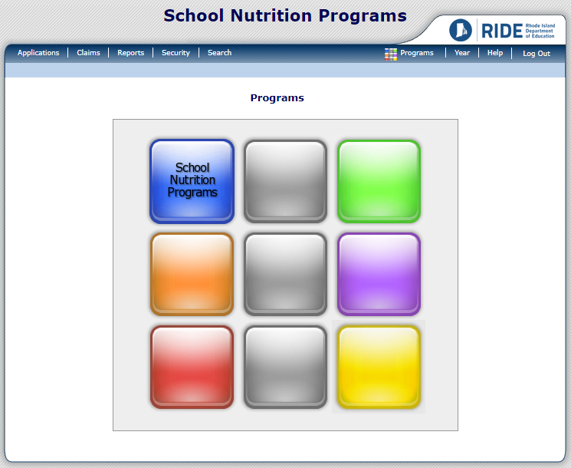
Log into CNP Connect with your username and password.
If you are connected to multiple sponsors, you will need to select the sponsor you wish to enter claims under. To do so, select the “search” button on the navigation bar at the top.
If you are only connected to one sponsor, you can skip to slide 6.
Notes:
Once you have logged in with your username and password, you will come to this landing screen as shown on your screen.
If you are connected to multiple sponsors, you will need to select the sponsor you wish to enter claims under. To do so, select the “search” button on the navigation bar at the top.
If you are only connected to one sponsor, you can skip to slide 6.

Slide 4
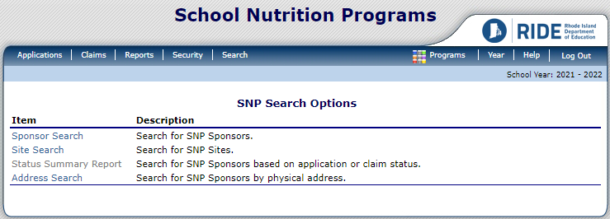
Select “Sponsor Search” from the search menu.
Notes:
Select “Sponsor Search” from the search menu.

Slide 5
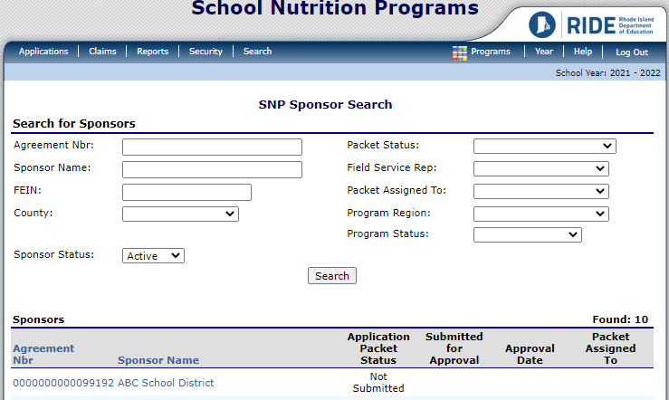
To view all of your available sponsors, select “search” from the sponsor search menu.
Your available sponsors will display below. Select the sponsor you wish to enter claims for.
Notes:
To view all of your available sponsors, select “search” from the sponsor search menu.
Your available sponsors will display below so you can select the sponsor you wish to enter claims for.

Slide 6
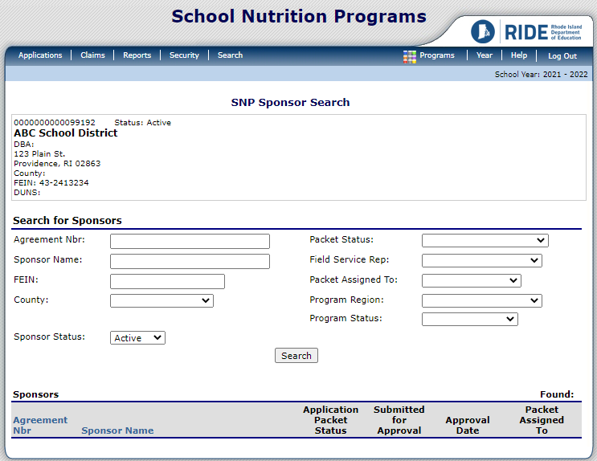
Be sure you’re entering your claim in the correct operating year. The school year you are currently in is always displayed in the upper right hand side of the menu.
To switch years, select “year” from the upper right side of the navigation bar.
Notes:
Now you want to be sure you’re entering your claim in the correct operating year. The school year you are currently in is always displayed in the upper right hand side of the menu.
To switch years, select “year” from the upper right side of the navigation bar.

Slide 7
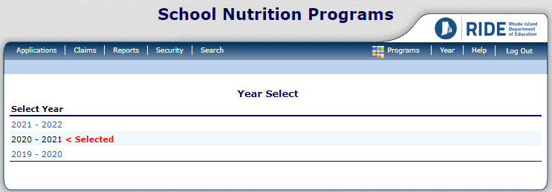
Select the operating year you wish to enter.
Notes:
Select the school year you wish to enter

Slide 8
Once the operating year is selected, enter the claiming menu by clicking on the “Claims” button on the navigation bar at the top.
Notes:
Once the operating year is selected, enter the claiming menu by clicking on the “Claims” button on the navigation bar at the top.

Slide 9
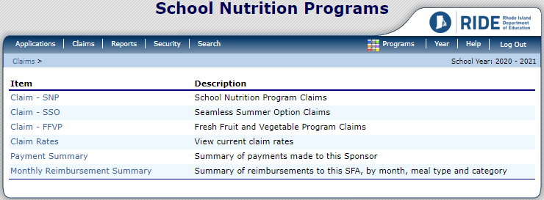
Select “Claim – SSO” to enter claims for the Seamless Summer Option (SSO).
Notes:
Select “Claim – SSO” to enter claims for the Seamless Summer Option (SSO).

Slide 10
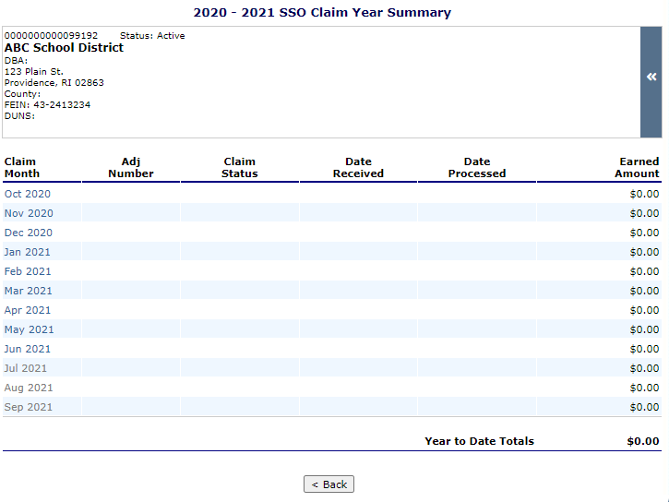
Months in blue are available for claiming entry. Months that are greyed out are unavailable either due to having been fully processed, or the month has not yet begun.
To enter the month you wish to submit a claim for, select the month and year.
For this example, we will enter a claim for May 2021.
Notes:
You can see that the months in blue are available for claiming entry. Months that are greyed out are unavailable either due to having been fully processed, or the month has not yet begun.
To enter the month you wish to submit a claim for, select the month and year.
For this example, we will enter a claim for May 2021.

Slide 11
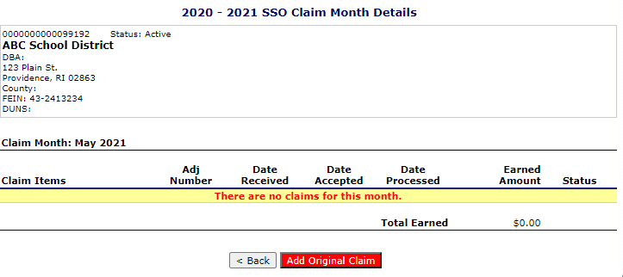
To add a new claim for the month selected, click “Add Original Claim”
Notes:
To add a new claim for the month selected, click “Add Original Claim”

Slide 12
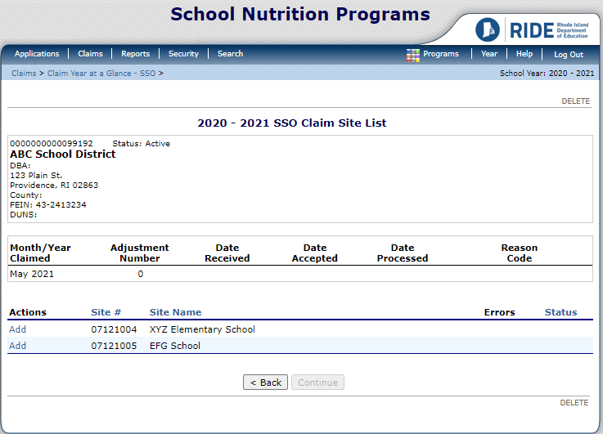
Select the site you wish enter a claim for by clicking on “Add” to the left of the site name and number.
Notes:
Select the site you wish enter a claim for by clicking on “Add” to the left of the site name and number.

Slide 13
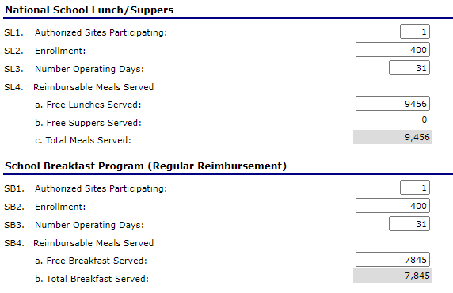
The meals checked off on the site application are the only meals that will be available for claiming.
Note that claims are entered by MONTH in this new system.
SL1. Enter the number of authorized sites participating. (This should be 1.)
SL2. Enter the student enrollment for that site.
SL3. Enter the number of operating days for the month.
SL4. Enter the number of claimed lunches. (All are free under the SSO.)
Repeat these steps for breakfast questions SB1-SB4.
Notes:
The meals that were originally checked off on the site application, are the only meals that will be available for claiming.
An important thing to note is that claims are entered by MONTH in this new system. So you will be entering one total number for the month under each meal you are claiming for.
So lets go through the entries required for a lunch claim:
In question SL1, enter the number of authorized sites participating. (This should typically be 1 since you are entering one site at a time.)
In SL2, enter the student enrollment for the site.
In SL3, enter the number of operating days for the month.
And in SL4, enter the number of claimed lunches for the month. (All meals are categorized as free under the SSO.)
The same series of questions will apply for breakfast SB1-SB4.

Slide 14
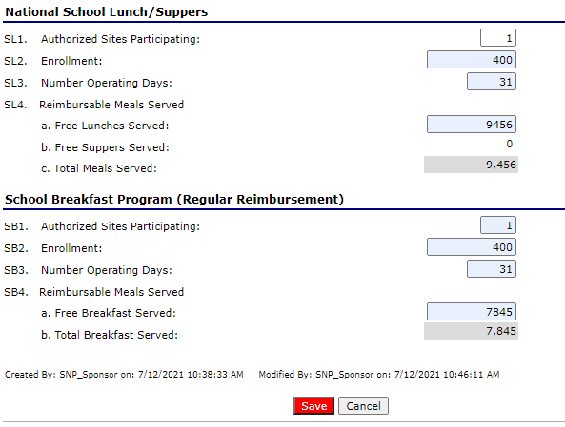
Once you have all claiming information entered for each meal, save your entries by clicking “save” at the bottom of the screen.
Notes:
Once you have all claiming information entered for each meal, save your entries by clicking “save” at the bottom of the screen.

Slide 15
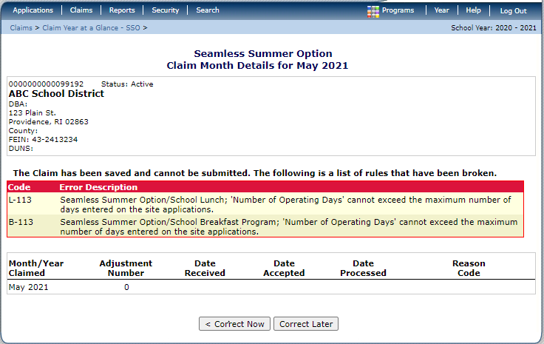
You may encounter errors after saving your claim.
Common errors include:
Entering a number of meals that exceeds student enrollment multiplied by the operating days.
The number of operating days exceeds the number of operating days entered in the site application.
Missing information.
If you receive an error message you may select “correct now” to fix the claiming error immediately, or “correct later” to go back another time. You will not be able to submit a claim with errors.
Notes:
You may encounter errors after saving your claim.
Some common errors include:
Entering a number of meals that exceeds student enrollment multiplied by the operating days… or
The number of operating days exceeds the number of operating days entered in the site application…
Or you may simply have missing information.
If you receive an error message you may select “correct now” to fix the claiming error immediately, or “correct later” to go back another time. You will not be able to submit a claim until any and all errors are resolved.

Slide 16
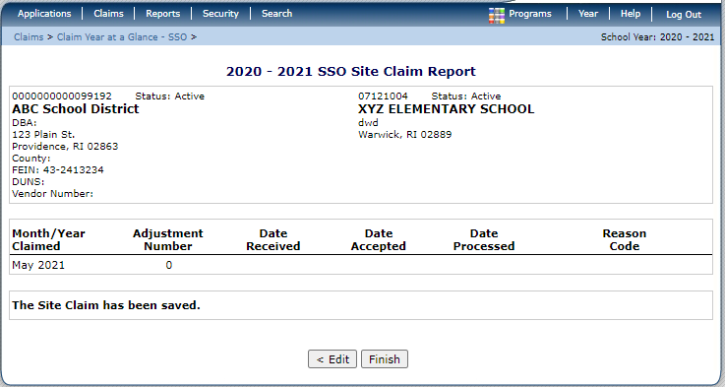
Once you have entered your claim and corrected any potential errors, you will be informed that “The Site Claim has been saved”. Click “Finish” to return to the Claim Site List.
Notes:
Once you have entered your claim and corrected any potential errors, you will be informed that “The Site Claim has been saved”. Click “Finish” to return to the Claim Site List.

Slide 17
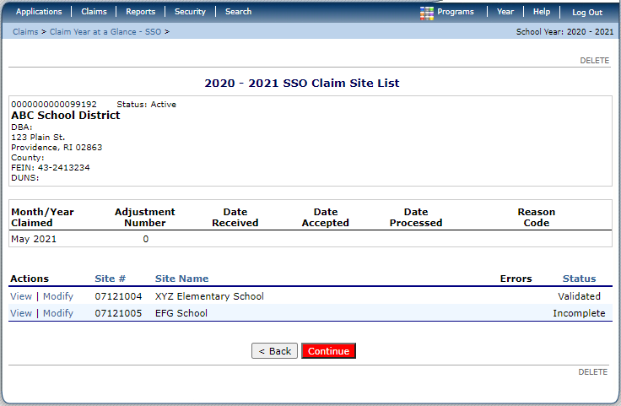
Repeat slides 12-16 for any other sites you wish to claim for the selected month. Once all of your sites are “Validated”, select “Continue”.
Notes:
Repeat the steps from slides 12-16 for any other sites you wish to claim for the selected month. Once all of your sites are “Validated”, select “Continue”.

Slide 18
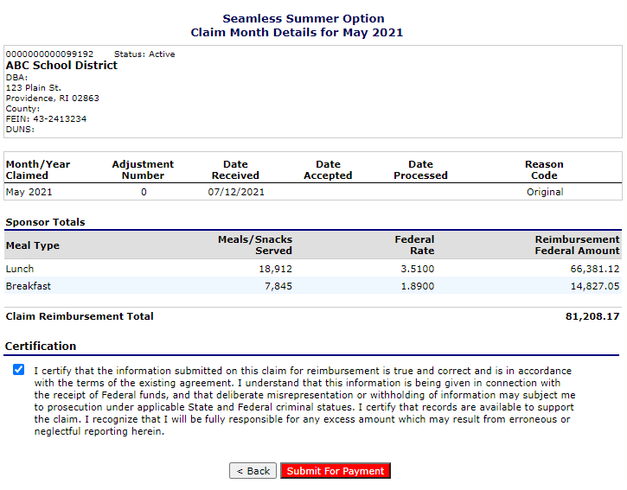
Combined totals for all sites by meal will display on the Claim Month Details page.
To submit the claim, you will need to select the certification checkbox after reading the Certification Statement.
Select “Submit for Payment” when ready to send to RIDE.
Notes:
Combined totals for all sites by meal will display on the Claim Month Details page, like you see here.
To submit the claim, you will need to select the certification checkbox after reading through the Certification Statement.
Select “Submit for Payment” when ready to send to RIDE.

Slide 19
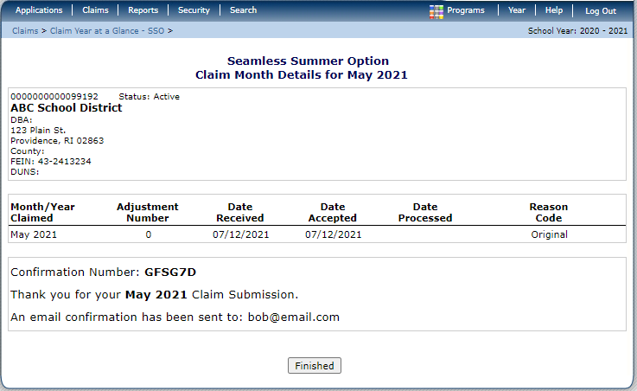
A confirmation message will appear on the screen. Click “Finished”.
Notes:
Next, a confirmation message will appear on the screen, and you may click “Finished”.

Slide 20
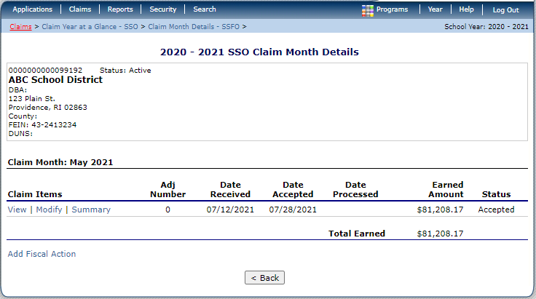
A summary of your monthly claim will display on the Claim Month Details page. Select “back” to go back to the main claiming menu for the school year.
Notes:
A summary of your monthly claim will display on the Claim Month Details page. You can select “back” to go back to the main claiming menu for the school year.

Slide 21
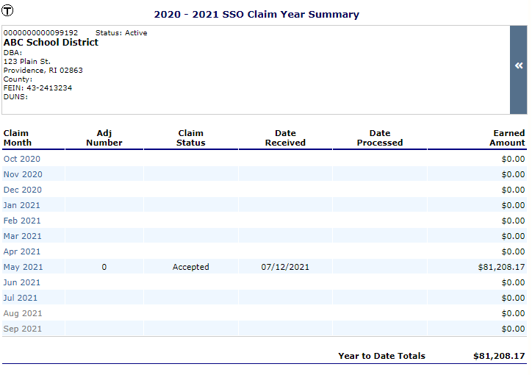
Here, you can see the claim we submitted for May 2021.
Once a claim has been paid, the Claim Status will change from “Accepted” to “Processed”.
Notes:
Here, you can see the claim we submitted for May 2021.
Once a claim has been paid, the Claim Status will change from “Accepted” to “Processed”.

Slide 22
If you need to modify a claim before it has been processed by RIDE, select the month that needs to be modified.
Notes:
If you need to modify a claim before it has been processed by RIDE, select the month that needs to be modified.

Slide 23
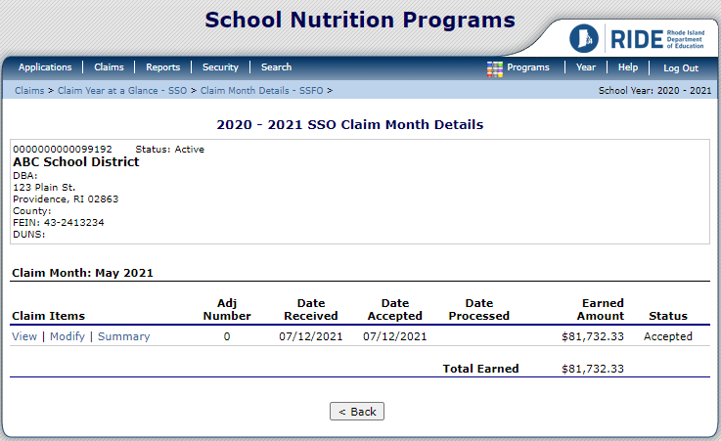
Click “Modify”.
Notes:
Click “Modify” on the claim.

Slide 24
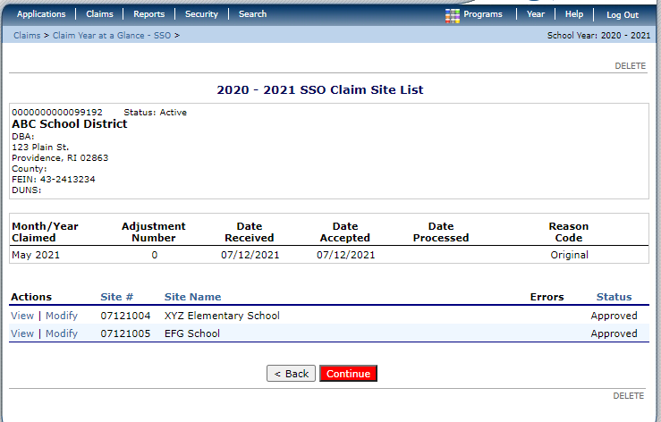
Click “Modify” for the site you wish to edit.
Notes:
Click “Modify” for the site you wish to edit.

Slide 25
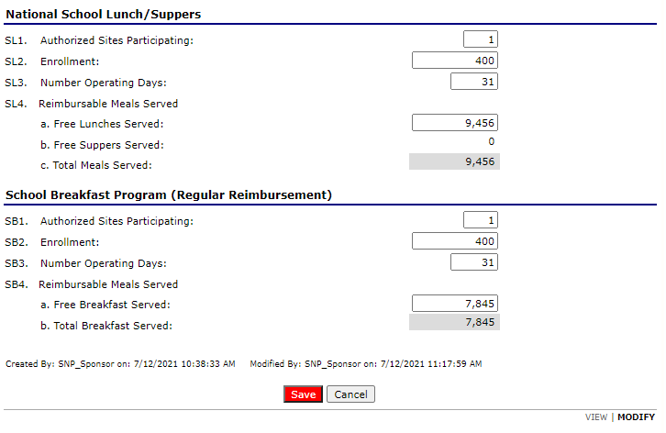
Edit your claim and click “Save”.
Repeat slides 15-20.
Notes:
Edit your claim and click “Save”.
Repeat slides 15-20.

Slide 26
To ensure prompt payment, we ask that all claims be entered within 10 calendar days after the close of the month for which you are claiming.
If you fail to submit a claim within 60 days of the last serving day in the month for which you are claiming, you will lose the ability to submit a claim for reimbursement for that month unless you submit and are approved for an exception request in accordance with our claiming policy.
Please contact us at RIDE if you have any questions about claiming under the SSO.
Notes:
To ensure prompt payment, we ask that all claims be entered within 10 calendar days after the close of the month for which you are claiming.
If you fail to submit a claim within 60 days of the last serving day in the month for which you are claiming, you will lose the ability to submit a claim for reimbursement for that month unless you submit and are approved for an exception request in accordance with our claiming policy.
Please contact us at RIDE if you have any questions about claiming under the SSO.

Slide 27
Contact Information
School Meal Programs
Sandra Fabrizio
RIDE Nutrition Program Specialist
Sandra.fabrizio@ride.ri.gov
401-222-4682
Jenn Goodwin
RIDE Nutrition Consultant
Jennifer.goodwin@ride.ri.gov
401-222-4269
Katie Silva
RIDE Nutrition Consultant
Katherine.silva@ride.ri.gov
401-222-4257
Child Nutrition Programs
Jessica Patrolia
RIDE Nutrition Programs Coordinator
Jessica.patrolia@ride.ri.gov
401-222-4253
Billy Trimble
Associate Director
William.trimble@ride.ri.gov
401-222-4650
Lauren Panzarella
Research Technician
Lauren.Panzarella@ride.ri.gov
401-222-4252
Notes:
If you have any questions about the information covered in this presentation, or any other questions about the School Meal Programs, feel free to contact us anytime. Thank you.

