Slide 1



EdReports
What’s the Big Deal,
Why Does it Matter,
and What Does This Have to do with Dyslexia?

Slide 2

EdReports
Curricular information you don’t have time to gather yourself
Hundreds of highly qualified educators
+
Page by page analysis
=
Evidence of effectiveness and information to help you determine if you want to use the program
Click here for additional information
on the EdReports process

Slide 3

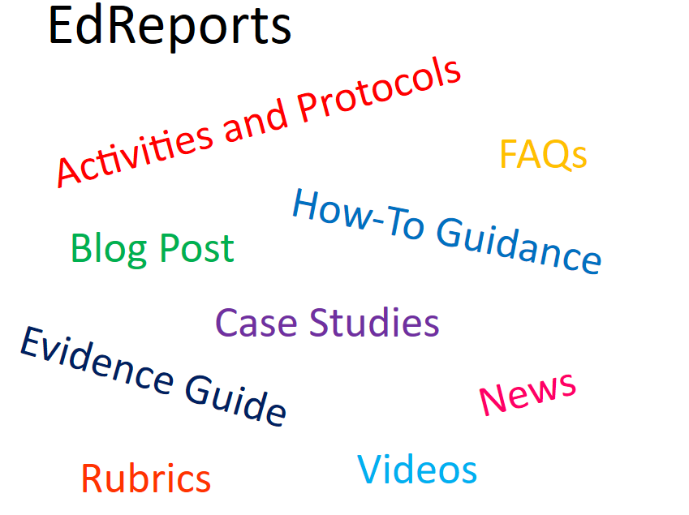

Slide 4

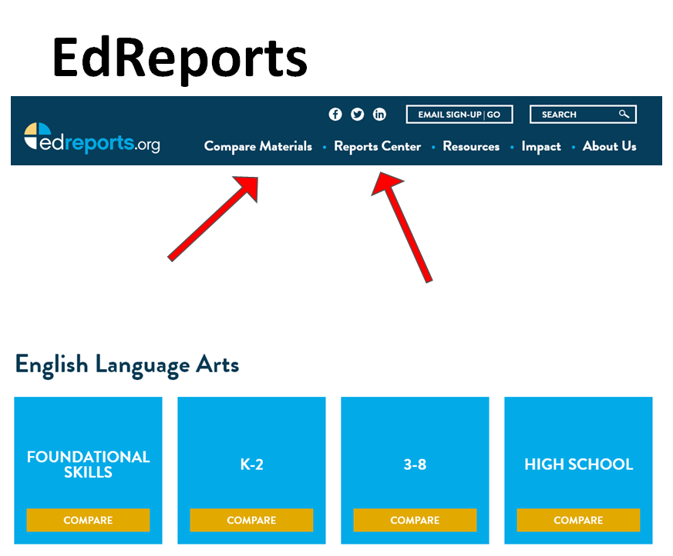

Slide 5

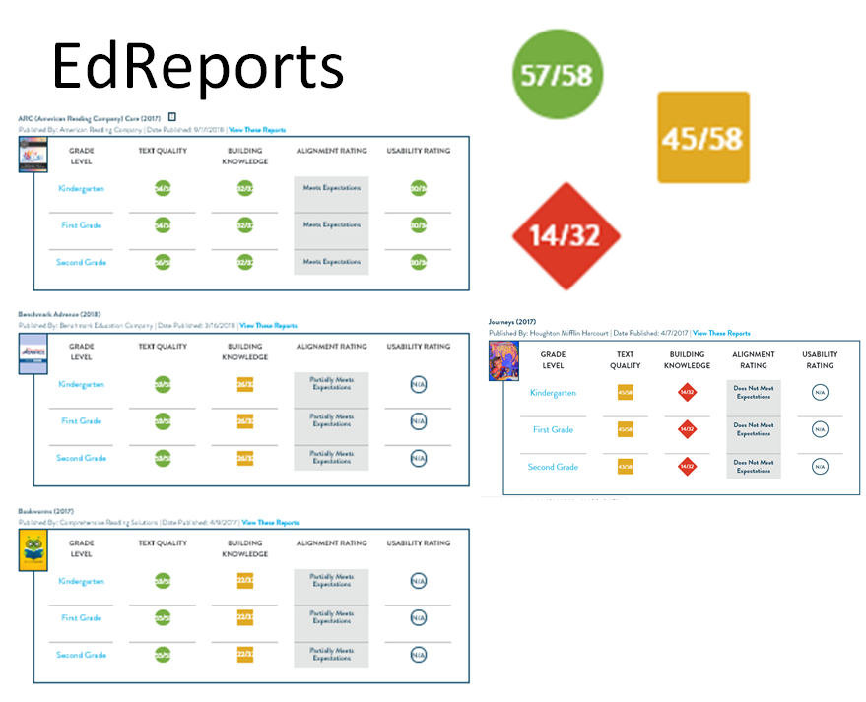

Slide 6

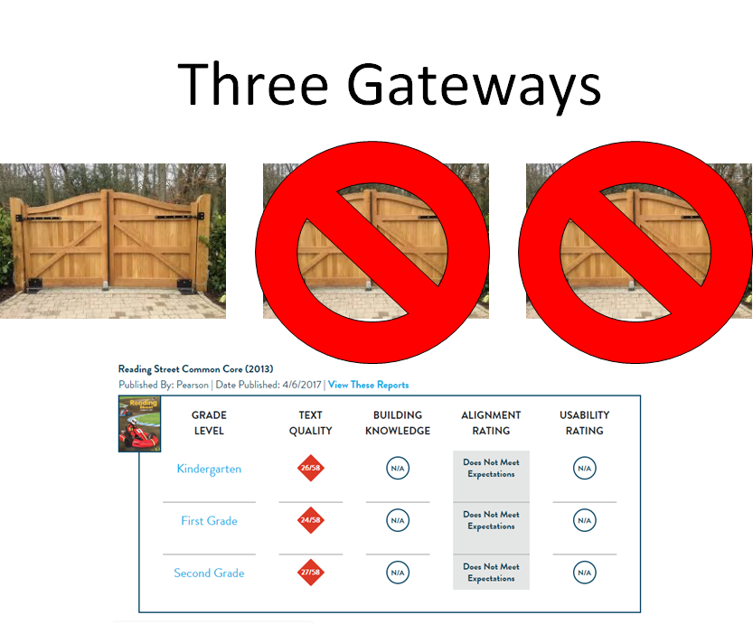

Slide 7

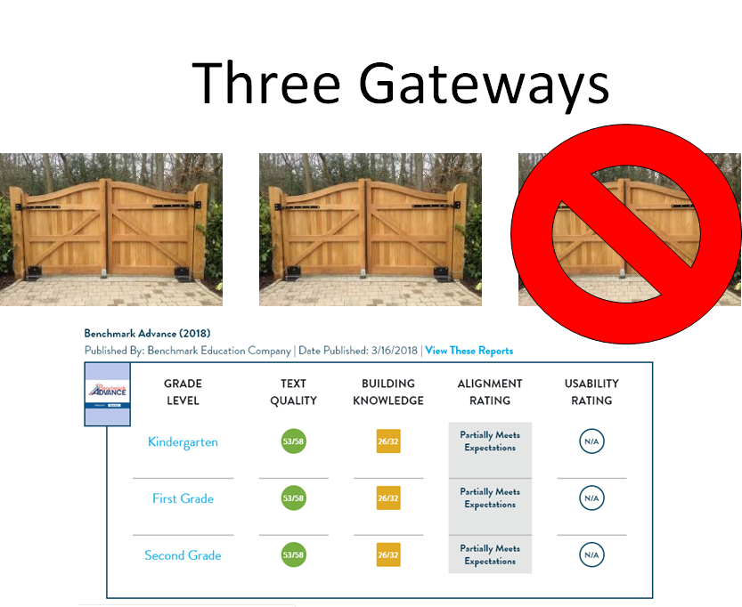

Slide 8

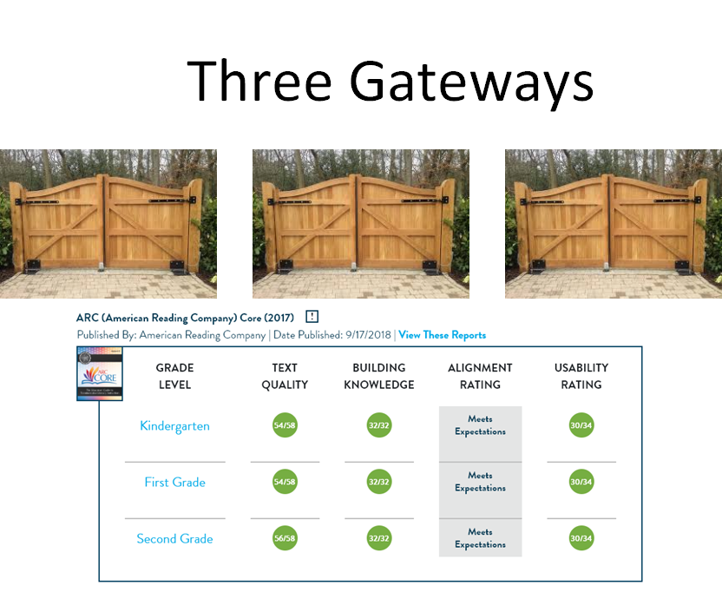

Slide 9


Slide 10

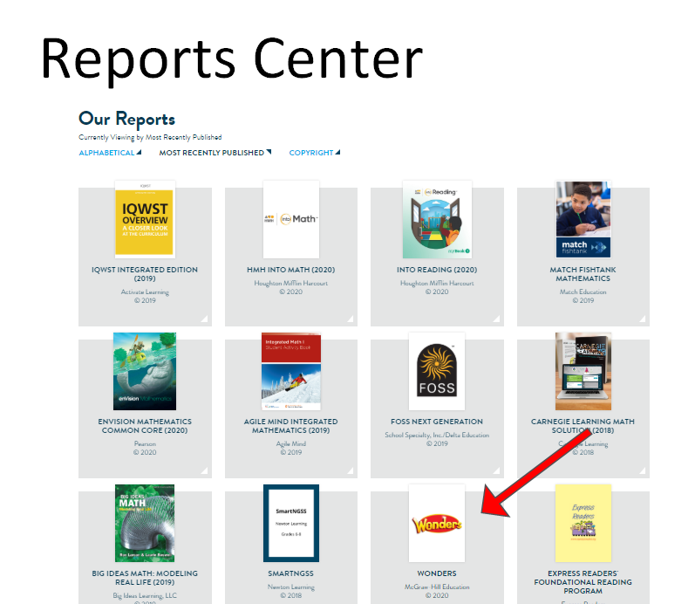

Slide 11

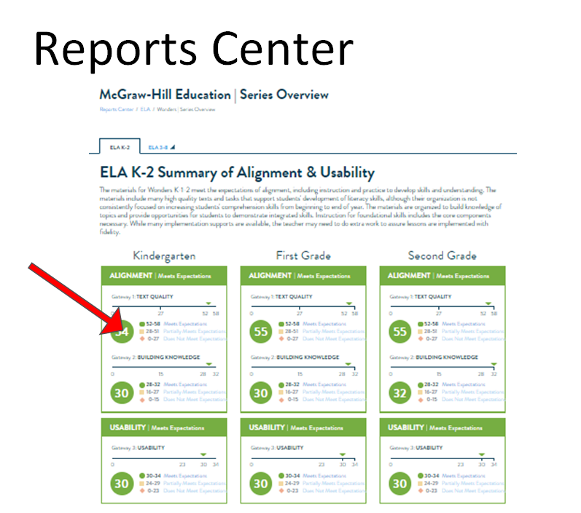

Slide 12

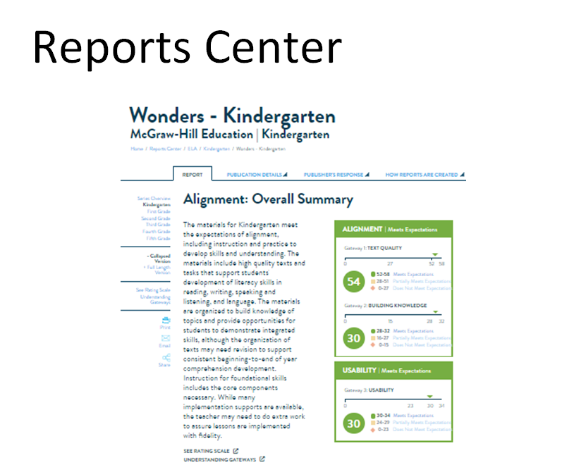

Slide 13

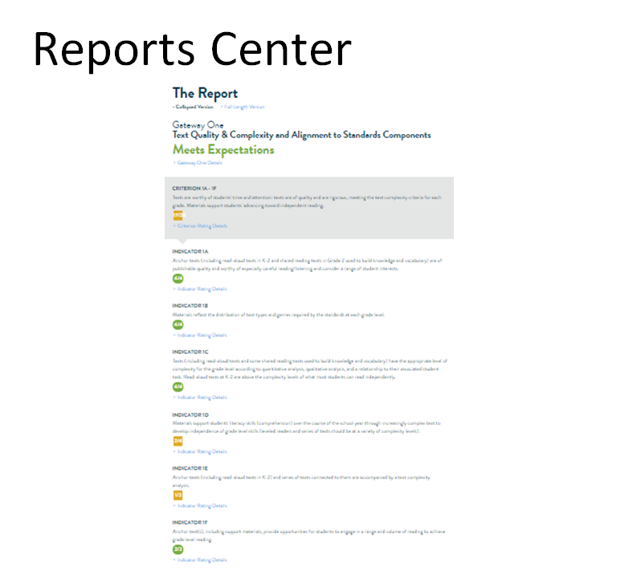

Slide 14

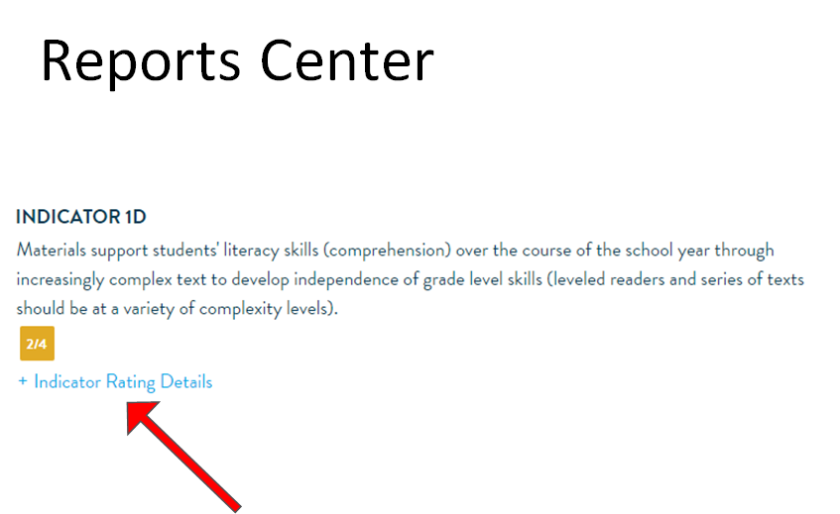

Slide 15

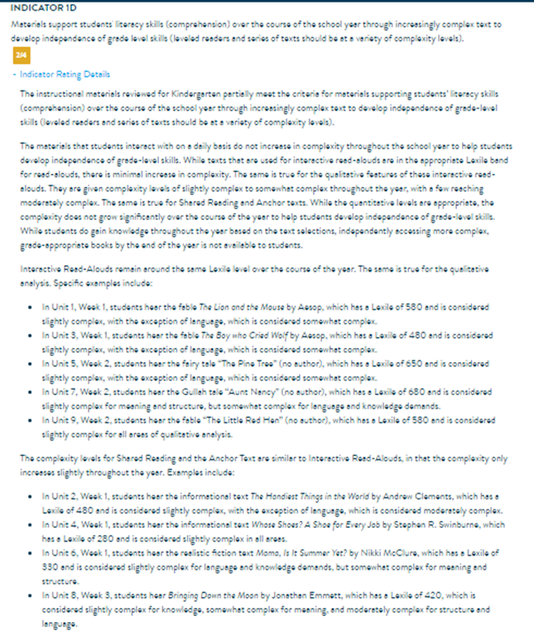

Slide 16

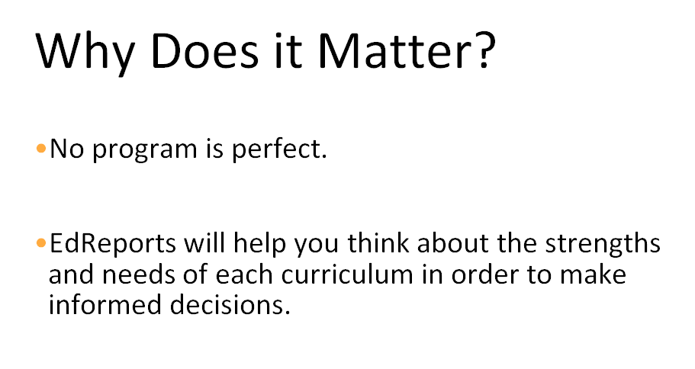

Slide 17

What does EdReports have to do with dyslexia?

Slide 18

For emergent readers, especially for students with word-level reading challenges including dyslexia, it is important to ensure the instruction of foundational reading skills within a Tier 1 Core Curriculum addressing all areas of Structured Literacy including:
Phonological and Phonemic Awareness
Sound-Symbol Correspondences
  Explicit, systematic phonics instruction
  Practice in decodable texts
Syllable Types
Encoding
Morphology
Semantics
Syntax

Slide 19
What do you do if your curriculum is missing specific foundational reading skill components necessary for emergent readers and students with dyslexia?
  1. Analyze the foundational skills using RIDE's Foundational Reading Skills Rubric and identify what is specifically needed to address gaps in Tier 1 Curriculum.
  2. Determine additional materials that address identified gaps.
  3. Collaboratively determine how additional materials can be incorporated within curriculum and instruction throughout the year.

Slide 20
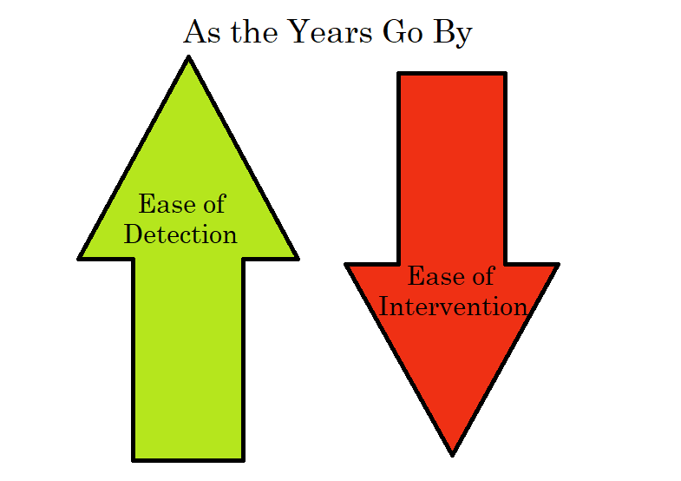
Despite solid Tier I instruction based in Structured Literacy, a student might struggle to encode or decode words. Teachers should identify the student as needing further diagnostic assessment. Early identification will help you identify these students earlier to avoid the dyslexia paradox.
Dyslexia Paradox:
Often, students are not identified with a language-based learning difference until later elementary grades when their reading struggles are more evident.
The older the children get, the more difficult it is to unteach coping mechanisms and automatize phonemic decoding strategies
Identifying students who struggle with word-level reading as early as Kindergarten will give them the best chance of successful remediation.

Slide 21
EdReports...
helps us dive into Curriculum
Having all green gateways does not indicate a “perfect” curriculum. This does provide a high-quality starting point for further review of supports for:
  Foundational Reading Skills
  Multilingual Learners
  Culturally Responsive Sustaining Education (CRSE)
  Differently-Abled Students
RESOURCES to Support: RIDE Curriculum Guidance

